Slide 1
Status report to 79th GRBP
(February 2024)
Transmitted by the co-chairs
of TF for Tyre Abrasion
Informal document GRBP-79-47-Rev.1
(79th GRBP, February 6-9, 2024,
agenda item 7 (f))
Task Force on Tyre Abrasion
On behalf of GRBP and GRPE

Slide 2
Task Force on Tyre Abrasion
Targets | Develop a robust procedure for measuring the abrasion of tyres: Test conditions and methods; Define the acceptable uncertainty for the tyre abrasion test method(s) and assess the uncertainty of the tyre abrasion test method; Based on the abrasion test method, define a characterisation of relative mileage potential index; Evaluate the abrasion performance and tread depth reduction of a wide range of tyres available in the market; Define abrasion limits for tyres in order to limit the emission of microplastics to the environment; Develop a proposal of amendment to UN Regulation No 117 for the type approval of tyres in respect to their abrasion.
Roles | Co-chairs: France (Elodie.COLLOT@utac.com) and European Commission (Theodoros.GRIGORATOS@ec.europa.eu) Secretariat: ETRTO (European Tyre and Rim Technical Organisation)
Reporting | To both working parties: GRPE and GRBP Adoption: GRBP
Web page | Task Force on Tyre Abrasion (TF TA) - Transport - Vehicle Regulations - UNECE Wiki ToRs (under revision): TF TA Terms of Reference

Slide 3


Task Force on Tyre Abrasion: facts and figures
Meetings
  15th hybrid-meeting: 20th July 2023
  16th web-meeting: 26th Sept 2023
  17th web-meeting: 26th Oct 2023
  18th web-meeting: 13th Nov 2023
  19th web-meeting: 13th Dec 2023
  20th web-meeting: 24th Jan 2024
  21st hybrid meeting: 6th Feb 2024
Attendees ~80
  CPs:
  European Commission, France, China, Germany, India, Japan, Norway, Netherlands, South Korea, Spain, Switzerland, UK, USA, Canada
  NGOs:
  ADAC, AVL, ETRMA, ETRTO, HORIBA, IDIADA, ITMA, JAMA, JATMA, LINK, OICA, SMMT, TRAC, TÜV Nord, UniBW., USTMA, UTAC, VTI

Slide 4
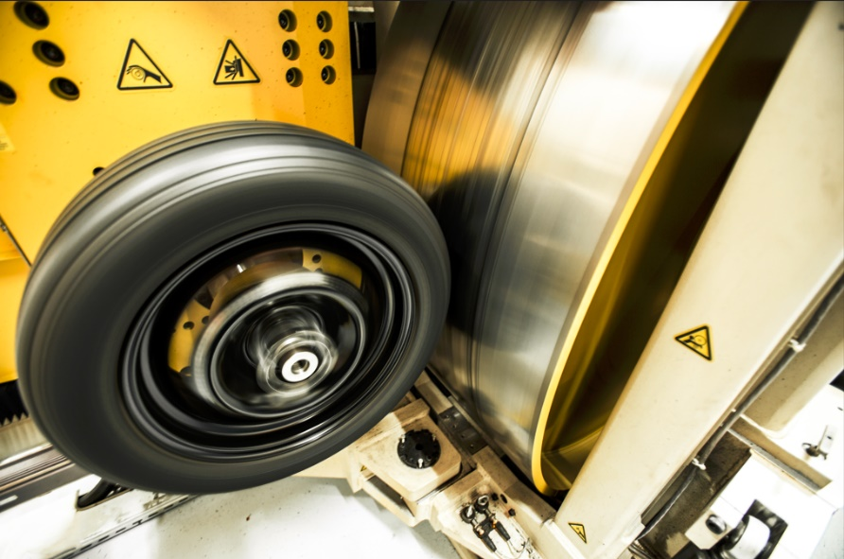
Testing methods developed by TFTA
©UTAC
©ADAC / Test und Technik
LABORATORY
(Indoor drum method)
IN-VEHICLE REAL LIFE
(On-road method)

Slide 5
Task Force on Tyre Abrasion: work progress
Work on the 2023 test campaign | Validation and correlation test campaign for 2023: ongoing for C1 Tyres selections (candidate and “reference” tyres) for correlation: done ☑ Tyres selections for alignment: done ☑ Validation test campaign on 3 on-road test centres and 4 drum test centres: done ☑ Alignment test campaign on 7 on-road test centres and 4 drum test centres: done ☑ Post processing: done ☑ (for the correlation) Market assessment: start of discussion (for tyre selection/organisation/logistics…) ◻
Working document | Test conditions and methods*: submitted ☑ for C1 tyres GRBP/2024/10 as amended by GRBP-79-12rev2 new supplement to UNR117.04 Revision of the ToRs (GRBP-79-31)
Market assessment for 2024 | For C1: preparation and first discussions on the number of tyres (~200 TBC), sizes and characteristics to be tested for 2024
*detailed description of the methods: GRBP-78-26 and latest conclusions in back up slides

Slide 6
Task Force on Tyre Abrasion: next
Work done | Final proposal of methods Feedback expected of the GRPE (January 24) → GRPE endorsed the proposed changes in the end of January 2024 Adoption expected at GRBP (February 24)
C1 tyres | Perform the market review (2024 and 1H 2025 (multi circuit assessment) Define and introduce reference tyre(s) for abrasion test in ASTM standard Set the limits for abrasion Sept 2025 Work on the feasibility of rating and definition of the mileage of tyres Feb 2025 “relative mileage potential calculated performance”
C2 tyres | Propose abrasion method(s) Feb 2026 Set the limits for abrasion Sept 2027 Anticipation of 1 year will be evaluated depending on the C1 method(s)’ suitability for C2 tyres C2 clustering
C3 tyres | Propose abrasion method(s) Feb 2027 Set the limits for abrasion Sept 2029

Slide 7
Back up

Slide 8
Content of the test campaign (indoor and on-road)
11 tyres, including Summer, 3PMSF, M+S
4 tyre size :
  155/65 R14, Load Index 75
  205/55 R16, Load Index 91 (SL) and 94 (XL)
  235/65 R17, Load Index 108 (XL)
  235/55 R 19, Load Index 105 (XL)
Test duplicated between vehicle and drum method
4 repetitions at each of the conditions
  On different drums (3 tbc)
  On 2 vehicle circuits, at 3 different temperature (low, medium, high)

Slide 9
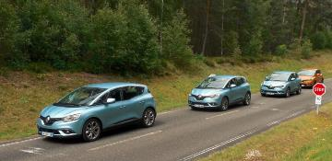
Analysis of the vehicle abrasion method
©UTAC
Items tested and analyzed :
Temperature sensitivity for summer, 3PMSF and M+S tyres
Vehicle effects
Dispersion of the vehicle method
Effect of Temperature on abrasion index
Alignment between the two abrasion circuits
Improvements implemented

Slide 10
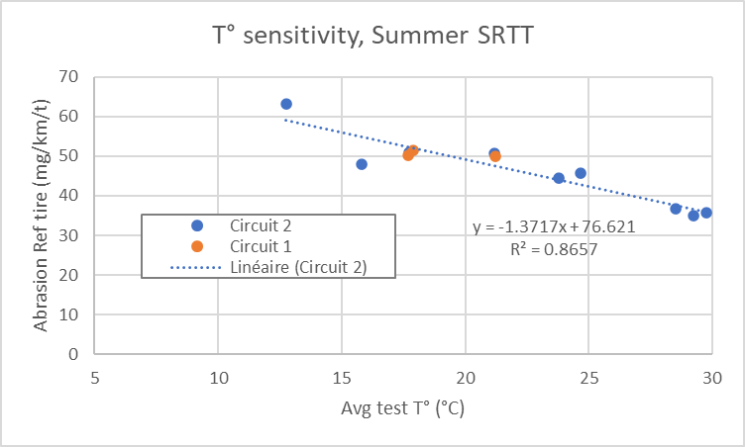
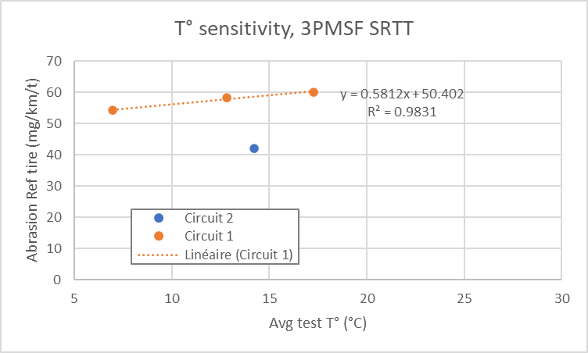
Reference tyres
Comparison of circuits 1 & 2
For summer reference tyre on circuit 2: Abrasion rate decreases with temperature
  With current data, negligible circuit effect between these 2 circuits: Same abrasion level on both circuits for summer SRTT at temperature around 20 °C
For 3PMSF reference tyre, Abrasion rate increases with temperature
  Shift on the abrasion level between the 2 circuits for 3PMSF SRTT
©UTAC
More points are needed on Circuit 2, Circuit 1 and other circuits & vehicles to define the allowed range of circuit abrasiveness.

Slide 11
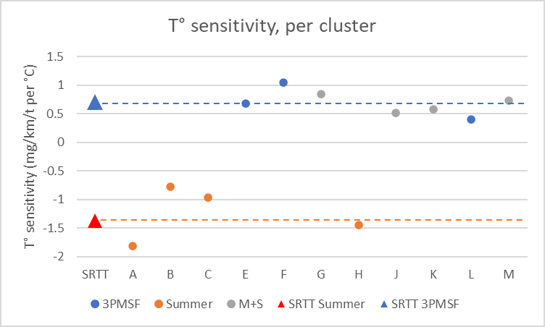
Temperature sensitivity per regulatory cluster
©UTAC
Reminder
The 3PMSF reference tyre is currently prescribed for the 3PMSF cluster
  (3 3PMSF in this test plan)
The Summer reference tyre is currently prescribed for the summer and M+S cluster clusters
  (4 M+S tyres and 4 summer tyres in this test plan)
We computed the temperature sensitivity of each tyre, and made the average per cluster
 | Average temperature sensitivity (mg/km/t per °C) | Standard deviation (mg/km/t per °C)
Summer | -1.25 | 0.47
Ref summer | -1.37
 | Average temperature sensitivity (mg/km/t per °C) | Standard deviation (mg/km/t per °C)
M+S | 0.67 | 0.15
3PMSF | 0.71 | 0.33
Ref 3PMSF | 0.71
M+S tyres tested in this test campaign behaves like 3PMSF tyres and not Summer tyres
➔ a change of cluster for M+S tyres is considered

Slide 12
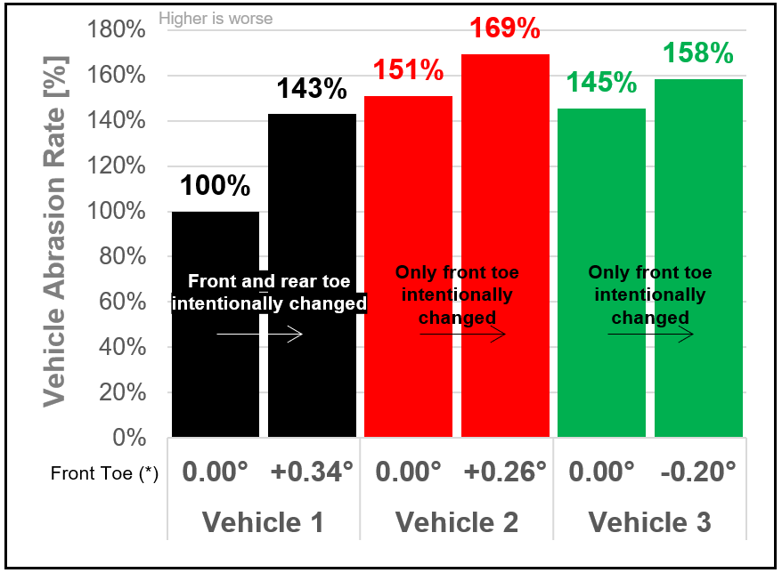
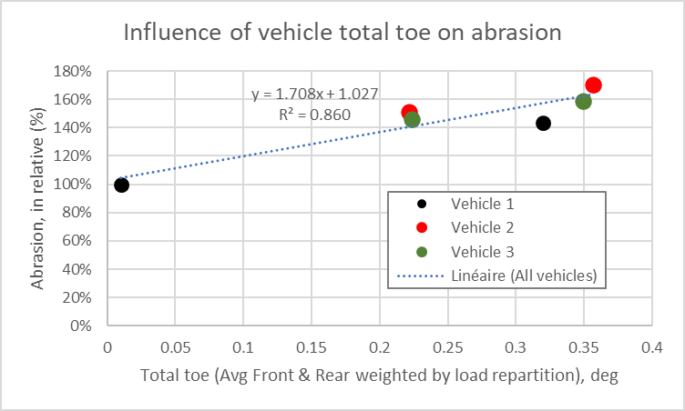
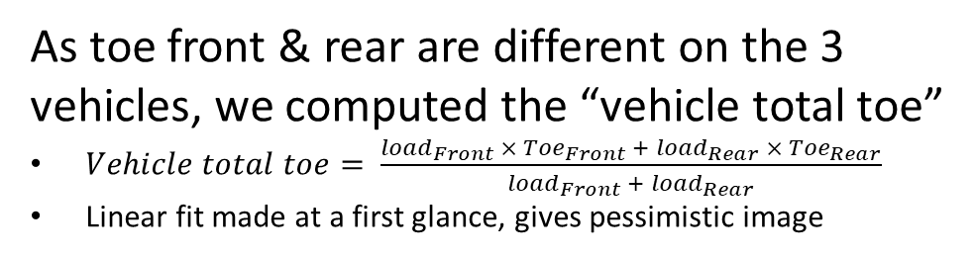
Analysis of vehicle effect
  The tests results reveals a very significant impact of toe on abrasion.
    The effect seems to depend on the vehicle (if we look only front toe)
©UTAC
      As toe front & rear are different on the 3 vehicles, we computed the “vehicle total toe”
      $Vehicle total toe= \frac{{load}_{Front} × {Toe}_{Front} + {load}_{Rear} × {Toe}_{Rear}}{{load}_{Front} +{ load}_{Rear}}$
      Linear fit made at a first glance, gives pessimistic image
  New Recommended settings :
 | Front | Front | Rear | Rear
 | Toe (°) | Camber (°) | Toe (°) | Camber (°)
Loaded condition, reference vehicle | 0°± tol (*) | [-1.2° ; 0°] | [0.05°; 0.15°] | [-1.9° ; -0.6°]
Loaded condition, candidate vehicle | 0°± tol (*) | [-1.2° ; 0°] | [0.05°; 0.15°] | [-1.9° ; -0.6°]
Front | Front | Rear | Rear
Toe (°) | Camber (°) | Toe (°) | Camber (°)
0° ± tol (*) | 0° ± tol (*) | 0° ± tol (*) | 0° ± tol (*)
0° ± tol (*) | 0° ± tol (*) | 0° ± tol (*) | 0° ± tol (*)

Slide 13
Test dispersion of the vehicle method
©UTAC
Synthesis of the test dispersion on vehicle method coming from this campaign :
Case | Standard deviation (in abrasion index) | Expanded uncertainty 95% (±2σ) | Range (in abrasion index) | σ/range (in %)
Raw | σ = 0.200 | ± 0.40 | 1.10 | 18.2%
Raw, w/o M+S | σ = 0.154 | ± 0.31 | 0.88 | 17.6%
Estimated landing point if the assumptions adopted to emulate M+S in 3PMSF cluster (*) will be verified | σ = ~0.14 | ~± 0.28 | 1.23 | 11.3%
Estimated landing point, M+S emulated in 3PMSF cluster, without Peugeot 308 | σ = ~0.10 | ~± 0.20 | ~1.06 | ~9.8%
(*) Assumptions: Abrasion Ref 3PMSF = f(T°) from Circuit 1 data
The dispersion must be reassessed because significant improvements have been made in the vehicle method (M+S tire, vehicle settings), with expected good improvement of the dispersion

Slide 14
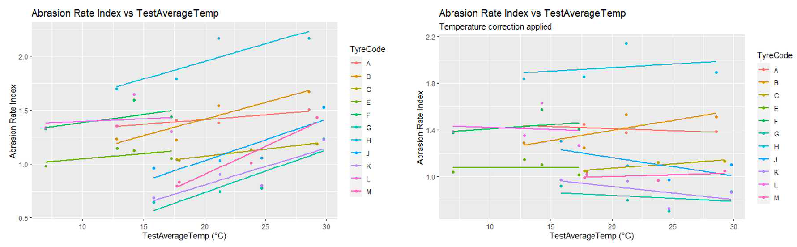
Analysis of temperature effect on abrasion index
©UTAC
The abrasion index appears sensitive to temperature variation, as it evolves with temperature
An improvement can be proposed, by correcting the abrasion rate before the index calculation
  Correction based on mean gradient of a group and difference to a reference temperature
  Still some correlation for some tyres after correction: if the tyre have a different temperature gradient than the one used for the correction, you still observe a temperature effect
A significant improvement may be expected from this temperature correction :
For vehicle method, a mean standard deviation for abrasion rate index of 0.11 instead of 0.2
  still using Sum SRTT as reference tyre for M+S, and without consideration of the new vehicle settings limits

Slide 15
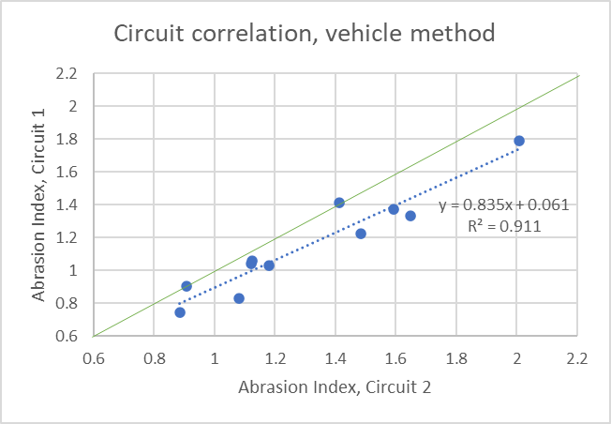
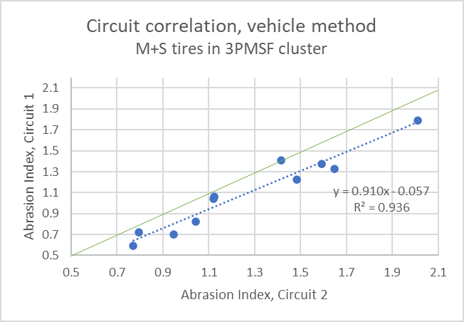
Alignment between vehicle circuits
©UTAC
Circuit alignment,
Emulation of M+S tyres in 3PMSF cluster
Circuit alignment, all raw data
A very good alignment of the two circuits is observed

Slide 16
Synthesis of the vehicle method improvements
©UTAC
Improvement already validated :
M+S tyres tested with 3PMSF reference tyre
Improved vehicle settings limits
Improvements under study :
Computation of the range for the σ/range indicator
Temperature correction in the computation of the abrasion index

Slide 17

Analysis of the drum abrasion method
©UTAC
Items tested and analyzed :
Available drum data
SRTT 16’’ vs SRTT 17’’
Analysis of abrasion rate & abrasion index
Analysis of temperature sensitivity & road surface
Dispersion of the drum method
Irregular wear
Improvements

Slide 18
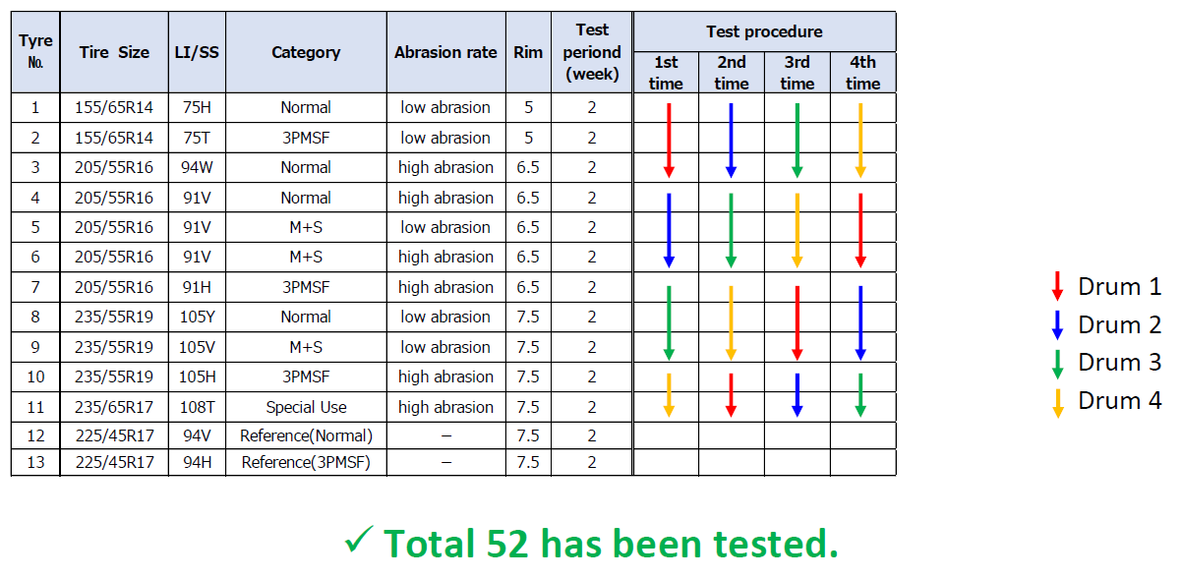
Drum available data
©UTAC
Test results of drum4 may not be usable due to a malfunction in the testing machine.
  The cause is still under analysis
Therefore, test data from other 3 test centers is considered for verification of indoor
1st repetition was performed with SRTT16. 2nd , 3rd , 4th repetition were performed with SRTT17.
Specific test to compare SRTT16 with SRTT17 was included during test campaign.

Slide 19
SRTT 16’’ vs SRTT 17’’
©UTAC
These data were used to convert abrasion index from the 1st repetition

Slide 20
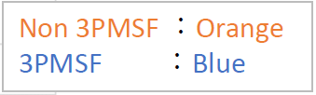
Analysis of the abrasion rate & index
©UTAC
Clear difference in abrasion rate per drum
The difference in abrasion rate between drums is cancelled by computing the abrasion index, relative to the reference tyre

Slide 21
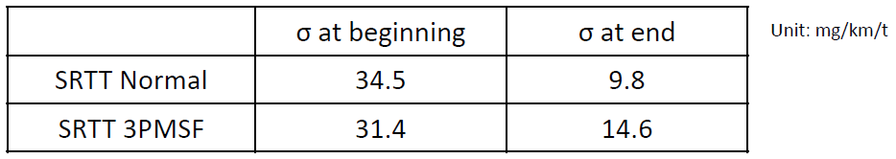
Limits of abrasion rate for reference tyres
©UTAC
Within a replacement cycle of test surface, the dispersion of abrasion rate shows a decreasing trend from the beginning to end of the cycle.
We confirmed σ of abrasion rate at the beginning and the end of test surface cycle:
Considering the larger dispersion, the range is set as the abrasion rate at beginning +/-2σ .
In case of SRTT17 Normal, the abrasion rate of the reference tyre : range from 50 mg/km/t to 190 mg/km/t.
In case of SRTT17 3PMSF, the abrasion rate of the reference tyre : range from 35 mg/km/t to 165 mg/km/t.
How can we reduce the abrasion rate range of the reference tyres?

Slide 22
Temperature and drum surface effect
©UTAC
No significant linear effect observed between the abrasion rate index and temperature
No significant linear effect observed between the ref. abrasion rate and temperature for the 3 ref patterns
No significant effect observed between sandpaper grit 80 and a realistic surface

Slide 23
Dispersion of the drum method
Test Temp: all
Drum Surface: all
Drums 1 to 3
Test Data: 39
©UTAC
Case | Standard deviation (in abrasion index) | Expanded uncertainty 95% (±2σ) | Range (in abrasion index) | σ/range (in %)
All tyres (39 data) | σ = 0.086 | ± 0.172 | 0.612 | 14.1%
w/o M+S (26 data) | σ = 0.103 | ± 0.206 | 0.392 | 26.4%
Estimated landing point if the assumptions adopted to emulate M+S in 3PMSF cluster (*) will be verified | σ = ~0.088 | ~± 0.176 | 0.649 | 13.6%
(*) Assumptions: conversion made using the 2 conversion factors
While applying the method as described, ETRTO drums (5-7) results seems to show a higher dispersion than drums 1 to 3
Case | Standard deviation (in abrasion index) | Expanded uncertainty 95% (±2σ) | Range (in abrasion index) | σ/range (in %)
Raw | σ = 0.200 | ± 0.40 | 1.10 | 18.2%
Raw, w/o M+S | σ = 0.154 | ± 0.31 | 0.88 | 17.6%
Estimated landing point if the assumptions adopted to emulate M+S in 3PMSF cluster will be verified | σ = ~0.14 | ~± 0.28 | 1.23 | 11.3%
Note: ratio dispersion / range should be reassessed with market assessment results which will give the best evaluation of the range.

Slide 24
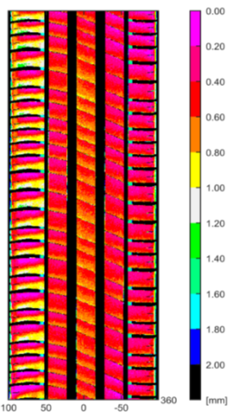

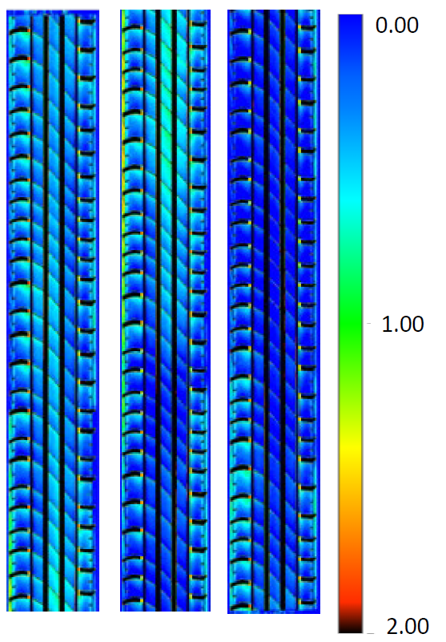
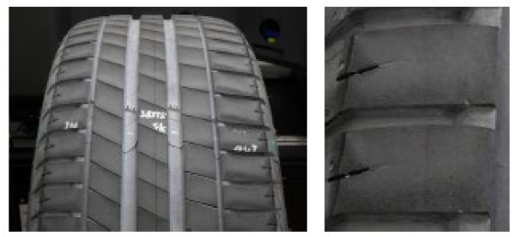
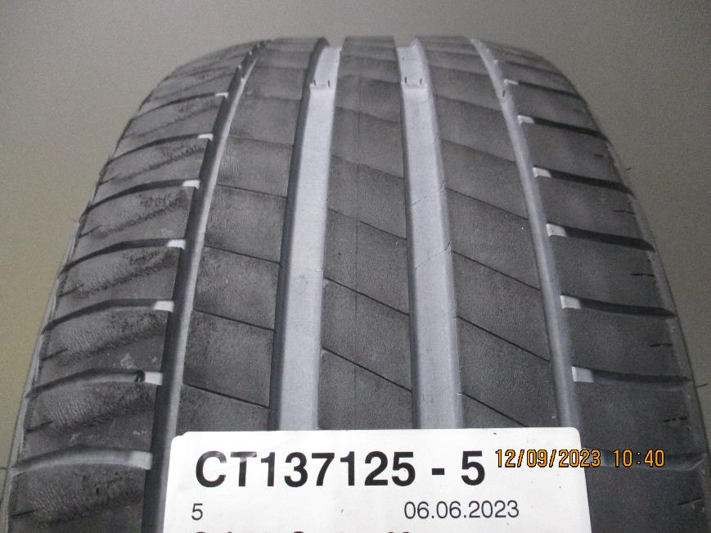
Tyre wear on drum test methods
©UTAC
Irregular Wear (heel & toe) was found on many tyres on drum tested by ETRTO.
Example SRTT 17’’ (Drum 5)
Irregular Wear was not observed in JASIC drum.
Example 225/45R17 94V XL (Drum 1)
Heel and Toe wear was found on all the ETRTO drum results
(More irregular wear on summer tyres)
Further analysis is ongoing

Slide 25
Improvements of the drum method
©UTAC
4 improvements of the drum method have been implemented :
Changing the reference tyres from SRTT 16’’ to SRTT 17’’
Definition of the limits of abrasion rate on Reference tyre to validate a drum test
De-gumming : limitation of the “3rd body” nature (powder) to only 2 types : Talc or Silica
Split the drum surface roughness indicator into 2 indicators (macro roughness, micro roughness),
  with an allowed range for each
Some other improvements have been proposed :
Define limits of flow rate for 3rd body (de-gumming system)
Update load and pressure of the tyre to improve the correlation with vehicle method
Update the forces animation (longitudinal and lateral) to improve the correlation with vehicle method

Slide 26
Analysis of the correlation between the two methods
©UTAC
Sometimes the abrasion rate indexes are very similar, sometimes more difference
Larger average standard deviation for vehicle method Could partly be explained due to temperature effect
A larger range of temperature
was tested for the vehicle
method
Need to check with the market assessment generated data if this is improved with the better test method definitions

Slide 27
Thank you

