Slide 1
New PTI-test for checking particulate filters of diesel cars with a particle counter
Informal document WP.29-191-34 191st WP.29, 14-16 November 2023 Agenda item 7
Proposal to amend Rule 1 and R.E.6 of the 97 Agreement
Hens Peeters Weem Co-chair
Informal Working Group on PTI

Slide 2
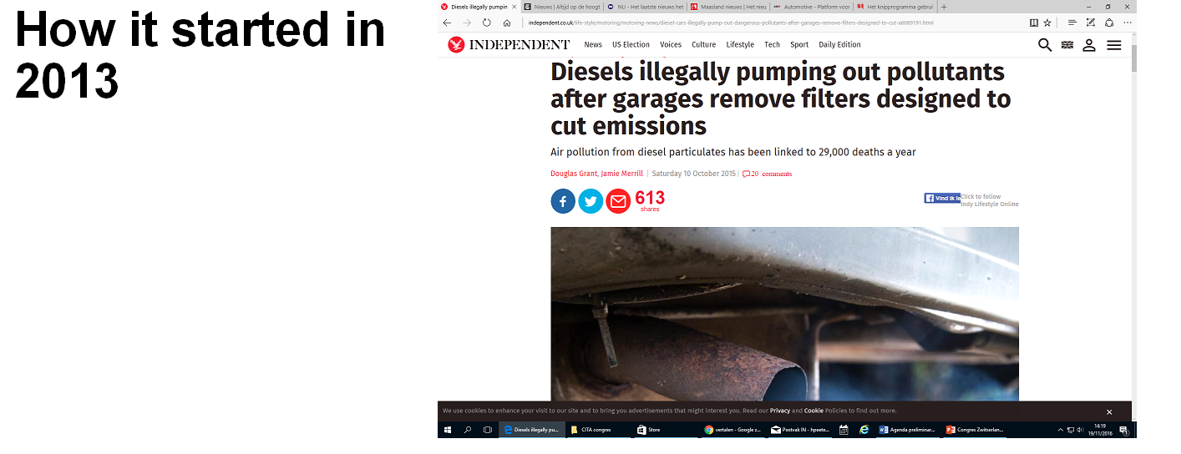
A lot of advertisements offering removal of particulate filters by diesel vehicles on the internet, but:
Almost no rejections in PTI

Slide 3
Result: The legally prescribed opacity test is not sufficient for modern vehicles with diesel engines.

Slide 5
Diesel filter damaged of removed

Slide 6
Reading OBD and opacity test not suitable

Slide 7
NPTI working group started in 2014: Germany, Belgium, Switzerland, UK, the Netherlands, Equipment industry, Metrology institutions, TNO, Environmental organizations
Their assignment:
Develop a new PTI test method for modern diesels;
Develop a device suitable for the PTI
Develop a testing method
Establish limit values

Slide 8
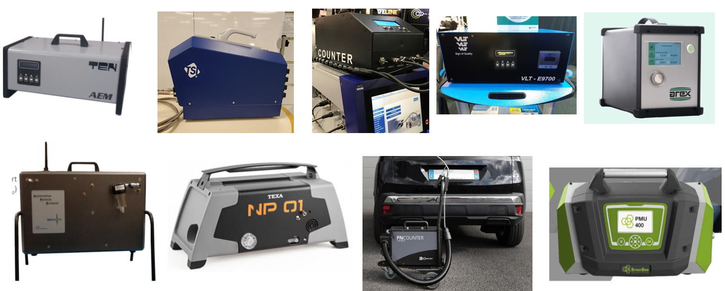
Some instruments:

Slide 9
Developments and results from 2022
Introduction of the new test in:
Belgium July 2022
Switzerland January 2023
The Netherlands January 2023
Germany July 2023
Summer 2023: Recommandation for PN test from European Commission.
EU Commission will introcuce PN test in the new proposal in the Roadworthiness Package
Interest from all over the world in introducing this test.

Slide 10
First results in Europe
First results:
Different countries control different emission classes. ranging from Euro 5 or Euro 6
The older the vehicles, the more rejection.
Rejection percentage varies between 6.5% and 15%

Slide 11
Proposal to amend Rule 1 and R.E.6 of the 97 Agreement
Rule 1: Option to use this test, no obligation.
R.E.6 Specifications, test method.
In cooperation with GRPE and adopted by GRPE and submitted to WP.29

