Slide 1
New design C3 SRTTs
Informal document GRBP-77-28-Rev.1
Agenda item 7 (c)
GRBP 78th session
August 2023

Slide 2
Agenda
Background
regulatory framework & reason for changing the current C3 SRTTs
New Design C3 SRTTs concept
SNOW test campaign
  Overview
  Analysis of test results
  Proposed approach / Correlation Factor
WGI test campaign
  Overview, Analysis of the Results and proposed approach
Timeline

Slide 3
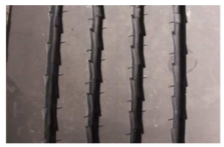
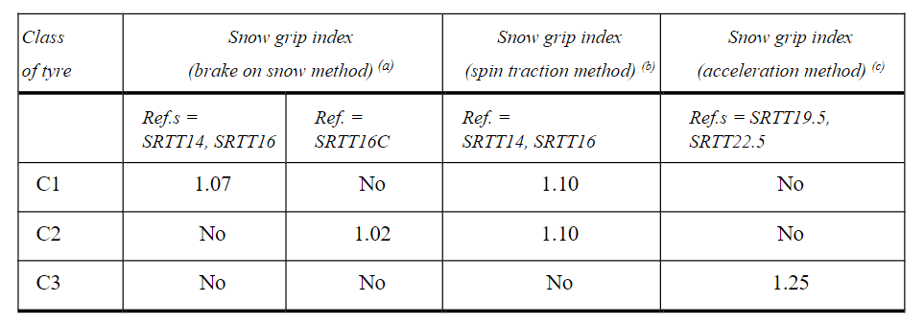
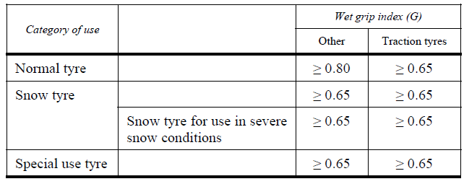
Background
Regulatory framework
The current C3 SRTTs 19.5 and 22.5 are used as reference tyres for snow grip and wet adhesion performance in UN Reg.117:
  F2871-16 for the size 245/70R19.5 and referred to as "SRTT19.5"
  F2870-16 for the size 315/70R22.5 and referred to as "SRTT22.5".
Snow grip index threshold for C3 (1.25) shall be passed to type approve
a tyre for use in severe snow conditions, according to an acceleration
test method (Annex 7)
Wet Grip index threshold for C3 shall be passed to type approve a tyre

Slide 4
Background
Reason to change the existing C3 SRTTs
Rib design of the tread pattern of current C3 SRTTs with limited snow performance capabilities
→ High performance variation depending on the track surface conditions during testing
  high performance variations in the evaluation of candidate tires
  poor correlation between different test providers and/or proving grounds
  Need to improve reproducibility of the SNOW test results (i.e., reduce the uncertainty of the test), while not deteriorating the Wet Grip reproducibility

Slide 5
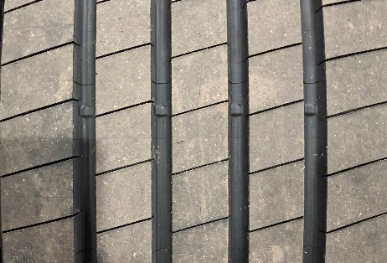
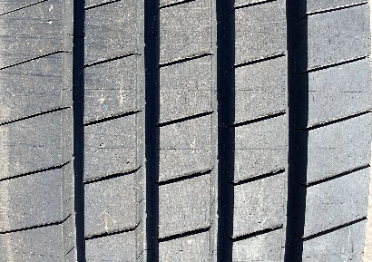
New Design of C3 SRTTs
  New pattern designs with sipes (blades) assures higher performance stability on snow test method, and not deteriorating the wet grip test method reproducibility
Current Design
New Design (22.5)
New Design (19.5)
Validation Tests campaigns
  Snow test campaigns were performed by ETRTO and JATMA members during 3 winter seasons (years from 2019 to 2022)
  Wet Grip test campaign was performed over 3 years at different locations and in different conditions
  → SRTT 22.5 current design vs. SRTT 22.5 new design
  → SRTT 19.5 current design vs. SRTT 19.5 new design

Slide 6
SNOW test campaign
Overview
3 winter seasons
4 different temperature ranges (for ambient and surface)
9 participating companies / test locations
20 different vehicles (SRTT19.5 and SRTT22.5)
176 tests results: 68 for SRTT 19.5 & 108 for SRTT 22.5

Slide 7
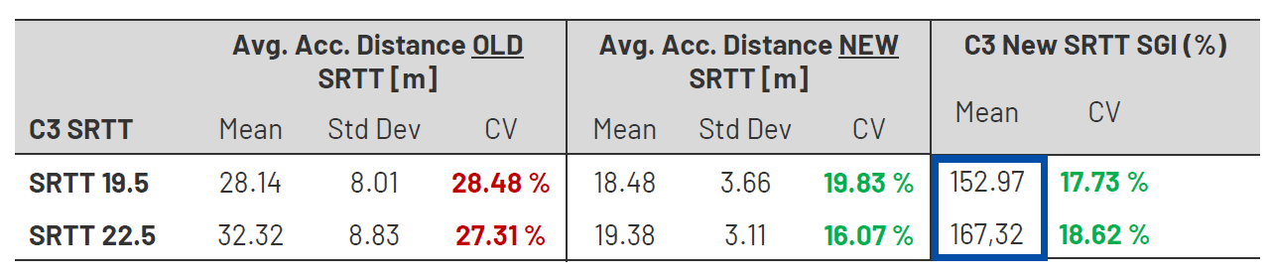

SNOW test campaign
Analysis of test results: variation of SRTTs acceleration distance
  High Coefficient of Variation coefficient (Std Dev.) of the current SRTTs confirmed → low reproducibility
  New Design C3 SRTTs (both 19.5 and 22.5) shows higher stability, with lower coefficient of variations → improved reproducibility
  New Design C3 SRTTs perform much better than current C3 SRTTs
  → correlation factor to be introduced in the regulation when test is performed vs new design C3 SRTTs (see following pages)

Slide 8
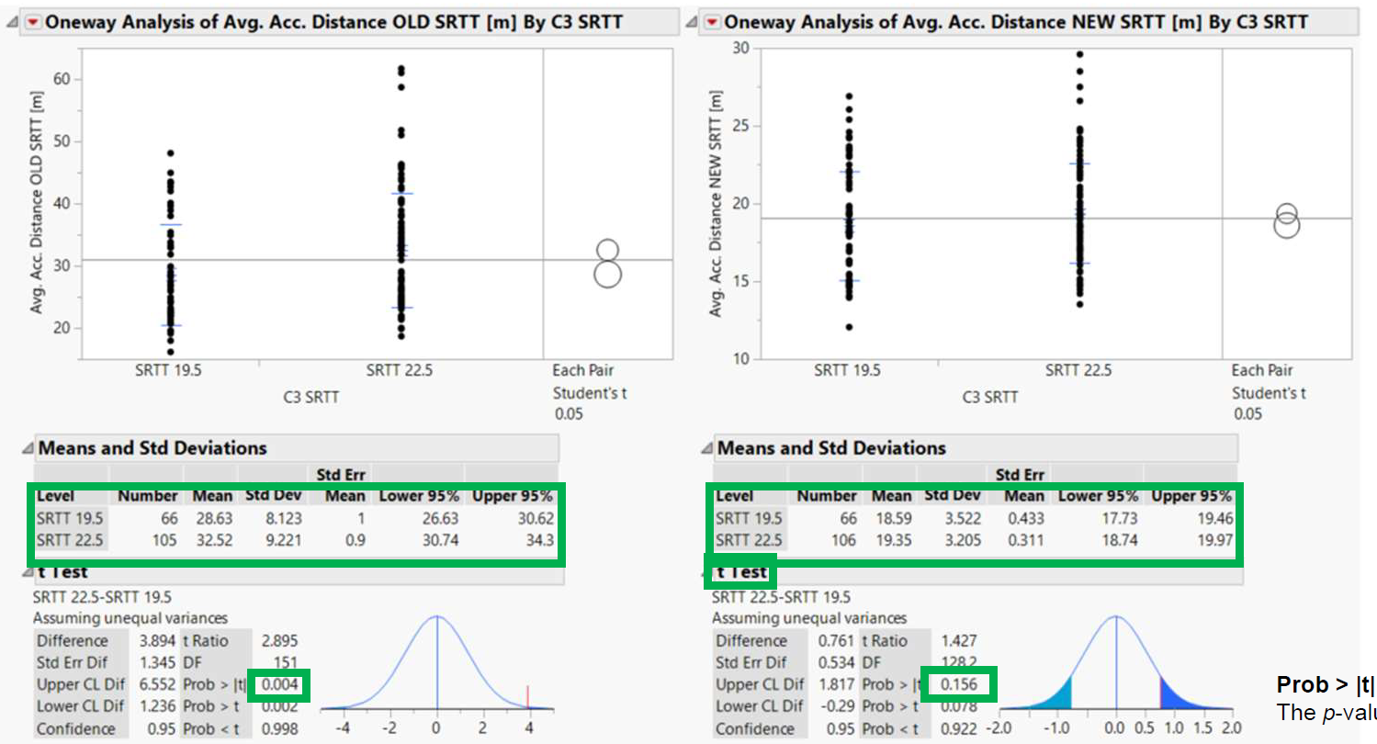
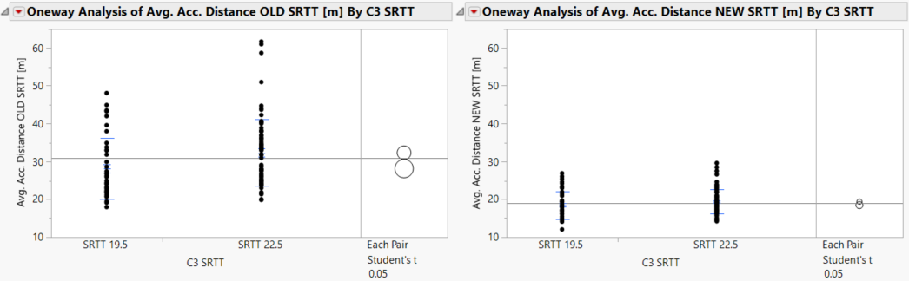
SNOW test campaign
Analysis of test results: equivalence of the new design SRTTs (19.5 and 22.5)
Current SRTTs
New SRTTs
  Statistically the New SRTT 22.5” and New SRTT 19.5” are equivalent in their performance
  (the 2 sizes show very similar average distance/acceleration)
  → Confirmed possibility of using both new SRTTs (19.5 and 22.5) as reference tyre irrespective of the size of candidate tyre

Slide 9
SNOW test campaign
Proposed approach: correlation Factor
  Similar approach used to manage the SRTT14 discontinuation and its replacement with SRTT16 (ref. UN Reg117.02 Supplement 13):
  Keep the existing threshold (1,25 vs existing SRTT)
  Apply a correlation factor (fixed by regulation) when test is performed vs new designed C3 SRTTs
      Correlation factor can be established by the analysis of the snow test campaign, considering
      - the equivalence of the 2 SRTTs
      - that vast majority of the C3-tyre sizes are tested vs. the SRTT 22.5
      - the worst cases testing (regulatory change can be managed by a supplement of UN R117)
$${SG}_{current SRTT}= \frac{Candidate}{current SRTT}= \frac{new SRTT}{Current SRTT}∙\frac{Candidate}{new SRTT}=1.67∙{SG}_{newSRTT}$$
    SG_{current} snow grip index of candidate vs. SRTT current
    SG_{new} snow grip index of candidate vs. SRTT new
    1,67 correlation factor fixed by regulation = ”new” vs. ”current”
    candidate weighted ave. acceleration of candidate tire
    New SRTT weighted ave. acceleration of new SRTT
    Current SRTT weighted ave. acceleration of current SRTT

Slide 10
WET grip test campaign
Target
- Confirm the stability of new C3 design SRTT also for WET performance
- Assess whether a correlation factor needs to be introduced also for WGI test
Overview
3 years testing
Different conditions (temp., track friction, vehicle)
9 testing companies / locations
More than 70 tests results

Slide 11
WET grip test campaign
Analysis of test results
  Coefficient of variation of Current C3 SRTT and New Design C3 SRTTs (BFC or mu) are similar → stability on wet is comparable
  Differently from Snow case, Current and New SRTTs are not so distant in terms of wet performance; the available data show anyhow a slight improvement of new design SRTTs Same as snow case, based on the data collected so far, statistically the New SRTT 22.5” and New SRTT 19.5” are equivalent (comparable average deceleration/mu peak)

Slide 12
WET grip test campaign
Proposed approach: unique correlation Factor
  Same approach proposed to manage the Snow case:
  Keep the existing thresholds (vs current SRTT)
  Apply a correlation factor (fixed by regulation) when test is performed vs new design C3 SRTTs:
      Correlation factor can be established by the analysis of the WGI test campaign results, considering:
      - the equivalence of the 2 SRTTs (19.5 and 22.5)
      - the worst cases testing (regulatory change can be managed by a supplement of UN R117)
→ Proposed correction factor is 1.04 for both 19.5 & 22.5, for both trailer and vehicle methods
$${WGI}_{current SRTT}= \frac{Candidate}{current SRTT}= \frac{new SRTT}{Current SRTT}∙\frac{Candidate}{new SRTT}=1.04∙{WGI}_{newSRTT}$$
    WGI_{current} wet grip index of candidate vs. SRTT current
    WGI_{new} wet grip index of candidate vs. SRTT new
    1,04 correlation factor fixed by regulation = ”new” vs. ”current”
    candidate BFC/mu of candidate tire
    New SRTT BFC/mu of new SRTT
    Current SRTT BFC/mu of current SRTT

Slide 13
WET grip test campaign
  Additional topics under investigation at ETRTO
  possibility of using both new SRTTs (19.5 and 22.5) as reference tyre irrespective of the size of candidate tyre
      Same as snow case, based on the data collected so far, statistically the SRTT 22.5” and SRTT 19.5” are equivalent (very similar average decel./mu peak)
  possibility to improve the track friction range definition for C2&C3 WGI test method
Ref. to appendix for preliminary information

Slide 14
Timeline for introducing new C3 SRTT’s
Ready for serial production
ASTM approval cycle
final design
Prototype design
2020
2021
2022
2023
2024
2025
informal document
for
GRBP
GRBP
Entry into Force *
(incl. transition provisions)
ETRTO Test Campaigns snow and wet grip
Update in the revision
of ISO 18106 (36 months)
Update ISO 15222
* Transitional provisions to be introduced: usage of both
current & new C3 SRTTs allowed for a certain period
Harmonization with other standards / regulations to be granted

Slide 15
Thank You

Slide 16
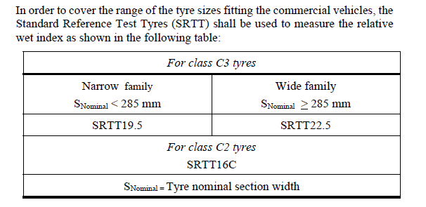
SRTT C3N or C3W usage for WGI
REGULATORY FRAMEWORK
Differently from Snow test, SRTTs C3N and C3W are currently not interchangeable for WGI test: choice depends on the section width of the candidate → burden for testing (possibility to fit SRTT and candidate under the same vehicle)
ETRTO TASK
Investigating if and how this constrain can be eliminated
ETRTO DIRECTION
Fix a shift factor by regulation to switch from one SRTT to the other SRTT (e.g. performance ratio C3W vs C3N)
$${WGI}_{C3N}= \frac{Candidate}{C3N}= \frac{C3W}{C3N}∙\frac{Candidate}{C3W}=[Shift factor]∙{WGI}_{C3W}$$
(*)
Preliminary results show no significant difference between C3N and C3W (Shift factor = 1?) → analysis ongoing
(*) Concept already present in regulation (when SRTT and candidate cannot be fitted under the same vehicle and other SRTT is used as «bridge»), but defined at local level and to be checked periodically

Slide 17
C2 & C3 track friction ranges
REGULATORY FRAMEWORK
Not only C1, but also C2&C3 tracks friction ranges are today defined using C1 SRTT16 µ-peak values on trailer
→ Logistic constrains (C1 trailer needed, not easy to drive with the trailer on the C2-C3 tracks braking lines)
ETRTO is considering how to improve the current C2&C3 track friction range definition
Class | Trailer method | Vehicle method
C1 | µ peak C1 SRTT16 [0.65-0.90] | BFC C1 SRTT16 [0.57-0.79]
C2&C3 | µ peak C1 SRTT16 [0.65-0.90]
ETRTO DIRECTION
C2 track to be defined using C2 SRTT16C
C3 track to be defined using the C3 SRTT (C3N or C3W)
Use µ-peak for trailer method and average deceleration (BFC) for vehicle method
Transition period to be considered
 | Trailer method | Vehicle method
C1 | µ peak C1 SRTT16 [0.65-0.90] | BFC C1 SRTT16 [0.57-0.79]
C2 | µ peak C2 SRTT16C [xx,xx] | BFC C2 SRTT16C [xx,xx]
C3 | µ peak C3 SRTT [xx,xx] | BFC C3 SRTT [xx, xxx]

Slide 18
New C3 SRTTs
Harmonization with other Standards / Regulations (1/2)
Country | Regulation | Test method(s) | SRTT22.5 | SRTT19.5 | Remarks
UN | R109.00.10 | Snow performance | ASTM F2870-16 | ASTM F2871-16
UN | R117.02.15 | Wet grip, snow performance | ASTM F2870-16 | ASTM F2871-16
UN | R117.03.01 | Wet grip, snow performance | ASTM F2870-16 | ASTM F2871-16
UN | R117.04.00 | Wet grip, snow performance | ASTM F2870-16 | ASTM F2871-16
EU | 2020/740 | Wet grip, snow performance |  |  | through reference to UN R117
GCC | GSO ECE 117:2016 | Wet grip | ASTM F2870-11 | ASTM F2871-11
Saudi Arabia | SASO2857:2016 | Wet grip |  |  | Reference to SASO GSO ECE 117 and SASO GSO ISO 15222
Brazil | INMETRO 379/2021 | Wet grip |  |  | Through reference to ISO 15222:2011 and UN R117, Annex 5
USA | USTMA TISB No. 50, Vol 3. | Snow performance | ASTM F2870 | ASTM F2871 | Test method refers to ISO 18106:2016; References to ASTM are undated

Slide 19
New C3 SRTTs
Harmonization with other Standards / Regulations (2/2)
Country | Regulation | Test method(s) | SRTT22.5 | SRTT19.5 | Remarks
China | GB/T 35163-2017 | Wet grip | T-CMA-HG 012-2016 | T-CMA-HG 011-2017 | 315/70R22.5 154/150L, 245/70R19.5 136/134M conforming to requirements of relevant Chinese associations (“ASTM F2870, ASTM F2871 … are not referenced, since there are corresponding standards in China”)
China | GB/T 33830-2017 | Snow grip | T-CMA-HG 012-2016 | T-CMA-HG 011-2017
India | AIS-142 (2019) | Wet grip, snow performance | ASTM F2870-11 | ASTM F2871-11
Korea | Energy Efficiency Reg. | Wet grip | ASTM F2870 | ASTM F2871 | References are undated
Thailand | TIS2721:2560 | Wet grip, snow performance | ASTM F2870-11 | ASTM F2871-11
ISO | 15222:2021 | Wet grip | ASTM F2870 | ASTM F2871 | References are undated
ISO | 18106:2016 | Snow performance | ASTM F2870 | ASTM F2871 | References are undated

