Slide 1
Status report to 78th GRBP
(August-September 2023)
Transmitted by the co-chairs
of TF for Tyre Abrasion
Informal document GRBP-78-26
(78th GRBP, August 30 – September 1, 2023, agenda item 7e)
Task Force on Tyre Abrasion
On behalf of GRBP and GRPE

Slide 2
Task Force on Tyre Abrasion
Targets | Develop a procedure for measuring the abrasion of tyres: test conditions and methods Rate the abrasion performance of a wide range of tyres available in the market Define abrasion limits for tyres in order to limit the emission of microplastics to the environment Assess potential correlation between abrasion performance and durability (mileage) of tyres. Develop a UN Regulation (or addition to UN Regulation No 117) for the type approval of tyres in respect to their abrasion
Roles | Co-chairs: France and European Commission Secretariat: ETRTO (European Tyre and Rim Technical Organisation)
Reporting | To both working parties: GRPE and GRBP Adoption: GRBP
Web page | Task Force on Tyre Abrasion (TF TA) - Transport - Vehicle Regulations - UNECE Wiki

Slide 3


Task Force on Tyre Abrasion: facts and figures
Meetings
  8th hybrid meeting: 30th-31st Jan 2023
  9th web-meeting: 10th Feb 2023
  10th web-meeting: 10th March 2023
  11th web-meeting: 30th March 2023
  12th web-meeting: 28th April 2023
  13th web-meeting: 11th May 2023
  14th web-meeting: 5th June 2023
  15th hybrid-meeting: 20th July 2023
Attendees ~80
  CPs:
  European Commission, France, China, Germany, India, Japan, Norway, Netherlands, South Korea, Spain, Switzerland, UK, USA, Canada
  NGOs:
  ADAC, AVL, ETRMA, ETRTO, HORIBA, IDIADA, ITMA, JAMA, JATMA, LINK, OICA, SMMT, TRAC, TÜV Nord, UniBW., USTMA, UTAC, VTI

Slide 4
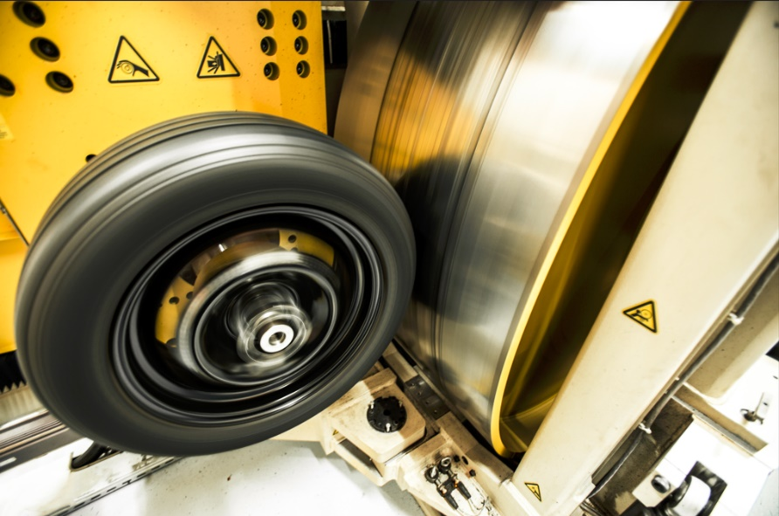
Testing methods developed by TFTA
©UTAC
©ADAC / Test und Technik
LABORATORY
(Indoor drum method)
IN-VEHICLE REAL LIFE
(On-road method)

Slide 5
Task Force on Tyre Abrasion: work progress
Work on the 2023 test campaign | Validation and correlation test campaign for 2023: ongoing for C1 Test conditions and methods: first drafts ◻ (to finalise after ongoing test campaign) On-road method: GRBP-78-17 Indoor drum method: GRBP-78-18 Tyres selections (candidate and “reference” tyres) for correlation: done ☑ Tyres selections for alignment: done ☑ Validation test campaign on 3 on-road test centres and 4 drum test centres: done ☑ Alignment test campaign on 7 on-road test centres and 4 drum test centres: starting ◻ Post processing: to start ◻ (21st September)

Slide 6
Drafting Scope
Applicable to C1 tyres as defined in R117. Excluded:
  Tyre not homologated for on road permanent usage (e.g. competition tyres)
  Free rolling tyres (trailers, caravan…) to be checked
  Temporary tyres (marked “temporary” only)
  Tyres designed for competitions;
  Tyres fitted with additional devices to improve traction properties (e.g. studded tyres);
  Tyres designed only to be fitted to vehicles registered for the first time before 1 October 2000;
  Professional off-road tyres.
Brackets and numbers: chapters in document
Red: under discussion

Slide 7
On-road method - Drafting Group
Objective
  Develop text on on-road test method
Roles
  Chair: EC
  Secretary: ETRTO
Participants:
  CP: Japan, European Commission, France
  NGOs: JATMA, ETRTO, ITMA, USTMA, OICA
  Companies: AVL, EDAG
Meetings
  1st Web meeting 21st March 2023
  2nd Web meeting 20th April 2023
  3rd Web meeting 9th May 2023
  4th Web meeting 16th May 2023
  5th Web meeting 25th May 2023
  6th Web meeting 30th May 2023
  7th Web meeting 15th June 2023
  8th Web meeting 27th June 2023
  9th Web meeting 17th July 2023

Slide 8
On-Road method - Table of Contents
Scope [1]
References [2]
Terms and Definitions [3]
Symbols and Abbreviations [4]
Instrumentation [5]
Tyre, tyre and wheel assembly and vehicle measurement [6]
Vehicle requirements [7]
Circuit, acceleration, speed [8]
Weather & climate [9]
Reference tyres [10]
Tyres and vehicles preparation [11, 12]
Test method and measurements [13]
Measurement uncertainty [14]
Test report [15]
Annex A: Calculations
Annex B: Calibration
Annex C: Abrasion rate
Brackets and numbers: chapters in document
Red: under discussion

Slide 9
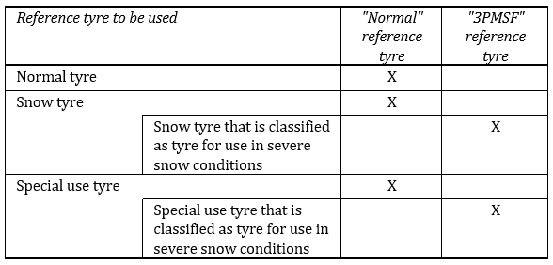
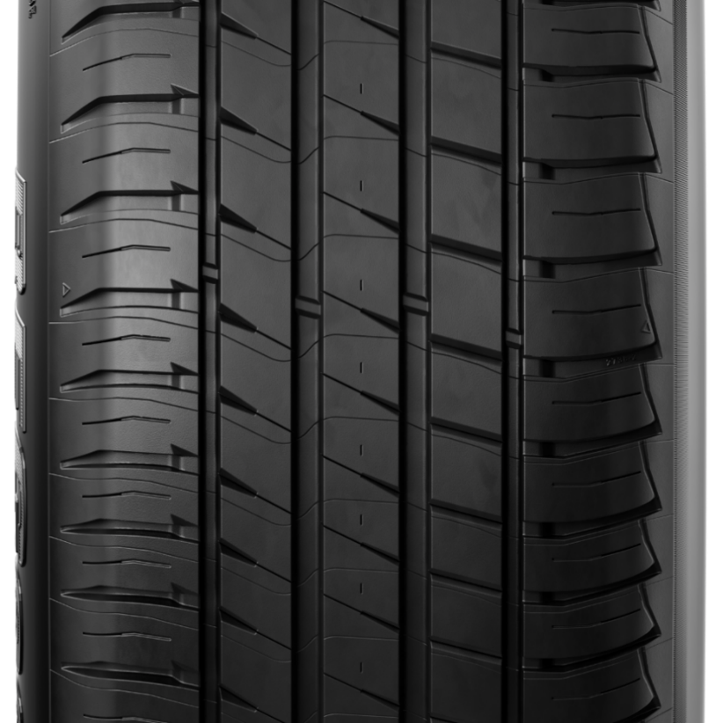
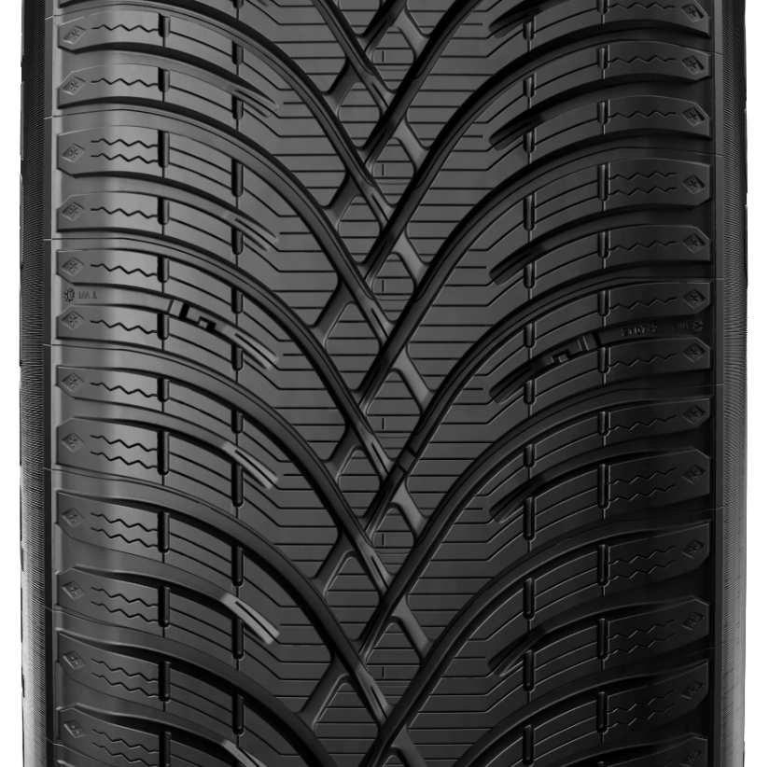
On-Road method - Reference tyres
Candidate tyres
Reference tyres shall be stored in
condition recommended by ASTM.
Normal: 225/45R17 94 XL 3PMSF: 225/45R17 94 XL
Brackets and numbers: chapters in document
Red: under discussion

Slide 10
On-Road method - Circuit [3 and 8.1]
Test distance: 8 000 km (-300 km to +1200 km) driven by repeating circuits on open public roads
Circuit consists of one or more loops, with cars returning to the departure point without being transported.
Circuit min distance 300 km of different roads.
Loop: section of circuit having the same start and end point. Loop driven opposite way is considered different loop. The loops of a circuit can be run in any order.
Brackets and numbers: chapters in document
Red: under discussion

Slide 11
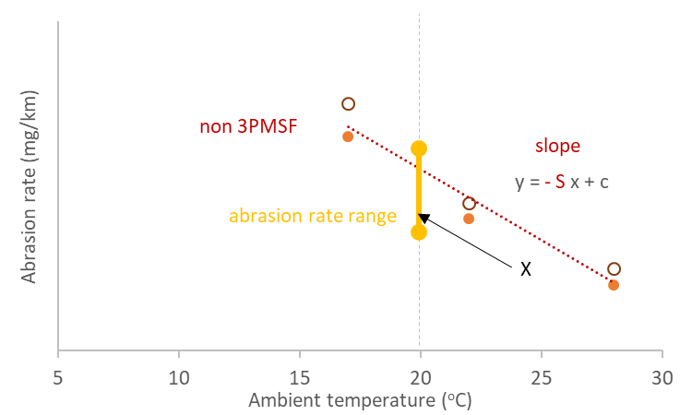
On-Road method - Circuit [8.6]
The circuit abrasion rate shall be determined:
  Convoy of at least 2 vehicles having the reference tyres (Normal or 3PMSF)
  At three ambient temperatures: one at least 15-25°C (Normal) or 5-15°C (3PMSF)
The circuit abrasion rate shall be (one needs to be checked)
  @20°C (Normal reference tyres) needs to be in the range [range] mg/km/ton
  @10°C (3PMSF reference tyres) needs to be in the range [range] mg/km/ton
13.9: If the circuit is modified by ≤10 km, or 10-30 km for ≤8 shifts or <100 km (or 20% of circuit, whichever is smaller), it is still valid
Brackets and numbers: chapters in document
Red: under discussion

Slide 12
On-Road method - Preparation
Example
Convoy
  13.1 General. Up to 4 vehicles. One is fitted with reference tyres
  13.3 Convoy composition. Homogeneous for:
    Number and position of driven wheels [7.1]
    FWD or RWD or AWD only in the convoy
    Same propulsion energy converters (e.g. ICE, or NOVC-HEV etc.)
    F2 vehicle ref. tyres <=1.2*F2 vehicle candidate tyres [7.1.9]
  13.4 Vehicles and drivers rotation
    Each tyre shall be exposed to the same distance (±10%) to all drivers and positions in convoy
Brackets and numbers: chapters in document
Red: under discussion

Slide 13
On-Road method - Preparation
Tyres preparation [11]
  11.2 Tyre mass measurement (without rim) [6.1]
  11.1 Tyre fitment on rim (and vehicle)
  11.3 Tyre and wheel assembly mass measurement [6.2] (optional)
  11.4 Tyre inflation pressure: Ref. tyres: 290 kPa, candidate tyres: 250 kPa for standard load tyres or 290 kPa for reinforced load and high load capacity tyres(XL, HL)
Vehicles preparation [12]
  Vehicle balasting [7.1.10]
    Tyre load 67% (±7%) of tyre load capacity (and not exceeding 85% vehicle max payload)
    Load distribution: FWD: 56% (±7%) to 44% (±7%); RWD/AWD: 50% (±7%) to 50% (±7%);
  12.2 Vehicle tuning (alignment) [7.1.1 to 7.1.4 and 6.4]
  12.1 Vehicle mass measurement and load at each wheel [6.3]
Brackets and numbers: chapters in document
Red: under discussion

Slide 14
On-Road method – Acceleration and Speed
Circuit approval
End of test
 | Urban | Regional | Highway | Global
Share (% distance) | 30 (±5) | 30 (±5) | 40 (±5) | -
Long. acc. stdev (m/s²) | 0.42-0.80 | 0.34-0.78 | 0.18-0.53 | 0.35-0.55
Lat. acc. stdev (m/s²) | 0.54-1.27 | 0.52-1.46 | 0.32-0.78 | 0.83-1.03
Instrumentation [5, Ann.B]
Circuit [8]
  13.2 Total distance 8000 km (-300 to +1200 km) along selected circuit
  8.1 Circuit of at least 300 km consisting of one or more loops
  8.2 Driving style distribution (see table)
  8.6 Abrasion level for reference tyres at 20°C (normal) and/or 10°C (severe snow) [range] mg/km/t
  To be checked at the end of the test (monitored continuously):
  8.3 Global (test) acceleration levels
  8.4 Speed requirements (<140 km/h)
Brackets and numbers: chapters in document
Red: under discussion

Slide 15
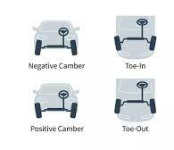
On-Road method - Measurements
13.5.1 Before and after test
Tyre mass [6.1]
Load on each tyre [6.3]
Vehicle alignments
  (unloaded and loaded vehicle) [6.4 and 7.1]
Tyre pressure
  Before test and after tyre fitment
  After test and before dismounting
Brackets and numbers: chapters in document
Red: under discussion

Slide 16
On-Road method - Measurements
13.5.2 During test
Long. and lat. acc. of each vehicle with frequency ≥10 Hz (e.g.constant monitoring) [8.5]
Speed of each vehicle (constant monitoring)
Tyre pressure each day (cold condition)
Average of five temperatures of at least start, end, at lower and higher altitude points [9.3.2 and 13.6]
Wet distance measurement [9.3.1], ice on road measurement [5.6]
At intermediate stops
Vehicle alignment of reference vehicle every 2 000 km [6.4 and 7.1]
Tyre and wheel assembly mass [6.2] (optional but compulsory during the test campaign)
Vehicle alignment of test vehicles [6.4 and 7.1] (optional at half distance but compulsory during the test campaign)
Brackets and numbers: chapters in document
Red: under discussion

Slide 17
On-Road method - Troubleshooting
13.10 Vehicle:
  Repair is possible: The repaired vehicle shall run the distance lost (without other vehicles of the convoy)
  Major failure or accident: The replacement vehicle equipped with the same (new) tyres shall run the distance lost (without other vehicles of the convoy)
  If failure happens to a test vehicle and not reference vehicle, the failed vehicle (and tyres) can be withdrawn.
13.11 Tyres:
  Tyre is destroyed: Spare part with same size and pattern is used. The mass loss of the other tyre is multiplied by two for the calculations
  Tyre is reparable: The added repair mass is taken into account in the calculations. Spare tyre can be used for max one loop. Distance will be considered in the calculations
Brackets and numbers: chapters in document
Red: under discussion

Slide 18
On-Road method - Validation [13.8]
 | Normal | 3PMSF
Average T (°C) | 7 to 35 | -3 to 20
Min/max for 90% of dist. (°C) | 2 / 40 | -7 / 25
Wet mileage | <20% | <20%
Ice or snow mileage | 0% | <5%
Weather and Climate [9.1, 9.2]
Accelerations [processing in Annex A]
  8.3.1 see table beside
  8.3.2 Long. and lat. acc. stdev
  within 5% of ref. vehicle values
Vehicle alignments [7.1]
  End-Start: ±0.15° toe, ±0.3° camber
Visual inspection
  Sidewall marking readable
  Tyre loss <1cm² of tread chunking area (for Ref tyre: all results invalid)
Ref. tyres abrasion rate value @20°C or @10°C within abrasion rate range
 | Global
Max speed (km/h) | 140
Long. acc. stdev (m/s²) | 0.35-0.55
Max long. acc. (m/s²) | ±5 (for ≥99.8% distance)
Lat. acc. stdev (m/s²) | 0.83-1.03
Max lat. acc. (m/s²) | ±5 (for ≥99.6% distance)
Brackets and numbers: chapters in document
Red: under discussion

Slide 19
On-Road method - Calculations [13.12]
ARRT = Abrasion Rate of Reference Tyres normalized to load
= (Σ(MRTS_{i}-MRTF_{i}) / D_{Ti} ) / Σ(Q_{R,i}) @T_{average}
MRTS_{i} = Mass of Reference Tyre Start (wheel i)
MRTF_{i} = Mass of Reference Tyre Final (wheel i)
D_{Ti} = Distance of tire i
Q_{R,i} = Test load of each reference tyre i
ARCT = Abrasion Rate of Candidate Tyres normalized to load @T_{average}
AICT = Abrasion Index of Candidate Tyre (independent on T_{ave})
= ARCT / ARRT
Brackets and numbers: chapters in document
Red: under discussion

Slide 20
On-Road method - Test report [15]
Calibration [Annex B]
Instrument | Interval | Criterion
Scale for tyres | Yearly and at major maintenance | ±2 g
Instrument for toe and camber | Yearly | +/- 0.033º
Acceleration/Speed sensor | Yearly
Scale for vehicle | Yearly and at major maintenance | +/- 0.1%
Temperature sensor | Yearly | ±1°C
Tyre pressure sensor | Yearly | ±3 kPa
Scale for tyre and wheel assembly | Yearly and at major maintenance | ±2 g
Brackets and numbers: chapters in document
Red: under discussion

Slide 21
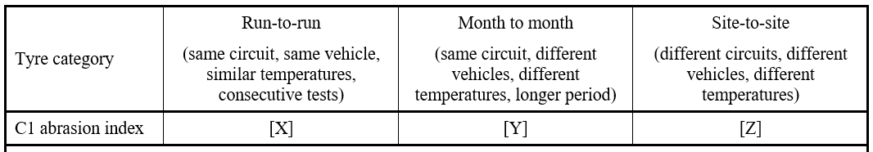
On-Road method - Measurement Uncertainty [14]
To be discussed when first data is available
Brackets and numbers: chapters in document
Red: under discussion

Slide 22
Indoor drum method - Drafting Group
Objective
  Develop text on indoor drum test methods
Roles
  Chair: JASIC
  Secretary: JATMA
Meetings
  1st Web meeting 22nd March, 2023
  2nd Web meeting 18th April, 2023
  3rd Web meeting 1st June, 2023
  4th Web meeting 20th June, 2023
Participants:
  CP: Japan, European Commission, France
  NGOs: JATMA, ETRTO, ITMA, USTMA, OICA
  Companies: Twms Consulting, AVL

Slide 23
Indoor drum method - Table of Contents
Scope [1]
Definitions and Terms [2]
Test method [3]
Test Conditions [4]
Test procedure [5]
Validation [6]
Processing of measurement results [7]
Input of test cycle [Annex XX – Appendix 1]
Test equipment tolerances [Annex XX – Appendix 2]
Replacement of sandpaper surface [Annex XX – Appendix 3]
Example of a test report [Annex XX – Appendix 4]
Brackets and numbers: chapters in document
Red: under discussion

Slide 24
Indoor drum method - Reference tyres [2.5.2.1]
Possible options of reference tyre are SRTT16 and SRTT17 (Summer & Winter).
  [(a) F2493 for the size P225/60R16 and referred to as "SRTT16"]
  [(b) Fxxxx for the size 225/45R17 and referred to as "SRTT17S"]
  [(c) Fyyyy for the size 225/45R17 and referred to as "SRTT17W"]
Comparative tests between the SRTT17 and SRTT16 are ongoing at JASIC, and if there are no problems, the SRTT17 will be adopted, which is the same as the vehicle method.
Brackets and numbers: chapters in document
Red: under discussion

Slide 25
Indoor drum method - Drum specification [3.2]
Tyre Wear Test Equipment
  A drum, a tyre mounting device, a loading device and an adhesion prevention system
Drum diameter
  The test dynamometer shall have a cylindrical flywheel (drum) with a diameter of at least [1,7] m.
  The roller diameter shall be defined and reported considering the thickness of test surface, to compute test speed and running distance correctly.
Width
The width of the test surface shall always exceed the width of the test tyre contact patch throughout entire test duration.
Brackets and numbers: chapters in document
Red: under discussion

Slide 26
Indoor drum method - Drum specification [3.2]
Surface
The test surface shall be applied to external surface of the cylindrical drum.
The test surface of drum shall:
(a) have MPD measured at the start and the end of the drum test,
according to [ISO 13473-1] except for low pass filter, applied from [0,2] mm to [2,0] mm.
(b) low pass filter cut-off shall be [0,1]mm for MPD data processing procedure.
(c) be textured with sands, stone or an alternative material, e.g., aluminum oxide resin
(d) The drum surface shall be built with rigid and not deformable material.
  Check surface by reference tyre abrasion rate.
    The abrasion rate of the reference tyre for all surface shall be in the range [30] mg/km to [100] mg/km
Brackets and numbers: chapters in document
Red: under discussion

Slide 27
Indoor drum method - Tyre carriage and drive system [3.3]
The tyre carriage and drive system shall be able to provide dynamic control of:
(a) tyre lateral force developed by the drag force produced by tyre slip angle during running
(b) Longitudinal tyre force or torque developed by tractive force by the tyre during braking and accelerating
Adhesion prevention system
  Tread wear test equipment shall be equipped with the powder delivery system to spray a controlled volume of such material (e.g., talc) on the test surface near the test tyre contact patch so that a test tyre does not adhere to and change the test surface.
Brackets and numbers: chapters in document
Red: under discussion

Slide 28
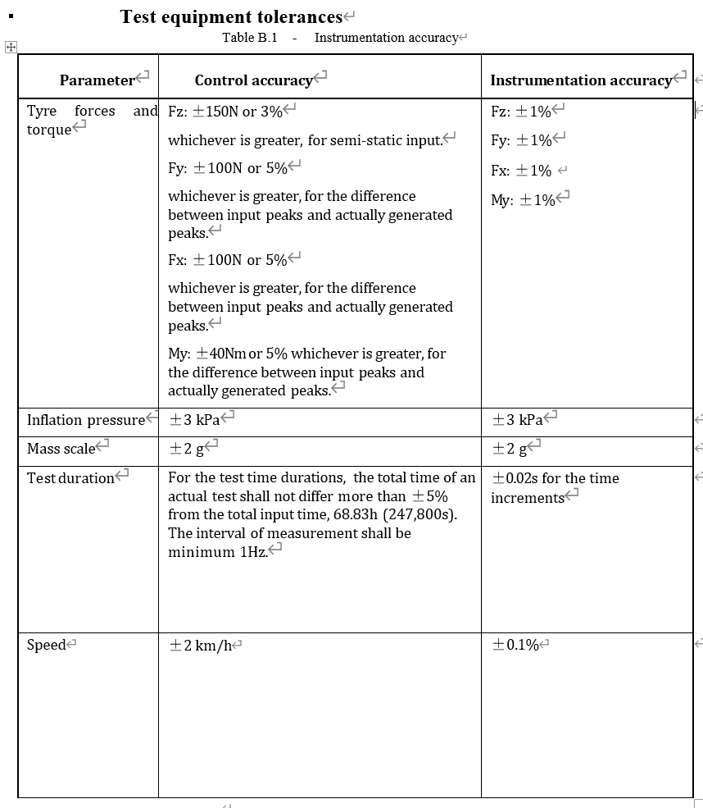
Indoor drum method - Test Conditions [4]
Test load
  Test load Fz is 80% of maximum load capacity
Tyre inflation pressure
  Standard load : 210 kPa
  Extra load : 250 kPa
Testing condition
  Longitudinal force, lateral force and speed : Appendix 1
  Running distance is 5 000km.
Brackets and numbers: chapters in document
Red: under discussion

Slide 29
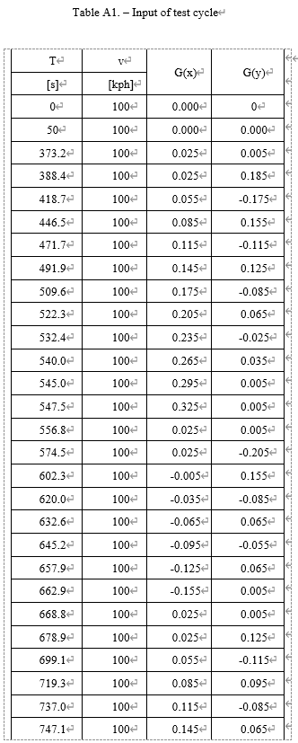
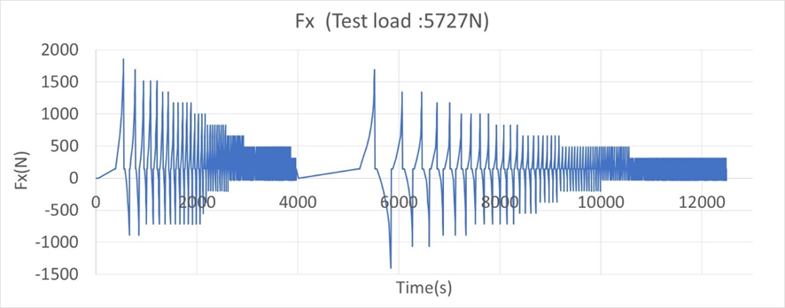
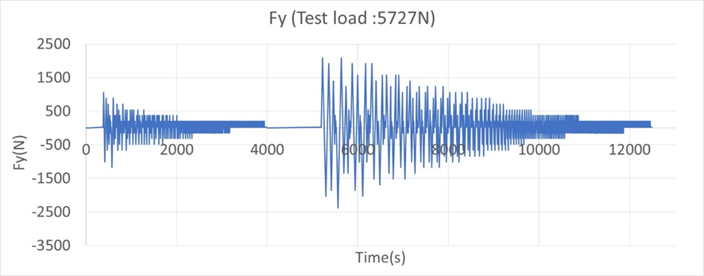
Indoor drum method - Input of test cycle [Appendix 1]
1 cycle : 250 km
Fx (or My) and Fy calculation
  Longitudinal force : Fx = Test load Fz × Longitudinal acceleration G(x)
or Tyre torque : My = Fz × G(x) × Loaded Radius RL
  Lateral force : Fy = Fz × Lateral acceleration G(y)
At a point of test duration T, the values of G(x) and G(y) shall be equal to those listed in Table A1;
G(x) and G(y) shall change linearly between two adjacent points.
Therefore, the values of Fx and Fy will also change linearly from one point to another.
The following graphs show samples of linear change for Fx or Fy with respect to T.
Brackets and numbers: chapters in document
Red: under discussion
T represents the total test duration from the beginning of the test
G(x) and G(y) represent the index compared to the standard acceleration due to earth gravity

Slide 30
Indoor drum method - Test procedure [5]
Thermal conditioning
Place the inflated tyre in the thermal environment of the test location for a minimum of 3 h.
Pressure adjustment
After thermal conditioning, the inflation pressure shall be adjusted to the test pressure.
Thermal environment
During the test, the ambient temperature, at a distance of not less than 0,15m and not more than 1 m from the tyre, shall be 25 °C ± 5 °C
Average temperature for reference and candidate tyre during test within 2 degrees
Mass measurement
The mass of tyre shall be measured before and after 5 000km of run set out in paragraph 5.6 for both reference and candidate tyres.
Brackets and numbers: chapters in document
Red: under discussion

Slide 31
Indoor drum method - Test cycle [5]
Input condition
  Both reference tyre and candidate tyre shall be tested according to input condition of Appendix 1.
  The Appendix 1 test condition of 250 km is set as one set, and the test cycle shall be repeated 20 times until 5 000 km is reached.
Brackets and numbers: chapters in document
Red: under discussion

Slide 32
Indoor drum method - Test cycle [5]
Basic test cycle (2 positions)
  Both reference tyre and candidate tyre shall be mounted different position of one drum. Test of both reference tyre and candidate tyre shall be conducted at the same time.
  Tyre positions shall be exchanged once after the completion of 2 500km.
  Direction of rotation shall remain constant throughout the test.
Alternative test cycle (1 position)
  In case test of reference tyre and candidate tyre is not possible at the same time,
  the alternative test cycle is available. As Reference tyre (R) and Candidate tyre (T),
  test order is following:
  R(1000km) - T(2000km) - R(2000km) - T(2000km) - R(2000km) - T(1000km)
  Repeat a set of Appendix 1 input conditions 4 times for 1 000 km and 8 times for 2 000 km.
Brackets and numbers: chapters in document
Red: under discussion

Slide 33
Indoor drum method - Measurement and recording [5.6.4]
The following shall be measured and recorded:
(a) Test speed;
(b) Load on the tyre normal to the drum surface, Fz;
(c) Test inflation pressure: initial and middle of the test, as defined in 5.3;
(d) Ambient temperature measured in degree °C;
(e) Force or torque applied to the test tyre and testing duration, with a maximum time interval of 1s;
(f) Test rim size;
(g) Mass of tyre; at the beginning and the end of the test
(h) MPD of the test surface; at the beginning and the end of the test
(i) Photograph of tyre after test run;
Brackets and numbers: chapters in document
Red: under discussion

Slide 34
Indoor drum method - Validation [6]
Test operate undergo with NO…
Permanent deformation
Loss of air
Visual inspection to check there are NO…
Visual evidence of tread, sidewall, ply, cord, inner liner, belt
Bead separation
Chunking
Open splices
Cracking
Broken cords
Rubber adhesion
Brackets and numbers: chapters in document
Red: under discussion

Slide 35
Indoor drum method - Calculations [7]
Abrasion Index ; Ari= ArT (g)/ ArR (g)
ArT : Abrasion rate(mg/km) of candidate tyre
ArT = MlT (g)/DT(km) x 1000(mg/g)
ArR : Abrasion rate(mg/km) of reference tyre
ArR = MlR (g)/DR(km) x 1000(mg/g)
MlT : Mass loss of candidate tyre, in grams
MlR : Mass loss of reference tyre, in grams
DT : Testing mileage of candidate tyre
DR : Testing mileage of reference tyre
Brackets and numbers: chapters in document
Red: under discussion

Slide 36
Open points on both test methods
Tread depth is included in the test campaign (mileage).
Ice tyres special requirements (e.g. average ambient temperature <5°C)
Units mg/km or mg/km/t

Slide 37
Task Force on Tyre Abrasion: next
Next steps | Start the post processing of the validation and correlation test campaign Draft the final proposal of method(s) for GRPE review (January 24) and GRBP adoption (February 24) Once the method(s) is validated and finalised Perform the market review (2024 TBC) Define and introduce reference tyre(s) for abrasion test in ASTM standard Set the limits for abrasion Work on the feasibility of rating and definition of the mileage of tyres Evaluate and adapt or propose method(s) and rating to C2 and C3 tyres

Slide 38
Back up

Slide 39
On-Road method - Open points
Tyre and wheel assembly mass measurements: To be decided after test campaign
Reference tyres abrasion rate range: To be decided after test campaign
Data (worst case) of abrasion and impact on result with distance 7700 km and 9200 km
Brackets and numbers: chapters in document
Red: under discussion

Slide 40
Indoor drum method - Open points
Reference tyre: needed?
Reference tyres abrasion rate range: To be decided after test campaign
Tolerances of test equipment: To be decided after test campaign
Brackets and numbers: chapters in document
Red: under discussion

