Slide 1
Informal document WP.29-190-24
190th WP.29, 20-22 June 2023
Agenda item 4.5.
Note by the secretariat
Assessment of UN Regulations under the purview of GRVA with regards to the use of the
Unique Identifier (UI) – 2 valid views
WP.29

Slide 2
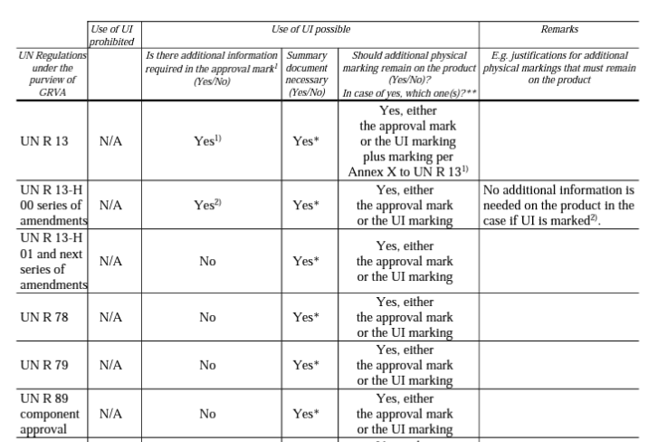
Views expressed at the 16th session of GRVA
Assessment of UN Regulations (GRVA-16-19)
The template was filled out under the assumption that the UI concept would be realized and activated in DETA
This assessment did not take accounts of the concerns expressed by some delegations e.g. at WP.29.
190th Session of WP.29 | June 2023 | Geneva

Slide 3
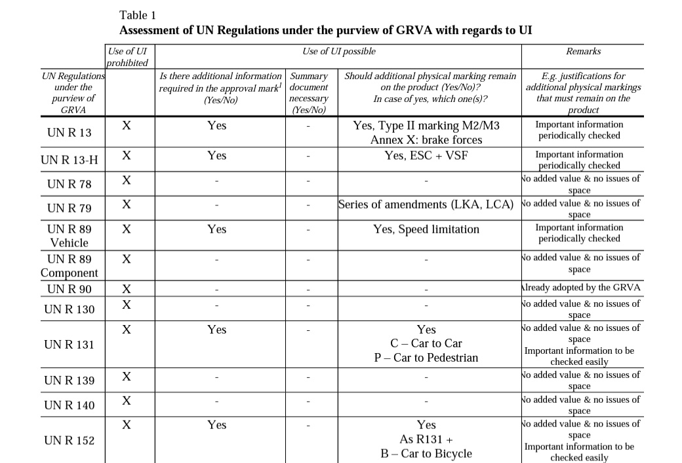
Views expressed at the 16th session of GRVA
Assessment of UN Regulations (GRVA-16-44)
Basis for the assessment in GRVA-16-44:
This alternative assessment was provided, having in mind:
The initial justification for UI i.e. issues related to space on automotive products not always available for multiple marking
The practical needs of other stakeholders
190th Session of WP.29 | June 2023 | Geneva

Slide 4
Summary
GRVA discussed:
The time needed to deliver the UI functionality in DETA.
The need to identify issues associated with UI that were not obvious at the beginning, in the current context.
OICA noted that the benefits of UI was mainly for small parts, not for the whole vehicle
CITA stated that UI, as envisaged, did not support harmonization
Upon request, CLEPA clarified that they did not support nor object putting UI on hold
190th Session of WP.29 | June 2023 | Geneva

