Slide 1
The role of human capital and education in innovation for sustainable development
Ralph Heinrich, Secretary, UNECE Committee on Innovation, Competitiveness and Public-Private Partnerships

Slide 2
Importance of Innovation for Sustainable Development
Innovation, or the development of new products, services, production processes, is central to achieving prosperity, within planetary boundaries, for all.
SDG 9: foster innovation, upgrade tech capabilities, create policy environment conducive to diversification and higher value-added
But also SDG 17 Means of Implementation: enhance access to STI, transfer of environmentally sound tech
Creating more growth and better jobs through empowering innovative entrepreneurship
Promoting ecological sustainability through optimising resource use, supporting green technology, and circular economy transition
Tackling social challenges and promoting equality through innovation

Slide 3
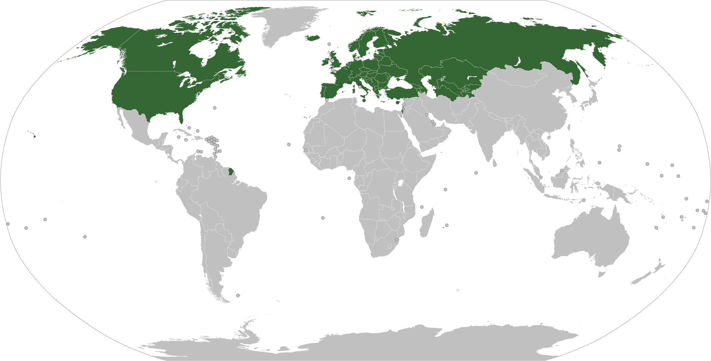
Policy support is crucial for creating more innovation where it is needed most
Capacity to innovate varies greatly across UNECE economies
Innovation thrives in nurturing eco-systems w/ strong education, science, companies, finance, market access, and strong linkages between them
Harnessing the transformative power of innovation for SD requires aligning private incentives w/ societal needs
Policies
Support innovation eco-systems
Internalize externalities
Holistic approach: catalytic, cross-sectoral, directional
Policy areas: governance, risk finance, science-industry linkages, innovation-enhancing procurement, innovation for the circular economy transition

Slide 4
Support for Innovation
Complete Support Cycle for Innovation
POLICY ANALYSIS
CAPACITY-BUILDING
REGIONAL POLICY DIALOGUE
National Innovation for Sustainable Development Reviews
Identification of policy issues
Development of international good policy practice
Su-regional Innovation Policy Outlooks
Support policy reforms
Based on int’l good practice and
On country-level analyses
Committee on Innovation, Competitiveness and PPPs promotes innovation for sustainable development
A Holistic approach: a complete support cycle for innovation policy development from identifying int’l good practice to diagnosing nat’l strengths & weaknesses to building capacity for policy reform
.

Slide 5
The role of human capital and education for innovation
Education is vital for fostering innovation
Human capital is an essential input for innovation, for research & development, and for the successful commercialization of new technologies and ideas. Formal education, vocational training & life-long learning are how we build and maintain human capital
Education supports innovation for sustainable development in 2 ways:
Fostering a culture of innovation and entrepreneurship for sustainable development
by raising awareness about sustainable development challenges,
shaping societal attitudes towards innovation and
encouraging individuals to identify opportunities, take calculated risks, and turn ideas into reality.
Providing the skills needed to develop and apply innovations
by developing critical thinking skills which are vital for innovation as they enable individuals to challenge existing norms and generate new ideas,
developing technical knowledge and skills, including in STEM, entrepreneurship

Slide 6
Our policy analyses
UNECE focus regions for innovation policy support:​
Eastern Europe ​
Western Balkans​
South Caucasus
Central Asia​
Current analyses on innovation policy include:
Innovation Policy Outlooks - assess the scope and quality of innovation policies, institutions, and processes across multiple countries in the region
Innovation for Sustainable Development Reviews - assess national innovation governance and provides tailored recommendations for improvement
Capacity building handbooks – support training activities

Slide 7
Stylized findings: main challenges
Skills mismatch and skills gap in the labour market
Weakness in the system of STEM education
Skills mismatches and gaps are one of the main problems that constrains the development of innovation
The growing demand for technical skills outstrips supply of qualified graduates, incl in STEM;
SMEs especially have less access to good practices and lack both the understanding of what skills are needed and the resources to obtain the right support;
Skills mismatch: Eg in Georgia, 40 per cent of unemployed women and around 34 per cent of unemployed men have higher education.
The system of STEM education is currently not well developed
Education systems not sufficiently in tune w/ needs of labor markets;
Often outdated curricula;
Lack of teaching equipment;
Lack of funding.

Slide 8
Stylized findings: main challenges
Lack of entrepreneurial skills
Brain Drain
Lack of necessary skills is considered to be one of the main obstacles to the development of entrepreneurship
Entrepreneurs often lack skills
attracting investment;
accessing foreign markets;
developing or adopting new tech.
There is often a big gap between the development of entrepreneurial skills in the capitals and in the regions.
Pertinent challenge for the economies is the high level of brain drain
Many countries face a lack of skilled professionals in key areas of economic activity;
Graduates emigrate from the country before they can contribute the cost of their training back to the economy in the form of taxes and improvements in productivity;
‘Brain drain’ can turn into 'brain waste’ – many educated emigrants are employed in low-skilled occupations.

Slide 9
Policy recommendations
Skills gaps & mismatch in labour market:
Increase public-private collaboration in technical and business services to identify market needs;
Invest in and reinforce skills development programmes to systematically build organizational, managerial and technological capacities;
Establish the right incentives to align the education system with market needs.
Weakness in the system of STEM education:
Build a STEM community engaging educators and individuals within and outside a formal educational setting to popularize STEM education and make technical careers more accessible;
Expand support schemes for students enrolled in STEM fields to include partial and full scholarships;
Establish an online resource for finding STEM education-related activities and funding opportunities.
Lack of entrepreneurial skills:
Strengthen the entrepreneurial culture and enhance start-up support by incentivizing coordination between support initiatives;
Promote start-up creation by ensuring sufficient coordination and awareness of innovation policy initiatives to exploit the entrepreneurial capacity of the broader population;
Include innovative entrepreneurship and skills sought after by innovative companies into curricula;
Support the temporary or part-time exchange of R&D staff between business and science institutions.
Brain drain:
Focus also on short-term measures to halt brain drain – they could include salary top-ups, placement schemes or tax exemptions for young professional;
Strengthen efforts to improve working and living standards, especially for early-career workers.

Slide 10
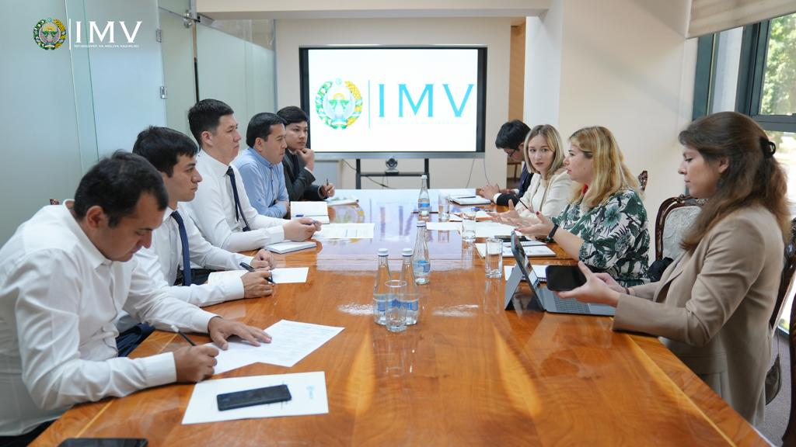
Building National Capacity for Reform
Assisting in the implementation of policy recommendations
Impact comes only when policy recommendations are implemented on the ground. This is hard and requires investing in the skills of policy makers and implementing agencies.
Advisory missions
Training workshops – e.g. ‘Training for university management on the role of business incubators for sustainable development’
Handbooks – e.g. ’Supporting Innovative High-Growth Enterprises in Eastern Europe and South Caucasus’, on “Business Incubators for Sustainable Development in the SPECA sub-region”

Slide 11
To learn more about our work please visit our website here
Questions? Please contact me at ralph.heinrich@un.org
75 YEARS
OF ECONOMIC INTEGRATION
AND COOPERATION
IN THE REGION
Thank you!

