Slide 1
Draft proposal Toolkit WIA
ESD-Key Strand 2 WIA and ESD
Hak van Nispen tot Pannerden
May 25, 2023

Slide 2
From to to school WSA WIA
School
University
Courses
NGO
Sports
Family
Friends
Music
…………
…………
Companies
Municipality

Slide 3
From school to WSA to WIA
It is a big change school -> WSA
Is a bigger change WSA-> WIA as a learning ecosystem
It is a challenge to create a Toolkit WIA that is inspiring and motivating for everyone.

Slide 4
Mandate Toolkit WIA
Strand 2 ‘WIA for transformational learning’
Leadership strand 2: Cyprus and The Netherlands
Expert group will be established
The Expert group will develop a workplan for strand 2 WIA and ESD in UNECE region
Expert group in cooperation with SC and leading countries will develop tools and capacity building for implementation of the toolkit WIA and ESD
Toolkit will be developed taking into consideration the policy framework WIA and ESD

Slide 5
Small team, joint effort
Expert Group
Project team
Support group

Slide 6
Expert group
Expert Group
Group of selected experts:
Expertise on framing and developing toolkits on WSA (WIA) and ESD
Availability to work systematically for developing the work plan activities
The leading countries to presented
Members of the expert group
Ass. Professor Jan Cincera, Masaryk University, Check Republic
Ass. Professor Kostantinos Korfiatis, University of Cyprus
Ass Professor Georgia Liarakou, Kapodistrian University of Athens, Greece

Slide 7
Project team
Support group
Support group
4-5 countries that want to participate and test the Toolkit WIA
Project team
Small dedicated team:
2x The Netherlands (André de Hamer, Heleentje Swart)
2x Cyprus (Thallia Michael, Cyprus, Simoni Partakidou)

Slide 8
Purpose
Practical toolkit to integrate WIA
Support for stakeholders (including youth) to understand their role
Ideas and practices
Help in the use of WIA in practice
Support for Member states to implement WIA in policy
Tool for networking and cooperation between Member States
Common language for communication between stakeholders about ESD

Slide 9
The route
The expert group will discuss the design and elements of the toolkit, after this has been agreed on in the Expert group the development will start.
Forms we suggest are
Website
Video for a general introduction WIA and ESD
A binder
Box of cards (dialogue cards and information cards and examples) with cross-overs between the dimensions of WIA
Translations of the Toolkit will be made by the secretariat.

Slide 10
Deliverables
General description (WIA, ESD and SDGs)
Dimensions of WIA and ESD based on the new framework
Sustainable competences
Concept on Pedagogy and didactics
Process of starting and implementing WIA
Networks that can be used
Tools, examples and inspiration
Literature
Training design
Guidelines and feedback mechanism

Slide 11
Timeline
 | 2023 |  |  | 2024 |  |  |  | 2025
 | Q2 | Q3 | Q4 | Q1 | Q2 | Q3 | Q4 | Q1
Start Expert group, Support group and Project team | x
Research and analysis |  | x
Pedagogical concept; General description and specific dimensions |  | x | x
Architecture and design |  |  | x
Development of the tools |  |  |  | x | x
Selection of examples and inspiration |  |  |  |  | x
Draft version |  |  |  |  | x
Presentation of the first draft in the 19th Meeting of the UNECE ESD SC |  |  |  |  | x
Regional conference ‘how to use the Toolkit WIA (hosted by one of the MS) |  |  |  |  |  | x
Final version |  |  |  |  |  |  | x
Publishing bij UNECE (after the 20th meeting for publication and translation) |  |  |  |  |  |  |  | x

Slide 12
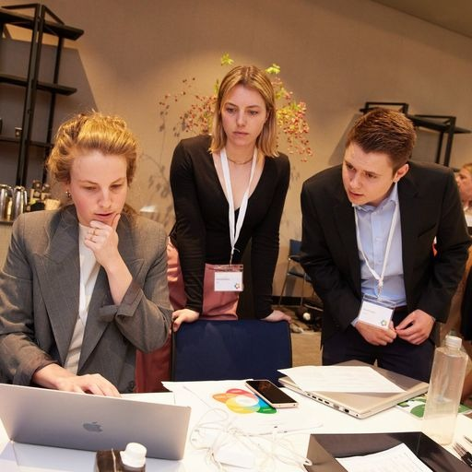
Capacity building and dissemination
Meetings/ regional activities back-to-back with SC meetings
International conference for implementation Toolkit WIA (by country that want to host it)
Joint events
Training events on demand
Webinars

Slide 13
Questions to be answered
General idea of the proposal
Members States for the support group
International conference about the use of the Toolkit in ±Q3 2024, if a MS want to host this
Workshops by country/(ies) that want to host it

