Slide 1
Informal document GRPE-89-39
89th GRPE, 30 May - 2 June 2023
Agenda item 2
Development of the
ITC Strategy on reducing greenhouse
gas emissions
in inland transport
Actions of the inland transport sector to join the global fight against climate change
INLAND TRANSPORT COMMITTEE
Francois Cuenot
UNECE, Sustainable Transport Division

Slide 2
Mandate
Decisions of ITC at its 85th annual session (Geneva, 21-24 February 2023,
see report ECE/TRANS/328, para. 60):
On the basis of ECE/TRANS/2023/21, the Committee
requested the secretariat, in close cooperation with the Committee’s Bureau and relevant subsidiary bodies, to develop an ambitious strategy document for reducing Green House Gas (GHG) emissions in inland transport based on international United Nations legal instruments under the Committee’s purview with priority actions for The Inland Transport Committee (ITC) and all its relevant subsidiary bodies, supported by a strong action plan with milestones, for consideration and possible adoption by the Committee at its 86th plenary session (2024);
requested the secretariat to report biennially through in-depth reports to the Committee on climate change and inland transport, starting at the Committee’s 86th session in 2024.
Inland Transport Committee | 2023 | Geneva

Slide 3
Support from ITC’s subsidiary bodies Working parties are asked 2 contributions
Thank you in advance for providing your inputs, as requested:
for the development of the climate change mitigation strategy for consideration and possible adoption by ITC at its 86th plenary session
by 29 September 2023
(if requested to meet the Working Party cycle, by 5 January 2024).
for the biennial report on climate change and inland transport to the Committee at its 86th session
by 29 September 2023.
Inland Transport Committee | 2023 | Geneva

Slide 4
1. ITC climate change mitigation strategy
What can GRPE do to contribute to the ITC climate change mitigation strategy
GRPE recommendations to ITC for a successful climate change mitigation strategy
Inland Transport Committee | 2023 | Geneva

Slide 5
1.A. What can GRPE do?
Proposal by the secretariat, ranked by level of ambition
GRPE to carry on with existing GHG-related topics in list of priorities (GRPE-87-54-Rev.1)
GRPE to commit to include more GHG measurement procedures from «emission list» (GRPE-87-55) to «list of priorities» (GRPE-87-54-Rev.1), with longer timeline
Other potential activities
GRPE to work on fleet-level CO2/GHG emission standards
Harmonization of Fuel Economy / Energy Efficiency standards procedures
ZEV definition (pre- and post- LCA methodology) and
Global/WP.29 FE target / ZEV mandate
Inland Transport Committee | 2023 | Geneva

Slide 6
1.B. What should be done for a successful ITC strategy => GRPE recommendations to ITC
Data driven strategy : quantified milestones and objectives
ITC get clarity on Countries’ commitments on decarbonization of inland transport (inland transport NDCs), to give guidance to GRPE future work activities
Avoid / Shift /Improve approach, GRPE focusing mainly on «Improve»
GRPE to advise ITC to also look at non-vehicle parameters (Annual distance, car ownership,…), as advised already in ECE/TRANS/2023/21
GRPE to request ITC (again) to provide the possibility to offer hybrid meeting option for meetings of its subsidiary bodies to reduce travel and associated GHG emissions
Inland Transport Committee | 2023 | Geneva

Slide 7
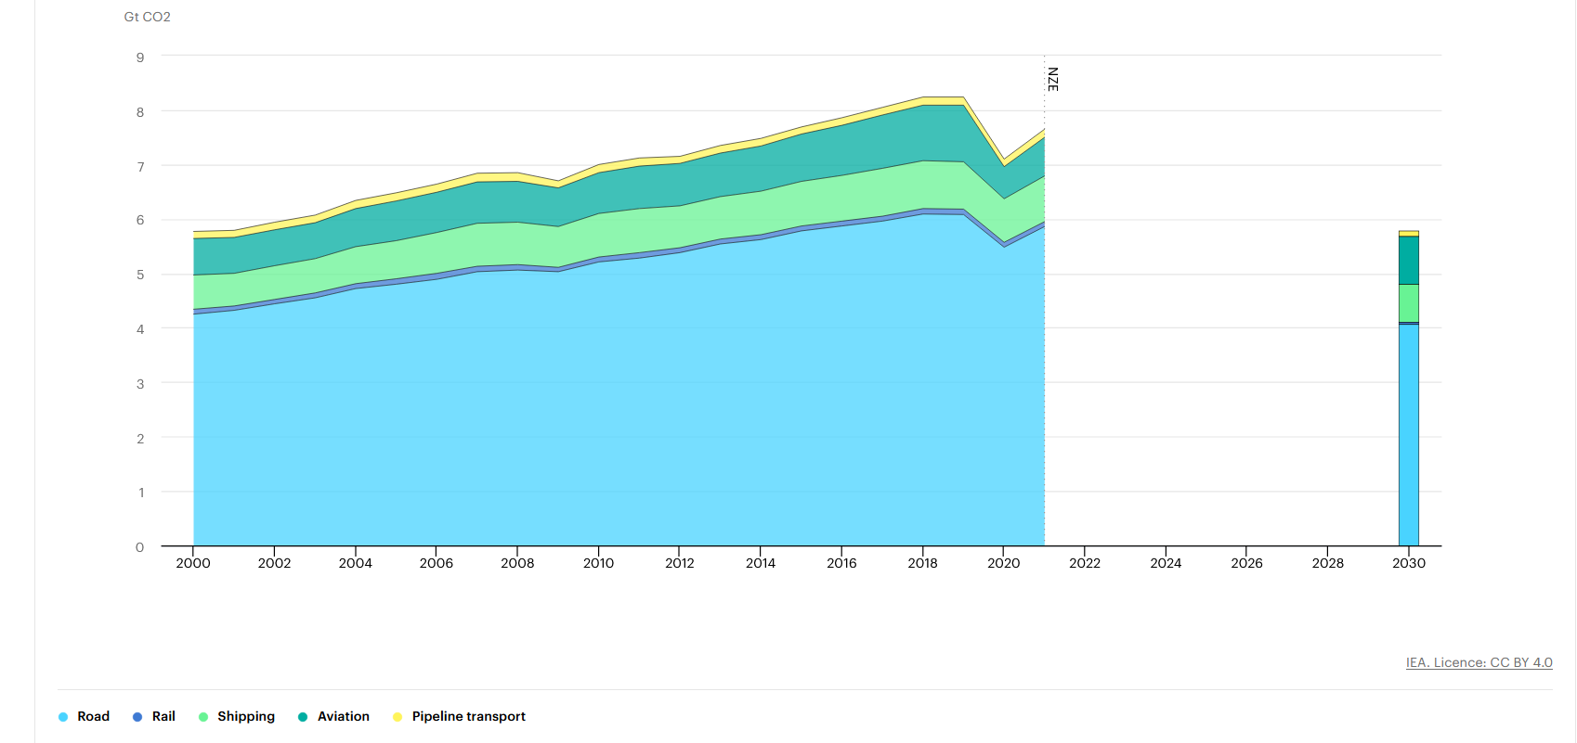
Data driven strategy: all about GtCO2! Inland transport (blue) to go from 6GtCO2 today to 4GtCO2 in 2030

Slide 8
Avoid / Shift/ Improve strategy
Source : UNDP, 2019

Slide 9
2. Biennial Report
GRPE to provide update on progress to existing and forthcoming activities in the GR
GRPE to update ITC on low carbon technologies take-up (electrification, other), using external sources, and CPs commitment
Inland Transport Committee | 2023 | Geneva

Slide 10
Next steps
and delivery deadline
Set-up Informal GRPE Task force on ITC CC mitigation strategy tasked to prepare some draft inputs
Already volunteered: Australia, France, Netherlands, UK, US, CLEPA, IMMA, OICA
Other interested parties ?
Virtual meetings
Two /three 2-hours meeting before then (first hybrid meeting during June WP.29, Secretariat to prepare first draft)
Draft contribution to be circulated by Mid July, under GRPE wirtten consultation, together with GTR brake amendment
Inland Transport Committee | 2023 | Geneva

