Slide 1
Electric Vehicles and the Environment (EVE IWG)
Submitted by the EVE informal working group
Informal document GRPE-89-36
89th GRPE, 31 May – 02 June 2023
Agenda item 9.
Report to 89th GRPE Session

Slide 2
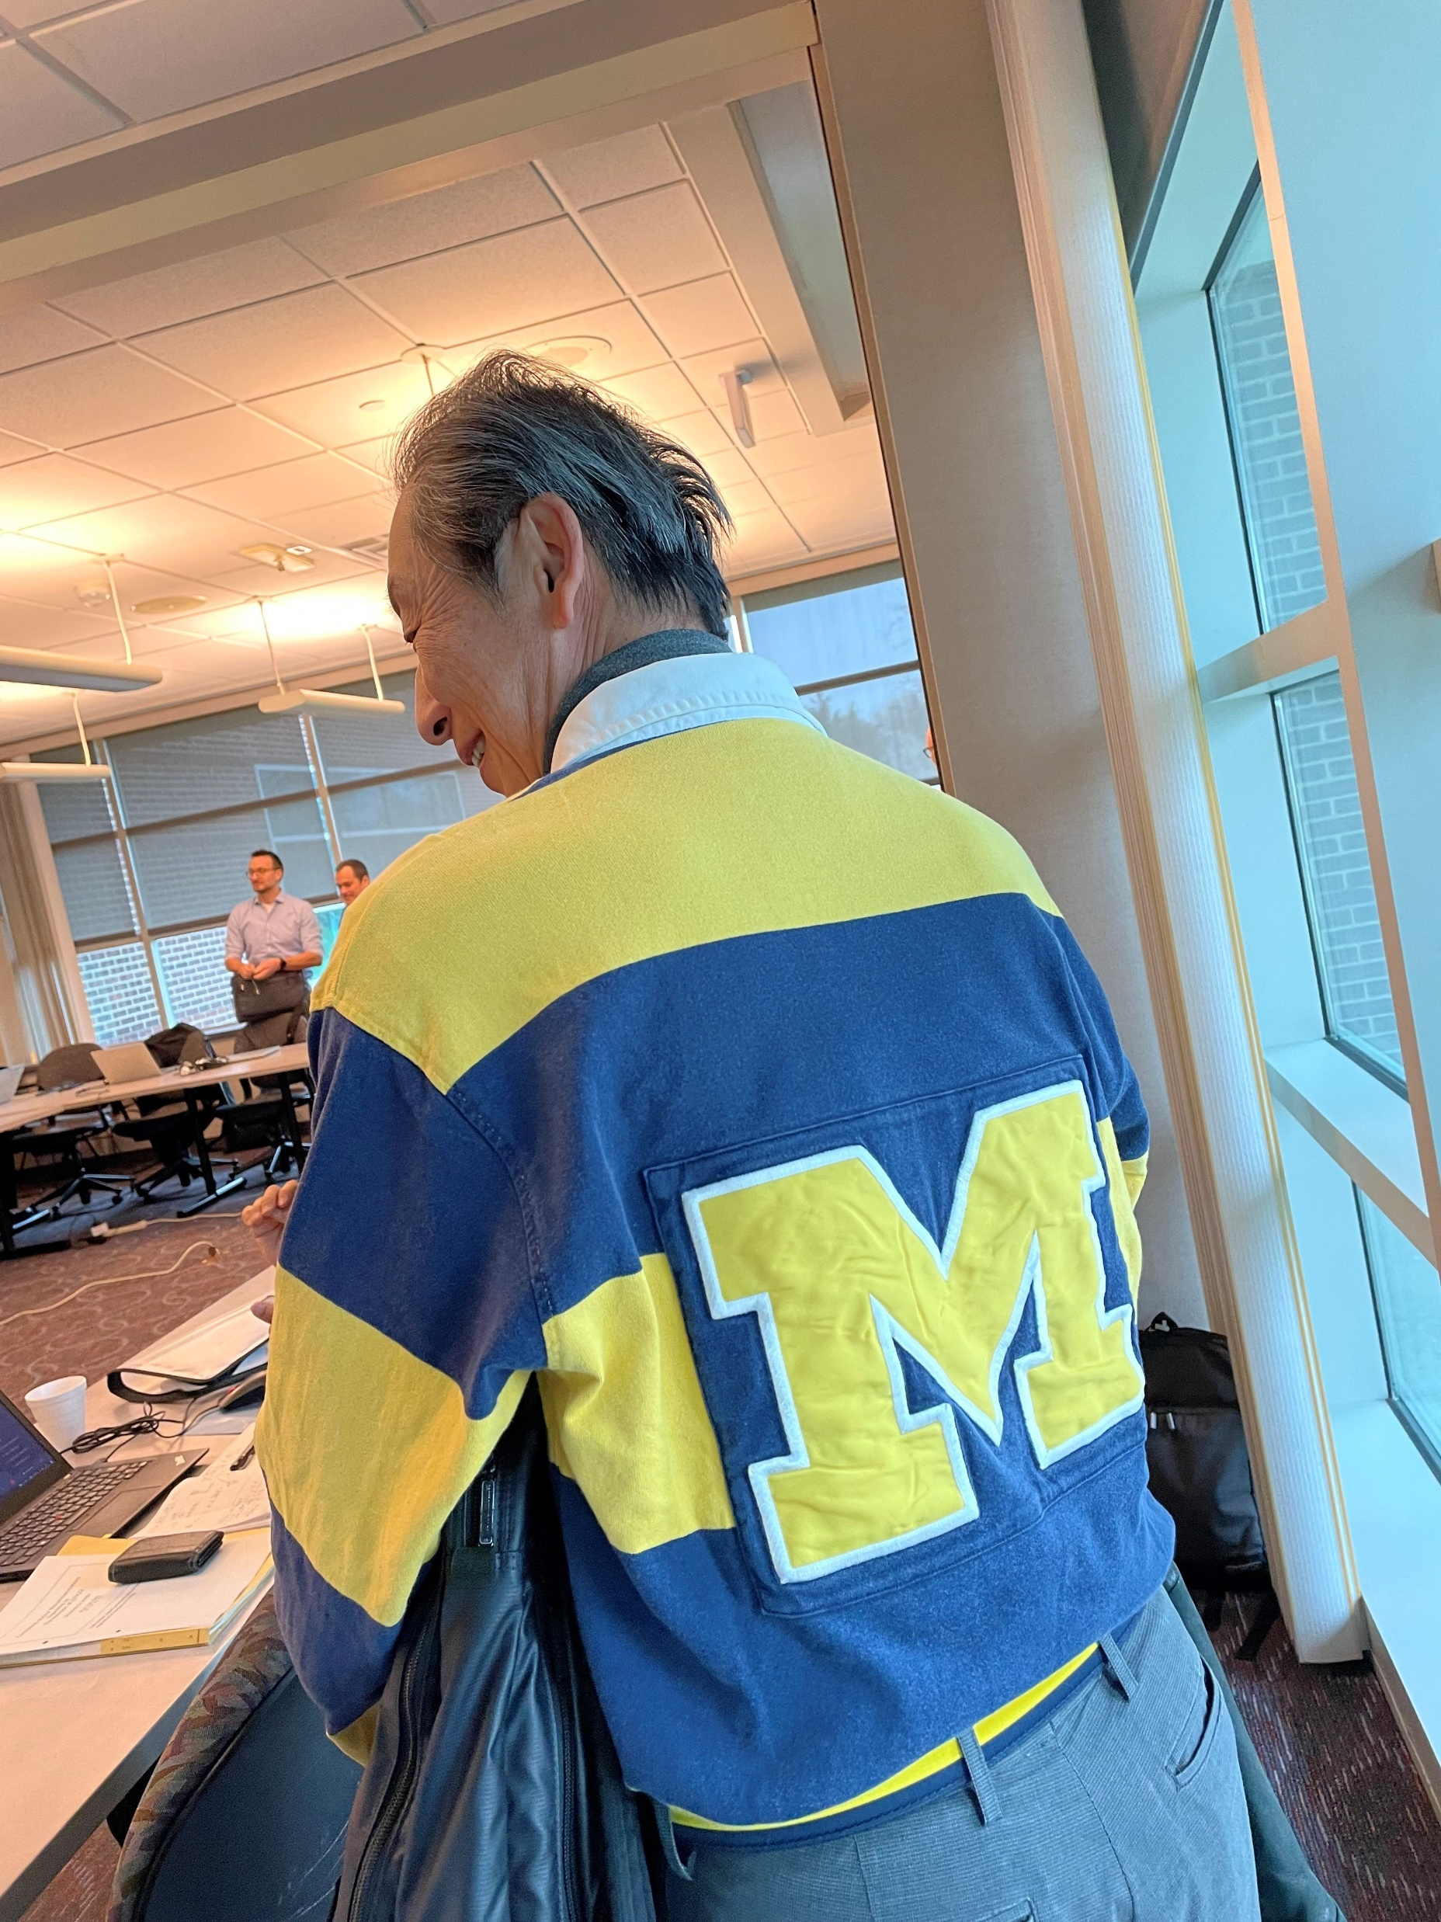
Recent EVE Meetings
Virtual meetings
60th EVE IWG March 24 and 27, 2023
In –person meetings
61st EVE IWG – April 25-26, 2023, in Ann Arbor, U.S.A.
62nd EVE IWG – May 30, 2023, concurrent with GRPE
“Go Blue!”

Slide 3
Current Work
Hybrid power determination (GTR-21)
EVE continuing to develop the GTR based on the experiences of stakeholders
In-vehicle battery durability (GTR-22) – Light-duty
Consider further development and refinement of GTR 22
New GTR for in-vehicle battery durability – Heavy-duty
Seeking authorization at 190th WP.29 session
Building from GTR-22, shaping around unique circumstances of heavy-duty vehicles.

Slide 4
GTR-21 Development: Hybrid Power Determination
Efforts on GTR-21 are focused refining the text and test procedures
Consideration of CAN signals in place of direct measurement
Data analysis ongoing
Appropriate accuracy requirements
Reviewing the source of current values
Measurement alternatives for highly integrated systems
Considering the use of vehicle CAN signals in lieu of instrumented values
China provided additional test data this week
Considering alternative for system bench testing
Develop family concept
Proposal from Japan reflected in the current draft update
Need for Candidate Method – still on hold, may not be required

Slide 5
GTR-22 Development: LDV Battery Durability
GTR-22 was finalized in 2022
Gaining experience with the GTR
Included in the implementation of Euro 7
Included in the US EPA’s LMDV Multipollutant Standards for 2027+ MY proposed rulemaking
EVE is focused on several issues
Temperature data requirements and consideration of CARB requirements
Accounting for energy consumption not related to mobility, with focus on category-2 vehicles that may have ancillary, non-propulsion electrical loads
Verification procedure is required and open issue
Category-2 minimum performance requirements

Slide 6
GTR-22 Development: LDV Battery Durability
MPR for Category 2 vehicles
OICA presented slides at EVE 61 on energy throughput in order to show options for the MPR
Main challenges for the energy throughput remain the determination of thresholds for the MPR and energy throughput verification
The European Commission made a proposal to change the V2X concept
All Energy not used for traction is accounted for in the virtual mileage
The group agreed to the proposal and the GTR-22 draft has been revised accordingly
3.25. “Total discharge energy for non-traction purposes” means the total amount of energy in Wh discharged from the battery for purposes other than traction to support the particular use case of a Category-2 vehicle and do not include air conditioning/heating for the cabin or other uses already present in categories 1-1 and 1-2.

Slide 7
Heavy-duty Durability GTR
Heavy-duty in-vehicle battery durability is now the most significant work being performed by the EVE IWG
While the overall framework of GTR-22 is helpful, there is limited technical similarity
Light-duty test procedures with respect to electrified vehicles are more mature
Light-duty vehicle activity is relatively homogenous
Heavy-duty vehicle activity and energy demands can vary significantly between applications (e.g. PTO, non-traction loading)
Potential common elements: SoH monitor, test procedure for verifying the monitor, initial battery condition, in-use assessments and minimum performance requirements

Slide 8
LDV vs HDV Durability Comparison
GTR-22
HDV GTR
Light-duty Vehicles
Heavy-duty Vehicles
Years
State of Health % of retained usable battery energy
(SOCE)
State of Health % of retained energy or capacity
Years
MPR
Distance Traveled
MPR
Distance Traveled
Battery Throughput
Supported by existing LD test procedures
Most likely new or revised test procedure(s) required
= significant effort

Slide 9
Heavy-duty Durability GTR
EVE-57-10-Rev1a
Summary of alternatives presented by OICA
Each alternative has pluses and minuses
Goals
Identical procedure for Reference Test and In-service Test
Leverage experience and existing capabilities of manufacturers and regulatory authorities

Slide 10
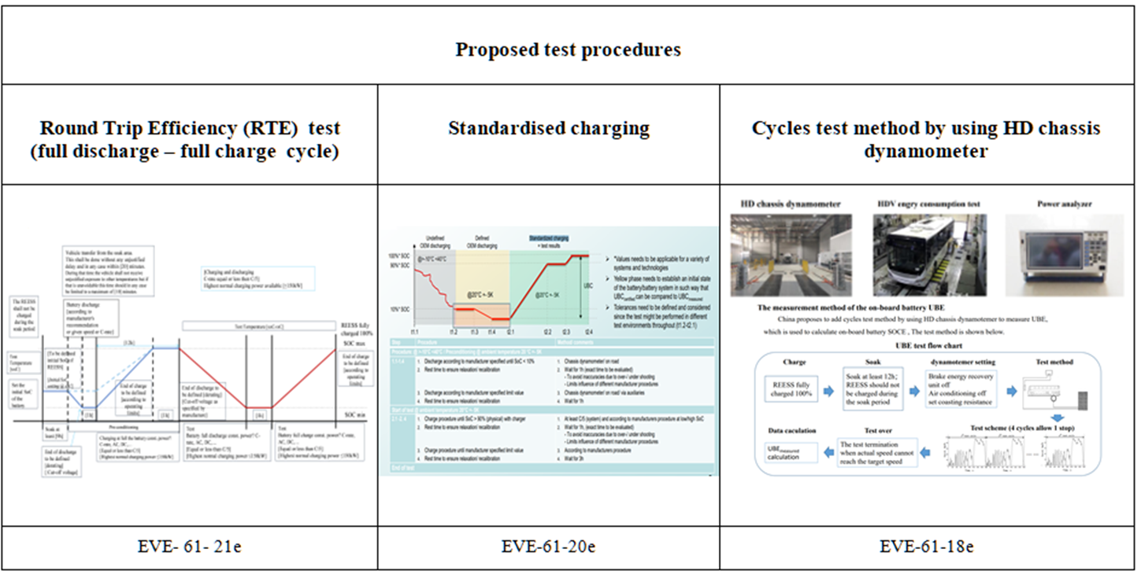
Heavy-duty Durability GTR
Test procedures under discussion

Slide 11
Current Timeline
June 2023:
Propose, to WP.29 AC.3, the development of new UN GTR on in-vehicle battery performance and durability of electrified heavy-duty vehicles (eHDV)
May 2021 - June 2023:
Support the Group of Experts on Energy Efficiency on the method for stating energy consumption from upstream emissions of electrified vehicles
June 2021 – June 2023:
Consider candidate test method, family concept and further validation testing for UN GTR 21
Continue information gathering on possible modifications to the UN GTR 22 on in-vehicle battery durability
Consider other GTR amendments, as necessary
January 2024:
Provide status update and draft UN GTR on eHDV battery performance and durability as an informal document, for further discussion and recommendation
Provide update on the future framework for UN GTR on eHDV battery performance and durability
Submit working document to GRPE for UN GTR 21 amendments, for consideration
Submit working document to GRPE for UN GTR 22 amendments, for consideration
June 2024:
Submit working document of UN GTR on eHDV battery durability to GRPE for consideration
Submit working document amendments for UN GTR 21 to WP.29 AC.3 for vote, if authorized
Submit working document amendments for UN GTR 22 to WP.29 AC.3 for vote, if authorized
November 2024:
Submit working document of UN GTR on eHDV battery durability to WP.29 for vote, if authorized

Slide 12
Proposed Future EVE Meetings
63rd EVE IWG – July 18-19, 2023 (virtual)
64th EVE IWG – September 19-20, 2023 (virtual)
65th EVE IWG – October 11-12, 2023 (in-person – Ottawa, Canada)

Slide 13
Thank you!
Michael Olechiw
EVE C0-chair
olechiw.michael@epa.gov
Penny Dilara
EVE C0-chair
Panagiota.DILARA@ec.europa.eu

