Slide 1
The UNECE ESD Reporting Framework 2021–2030
UNECE Steering Committee on ESD 25-26 May 2023 (Agenda Item 4)
Dr Paul Vare
Academia Representative on UNECE Steering Committee on ESD
(Co-author of UNECE Strategy for ESD 2003-2005)

Slide 2
Strengths of UNECE reporting
The National Implementation Report (NIR)…
“…is not meant for ‘benchmarking’ countries performance, but mainly to learn
from each other and give inspiration to each other, e.g. by offering good practices.”
National Focal Points are “advised to form a ‘working group’… …to have informants from all levels of education… …to also have a multi-stakeholder approach in the working group…”
“…the journey is as exciting as the destination – the process is as important to the implementation process itself and not just for reporting.”
The reporting format has adapted over time to meet emerging priorities.

Slide 3
Challenges of UNECE reporting
NIRs have different level of detail – varies from insufficient qualitative data (open-ended items) to clarify quantitative responses to detailed information and lengthy explanations
Not all countries participate (34 our of 56 Member States reported in the fourth cycle)
Different number of reporting countries from each region and disparity in the country size make international comparisons difficult
Adaptations over time make temporal comparisons difficult

Slide 4
Contents of the new reporting format
Part 1 refers to the UNECE strategy 2005
Part 2 refers to the Framework 2021-2030
Part 3 summary and self-assessment by countries

Slide 6
Part 2 comprises our four priority action areas for 2021-2030:
Strand 1: Quality Education and ESD
Strand 2: Whole Institution Approach / Whole School Approach and communities of transformational learning
Strand 3: Digital Education, information and communication technology and ESD
Strand 4: Entrepreneurship, employment, innovation and ESD

Slide 8
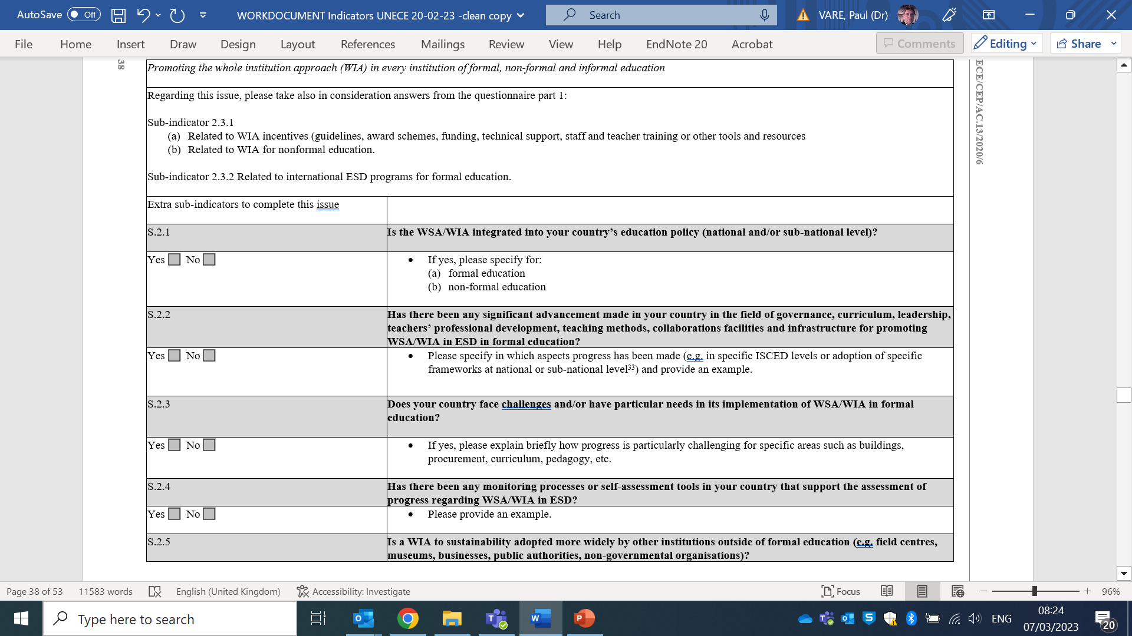

Slide 9
The reporting timeline
For Agenda Item 5
Paragraph 16 of the reporting format states:
(c) The deadline for submission of reports to the secretariat for the reporting phase in 2024 will take into account United Nations document management procedures and is: 30 November 2024;
(d) The ECE secretariat will post the reports and case studies on its website;
(e) The ECE secretariat will prepare a final synthesis report for 2026 … the first draft of the progress report will be presented at the Steering Committee’s nineteenth meeting in 2025.

Slide 10
Data may also be used for reporting on…
UNESCO’s ‘ESD for 2030’ framework
The EU Framework on ESD and the GreenComp
Reporting on SDG’s and specifically on SDG 4 and SDG 4.7
Reporting on Global Education, specifically Recommendation 1974 concerning Education for International Understanding, Co-operation and Peace and Education relating to Human Rights and Fundamental Freedoms

Slide 11
Questions?

Slide 12
Proposal for guidelines and workshops to support the UNECE ESD strategy 2021-2030 Monitoring and Evaluation (M&E) process
Agenda Item 6
Establish a M&E Support Group (experts and experienced National Focal Points) to provide:
Online workshops (October 2023) guidance how to answer the questionnaire
A (sub)regional ‘face to face’ workshop (2-3 days – January 2024) for several National Focal Points to advise as above plus more in-depth support on developing the M&E process in each country including data collection and research
A country-specific workshop (2-3 days) to advise the NFP (and their team) through the above process plus the interpretation of the country’s questionnaire, i.e. targeted on the specific situation in the country
Costs to be discussed between UNECE and the countries involved.

Slide 13
Questions?

