Slide 1
Informal Working Group on Functional Requirements for Automated Vehicles Status Report
Informal document GRVA-16-30
16th GRVA session, 22-26 May 2023 Provisional agenda item 4(a)
16th GRVA Session
22-26 May 2023

Slide 2
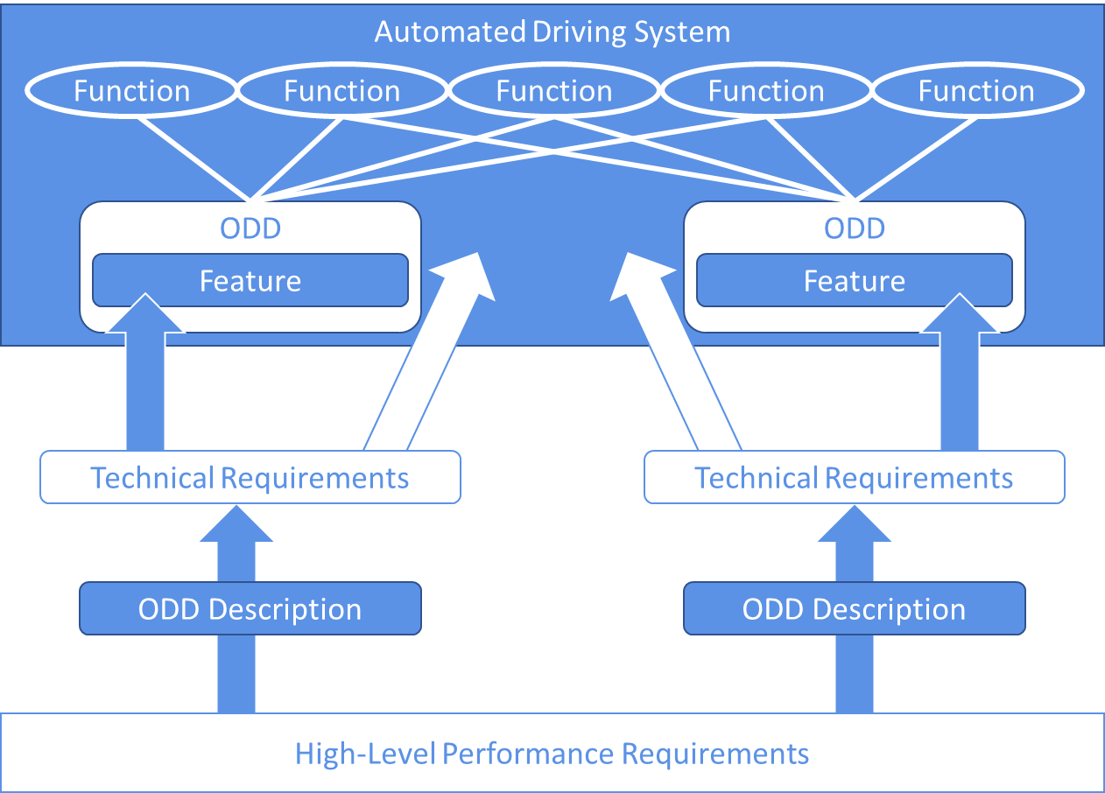
Guidelines on ADS Safety Requirements: Rationale and General Elements
Background
Mandate
WP.29 established an Informal Working Group on Functional Requirements for Automated Vehicles (FRAV) in 2019 (WP.29/1147/Annex V). WP.29 provided a Framework document on automated/autonomous vehicles (WP.29/2019/34) to guide this work. FRAV was mandated to develop common functional (performance) requirements for automated/autonomous vehicles addressing system safety, failsafe response, HMI/operator information, and object and event detection and response (OEDR).
2019
FRAV considered the technologies enabling automated vehicles with particular reference to the voluntary standard SAE J3016 taxonomy. FRAV agreed that its mandate covered automated driving systems (ADS) described under the SAE standard as Level 3-5 driving automation systems. Given the diversity of potential ADS applications, FRAV decided to develop performance requirements applicable across these levels of automation but without reference to the levels to ensure technology-neutral and future-proof outcomes. FRAV concurred with the Informal Working Group on Validation Methods for Automated Driving (VMAD) that the assessment of ADS safety required new methods based on a multi-pillar approach including the development of traffic scenarios under which to evaluate ADS performance.
2020
FRAV analysed ADS technologies and safety elements relevant to its mandate. ADS replace the driver in performance of the entire Dynamic Driving Task (DDT). Therefore, an ADS is a system composed of functional capabilities that enable performance of the DDT. However, ADS may be designed to operate under specific conditions collectively known as an Operational Design Domain (ODD). Safety concerns would not preclude an ADS from performing the DDT in more than one ODD. FRAV defined the term “feature” to describe the application of DDT functional capabilities within an ODD, allowing for ADS that may offer more than one feature. FRAV consolidated input on safety elements to establish five principles under which to structure its work: 1) the ADS must drive safely, 2) the ADS must manage safety-critical situations, 3) the ADS must safely manage system failures, 4) the ADS must interact safely with users, and 5) the ADS must maintain a safe operational state throughout the useful life of the vehicle. Given the diversity of traffic conditions, FRAV determined that common requirements for DDT performance would be at a high-level backed by procedures to derive pass/fail criteria under specific scenarios.

Slide 3
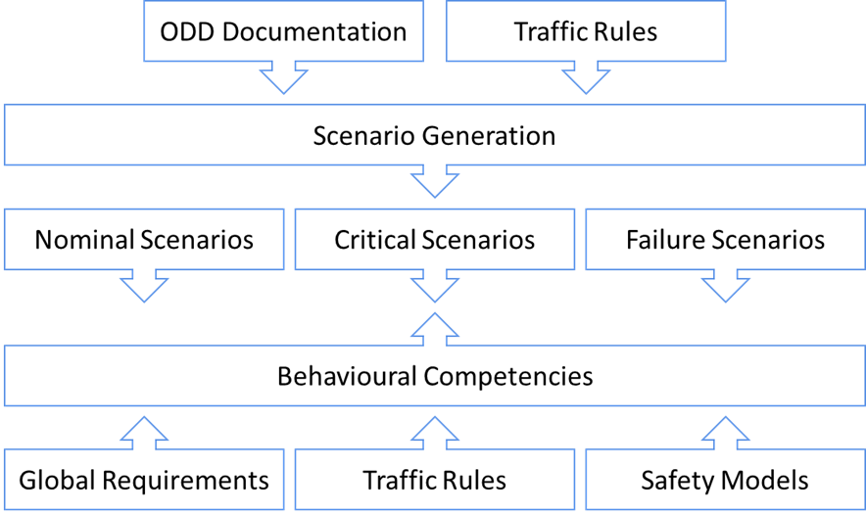
Guidelines on ADS Safety Requirements: Rationale and General Elements
Background
2021
Based on the five principles for ADS safety, FRAV developed statements on safety requirements covering key performance and functional aspects. In parallel, FRAV considered various methodologies for deriving pass/fail criteria from these high-level requirements applicable to scenario-based assessments as developed by VMAD. FRAV recognised the validity of these various methods while perceiving differences in how they might apply depending on the aims of the requirements and the nature of the assessment scenarios. FRAV determined a need for scenarios covering nominal ADS performance of the DDT, performance of the DDT in managing potential conflicts, and ADS responses to system faults that compromise the capability to perform the DDT. FRAV further recognised that HMI requirements would apply in different ways depending on the roles users would be expected to perform (or be prohibited from performing) in the operation of ADS vehicles.
2022
FRAV developed a framework to enable the assessment of ADS performance against verifiable criteria under specific scenarios. The framework yields scenarios sufficient to assess ADS performance across traffic situations foreseeable within the ODD of its feature(s). The framework enables application of high-level requirements (including compliance with traffic rules) and methodologies for safety models to determine pass/fail criteria under each scenario. These criteria, known as “behavioural competencies”, establish expected and acceptable ADS responses to traffic conditions represented in the scenarios. The framework recognises that exceptions to the high-level requirements (including traffic rules) may be justified and provides means to evaluate such exceptions. The framework enables comprehensive safety requirements while addressing the complexity of driving and the diversity of traffic rules, road conditions, and driving and road-user behaviours.

Slide 4
Guidelines on ADS Safety Requirements: Rationale and General Elements
Background
2023
FRAV turned most of its attention to the safety of interactions between an ADS and ADS vehicle users. The SAE J3016 levels of automation highlight the diversity of ADS applications and their relationships with users. From an HMI perspective, users might be located inside or outside the vehicle, might be permitted to intervene or prohibited from intervening in DDT performance, and might interact with many ADS (e.g., fleet management) or only one. Safety involves attention to user understanding of the ADS, misuse prevention, real-time information on ADS and vehicle operational status, and information on anticipated or probable conditions and interactions. Transitions of control from the ADS to the user whether initiated by the user or by the ADS (fallbacks to the user) require attention to the user’s situational awareness and control over the vehicle prior to ADS release of control over the DDT. Time can be a factor as the ADS and user relationship and traffic conditions can change during a trip. The relevance of these considerations varies depending on the ADS design and use cases. FRAV is developing requirements with attention to providing a technology-neutral framework for balanced application across ADS configurations, initially focused on in-vehicle interactions involving drivers, fallback users, and passengers but extendable to further user relationships with ADS.
Ongoing Work and Expectations
FRAV expects to submit its complete recommendation to the September GRVA session pursuant to the outcome of deliberations on the safety of interactions between ADS and ADS vehicle users.
FRAV anticipates additional discussions on the framework for establishing scenarios and behavioural competencies, including on methodologies for safety models relevant to ADS performance under critical scenarios.
FRAV and VMAD have established an Integration Group to guide work on a formal joint submission to the January GRVA session. In accordance with WP.29 procedures, FRAV anticipates submission of the formal document 12 weeks prior to the January session.

Slide 5
Guidelines on ADS Safety Requirements
Summary of contents
Section 1: Introduction and background
Section 1 provides the rationale behind FRAV’s strategy for addressing the diversity of ADS applications and the conditions under which ADS will operate. The section covers research on driving, application of this research to automated driving, the functions comprising the DDT, performance of the DDT in ODD (i.e., ADS features), and interactions between ADS and users of ADS vehicles.
Section 4. Documentation
The documentation provisions require descriptions of each ADS and its features for the purposes of the assessment and to promote correct user understanding of the ADS. The term “documentation” refers to any means used to meet these purposes.
Section 5. Safety requirements
The safety requirements align with the five core aspects of ADS safety derived from the initial discussions on ADS safety elements. The requirements address ADS performance of the DDT, ADS interactions with users, and ADS operational safety throughout the useful life of the vehicle.
Section 2. Purpose
The document proposes strategies and structures for establishing ADS safety requirements applicable across the diversity of ADS applications and the road environments in which they might operate. FRAV determined that technical requirements depend on the ADS configuration, intended uses, and limitations on use. Therefore, the document proposes high-level requirements for application to specific ADS use cases and the traffic scenarios and user interactions relevant to those cases.
Section 5.10. Nominal DDT performance
This section addresses the principle that an ADS must drive safely. The section proposes high-level requirements for safe driving in the absence of any reasons for exceptional behaviours or outcomes.
Section 3. Definitions
The document proposes definitions for terms to enable the establishment of requirements applicable as warranted to specific ADS use cases. The terms address the diversity of ADS applications, the environments in which they will operate, and the interactions they will have with users while enabling differentiation among specific applications.
Section 5.11. DDT performance in critical scenarios
ADS are required to drive safely and avoid collisions; however, conditions may arise that require exceptional responses or where a collision might not be avoidable. An ADS cannot control external traffic conditions but should respond as feasible to mitigate risks generated by the actions of other road users and other conditions.
Section 5.12. DDT performance in failure scenarios
This section addresses ADS failsafe responses to system failures, including fallbacks to a minimal risk condition or to a limited performance of the DDT.

Slide 6
Guidelines on ADS Safety Requirements
Summary of contents
Section 5.13: ADS interactions with users
This section addresses HMI and operator information. ADS and user interactions vary depending on the intended uses of the ADS, the degree to which a user may intervene in performance of the DDT (if any), and the reliance (if any) of the ADS on the user as a fallback. ADS may involve in-vehicle interactions and/or remote interactions from outside the vehicle. User capabilities, including capacity to operate a vehicle, require attention. HMI and user information needs to be aligned with the role(s) a user may play in ADS operation to ensure appropriate understanding of the ADS, real-time information on the operational status of the ADS, and information on anticipated conditions and interactions while addressing risks of misuse. This diversity presents challenges where FRAV has prioritised its focus on interactions with a driver, a fallback user, and a passenger.
Annex
This annex describes a framework for deriving objective performance criteria from the high-level requirements for ADS performance of the DDT.
Assessment of DDT performance requires traffic scenarios sufficient to evaluate the ADS capability to perform the entire DDT necessary to operate the vehicle in the ODD of the ADS feature(s). The annex provides guidance on the establishment of nominal, critical, and failure scenarios.
DDT performance inherently involves adaptation to dynamic traffic conditions (behavioural competencies). The annex provides guidance on the establishment of valid behavioural competencies based on the high-level requirements.
Traffic rules govern driving behaviours and interactions; however, these rules and related infrastructure vary across the world. The annex provides guidance on how traffic rules can be deconstructed to derive scenarios and behavioural competencies applicable to these scenarios.
Under scenario assessments, ADS demonstrate behavioural competencies that produce outcomes. In principle, ADS competencies and scenario outcomes shall be consistent with the high-level DDT requirements. However, conditions outside the control of an ADS can produce scenarios that require exceptional driving responses (exception to traffic rules, evasive manoeuvre) or result in unavoidable outcomes (collision). The annex provides guidance on methodologies for safety models that enable evaluation of exceptional ADS behaviours and/or scenario outcomes.
Section 5.14. Useful life safety
This section addresses ADS maintenance and the possibility that an ADS may no longer be fit for continued use during the life of the vehicle.
Appendix
This section provides a placeholder for guidelines to promote consistency across ODD descriptions and other documentation relevant to ADS assessments.

Slide 7
Informal Working Group on Functional Requirements for Automated Vehicles Status Report
Informal document GRVA-16-30
16th GRVA session, 22-26 May 2023 Provisional agenda item 4(a)
16th GRVA Session
22-26 May 2023
FRAV welcomes questions, feedback, and guidance from GRVA.

