Slide 1
UN-R79 ACSF A RCP-topic Remote Controlled Parking RCP open up for vehicle combinations
Submitted by the experts
from CLEPA and OICA
Informal document GRVA-16-09
16th GRVA, 22-26 May 2023
Provisional agenda item 6(b)

Slide 2
Topic Motivation
For UN-ECE-R 79: Cat. A „Remote Controlled Parking RCP“ should be enabled also for vehicle combinations.
Safety benefit due to the driver will be able to see what is behind the trailer.
The function derives the steering angle of the wheels based on the chosen angle between motor vehicle and trailer.
Sensors aim to avoid any collision (to be homologated with the motor vehicle).

Slide 3
Proposal
for a Supplement to the 03 and 04 series of amendments to UN Regulation No. 79 (Steering equipment).
Paragraph 2.4.8., amend to read (bold text added):
2.4.8. "Remote Controlled Parking (RCP)" means an ACSF of category A, actuated by the driver, providing parking or low speed manoeuvring. The actuation is made in close proximity to the vehicle or the vehicle combination.
2.4.9. "Specified maximum RCP operating range (S_{RCPmax})" means the maximum distance between the nearest point of the motor vehicle or of the contour of both vehicles in case of vehicle combination and the remote control device or alternatively the driver (for systems based on detection of driver position and movement), up to which ACSF is designed to operate.
Requirement section remains unchanged, e.g.:
5.6.1.1.4. In case the system includes accelerator and/or braking control of the vehicle, the vehicle shall be equipped with a means to detect an obstacle (e.g. vehicles, pedestrian) in the manoeuvring area and to bring the vehicle immediately to a stop to avoid a collision.

Slide 4
Justification
The proposal aims to clarify the provisions for ACSF Cat. A "RCP" for vehicle combinations.
The current definition for RCP S_{RCPmax} sets a maximum limit of 6 m distance to the motor vehicle, which is insufficient in situations where the operation is supervised by the driver located behind the vehicle combination.
In reverse parking / manoeuvring-situations this condition offers safety advantages, as the driver can see what is behind the trailer better.
All paragraphs providing requirements for a Remote Controlled Parking System remain unchanged and applicable to the vehicle combination.
Most notably, collision avoidance and obstacle detection in the manoeuvring area as required by paragraph 5.6.1.1.4 is to be proven during the approval process.
The demonstration of safe system behaviour under fault and non-fault conditions remains to be subject to discussion and agreement between the manufacturer and the Technical Service and shall be described in the Annex 6.
See next slide a simplified illustration of the situation for the vehicle combination and the driver.

Slide 5
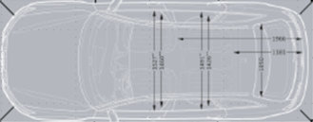
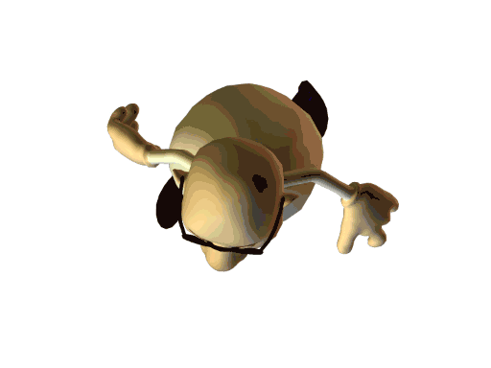
How does the function work ?
What means "Specified maximum RCP operating range (S_{RCPmax})” in this case ?
S_{RCPmax} = 6m around the countour of the vehicle combination
Sensor
Max. 6m
Motor Vehicle Trailer
Sensor
Max. 6m
Max. 6m
Overall Contour
Max. 6m
Max. 6m
Responsible Driver with key / remote control

