Slide 1
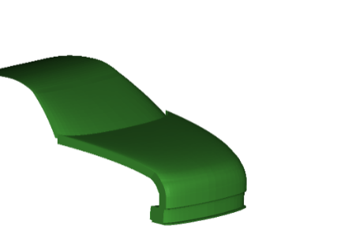
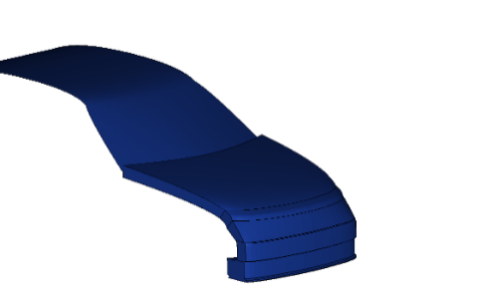
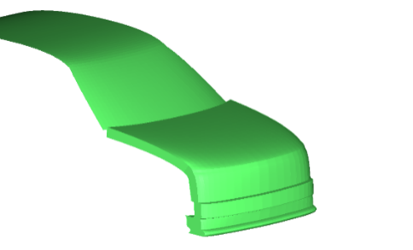
Generic Vehicle Models for MR1
Informal document GRSP-73-59 (73rd GRSP, 15-19 May 2023 agenda item )
Roadster
Familycar
SUV

Slide 2
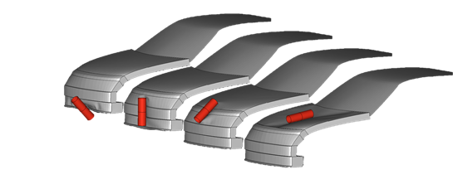

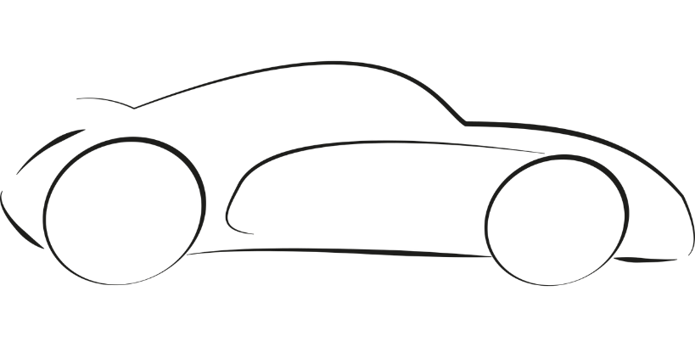
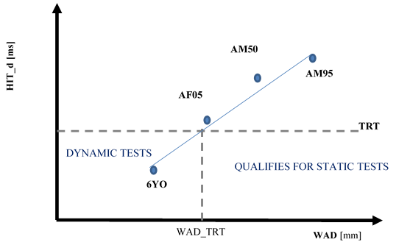
Overall DPPS Process
1. GV Plausibility check
GV Models
Impactor corridors
OK
2. HBM qualification with GV
GV Models + HBM
HBM corridors
OK
3. Head Impact Time vs. WAD determination
DPPS vehicle + HBM
HIT vs. WAD graph
4. DPPS decision for tests
Static test / dynamic HIT

Slide 3

Building Blocks
Finite Element Software
(supplied by code-houses to Industry)
1. Plausibility check
Roadster
Familycar
SUV
Generic Vehicle Models
available on UNECE website – MR1
2. Human Body Model qualification
Human Body Models (openly available or by suppliers)
3. HIT vs. WAD determination
Vehicle Simulation Models of vehicle with DPPS of Vehicle Manufacturer
4. Use HIT for
DPPS decision

Slide 4
What are Generic Vehicle Models?
FE Code | Unit System | Master files | File ID
LS-Dyna | mm, kg, ms | GV_FCR_R3_1_mm_kg_ms.key | D-GV-1
 |  | GV_RDS_R3_1_mm_kg_ms.key | D-GV-2
 |  | GV_SUV_R3_1_mm_kg_ms.key | D-GV-3
 | mm, to, s | GV_FCR_R3_1_mm_to_s.key | D-GV-4
 |  | GV_RDS_R3_1_mm_to_s.key | D-GV-5
 |  | GV_SUV_R3_1_mm_to_s.key | D-GV-6
RADIOSS | mm, kg, ms | GV_FCR_R3_1_mm_kg_ms.0000.rad GV_FCR_R3_1_mm_kg_ms.0001.rad | R-GV-1 R-GV-10
 |  | GV_RDS_R3_1_mm_kg_ms.0000.rad GV_RDS_R3_1_mm_kg_ms.0001.rad | R-GV-2 R-GV-20
 |  | GV_SUV_R3_1_mm_kg_ms.0000.rad GV_SUB_R3_1_mm_kg_ms.0001.rad | R-GV-3 R-GV-30
 | mm, to, s | GV_FCR_R3_1_mm_to_s.0000.rad GV_FCR_R3_1_mm_to_s.0001.rad | R-GV-4 R-GV-40
 |  | GV_RDS_R3_1_mm_to_s.0000.rad GV_RDS_R3_1_mm_to_s.0001.rad | R-GV-5 R-GV-50
 |  | GV_SUV_R3_1_mm_to_s.0000.rad GV_SUV_R3_1_mm_to_s.0001.rad | R-GV-6 R-GV-60
VPS | mm, kg, ms | GV_FCR_R3_1_mm_kg_ms_VPS.inc | V-GV-1
 |  | GV_RDS_R3_1_mm_kg_ms_VPS.inc | V-GV-2
 |  | GV_SUV_R3_1_mm_kg_ms_VPS.inc | V-GV-3
 | mm, to, s | GV_FCR_R3_1_mm_to_s_VPS.inc | V-GV-4
 |  | GV_RDS_R3_1_mm_to_s_VPS.inc | V-GV-5
 |  | GV_SUV_R3_1_mm_to_s_VPS.inc | V-GV-6
Human readable text files
interpreted by the different FE software
no executables (software)

Slide 5
How does a GV Model file look like?
Example:
*KEYWORD
$*******************************************************************************
$ FILE ID: D-GV-1 *
$ *
$ DESCRIPTION: *
$ *
$ Generic Vehicle Models for the qualification of Human Body Models *
$ as described in M.R.1 - Mutual Resolution No. 1 of the 1958 and the 1998 *
$ Agreements ECE/TRANS/WP.29/1101 Addendum 5 *
$ *
$ ==========
$ NODE cards
$ ==========
$
*NODE
1000000 -116.12 -587. 224.81
1000101 -262.54999 -587. 701.16998
1000102 -252.04385 -579.58826 701.16998
1000103 -243.27393 -579.58801 692.83368

Slide 6
Differences between Dummies and GV Models in Mutual Resolution 1 (MR1)
Crash-test Physical Dummies
Generic Vehicle Models
Drawings specified in MR 1
  products purchased at suppliers
Certification specified in MR1.
  If not fulfilled, replacement parts will be purchased at suppliers.
Not sensitive to the lab environments they are used within specified conditions.
Issues with specific Dummies reported to suppliers.
  General issues with dummies are reported to GRSP by CP or NGOs
Directly provided by UNECE
  Downloaded from website
Certification specified in MR1.
  If not fulfilled, OEM can change this model. However, this should be avoided as much as possible to ensure comparability of the models.
Simulation models are sensitive to the simulation environment they are used in.
Issues to be collected dynamically
  depend on simulation environment
  need to be addressed in updated versions of GV models

Slide 7
Proposal for reporting and technical support
Who is the contact for users if they encounter issues in the usage?
  UN Contact form for technical support on Generic Vehicle Models
    forwarded to Austrian experts
How to ensure that any issues are addressed in updated versions of the GV models?
  clarify in MR1 that any identified issues which require changes + the required changes must be reported to GRSP through a Contracting Party

Slide 8
Draft of MR1 GRSP-73-10e_rev1
4.1. The certification of Impactor simulations on the generic vehicle models may be performed if the user has any doubt that the generic vehicle models work properly with the solver version and control cards used as plausibility check. If issues (i.e. significant the deviations to the reference curves outside of the provided corridors shown in red) are identified, the user shall switch to another solver version, [and] review the control settings [and report the issue to gv.vsi@tugraz.at. GRSP through a Contracting Party].
4.4. If modifications of the models are required, they shall comply with the specified corridors and be documented and reported to [GRSP through a Contracting Party].

Slide 9
Copyright of GV Models
All stakeholders (funding Organisations & Contributors) of GV models have formally agreed (signed) confirmations to enable usage and upload of GV models by UNECE
Letter by Graz University of Technology on its way

