Slide 1

Transmitted by the expert from Japan
Informal document GRSP-73-29
（73rd GRSP, 15-19 May 2023,
agenda item 6)
Outline of the
Amendment of R16
Japan / NTSEL

Slide 2
Objective
When the slack of the buckle belt became larger, the forward movement of the occupant became larger, reducing occupant safety (GRSP69-24, GRSP70-32). Japan therefore proposed amending R16 to limit the slack of the buckle belt in rear seats (GRSP2021-19).
In the interested members meeting on 8th April 2022, it was pointed out that Japan’s proposal would cause additional work for vehicle manufacturers and TS, though the number of vehicles affected was very small.
Accordingly, Japan would like to amend and simplify the confirmation method. ( This showed in the interested members meeting on 25th April 2023.)

Slide 3
Flowchart of Amended Confirmation Method
The difference between the actual strap length and the straight line distance between the effective belt anchorage and buckle point should be [50] mm or less, and checked by 3D drawings and data.
Yes
No
Check the difference between the parts and data (if needed, judged by TS).
Satisfy one of the following conditions:
A. Conduct a tensile test of the buckle strap assembly using [8] kN; the movement should be [50] mm or less.
B. The manufacturer shows that the buckle strap assembly has the same performance as requirement A, and TS allows it.
Not needed
Needed
Approved
Compare the parts and data.
Satisfied
Not satisfied
Same
Different
Approved
Not approved
Approved

Slide 4
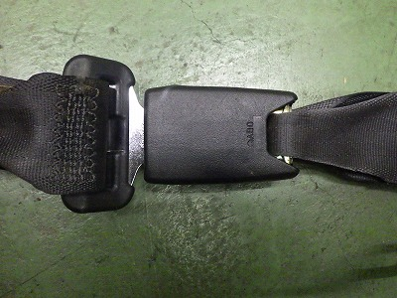
Definition
BC point
BC point
Center of the slit hole which fasten the buckle strap and buckle
Bd point
The point of the BC point at the buckle position when the occupant (AM50 or AF05 at the manufacturer’s choice) is restrained in the design seatbelt path.

Slide 5
Concept of Tensile Test
Bc point
[8] kN
Movement
Buckle strap assembly
Distance between
EA and Bd in data
Tensile test
EA point
EA point
[8] kN
Movement ≤ [50] mm

Slide 6
Tensile Test Method of the Buckle Strap Assembly
Fix the EA point and buckle of the buckle strap assembly in the tensile test machine.
The distance between the EA point and the Bc point should be the same as the distance between the EA point and Bd point in the 3D drawings and data. The usage condition of the Bd position means that the seatbelt is fastened for an occupant whose size is AM50 or AF05 (manufacturer’s choice).
Conduct the tensile test under a tensile force of [8] kN.
Check the movement.

Slide 7
Remaining Issues
Japan will conduct the tensile test method of the Buckle Strap Assembly and confirm that there are any problem or not in the test procedure (till the end of June) .
Japan and OICA will check the effect of the pre-tensioner to the forward movement of the rear seat occupant ( till end of the August if possible, or till 74th GRSP) .

Slide 8
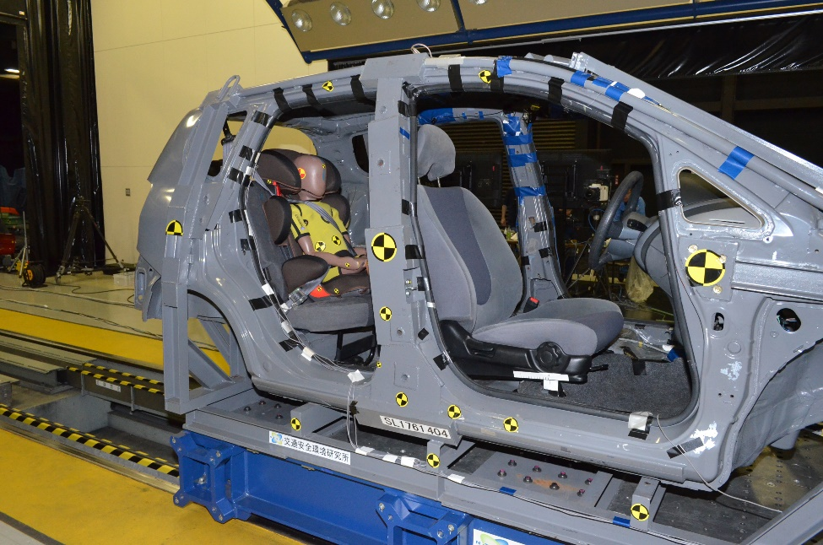
( Referenrce ) Lap Belt Load
7.7 kN
5.2 kN
*tested by NTSEL
The Lap Belt Load was measured in Sled test.
The acceleration pulses were used the R129 and the vehicle pulse measured in 50kph FWRB frontal impact test.
From above results, we considered [8] kN as the alternative test load.

