Slide 1
Report to 89th Session of GRPE (May-June 2023)
Transmitted by the Netherlands
Informal Document GRPE-89-23
89th GRPE, 31st of May – 2nd of June, 2023,
agenda item 17
Task Force Automated Vehicles Regulation Screening
(TF-AVRS)

Slide 2
TF Automated Vehicles Regulation Screening
6
13
Number of Meetings
Participants (Contracting Parties & NGOs)
Web-meetings
1st Kick-off meeting: 13th March 2023
2nd TF-AVRS: 4th April 2023
3rd TF-AVRS: 17th April 2023
4th TF-AVRS: 9th May 2023
5th TF-AVRS: 22nd May 2023
CPs: Germany, France, United Kingdom, South Africa, Unites States, Netherlands
NGO‘s: OICA
Report TF-AVRS – GRPE-89

Slide 3
TF Automated Vehicles Regulation Screening
Targets
WP29 requests a screening of regulation for application of Automated Vehicles.
GRVA proposed a template for the screening
TF-FADS (GRVA) provides further guidance
Roles
Chair: [Netherlands]
Secretariat: […]
TF-AVRS wikipage
https://wiki.unece.org/pages/viewpage.action?pageId=198672917&src=contextnavpagetreemode

Slide 4
Screening process: Considered items
1. Terminology
Relevant terms based on GRVA guidance
2. Use cases AVs
Driverless AVs
With passenger
Without passengers (cargo)
AVs with driver
Bi-directional AV’s
3. Other considered items
Telltales & warning signals
Test modes

Slide 5
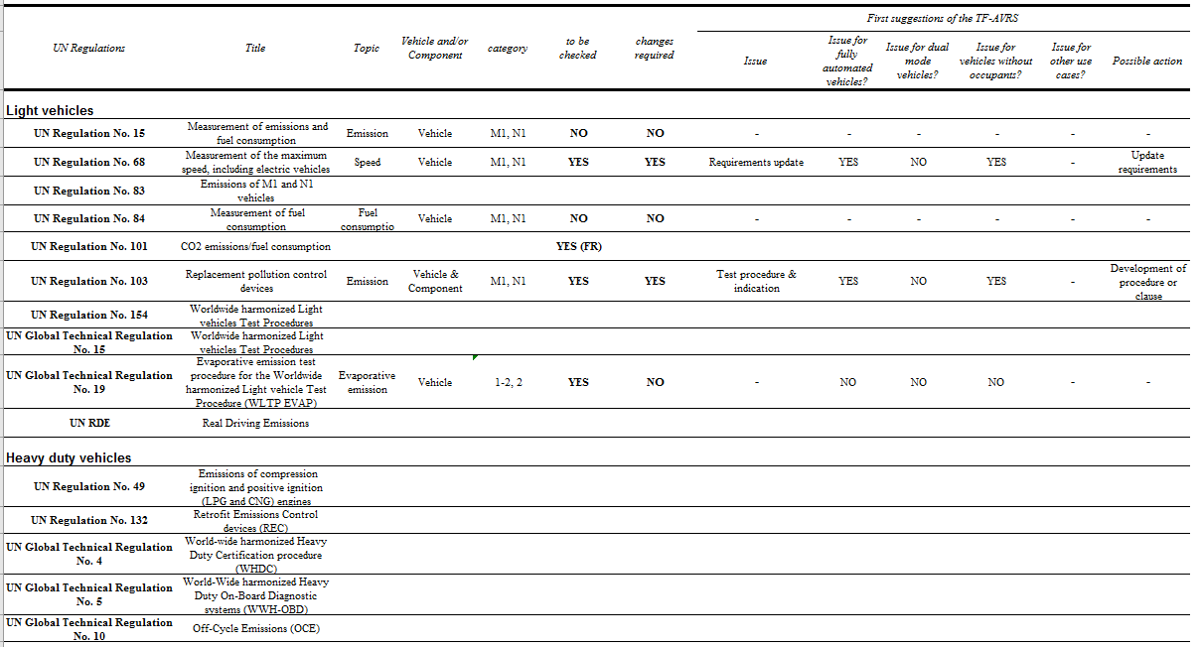

Slide 6
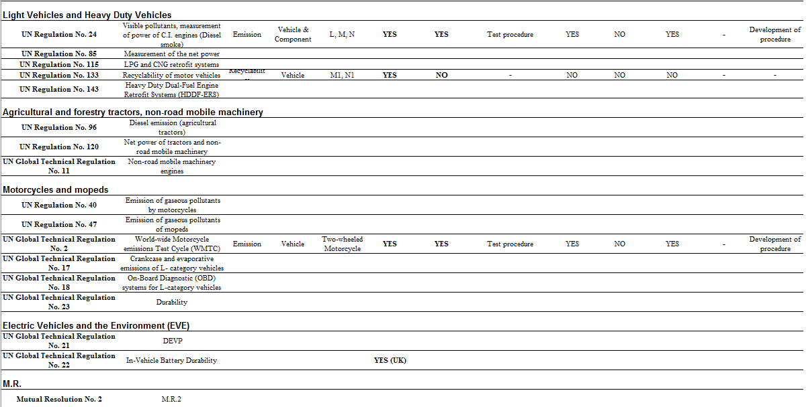

Slide 7
TF-AVRS Results
First focus on light vehicles
No vehicle categories will be excluded from screening
2 Regulations are excluded from screening
6 regulations are screened
2 regulations are planned to be screened

Slide 8
Next steps
Continue with meetings once per month
Participants from CP’s and NGO’s are most welcome in order to accelerate the screening

Slide 9
Guidance GRPE
TF-AVRS Chair, CP => Vacant, currently carried out by NL. NL is willing to volunteer for the chairing position.
TF-AVRS Secretary, NGO => Vacant, asking for volunteers.

Slide 10
Thank you for your attention

