Slide 1
Education for Sustainable Development Progress in Austria 2022 / 2023
Implementing the UNECE ESD Strategy
Dr. Peter Iwaniewicz / Serafin Groebner, MA MSc
Department V9 - Sustainable Development and Awareness Raising
Geneva, 24th May 2023
Maria Blomenhofer, BA
Youth Representative
AT UNESCO Commission

Slide 2
CONTENTS
01
Progress and planned measures in the formal education sector
04
Good practice examples in implementing strand 4 “Entrepreneurship, employment, innovation & ESD”
02
Good practice examples in the non-formal sector
05
Promoting Youth Participation through cooperation
03
Good practice examples in implementing strand 3 „Digital education, information & communi-cations technology & ESD”
06
Thank you by Peter Iwaniewicz

Slide 3
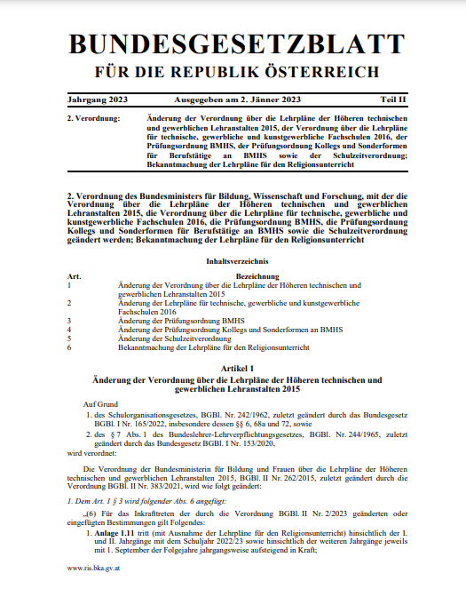
Progress and planned measures in the formal education sector
Successful curricula reform: renewing the curricula for elementary and lower secondary schools 2022. Cross-curricular educational principles are strengthened. ESD was introduced as a guiding principle.
Multi-stakeholder cooperation process in planning: currently an UNESCO ESD-Net Country Initiative proposal is being reviewed. Austria is likely to take part in such a process within the next year.

Slide 4
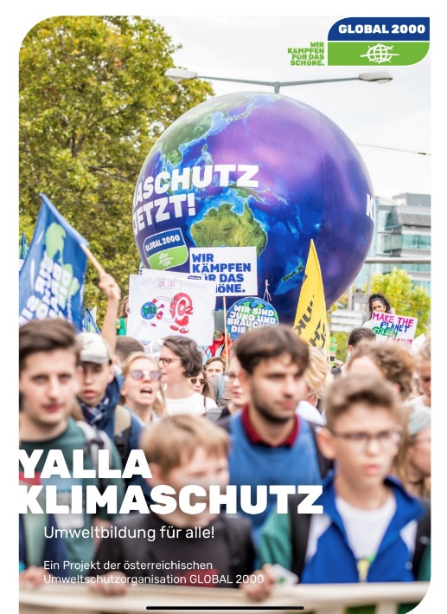
Good practice examples in the non-formal sector
Goal: make ESD and climate-change education accessible for everyone („leave no one behind“)
Measures: Initation of two programs (completed piloting in 2022):
Project „Yalla- Empowerment for a sustainable future“ Cooperation with NGO „Global 2000“: making ESD accessible for disadvantaged students
Cooperation with Austrian nationwide network for open youth work (bOJA) to equip youth workers with ESD-toolkit

Slide 5
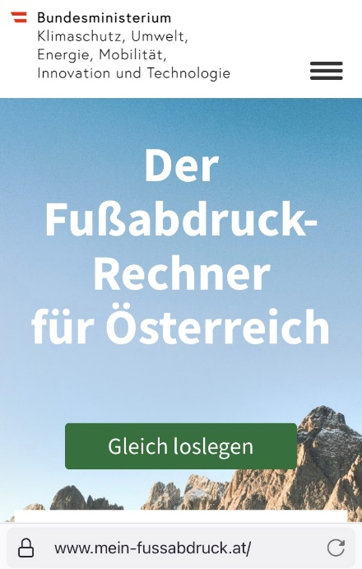
Good practice examples: Strand 3 „Digital education, information and communications technology and ESD”
Goal: Multipliers need to be equipped with up-to-date knowledge, tools and digital skills
Measures:
Annual ESD Summer Academy for multipliers has added a digital format i.e. exploring the possibilities of virtual reality for ESD
ESD-Circle: Regular free online learning and exchange format for multipliers on new methods, topics and tools
Platform Bildung2030.at showcasing newest developments
Relaunch of the Austrian footprint calculator (mein-fussabdruck.at)

Slide 6
Good practice examples: Strand 4 “Entrepreneurship, employment innovation and ESD”
Goal: support organizations which hold the required knowledge, values, attitudes, qualifications and skills for new jobs related to green and circular economy
Measure: Voluntary Environmental Year (FUJ)
Increase in annual budget to make as attractive as other volunteering programs (500 Euro/month/person)
Adding the “Climate Ticket” for each young volunteer - making public transport in Austria free for duration of their placement

Slide 7
Promoting Youth Participation through cooperation
Empowerment of youth and marginalized groups: Foster transparent actions and multi-sectoral cooperation with civil society
Youth-led initiatives in Austria: Political organizations nominate Youth Delegates, leveraging their knowledge and networks
Youth’s Knowledge and Engagement: Knowledge sharing and exchanging for mutual benefits
Sustainable Development: Empowerment and collaboration of youth as prerequisite of sustainable societal transformation
The UNECE ESD Youth Platform as possibility for collaboration and inclusivity

Slide 8
Thank you!
Contact: Serafin Groebner, MA MSc serafin.groebner@bmk.gv.at Tel.: +43 664 8373404

