Slide 1
GRE Task Force LED Substitutes / Retrofits (TF S/R) Status report for GRE88
Submitted by the Task Force on Substitutes / Retrofits (TF S/R)
Informal document GRE-88-13
(88th GRE, 25 to 28 April 2023,
agenda item 5)
19/04/2023
K. Manz, DE (Chairman)
Ph. Bailey, UK (Vice-Chairman)
Ph. Plathner, IEC (Secretary)

Slide 2
Meetings of TF S/R
Actions completed :
Step 1: LED Substitutes
Step 2: LED Replacements (“Retrofits”)
Step 2A: Administrative items
Step 2B: Technical items based on “full equivalence”
New work item:
re-evaluate equivalence criteria of high power LEDr,
as assigned by GRE87 (GRE87 report, paragraph 15; see also GRE-87-02)
16th meeting: 2023-March 07/08 hybrid meeting in Bonn (report: TFSR-16-04)

Slide 3
Excerpt from GRE-87 report
Section 15 (copied and emphasis added):
The expert from IEC analysed the approval process of LED replacement light sources according to UN Regulation No. 37 (GRE-87-02), based on the full photometric equivalence according to the guidelines (GRE-83-15). According to him, full-equivalence solutions were not feasible for high flux categories with the today's LED technology. As a consequence, some countries were issuing national approvals deviating from the full photometric equivalence, based on extensive testing (in headlamps and vehicles) for limited light source specifications and resulting in a positive list for particular vehicle models. GRE stressed the advantages of harmonization at the United Nations level and noted that several contracting parties were in favour of cautious re-evaluation of the equivalence criteria for LED replacement light sources. GRE invited IEC to start this work as a new activity of the Task Force on Substitutes and Retrofits (TF SR) in cooperation with those contracting parties.
Target of discussion in this Task Force:
Create foundation for a converging discussion to achieve LEDr unification in all UNECE countries

Slide 4
The document scope
R37
Filament Light Sources
By thermal radiation (incandescence) By LED technology
R99
HID light sources
R128
LED light sources
LED substitute light sources
Excluding LEDr
The fundamental concept of LEDr in R37 is not under discussion
R.E.5 Category sheets
Filament light sources by thermal radiation
LED replacement light sources incl H11, C5W
HID light sources
LED light sources, including LED substitute light sources
Equivalence Document
GRE-83-15
Under discussion is a bi-directional approach for high power LEDr
Under discussion is a bi-directional approach for high power LEDr

Slide 5
Reminder: what is already covered for LEDr in R37 and RE5
„administrative“ framework for LEDr approval
Electrical requirements (incl. AE device, if any)
Thermal requirements
Mechanical requirements (incl. installation items)
EMC requirements
These items are NOT under discussion
Only certain photometric requirements needs to be re-evaluated to optionally allow a „bi-directional“ emission characteristic

Slide 6
Potential ways forward for high power LEDr (in R37 / R.E.5)
1 – “intelligent equivalence” on light source level
(also called “EQ+”)
Detailed light source specification via emission in two directions
Making full use of LED technology benefits
Several deviations from “full photometric equivalence”
Keeping LEA and contrast requirements (in 2 viewing directions only)
Modified far-field emission requirements
Valid in all headlamps / vehicles
No need to consider mis-use
Not used in any country so far
2 – “application-level equivalence”
(also called “positive list approach”)
Very limited requirements on light source level
Making full use of LED technology benefits
Confirmation of UN compliant photometry in the application by measurement
Valid in tested vehicles / headlamps *
Already accepted by several contracting parties (via national type approval)
Germany, and some countries accepting:
Austria
Czech Republic
Croatia
France
South Korea
* Mis-use can be addressed via “special measures” to prevent glare , to be discussed further

Slide 7
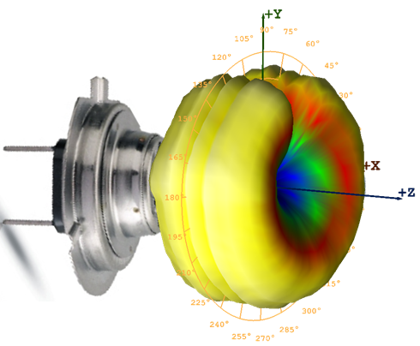
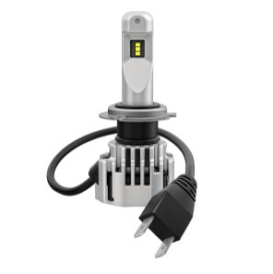
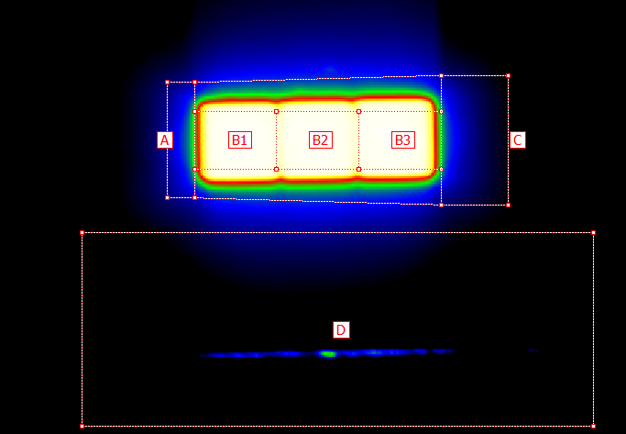
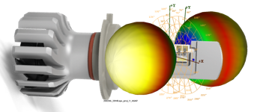
Idea to introduce alternative equivalence specification to allow bi-directional emission
Key elements of the light source specification and PROPOSED amendments to H11_LEDr
“Far-field” → Normalized Intensity Distribution
“Near-field” → box and contrast requirements
PROPOSAL: allow far-field emission characteristic of “back-to-back” LEDs with Lambertian radiation pattern
PROPOSAL: same LEA as “full-equivalent“, but only from view “A” and “-A”, i.e. exclude “B”
Notes:
Explain the performance of the lamp that we want to bring into R37:

Slide 8
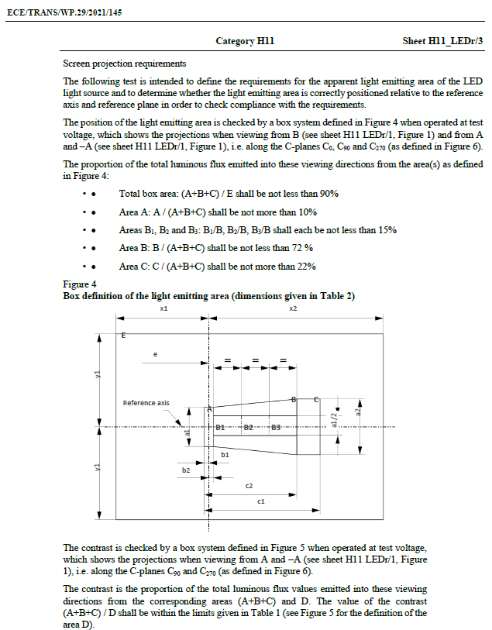
IMPACT on existing H11-LEDr sheet
Under discussion
„Near-field“
WP.29/2021/145 → Sheet H11_LEDr/3
KEEP all essential characteristics (Table 1) unchanged, especially the contrast requirement to avoid glare !
These correspond to the primary (main) directions of emission “A” and “– A”
KEEP all essential characteristics (Table 1) unchanged, especially the box and contrast requirement to avoid glare !
These correspond to the primary (main) directions of emission “A” and “– A”
REMOVE the box requirements in the secondary (third) direction “B”
In order to maintain relationship between meridional “A” and “–A” emission directions INSERT one new parameter: the spacing parameter “z” describing the “thickness”

Slide 9
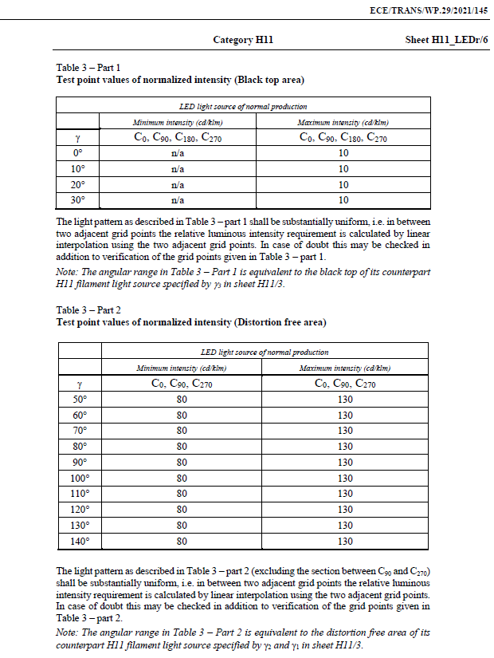
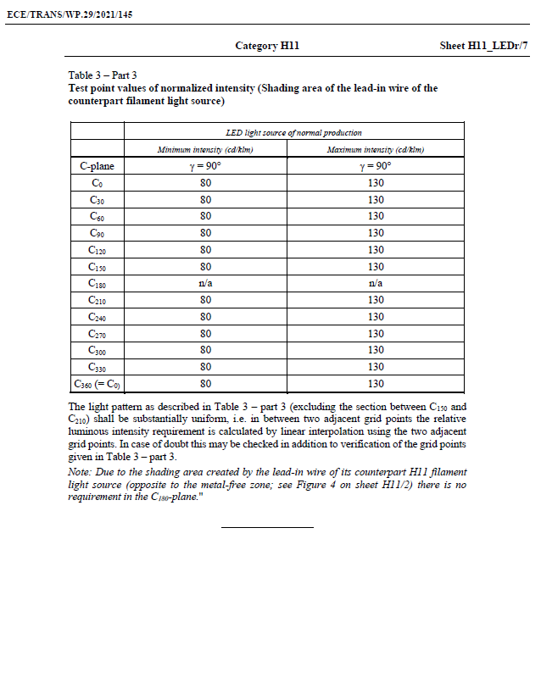
„Far-field“
IMPACT on existing H11-LEDr sheet
Under discussion
WP.29/2021/145 → Sheets H11_LEDr/6 and /7
ALLOW more light in the main emission directions (angular range of “A”, “–A” and close-by) and REDUCE intensity requirement for secondary directions (angular range of “B” and close-by)
This would make it possible to take full advantage of LED technology
In a nutshell: “shift” some light from less used directions to directions more relevant for beam shaping.

Slide 10
National Approvals : TARGET: Aligned between France and German (and based on German approval: Austria, Czech Republic, Croatia)
Photometric and geometrical tests of light source
^{A} French law requires 20% carpark coverage of registered vehicles in between [2013] to [2023] with this light source
French legal text:
« Les véhicules choisis pour les essais doivent être représentatifs et correspondre à au moins 20 % des véhicules immatriculés dans le parc français, sur une plage temporelle de 10 ans précédant la demande de réception. Cette liste est confidentielle entre le demandeur et le ministère et service technique en charge de la réception nationale. »
“The vehicles chosen for the tests must be representative and correspond to at least 20% of the vehicles registered in the French fleet, over a period of 10 years preceding the acceptance request. This list is confidential between the applicant and the ministry and technical service in charge of national reception.”
Photometric test in left and right headlamp
CoP requirements apply
Mechanical check for fitment in headlamp
Incl accessories, if specified
Mechanical and Electrical check in vehicle
Incl accessories, if specified
Positive list with “market coverage requirements” ^{A}

Slide 11
Next steps
Meeting in June – week of 12 June – exact date to be confirmed by GRE

