Slide 1
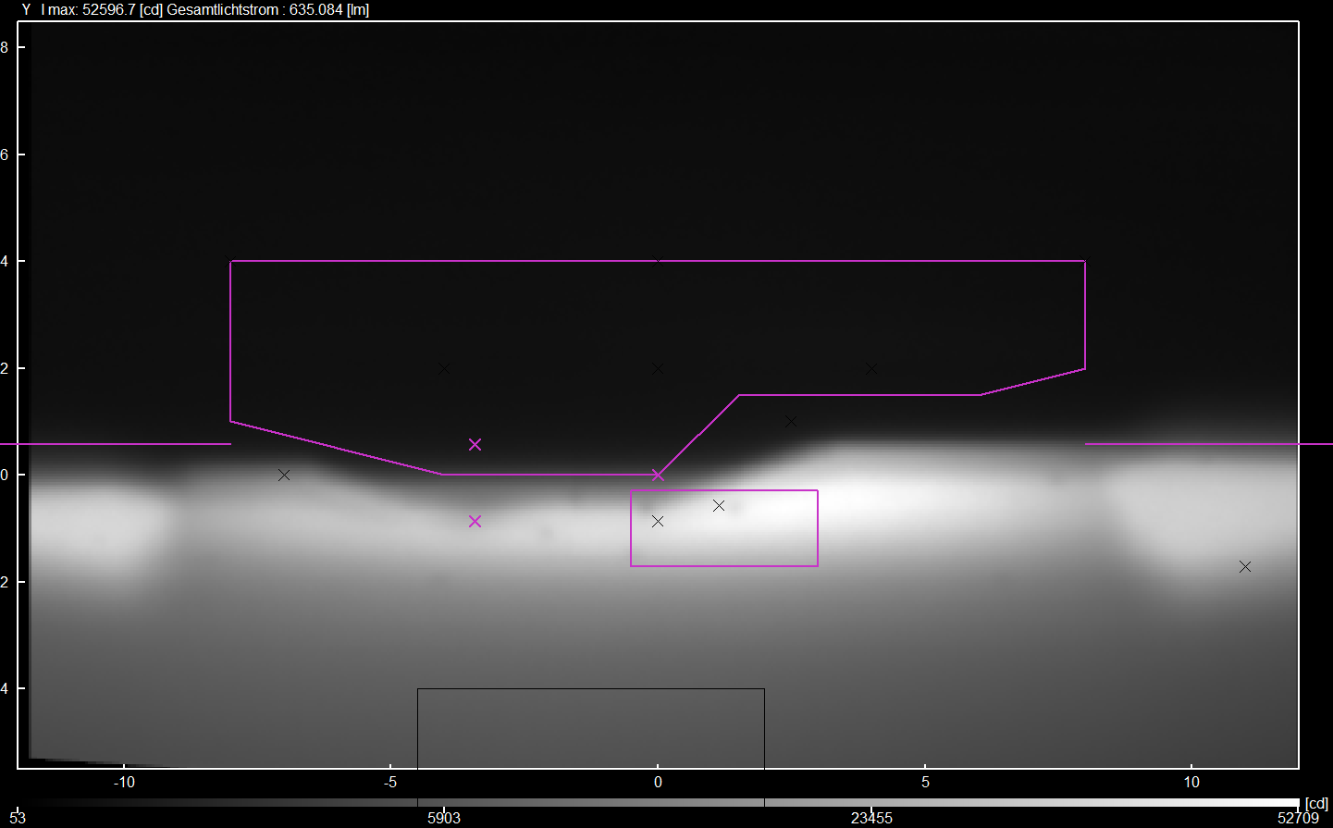
Informal document GRE-88-10
(88th GRE, 25-28 April 2023, agenda item 7)
Improved failure provisions for UN R149-01 and including “high definition” headlamps
- Main aspects of the approach -
88th GRE session, 25-28 April 2023
-GTB/ WG-FL (Front lighting)-

Slide 2
Improved failure provisions of “high definition” headlamps
Motivation
Considering the current regulatory text in UN R48, the failure requirements for principal dipped-beam headlamps using multiple light sources are quite simple and state very generally that, every failure of a LED module shall lead to either switching OFF the LED module(s) of the principal dipped-beam or activating a tell-tale indicating failure.
Failure of one LED module → considerable loss of dipped-beam performance
While new technologies and light sources are available, we now have dipped-beam headlamps constituted of a large number of light-emitting elements where a failure of any first of these does not lead to an essential change of performance in photometric values.
-GTB/ WG-FL (Front lighting)-

Slide 3
Improved failure provisions for UN R149-01 and including “high definition” headlamps - Details of the concept
For principal dipped-beam headlamps in UN R48:
the existing requirements are kept and apply to devices type-approved according to UN R112 or to the original series of amendments to UN R149;
existing requirements are adapted for failure detection at vehicle level to suit devices type-approved according to UN R149 01 series;
a new option is added for the principal dipped-beam headlamps type-approved according to the 01 and subsequent series of UN R149, if there is a failure signal provided by the device.
At device level, for UN R149-01 series:
insertion of detailed provisions for providing a failure signal, based on different technologies
UN R48
Failure detected by vehicle
→ extended provisions
UN R149 01 series
Failure detected by device
→ new detailed provisions
-GTB/ WG-FL (Front lighting)-

Slide 4
Improved failure provisions of “high definition” headlamps
Details of the concept – new provisions UN R149-01 series
Manufacturer shall choose at least one criterion depending on the diagnosis technology to provide a failure signal
First element failure
New detection possibilities intended to be offered in R149-01
Luminous flux
Legal values
Number of failed elements
Any first light source or light-emitting element fails
> 5 % flux loss of a specific function
Luminous intensity
< 80% of any minimum requirement
> 5 % of the overall number of light-emitting elements failed
Adaption of the current provision for light sources
Low value to avoid negative impact on traffic safety and to minimize the probability of dark holes
20% tolerance corresponds to the Conformity of Production criteria
Low value to avoid negative impact on traffic safety and to minimize the probability of dark holes
-GTB/ WG-FL (Front lighting)-

