Slide 1
Review of UN Regulations and GTRs on their fitness for ADS
Transmitted by the representative of France on behalf of the chairs of the WP29 screening taskforces
Informal document WP.29-189-20 189th WP29, 7–9 March 2023 Agenda item 8.6.2.

Slide 2
Mandate from WP.29
At its 186th session in March 2022, WP.29 requested all its subsidiary working parties to perform a screening of the UN Regulations and Global Technical Regulations (GTR) of relevance regarding their fitness for Automated Driving Systems (ADS) until March 2023.
At its 14th session in September 2022, GRVA gave additional guidance as to what kind of automated vehicles to consider, etc. (informal document GRVA-14-54r1)
Pending request for deadline extension until June 2023 to give additional time to GRs with staggered session schedules

Slide 3
Common work method across GRs
The taskforces of the different GRs have agreed to work on the same deliverables:
High-level summaries for each Regulation
Comprehensive files for the detailed screening
A “whitebook” for handling automated driving when drafting new Regulations
The review does not include definitive solutions for changing Regulations, but taskforces may offer suggestions (amendments, new Regulations, new vehicle categories…)

Slide 4
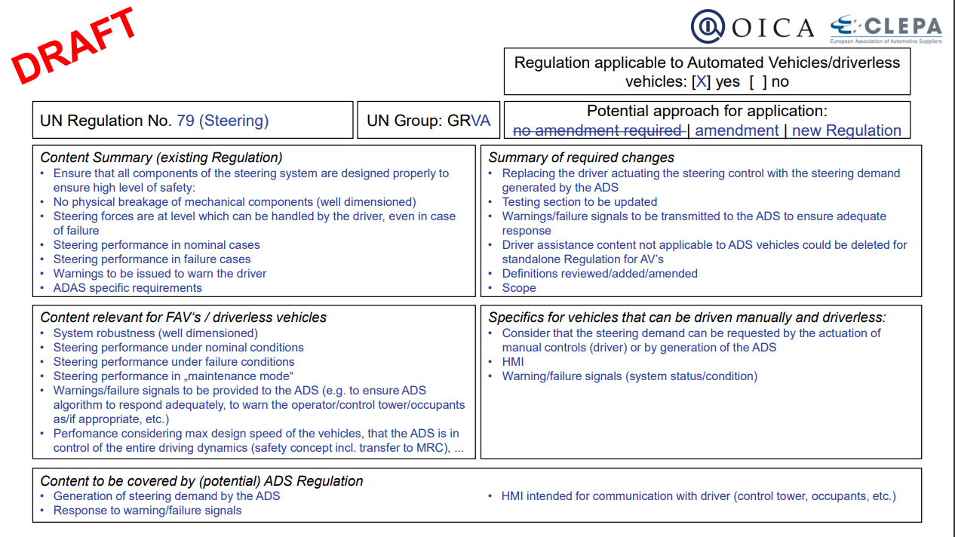
High-level assessment
This template can both serve as a preliminary analysis of a Regulation before its detailed review, and as a final report to give a summary of the detected issues and possible options

Slide 5
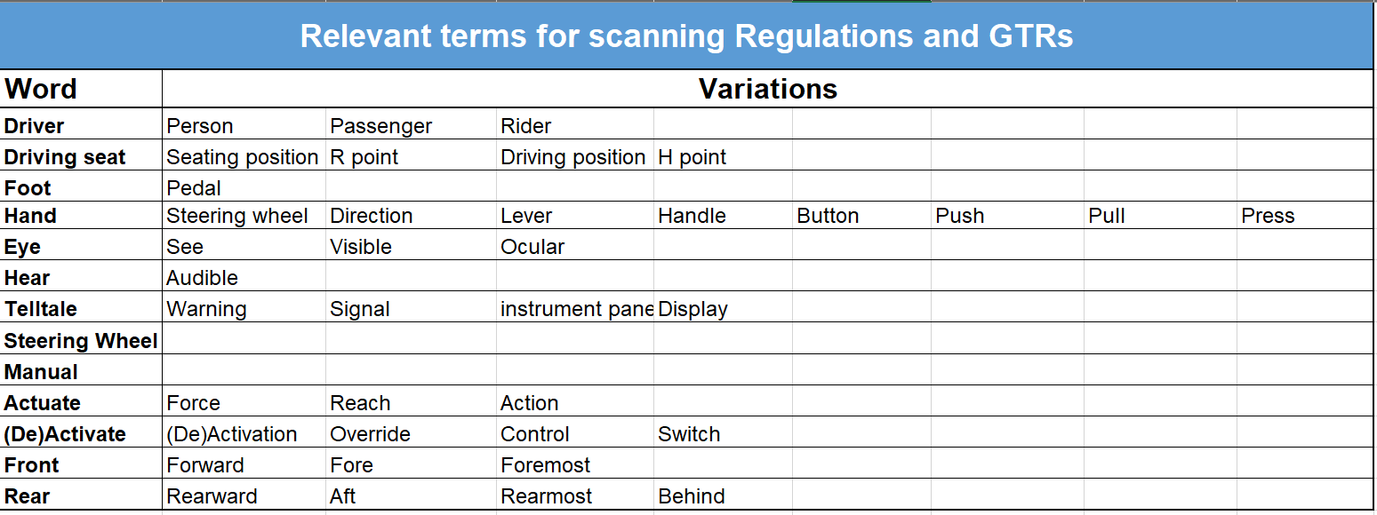
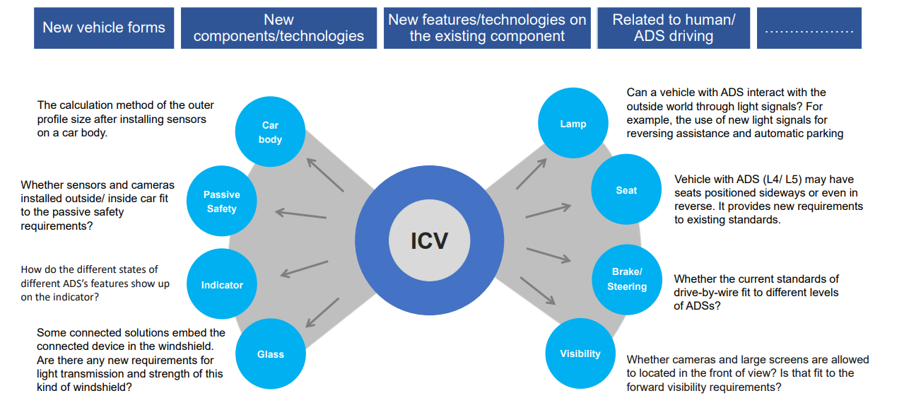
Detailed screening (1/2)
Points of interest:
Use cases: full automation, dual-mode, no occupants, etc.
Possible approaches: amending Regulations, drafting specific Regulations for automated vehicles, creating new vehicle categories, etc.
Consider both explicit and implicit concepts

Slide 6
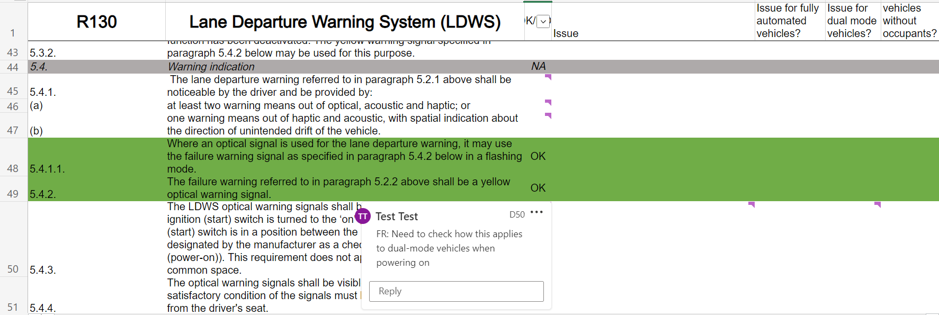
Detailed screening (2/2)
Online collaborative environment and example of a detailed review for a GRVA Regulation

Slide 7
Status of the screening taskforces
As of early March 2023:
GRBP: Detailed screening ready to start
GRE: Detailed screening and deliverables done for R48
GRPE: First meeting to take place soon
GRSG: Detailed screening in progress (55% done)
GRSP: Detailed screening in progress (80% done)
GRVA: Detailed screening in progress (75% done)
Detailed screening
Drafting deliverables
High level assessment
Not all taskforces might be able to get validation from their GR before the June WP29 session
GRPE
GRBP
GRSG GRVA GRSP
GRE

Slide 8
Status of all WP29 Regulations and GTRs
GRBP | R9 | R28 | R30 | R41 | R51 | R54 | R59 | R63 | R64 | R75 | R92 | R106 | R108 | R109 | R117 | R124 | R138 | R141 | R142 | R164 | R165 | GTR16
GRE | R10 | R37 | R48 | R53 | R74 | R86 | R99 | R128 | R148 | R149 | R150
GRPE | R24 | R40 | R47 | R49 | R68 | R83 | R84 | R85 | R96 | R101 | R103 | R115 | R120 | R132 | R133 | R143 | R154 | GTR2 | GTR4 | GTR5 | GTR10 | GTR11 | GTR15 | GTR17 | GTR18 | GTR19 | GTR21 | GTR22 | GTR23
GRSG | R18 | R26 | R34 | R35 | R36 | R39 | R43 | R46 | R52 | R55 | R58 | R60 | R61 | R62 | R66 | R67 | R71 | R73 | R81 | R93 | R97 | R102 | R105 | R107 | R110 | R116 | R118 | R121 | R122 | R125 | R144 | R147 | R151 | R158 | R159 | R160 | R161 | R162 | R163 | R166 | R167 | GTR6 | GTR12
GRSP | R11 | R12 | R14 | R16 | R17 | R21 | R22 | R25 | R29 | R32 | R33 | R42 | R44 | R80 | R94 | R95 | R100 | R114 | R127 | R129 | R134 | R135 | R136 | R137 | R145 | R146 | R153 | GTR1 | GTR7 | GTR9 | GTR13 | GTR14 | GTR20
GRVA | R13 | R13H | R78 | R79 | R89 | R90 | R130 | R131 | R139 | R140 | R152 | R155 | R156 | R157 | GTR3 | GTR8
R89 | Not yet screened
R30 | Applicable (or mostly applicable)
R12 | Not applicable (or not applicable except in dual mode)
R13 | Work needed on the Regulation / new Regulation needed
R158 | Not applicable or mostly not applicable AND amendments or new Regulation needed
R48 | Applicable or mostly applicable AND amendments or new Regulation needed
Work in progress, to be validated after completion of screening for all Regulations and GTRs

Slide 9
Examples of high level issues
Vehicle categories: current categories do not reflect the diversity of use cases for automated driving:
Dual mode vs fully automated
Carrying occupants vs freight only
Supervision inside vehicle vs remote supervision
Telltales & warning signals: a standardised way to share information is necessary: what information is relevant to whom (passenger, occupant in driver seat, remote supervisor…)
Test mode: might be necessary for certain Regulations

Slide 10
Contact information
GRBP (SIG AVRS): Jan Sybren BOERSMA (NL) JBoersma@rdw.nl
GRE (TF AVSR): Karl MANZ (DE) karl.manz@t-online.de
GRPE (TBD) - Point of contect:Niels DEN OUDEN (NL) NdenOuden@rdw.nl
GRSG (TF AVRS): Hans LAMMERS (NL) hlammers@rdw.nl
GRSP (TF AVRS): Rudolf GERLACH (DE) gerlach@de.tuv.com
GRVA (TF FADS): Romain PESSIA (FR) and Linlin ZHANG (CN)
romain.pessia@developpement-durable.gouv.fr zhanglinlin@catarc.ac.cn
Notes:
The GRVA TF can be used as a point of contact for questions related to automated driving (definitions, use cases etc.)

