Slide 1
Informal document WP.29-189-09
(189th WP.29, 7 to 9 March 2023
Agenda item 8.3
Actions of the inland transport sector to join the global fight against climate change
Draft Economic Commission for Europe Road Safety Action
Plan 2023 – 2030
Item 4
85th Session
INLAND TRANSPORT COMMITTEE

Slide 2
Draft Economic Commission for Europe Road Safety Action Plan 2023 – 2030
Approach and Main Principles
Stems from elements and principles contained in the Global Plan for the Decade of Action for Road Safety 2021- 2030
Aims to provide support to countries for the implementation of the Global Plan
Supports implementation of the ITC Recommendations and the United Nations road safety legal instruments
Provides a basis for an integrated safe system approach
Designed as a living document that will be updated by regular input provided by ITC Working Parties
Implementation will be reported to ITC at its annual sessions.
85th Session of the Inland Transport Committee | 2023 | Geneva

Slide 3
Draft Economic Commission for Europe Road Safety Action Plan 2023 – 2030
Approach and Main Principles (cont.)
ITC as the United Nations inter- and intra-regional centre for inland transport and custodian of United Nations conventions and agreements for inland transport, which include the United Nations conventions for enhancing road safety recommended by GA Resolution 74/299 and the Global Plan, will via its respective Working Parties enhance its international regulatory support by further developing existing conventions and/or new legal instruments, as appropriate.
Activities by respective Working Parties will cover a screening of existing legal instruments, identifying of loopholes or missing elements and establishing necessary amendments or new legal instruments for a better support in achieving the introduction of national road safety system.
ITC Capacity Development Action Plan, ECE road safety tools, existing and new training materials, standards and competency criteria, and training courses developed under the auspices of the respective Working Parties will provide the basis for assisting countries in the implementation of the ITC Recommendations.
85th Session of the Inland Transport Committee | 2023 | Geneva

Slide 4
Draft Economic Commission for Europe Road Safety Action Plan 2023 – 2030
Approach and Main Principles (cont.)
With the development of indicators for the different areas, ITC will provide a monitoring tool allowing countries to benchmark their progress in implementing the ITC Recommendations and the ITC Strategy until 2030 with its special priority for road safety as well as their impact on the national road safety situation. Conversely, this ECE Road Safety Action Plan 2023 – 2030 will provide an opportunity for ITC to build a missing link between the international and national levels, and help countries, in particular new contracting parties, to further implement the legal instruments.
85th Session of the Inland Transport Committee | 2023 | Geneva

Slide 5
Draft Economic Commission for Europe Road Safety Action Plan 2023 – 2030
Approach and Main Principles (cont.)
The five different areas of actions identified (a) road safety management (or the bridging pillar), (b) safe user, (c) safe vehicle, (d) safe roads and (e) effective post-crash response) provide an input to the programme of work of the different working parties / groups of experts of ECE with the ultimate goal to achieve a comprehensive and efficient national road safety system building on the international regulatory framework, good practice and experience.
Sections provide for a structured approach; ITC Working Parties are encouraged to follow. They contain suggestions aiming to initiate substantive discussion at the different groups.
85th Session of the Inland Transport Committee | 2023 | Geneva

Slide 6
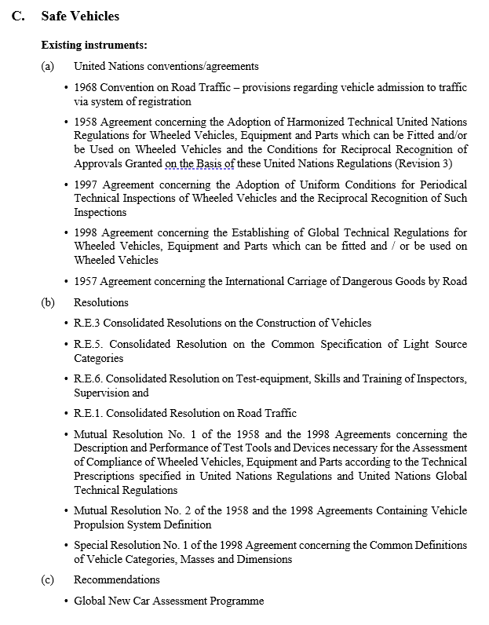
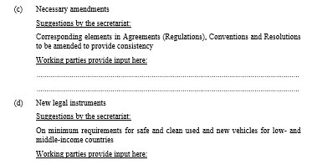
Draft Economic Commission for Europe Road Safety Action Plan 2023 – 2030
85th Session of the Inland Transport Committee | 2023 | Geneva

Slide 7
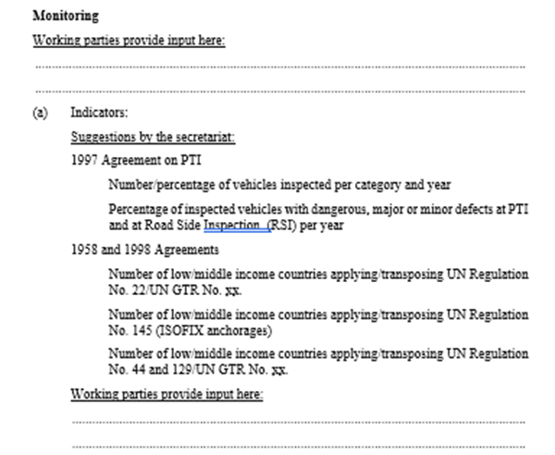
Draft Economic Commission for Europe Road Safety Action Plan 2023 – 2030
85th Session of the Inland Transport Committee | 2023 | Geneva

Slide 8
Actions of the inland transport sector to join the global fight against climate change
85th Session
Thank you!
INLAND TRANSPORT COMMITTEE
Walter Nissler
Chief of Section
UNECE
Date 23 I 02 I 2023, Geneva

