Slide 1
Presentation GRVA-EMB-04/Rev.1
GRVA-15-17
Proposal for a supplement to the 12 series of amendments to UN Regulation No. 13 (Heavy vehicle braking)
Scope of amendment and affected sections and paragraphs
Workshop in Brussels – March 29th/30th

Slide 2
Electromechanical Brakes (EMB)
GRVA-15-17 is a proposal for a supplement to the 12 series of amendments to UN Regulation No. 13 (Heavy vehicle braking)
Contains 27 pages: 14 pages of UN R13 supplements and 13 pages Justification
Supplement aims to amend following parts
Para 2 Definitions 1 page
Para 5 Specifications 7 pages
Annex 2 Communication concerning the approval ½ page
Annex 4 Braking tests and performance of braking systems 1 page
Annex 7 Provisions relating to energy sources and energy storage devices New part D 4 pages
Annex 8 Provisions relating to specific conditions for spring braking systems → exclusion of EMB change in title only
Annex 13 Test requirements for vehicles fitted with anti-lock systems ½ page

Slide 3
Electromechanical Brakes (EMB)
Main body includes
Definitions: 2 modified and 8 new definitions
Specifications:
5.1.4. Provisions for the periodic technical inspection (PTI) of braking systems (data and reference braking forces)
5.2.1 Characteristics of braking systems for Vehicles of categories M2, M3 and N
Seamless integration of EMB-requirements with same safety level e.g. two braking circuits, failure response, warning (
Current 5.2.1.27 “Special additional requirements for service braking systems with electric control transmission” has been amended by “except electro-mechanical braking system”
New 5.2.1.35. “Special additional requirements for service braking systems with electro-mechanical braking system with electric transmission” (3,5 pages)

Slide 4
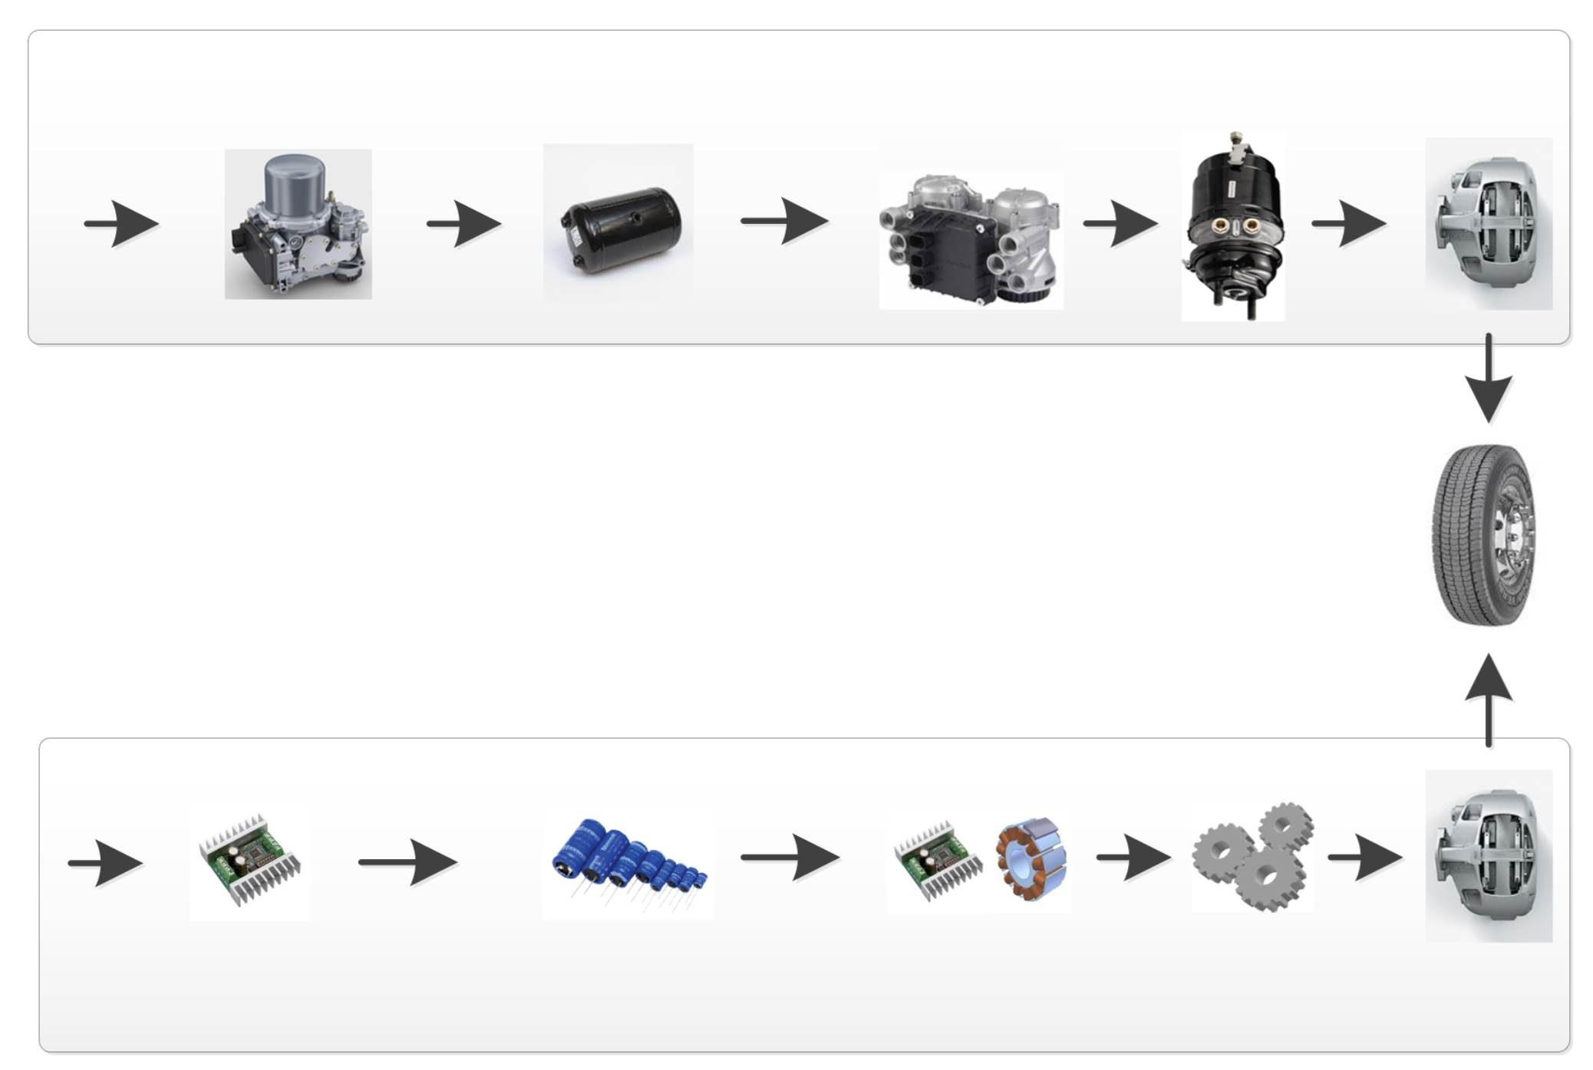
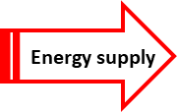
UN R13 and Electro-Mechanical Brakes (EMB) Energy Transmission principles (Pneumatic vs. Electric)
1.(a)
Copy of slide 6 of GRVA-EMB-02
EBS
E-APU
Pneumatic energy
storage
EBS Modulator
Actuator
Caliper
Pneumatic Energy
Annex 7 part A
5.2.1.27
Energy supply
Energy reserve
Actuation
EMB
Annex 7 new part D
New 5.2.1.35.
Electric Energy
DC/DC
Electric energy storage
Drive and Motor
Gears
Caliper
4

