Slide 1
Presentation GRVA-EMB-02/Rev.1
Electromechanical Brakes and UNECE R13/R13-H
Workshop in Brussels – March 29th/30th

Slide 2
Day 1, 10:00 – 12:00
1. Overview of new technical concepts for Electro-Mechanical Brakes

Slide 3
Electro-Mechanical Brakes (EMB) Purpose and Scope
Electric transmission:
Current regulation for the service braking only addresses electric control transmission
The purpose of the EMB amendment is to address also electric energy transmission in the regulation
In a first step for UNECE-R13, the scope is limited to EMB on the motor vehicle; the trailer remains as today

Slide 4
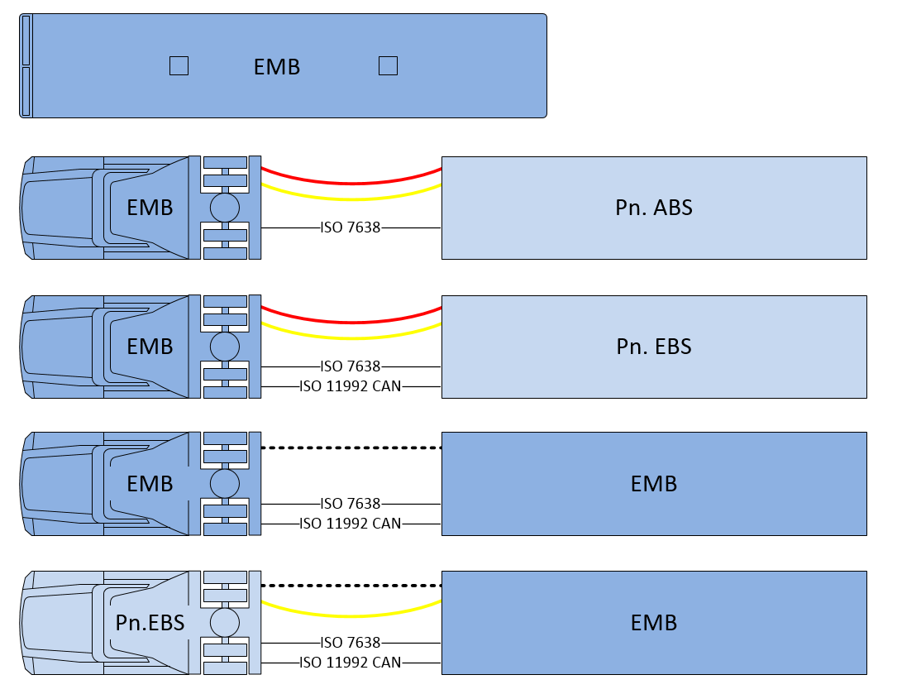
UN R13 and Electro-Mechanical Brakes (EMB) Amendment scope and motivation
Agenda item 1.(a)
Motor vehicle with EMB brakes on all axles (not mixed with Pneumatic Or Hydraulic systems)
Motor vehicle with EMB brakes with “conventional” trailer interface according to current UN R13
Trailers with EMB excluded from scope
UN R13-H not included but considered, in particular when creating new definitions
Advantages and possibilities by amending Electric Energy Transmission to UN R13
Improved energy efficiency in EV´s (vs. air compressor)
Improved braking control
Elimination of noise emissions from pneumatics

Slide 5
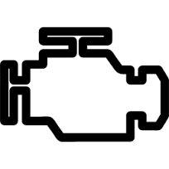
Type of powertrain
Received Energy
Supply
Supplied
energy
1.(a)
source
Conditioning
+ Governor valve
+ Air dryer
COMPRESSOR
compressed air
pressurized fluid
vacuum
low voltage power
…
ICE
MECHANICAL
Energy supply
ALTERNATOR
24V
PUMP
BEV
No source
low voltage power
Energy supply
HIGH VOLTAGE POWER
DC/DC
ICE
Generator
TB
Hybrid

Slide 6
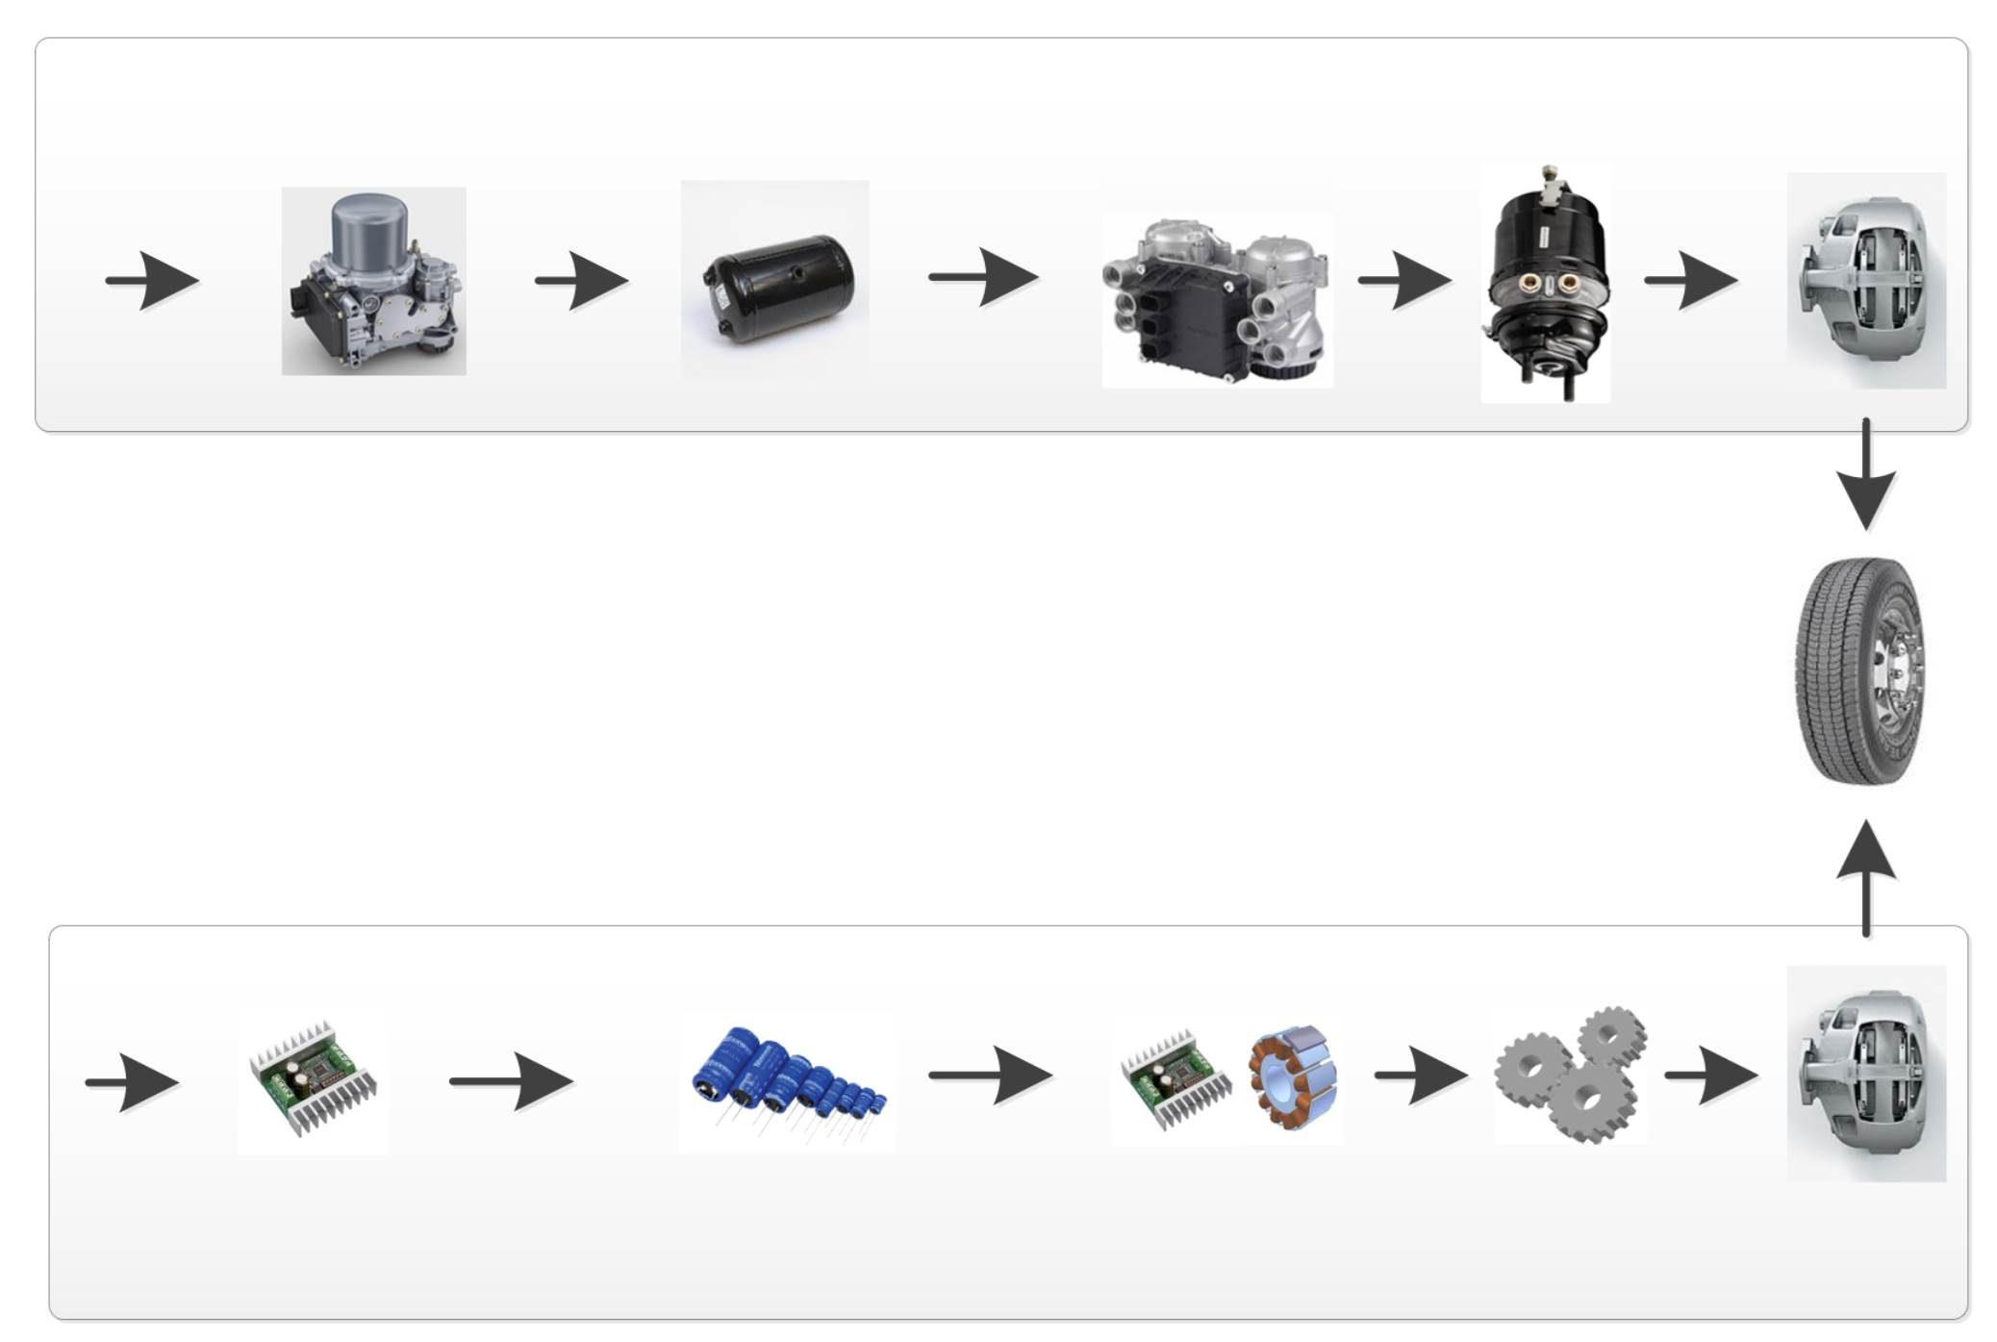
UN R13 and Electro-Mechanical Brakes (EMB) Energy Transmission principles (Pneumatic vs. Electric)
1.(a)
EBS
E-APU
Pneumatic energy
storage
EBS Modulator
Actuator
Caliper
Pneumatic Energy
Annex 7 part A
5.2.1.27
Energy supply
Energy reserve
Actuation
EMB
Annex 7 new part D
New 5.2.1.35.
Electric Energy
DC/DC
Electric energy storage
Drive and Motor
Gears
Caliper
6

Slide 7
Motivation amending UN R13-H on Full Power Braking Systems
1.(b)
Full Power Braking Systems are under development as an alternative to conventional hydraulic braking systems.
Currently potential approvals to UN-R 13H/01 Suppl.4 for such Full Power Braking Systems are unclear due to missing defnitions and requirments.

Slide 8
Classification Brake by Wire (BBW) versus Electro Mechanical Brake (EMB)
Agenda item 1.(b)
Control and Energy Transmission
→ Brake By Wire (BBW)
Energy Transmission
→ EMB
a mix of energy
is converted to actuating forces by purely mechanical means
electro-hydraulic braking system
(EHB)
electric-mechanic/ electro-hydraulic braking system
(EMB-EHB)
electrical power only
is converted to actuating forces by purely mechanical means
electric-mechanic braking system
(EMB)

Slide 9
Day 1, 13:00 – 18:00
2. Traditional brakes and new concepts

Slide 10
Main challenges
Keep same safety level as with current technologies
Account for new technology, while avoiding design restrictions
Keep the requirements performance-/function oriented
Avoid unwanted side-effects on existing regulation
Keep R13 and R13-H definitions and principles aligned
Example technical challenge:
Effect of ageing and temperature on the performance of energy storage devices
Example regulatory challenge:
Ensure energy warnings are displayed to the driver acc. to performance level

Slide 11
Day 1, 13:00 – 16:00
Traditional brakes and new concepts
(2a) “Full” EMB for Heavy Duty Motor Vehicles

Slide 12
System Board-net (Energy and Control transmissions)
Energy Source, Supply ,Storage and friction brake actuation
Existing typical layout (EBS)
Intermediate layout between EBS and EMB
Targeted EMB principal layouts

Slide 13
Agenda item 2.(a)
Energy transmission = pneumatic
Control transmission = electric + pneumatic (backup)
R13 - Existing typical layout - EBS
Mechanical drive
ICE
Compressor
Energy
Reserve 1
Circuit 1
Supply
Tank
Brake Valve
1
Brake Valve
2
Energy
Reserve 2
Circuit 2
Alternator
“energy source of the electric control transmission” (5.2.1.27.5)
3
Brake Controller
1
2
Energy Supply * (including energy source, if any)
Energy Reserve
Transmission
Battery
24V
KL 30.1
Control Transmission I
Electric
I Pneumatic
Energy Transmission I
Electric
I Pneumatic
Control
2.5.1. "Control transmission" means the combination of the components of the transmission which control the operation of the brakes, including the control function and the necessary reserve(s) of energy.
to be defined

Slide 14
2.(a)
Energy transmission = pneumatic
Control transmission = electric + pneumatic (backup)
R13 - Existing typical layout - EBS
Traction Battery (HV)
Electric Compressor
Energy
Reserve 1
Circuit 1
Supply
Tank
Brake Valve
1
Brake Valve
2
Energy
Reserve 2
Circuit 2
DC/DC
3
Brake Controller
1
2
Energy Supply * (including energy source, if any)
Energy Reserve
Transmission
Battery
24V
KL 30.1
Control Transmission I
Electric
I Pneumatic
Energy Transmission I
Electric
I Pneumatic
Control
2.5.1. "Control transmission" means the combination of the components of the transmission which control the operation of the brakes, including the control function and the necessary reserve(s) of energy.
to be defined

Slide 15
2.(a)
Energy transmission = pneumatic
Control transmission = electric
R13 - Intermediate step between EBS and EMB
Traction Battery (HV)
Electric Compressor
Energy
Reserve 1
Circuit 1
Supply
Tank
Brake Valve
1
Brake Valve
2
Energy
Reserve 2
DC/DC
Circuit 2
Brake Controller 1
Brake Controller 2
1
2
Energy Supply * (including energy source, if any)
Energy Reserve
Transmission
Control Transmission I
Electric
I Pneumatic
Battery 1
Energy Transmission I
Electric
I Pneumatic
Control
to be defined
Battery 2

Slide 16
2.(a)
Energy transmission = electric
Control transmission = electric
R13 EMB Targeted layouts – layout 1a
(Electro-Mechanical-Brake)
Energy
Reserve 1
Specific battery to braking
Traction Battery (HV)
KL 30.1
DC /DC
Circuit 1
Brake Controller
1
Brake Controller
2
Battery
24 V
Energy
Reserve 2
Circuit 2
1
2
Energy Supply * (including energy source, if any)
Energy Reserve
Transmission
Control Transmission
Energy Transmission I
Electric
I Hydraulic
Control
to be defined

Slide 17
2.(a)
Energy transmission = electric
Control transmission = electric
Energy Reserve 1
R13 EMB Targeted layouts – layout 1b
(Electro-Mechanical-Brake)
Battery 24V
battery for braking
And other consumers
Traction Battery (HV)
KL 30.1
DC /DC
Circuit 1
Brake Controller
1
Brake Controller
2
Battery 24V
Circuit 2
1
2
Energy Reserve 2
Energy Supply * (including energy source, if any)
Energy Reserve
Transmission
Control Transmission
Energy Transmission I
Electric
I Hydraulic
Control
to be defined

Slide 18
III. Performance requirements for single failure

Slide 19
5.2.1.2.7.2. If the service braking force and transmission depend exclusively on the use, controlled by the driver, of an energy reserve, there shall be at least two completely independent energy reserves, each provided with its own transmission likewise independent; each of them may act on the brakes of only two or more wheels so selected as to be capable of ensuring by themselves the prescribed degree of secondary braking without endangering the stability of the vehicle during braking; in addition, each of the aforesaid energy reserves shall be equipped with a warning device as defined in paragraph 5.2.1.13. below. In each service braking circuit in at least one of the air reservoirs a device for draining and exhausting is required in an adequate and easily accessible position;
Agenda item 2.(a)
UN R13 Today

Slide 20
2.(a)
Energy transmission = pneumatic
Control transmission = electric + pneumatic (backup)
R13 - Existing typical layout - EBS
Traction Battery (HV)
Electric Compressor
Energy
Reserve 1
Circuit 1
Supply
Tank
Brake Valve
1
Brake Valve
2
Energy
Reserve 2
Circuit 2
DC/DC
3
Brake Controller
1
2
Energy Supply * (including energy source, if any)
Energy Reserve
Transmission
Battery
24V
KL 30.1
Secondary performance
Control Transmission I
Electric
I Pneumatic
Energy Transmission I
Electric
I Pneumatic
Control
2.5.1. "Control transmission" means the combination of the components of the transmission which control the operation of the brakes, including the control function and the necessary reserve(s) of energy.
to be defined

Slide 21
2.(a)
Energy transmission = electric
Control transmission = electric
R13 EMB Targeted layouts – layout 1a
(Electro-Mechanical-Brake)
Energy
Reserve 1
Specific battery to braking
Traction Battery (HV)
KL 30.1
DC /DC
Circuit 1
Brake Controller
1
Brake Controller
2
Battery
24 V
Energy
Reserve 2
Circuit 2
1
2
Energy Supply * (including energy source, if any)
Energy Reserve
Transmission
Secondary performance
Control Transmission
Energy Transmission I
Electric
I Hydraulic
Control
to be defined

Slide 22
5.2.1.5. Where use is made of energy other than the muscular energy of the driver, there need not be more than one source of such energy (hydraulic pump, air compressor, etc.), but the means by which the device constituting that source is driven shall be as safe as practicable.
2.(a)
UN R13 Today

Slide 23
2.(a)
Energy transmission = pneumatic
Control transmission = electric + pneumatic (backup)
R13 - Existing typical layout - EBS
Traction Battery (HV)
Electric Compressor
Energy
Reserve 1
Circuit 1
Supply
Tank
Brake Valve
1
Brake Valve
2
Energy
Reserve 2
Circuit 2
DC/DC
3
Brake Controller
1
2
Energy Supply * (including energy source, if any)
Energy Reserve
Transmission
At least 8 applications before Secondary performance
Battery
24V
KL 30.1
Control Transmission I
Electric
I Pneumatic
Energy Transmission I
Electric
I Pneumatic
Control
2.5.1. "Control transmission" means the combination of the components of the transmission which control the operation of the brakes, including the control function and the necessary reserve(s) of energy.
to be defined

Slide 24
2.(a)
Energy transmission = electric
Control transmission = electric
R13 EMB Targeted layouts – layout 1a
(Electro-Mechanical-Brake)
Energy
Reserve 1
Specific battery to braking
Traction Battery (HV)
KL 30.1
DC /DC
Circuit 1
Brake Controller
1
Brake Controller
2
Battery
24 V
Energy
Reserve 2
Circuit 2
1
2
Energy Supply * (including energy source, if any)
Energy Reserve
Transmission
At least 8 applications before Secondary performance
Control Transmission
Energy Transmission I
Electric
I Hydraulic
Control
to be defined

Slide 25
Proposed definitions
2.(a)
e.g. compressor, pump, alternator…
But not the traction battery nor a DC/DC converter
"Energy source" means a device which receives energy and converts it into the required form (i.e. medium). An energy storage device is not considered as a source.
“Energy supply” means all parts, including an energy source, if any, that are necessary to supply energy for the operation of the braking system. The supplied energy can be used to be stored in the energy storage devices and/or can be used directly to feed the control transmission and/or the energy transmission.
e.g. DC/DC converter
“Energy reserve” means the stored energy needed for the operation of the braking system.

Slide 26
Day 1, 16:30 – 18:00
Traditional brakes and new concepts
(b) Provistion of Energy for braking systems on passenger cars (ICE and BEV)
(c) Hybrid brake system on passenger cars (e.g. hydraulic front-, electro mechanic rear axle)
Passenger Car layouts
electro-mechanical-brake
electro-hydraulic-brake
electro-mechanical-brake / electro-hydraulic-brake

Slide 27
Agenda item 2(b)
R13H todays layout – Full Power Braking Systems with mechanical fallback
UN R13-H, para. 5.2.2.9.
LV
Battery
Traction Battery (HV)
DC/DC
KL 30
Brake Control Unit
hydraulic
hydraulic
Circuit 1
Circuit 2
with
mechanical fall back
hydraulic
hydraulic
Steering System
Other
consumers
Energy Supply (including energy source, if any)
Energy Reserve
Transmission
Control Transmission
Energy Transmission I
Electric
I Hydraulic
Control
Not exclusively used by braking system, but total vehicle functions, e.g. Steering

Slide 28
2(b)
R13H Targeted layouts – layout 1a # (electro-mechanical-brake)
LV-Battery
Traction Battery (HV)
DC /DC
KL 30.1
Circuit 1
Brake Controller
1
Brake Controller
2
DC/DC
KL 30.2
Circuit 2
1
2
Energy Supply (including energy source, if any)
KL 30.1 = (+) circuit1
KL 30.2 = (+) circuit2
There can be [n] circuits ^{(*)}
(*) 5.2.8. The action of the service braking system shall be distributed between the wheels of one and the same axle symmetrically in relation to the longitudinal median plane of the vehicle.
Energy Reserve
Steering System
Other
consumers
Transmission
Control Transmission
Energy Transmission I
Electric
I Hydraulic
Control
Not exclusively used by braking system, but total vehicle functions, e.g. Steering

Slide 29
2(b)
R13H Targeted layouts – layout 2a # (electro-hydraulic-brake)
LV-Battery
Traction Battery (HV)
DC /DC
KL 30.1
hydraulic
Brake Controller1
Brake Controller 2
hydraulic
hydraulic
Modulator 1
Modulator 2
hydraulic
DC /DC
KL 30.2
1
2
Energy Supply (including energy source, if any)
KL 30.1 = (+) circuit1
KL 30.2 = (+) circuit2
There can be [n] circuits ^{(*)}
(*) 5.2.8. The action of the service braking system shall be distributed between the wheels of one and the same axle symmetrically in relation to the longitudinal median plane of the vehicle.
Energy Reserve
Steering System
Other
consumers
Transmission
Control Transmission
Energy Transmission I
Electric
I Hydraulic
Control
Not exclusively used by braking system, but total vehicle functions, e.g. Steering

Slide 30
2(c)
R13H Targeted layouts – layout 3a#
(electro-mechanical-brake / electro-hydraulic-brake)
LV-Battery
Traction Battery (HV)
DC /DC
KL 30.1
hydraulic
Brake Controller1
Brake Controller 2
hydraulic
Modulator 1
DC /DC
KL 30.2
1
2
Energy Supply (including energy source, if any)
KL 30.1 = (+) cicuit1
KL 30.2 = (+) circuit2
There can be [n] circuits ^{(*)}
(*) 5.2.8. The action of the service braking system shall be distributed between the wheels of one and the same axle symmetrically in relation to the longitudinal median plane of the vehicle.
Energy Reserve
Steering System
Other
consumers
Transmission
Control Transmission
Energy Transmission I
Electric
I Hydraulic
Control
Not exclusively used by braking system, but total vehicle functions, e.g. Steering

Slide 31
Day 2, 9:00 – 12:00
3. Past activities
Brief review, Structure list and format of exiting documents

Slide 32
Day 2, 9:00 – 12:00
4. UN R13 and UN R13-H
Scope of amendment and affected sections and paragraphs, see embedded document below (UN R13).

Slide 33
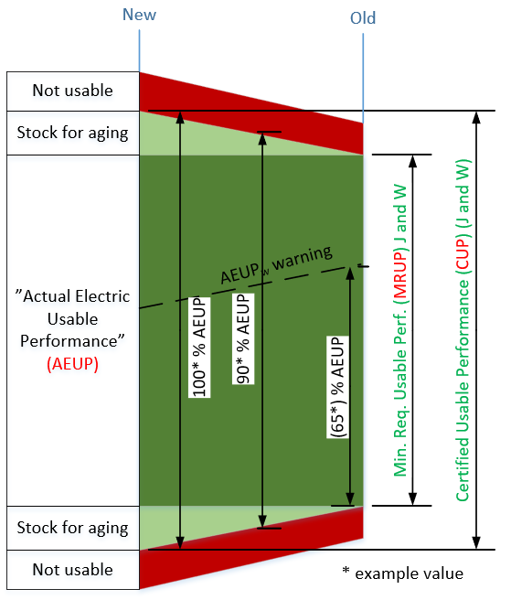
Electrical Energy Storage device
Addressing the effect of ageing - example
New definitions:
“Certified Usable Performance (CUP)” means the maximum usable performance of an electrical energy storage device available for an electro-mechanical braking system determined at the time of type approval.
“Minimum Required Usable Performance (MRUP)” means the minimum usable performance of an electrical energy storage device available for an electro-mechanical braking system to fulfil the relevant requirements of this Regulation.
“Actual Electric Usable Performance (AEUP)” is the level of energy stored in an electrical energy storage device, as well as its available power, at a given time. It is defined as a percentage of the CUP value.
New proposal
The “usable performance” means the portion of the performance of an electrical energy storage device that is actually available to the supplied system (e.g. the system may not use the maximum theoretical performance).
→ Still pending discussion and proposal will be updated during Q2 2023

Slide 34
Agenda item 4.
Content of the planned amendments to UN R13-H
Introduce and amend definitions for energy supply, energy source, and energy reserve. To ensure a harmonization with UN R13.
Link the demonstration of the independency among the energy reserves (electrical) to annex 8.
Additions and clarifications to requirements of electric control transmission regarding Full Power Braking Systems (i.e., para. 5.2.20).
Clarify and align the required capacity of electrical energy reserves to hydraulic energy reserves (e.g., para. 5.2.4.2., 5.2.14., annex 4).
Amend trigger conditions in case of loosing one brake circuit (reference: para. 5.2.3@ hydraulic systems: warning at a differential pressure of more than 15.5 bar)

Slide 35
Day 2, 13:00 – 15:00
UN R13 and UNR13-H
Approach and harmonization e.g. Energy Transmission
Ambitions: Keep R13 and R13-H definitions and principles aligned (ref. Day 1 principal layouts)

Slide 36
Proposed definitions
e.g. compressor, pump, alternator…
But not the traction battery nor a DC/DC converter
"Energy source" means a device which receives energy and converts it into the required form (i.e. medium). An energy storage device is not considered as a source.
“Energy supply” means all parts, including an energy source, if any, that are necessary to supply energy for the operation of the braking system. The supplied energy can be used to be stored in the energy storage devices and/or can be used directly to feed the control transmission and/or the energy transmission.
e.g. DC/DC converter
“Energy reserve” means the stored energy needed for the operation of the braking system.

Slide 37
Day 2, 15:30 – 16:00
Wrap up and next steps
Format and structure of future work - Discussion

