Slide 1
Transmitted by the expert of the Netherlands
Informal document GRSG-125-34-Rev.1 GRSG 125th session, 27 – 31 March 2023 Agenda Item 14
TF-AVRS
Status Update March 2023

Slide 2
Recapture GRVA-14-54r1

Slide 3
Status Update TF-AVRS (Automated Vehicles Regulatory Screening)
Since GRSG-124, 3 meetings took place (online): 14 December 2022, 6 February and 22 March 2023.
During the first meeting, tasks were assigned to CPs and NGOs.
During the second and third meeting, the outcome of the screening was discussed for each Regulation and the common criteria gathered.
NL as chair of this TF would like to thank the colleagues from USA, China, Germany, France, Japan, OICA, CLEPA for their participation and input.

Slide 4
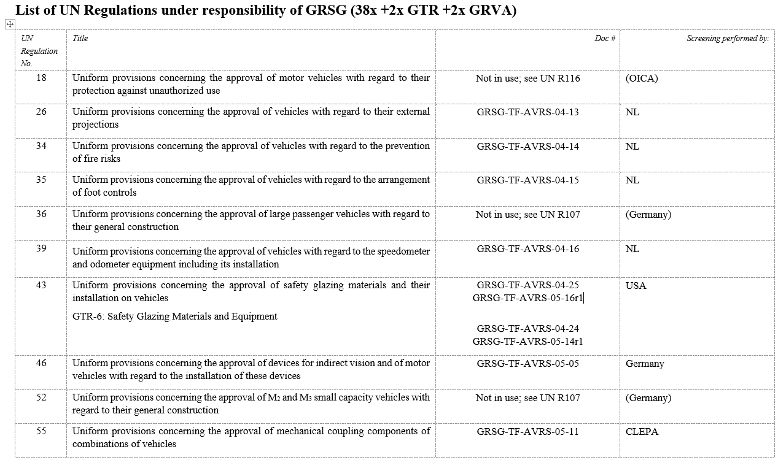

Slide 5
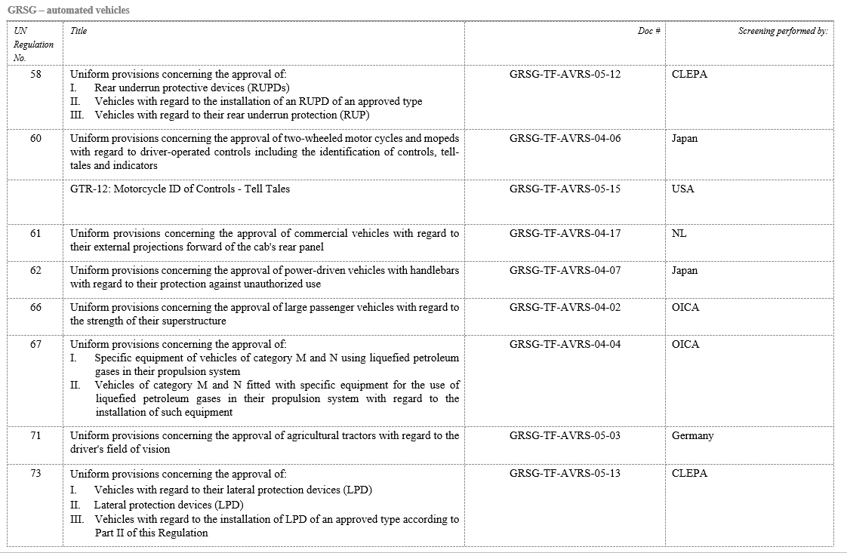

Slide 6
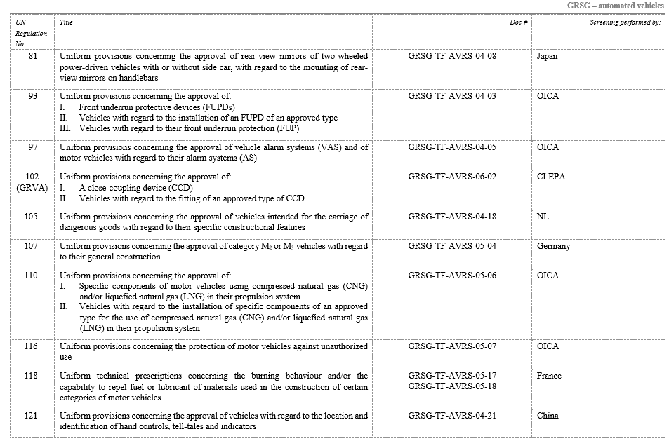

Slide 7
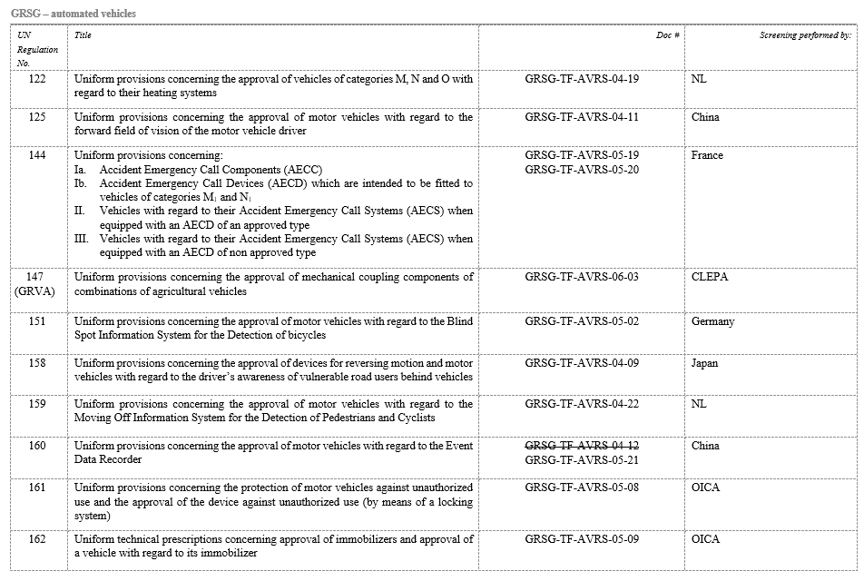

Slide 8
All documents available at the UNECE Wiki page

Slide 9
General findings:
Some of the issues can be easily fixed by rewording; e.g. references to “driver”, “steering control”, etc. => GRSG task in a next step
For some functions, we need to consider the high-level requirement. For example: - Q: what is the reason we have tell-tales in a vehicle ? - A: to inform the driver about a setting, a potential issue with the vehicle’s hardware, as a warning for a dangerous situation, etc. - Q: what if there is no driver in the vehicle ? Who needs to be informed, if anyone ? - A: An operator, a control center, occupants in the vehicle (if any), fellow road users ? => discussion for WP.29
For some situations, we need to consider if it is desirable at all to have an automated vehicle w/o driver, e.g. in case of ADR vehicles (UN R105) or buses (UN R107) in case of transport of children. => Discussion for WP.29

Slide 10
Way forward (beyond GRSG responsibility) :
Several pre-requisites have to be defined in order to start the next phase: - vehicle categories: new vehicle categories for automated vehicles, dual mode vehicles, vehicles w/o occupants are going to be defined ? or - shall the prescriptions be defined such that different requirements may apply to different scenarios using the current vehicle categories.
Next pages show some examples of the screening performed

Slide 11
Notes:
Special Resolution SR. 1 and referenced industry standards (e.g., ISO, SAE, etc.) were out of scope for this effort.
Regulation applicable to Automated Vehicles/driverless vehicles: [X] yes [ ] no
UN GTR No. 6 Safety Glazing Materials
UN Group: GRSG
Potential approach for application: no amendment required | amendment | new Regulation
Content Summary (existing Regulation)
GTR No. 6 specifies safety glazing requirements for windscreens and windows with regards to driver visibility and occupant safety.
Summary of required changes
Modify definitions which reference the driver, the driver’s field of vision, or the steering wheel.
Extend the applicability of the impact requirements to the rear windscreen for bi-directional vehicles.
Modify the compliance tests to be performed without a driver seat or steering wheel.
Content relevant for FAV‘s / driverless vehicles
If occupants are present:
Impact requirements would be applicable.
Optical requirements may not be relevant.
If occupants are not present, GTR No. 6 would not be applicable.
Specifics for vehicles that can be driven manually and driverless:
For dual-mode vehicles, all requirements in GTR No. 6 would be applicable.
Content to be covered by (potential) ADS Regulation
Equivalent occupant safety requirements for HUD screens or alternative windscreen solutions.

Slide 12
Regulation applicable to Automated Vehicles/driverless vehicles: [X] yes [] no
UN Regulation No.144 Accident Emergency Call Systems (AECS)
UN Group: GRSG
Potential approach for application: no amendment required | amendment | new Regulation
Content Summary (existing Regulation)
Scope : M1 N1
the approval of Accident Emergency Call Components (AECC) which are intended to be fitted as part of an Accident Emergency Call Device (AECD).
The approval of AECDs which are intended to be fitted to vehicles of categories M1 and N1
the approval of vehicles of categories M1 and N1 with regard to their Accident Emergency Call System (AECS) when equipped with an AECD
the approval of vehicles of categories M1 and N1 with regard to their AECS when equipped with an AECD which has been separately approved or not according to Part Ib of this Regulation.
Optional scope : other vehicles categories.
Summary of required changes
1) Manual function for transport of goods is not relevant (e.g control)
2) Extension of scope to M2 and M3 category ?
3) Information and warning signal could be transfered to a supervision center (for vehicles without occupants) and/or duplicate (for vehicles with occupants depending the use cases : robotaxi or private vehicles) ?
4) Some requirements are not applicable to vehicles without occupants
Content relevant for FAV‘s / driverless vehicles
All regulation R144 for vehicles with occupants
Some parts not relevant or to be adapted for vehicles without occupants
Specifics for vehicles that can be driven manually and driverless:
Dual-mode vehicles must comply with current standards + specifications for driverless vehicles.
Content to be covered by (potential) ADS Regulation
None

Slide 13
Note: Japanese consideration does not include L6/L7
Regulation applicable to Automated Vehicles/driverless vehicles: [X] yes [ ] no
UN Regulation No.62 (PROTECTION AGAINST UNAUTHORIZED USE)
UN Group: GRSG
Potential approach for application: no amendment required | amendment | new Regulation
Content Summary (existing Regulation)
Scope: L1-L7, if fitted with handlebars
Steering lock in a position where you cannot go straight or mission lock
Variation of key
Breaking torque
Electromagnetic compatibility
Summary of required changes
Define such as digital keys need to be added, as mechanical keys are useless when vehicles are self-parked by unmanned.
Content relevant for FAV‘s / driverless vehicles
Define such as digital keys are needed because physical keys (include FOB-keys) are useless when vehicles are self-parked by unmanned.
If the FAV is not fitted with handlebars, it will be out of scope, so it is necessary to cover it with ADS regulations.
Specifics for vehicles that can be driven manually and driverless:
Define such as digital keys are needed as physical keys (include FOB-keys) are useless when vehicles are parked by unmanned even if it is DMV.
Content to be covered by (potential) ADS Regulation
FAVs without handlebars must be covered by ADS regulations.

Slide 14
Regulation applicable to Automated Vehicles/driverless vehicles: [X] yes [] no
UN Regulation No.67 specific equipment for the use of LPG in their propulsion system
UN Group: GRSG
Potential approach for application: no amendment required | amendment | new Regulation
Content Summary (existing Regulation)
Scope: This Regulation applies to: Part II Approval of vehicles of category M and N fitted with specific equipment for the use of liquefied petroleum gases in their propulsion system with regard to the installation of such equipment.
Summary of required changes
For clarification purpose, “if fitted” could be added to the presence of a heating system to heat the passenger compartment. Even without this change, the current Regulation applies and can be used.
Content relevant for FAV‘s / driverless vehicles
100% relevant
Specifics for vehicles that can be driven manually and driverless:
Not applicable.
Content to be covered by (potential) ADS Regulation
None

Slide 15
Thank you for your attention !

