Slide 1
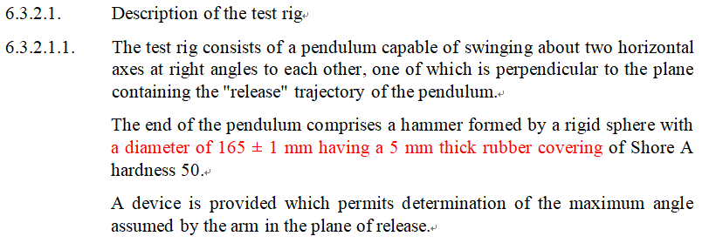
UN Regulation 46
Informal document GRSG-125-24
(125th GRSG, 27 - 31 March 2023 Agenda item 4(a))
UN R 46 impact test rig
Background The regard of UN R 46, two different interpretations of the diameter of sphere have occurred.
Argue
or
165mm
155mm
175mm
165mm ±1mm
- 1p -

Slide 2
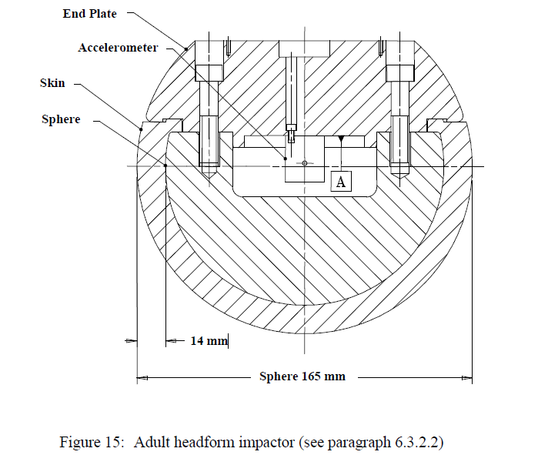
UN Regulation 46
UN R 46 impact test rig
Relevant Regulations
Other relevant regulations including an impactor, which are
representing a head, are defining the geometric diameter value as 165mm
GTR 9
FMVSS TP.111
UN R 21
GTR No 9. Para. 6.3.2.2
The adult headform impactor shall be made of aluminium, be of homogenous construction and be of spherical shape. The overall diameter is 165 ± 1 mm as shown in Figure 15.
- 2p -

