Slide 1
Windscreen Tint
Submitted by the expert of Japan
Informal document GRSG-125-23
GRSG 125th session, 27-31 March 2023
Agenda item 15(e)

Slide 2
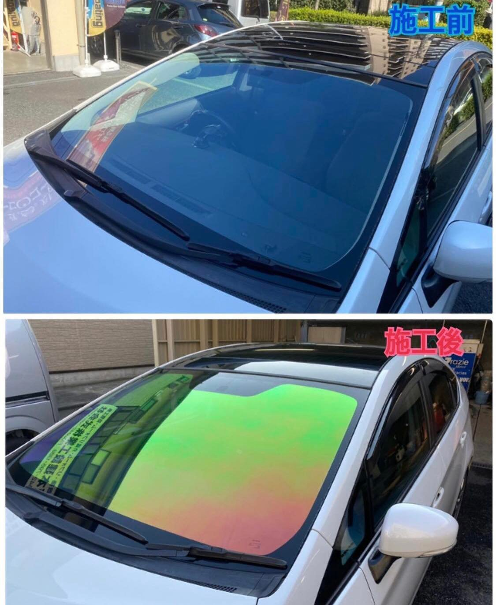
before
after
While Japan is gathering information on this kind of the windscreen tint, it is said that the luminance transmittance of some of them is over 70% (described in the UNR43 and GTR6).
If there are concerns on the visibility through such colored tint (e.g., depending on ambient lightness including night time, angle of the windscreen, and the colour of the traffic signals and signs) even though its luminance transmittance is over 70%, we will need to consider how to address this issue, including voluntary approach, PTI, or developing new technical requirements and/or test methods.
We acknowledge that Police agency, other than through PTI, could also check the luminance transmittance not only in Japan but also in other countries. In Japan it is not allowed to drive using mobile phone by Road Traffic Act.

Slide 3
(Cont’d)
In the future front windscreen glazing might not be necessary for autonomous vehicle in SAE level 5, but in some mode (e.g., dual-mode and emergency situation) the glazing might still work in addition to external HMI.
If you have similar concerns and/or any information on this issue including on the researches in the past for this kind of tint, and if you already have any national requirement for such windscreen tint, please let us know through following web format by 30th April 2023;
https://forms.office.com/r/qF9nKLmrAC

