Slide 1
Submitted by the expert from Republic of Korea
Informal document GRSG-125-16
(125th GRSG, 27-31 March 2023, Agenda item 8)
The summary report
of the Tech Seminar for the Radiant Warmer

Slide 2
Background of the Tech Seminar
Informal document GRSG-125-xx
(125th GRSG, 27-31 March 2023, Agenda item 8)
History
The Republic of Korea introduced two informal documents in the 124th GRSG Session(October 2022).
GRSG-124-04 : Proposal to amend UN/ECE Regulation No. 122 (Heating Systems)
GRSG-124-05 : The introduction of the Radiant Warmer’s technical importance and advantage for EV
There were requests for the technical demonstration to help understanding the Radiant Warmer from some CPs.
The Republic of Korea planned the Tech Seminar and informed all CP members through the GRSG
Secretariat.
Purpose
Introducing the Radiant Warmer which is being developed by several component makers around the world
Discussion of the predictable safety aspects of the Radiant Warmer
Discussion of future plans for how to deal with the proposal of R.122
1p

Slide 3
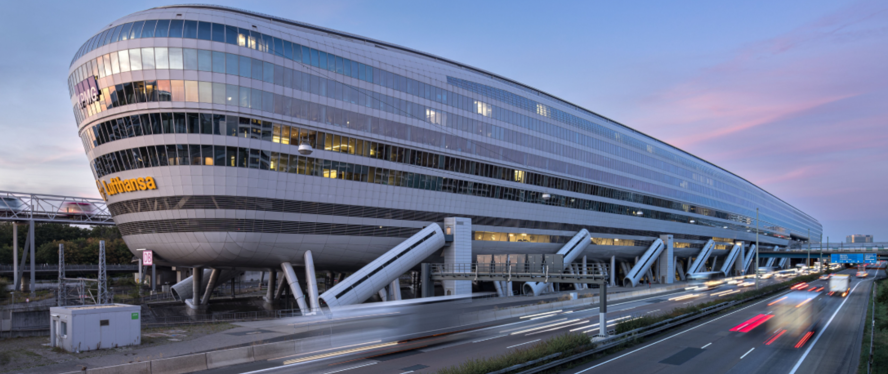
Tech Seminar of Radiant Warmer
Informal document GRSG-125-xx
(125th GRSG, 27-31 March 2023, Agenda item 8)
Date and Venue
Date : March 8, 2023
Venue : Frankfurt, Germany (The Squaire : https://www.thesquaire.com)
Main Activity
Participant |  | Demonstration | Presentation
Government, etc. | GERMANY | - | -
 | NETHERLAND | - | -
 | SOUTH KOREA (Gov./Univ.) | - | ○
Vehicle Manufacturer | HYUNDAI (Korea) | ○ | -
 | ISUZU (Turkey) | - | -
Component Manufacturer | SEOYON E-HWA (Korea) | ○ | -
 | GENTHERM (Korea/Germany) | ○ | ○
 | VALEO (Korea/France) | ○ | ○
 | CLEPA (Japan Denso) | ○ | ○
2p

Slide 4
The result (1)
Informal document GRSG-125-xx
(125th GRSG, 27-31 March 2023, Agenda item 8)
Discussion point
The Radiant Warmer is generally covered by the various textile materials and the surface temperature exceeds 80℃ that is legal limitation. However it is to maximize the efficiency of the Radiant Warmer.
The surface temperature of the radiant warmer currently being considered is approximately 90℃ to 130℃.
Because of this fact, the proposal of R.122 was introduced in the last GRSG session(2022. Oct.).
According to the results of a study conducted separately, we confirmed that the surface temperature of a cloth material at an equivalent level to 70℃, which is the legal limit temperature of the metal surface, is around 160℃.
On the other hand, another safety concern is expected that the radiant heat warmer may be easily contacted by the occupant.
In conclusion, R.122 needs to be revised in consideration of new aspects of safety measures.
3p

Slide 5
The result (2)
Informal document GRSG-125-xx
(125th GRSG, 27-31 March 2023, Agenda item 8)
Safety measures under consideration (Examples)
Detection and Temperature control
Step-by-step temperature drop by operating time
Auto stop after a certain period of time
Temperature setting function by location by occupants, etc.
Future plan (suggested proposal)
Based on the discussion points and safety measures,
the new informal document will be submitted by Republic of Korea in coming GRSG session (March, 2023)
4p

Slide 6
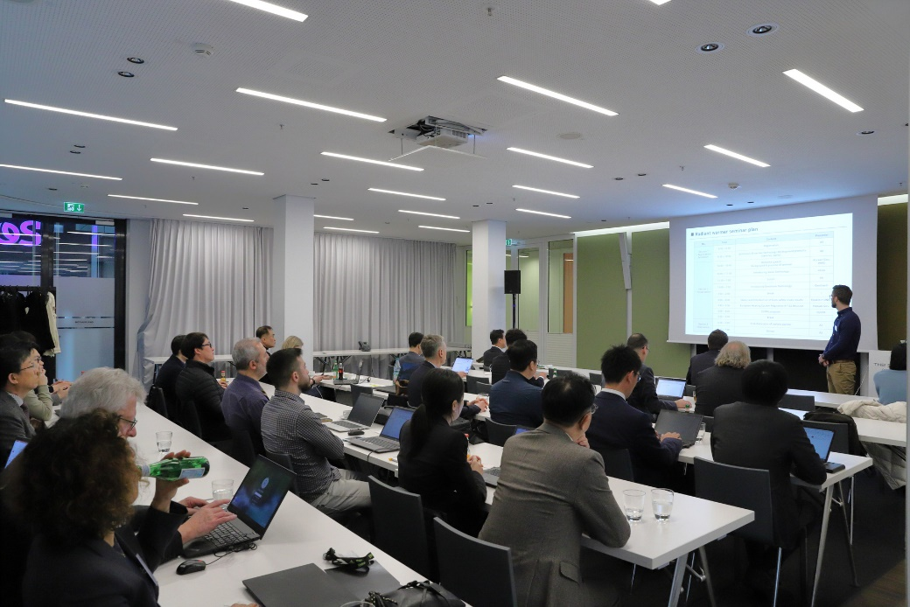
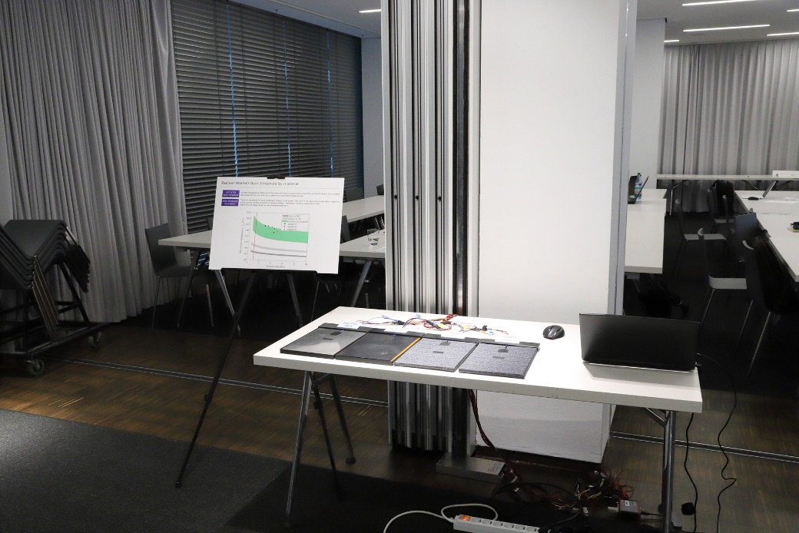
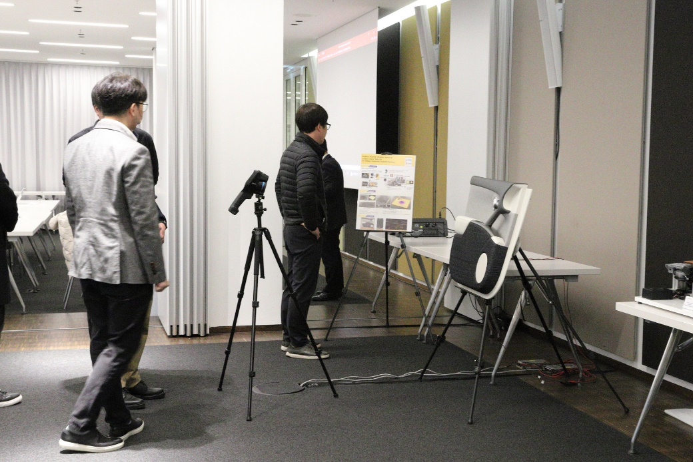
Appendix
Informal document GRSG-125-xx
(125th GRSG, 27-31 March 2023, Agenda item 8)
5p

Slide 7
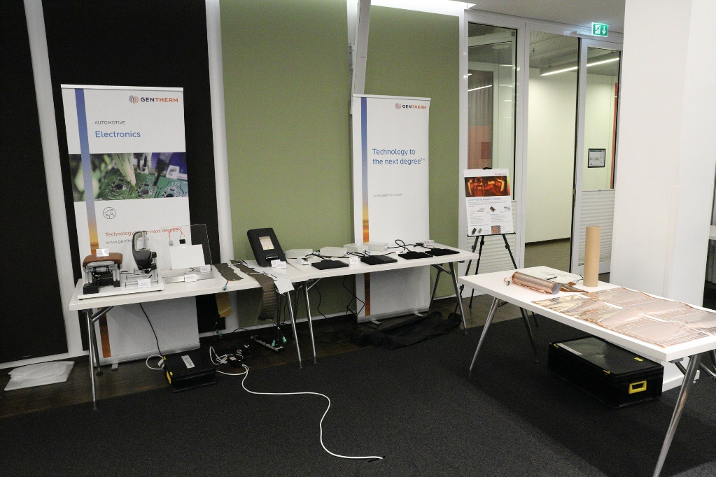
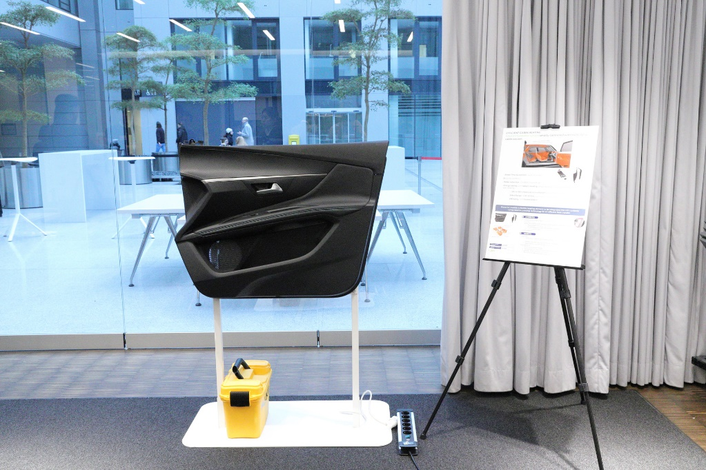
Appendix
Informal document GRSG-125-xx
(125th GRSG, 27-31 March 2023, Agenda item 8)
5p

Slide 8
Appendix
Informal document GRSG-125-xx
(125th GRSG, 27-31 March 2023, Agenda item 8)
Thank you for your attention
6p

