Slide 1
Integration of Gender Aspects into Environmental Policies
-
Biljana Filipović Đušić,
Ministry of Environmental Protection of the Republic of Serbia

Slide 2
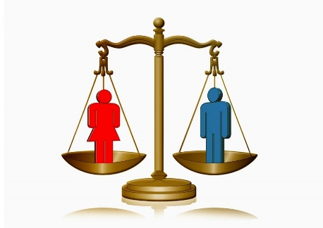
Relevant Legislative and regulatory framework
The Law on Gender Equality was adopted in May 2021 (regulates oobligations of public authorities, employers and other partners to mainstream the gender perspective in the field in which they operate.
Certain provisions determine the areas in which general and special measures are implemented, including environmental protection.
National Gender Equality Strategy for the period 2021.-2030. applies an integrative approach - from sectoral policies to integrated public policy.

Slide 3
Institutional Framework in the Republic of Serbia
Article 59
Formation, implementation, monitoring and enhancement of policies for the achievement of gender equality shall be done by:
1) the Government;
2) Ministries, other government institutions competent for areas where general and special measures for the achievement and promotion of gender equality were determined and implemented;
3) Coordination Body for Gender Equality;
4) Institutions of the autonomous province;
5) Institutions of local self-government units;
6) Other public authorities, organizations and institutions that participate in preventing sex- and/or gender-based discrimination in accordance with their powers and/or in preventing gender-based violence.
https://antidiskriminacija.rs/preporuka-mera-za-ostvarivanje-
ravnopravnosti-lokalnim-samoupravama-za-zene-i-mlade/

Slide 4
Gender equality in the field of environmental protection
Article 42
Environmental authorities provide equal opportunities for women and men in the natural resource management system and the right to be informed about the state of the environment. Different interests, needs and priorities of women and men are considered and taken into consideration when managing human resources.
The Ministry responsible for environmental protection during the planning, management and implementation of environmental plans, projects and policies conducts the gender mainstreaming process.
Local self-government units conduct the gender mainstreaming process during the planning, management and implementation of environmental plans, projects and policies.

Slide 5
Organisational structure in the Ministry of Environmental Protection
In 2021, in line with the act on the internal organization and job specification, the Ministry formed:
Group for the Promotion of Gender Equality, Inclusion of Persons with Special Needs and Integration of Marginalised Social Groups in the Environmental Protection Process (currently employs 1 person).
Internal Network for Gender Equality (including representatives from each Ministry’s sectors and headed by Secretary of the Ministry).

Slide 6
Gender and environment
The Ministry of Environmental Protection recognised the need to do better research, analysis and presentation of this topic to the public.
With the support of UN agencies and the OSCE, we have been working on:
– Gender mainstreaming in environmental policies,
– Educating on gender equality and the environment,
– Advocating the creation of a favourable environment for women’s environment-related activities,

Slide 7
Gender-Responsive Budgeting
Article 5
ttps://www.google.com/search?
The public authorities shall undertake to conduct a gender analysis of the budget and plan revenues and expenses so as to promote gender equality in accordance with the law regulating the budget system and the principle of gender equality within the budget process.
Ministry for Environmental Protection Plans for 2022:
Preparation of gender analysis of revenues and expenses and allocation of financial resources
Within the Program Activities for the Support of Civil Society Projects, those aimed at promoting gender equality and women's entrepreneurship in the field of green and circular economy will be supported.

Slide 8
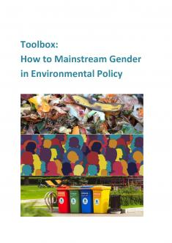
Capacity Building on the linkages between Environment and Gender
With the support of the UNECE Gender Equality Team, a set of relevant tools for gender mainstreaming into different sectoral policies and programmes were presented:
Toolbox - How to mainstream gender into environmental policy
https://unece.org/environment-policy/publications/toolbox-how-mainstream-gender-environmental-policy

Slide 9
Activities to date with UNECE support
Training for MoEP representatives 27/11/2020
(Basic information on gender equality, institutional and legal aspects at the international level, as well as the importance of the link between the environment and gender equality)
Webinar on gender mainstreaming 28/01/2021
(a set of relevant tools for gender mainstreaming into different sectoral programmes and policies was presented. Applied to 2 documents: National Waste Prevention Programme and the Roadmap for Circular Economy in Serbia, but can be applied to any other sector of environmental policy) Output doc: Methods and toolkits for gender mainstreaming in environmental policies
Training for Local-self government units representatives – gender mainstreaming into environmental policies
( improving gender equality at the local level was presented; the importance of gender responsive budgeting, informing about basic knowledge on gender aspects in sectors: water, energy, circular economy, climate change, waste management.

Slide 10
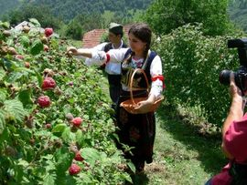
Cooperation with municipalities and cities
By organising this thematic workshop, we continued to work on gender mainstreaming into environmental policies by initiating cooperation with the representatives of cities and municipalities and Regional Development Agencies,
Objective: Providing information on basic knowledge on gender aspects in water, energy, circular economy, climate change, waste and chemical management sectors...

Slide 11
Activities with the support of UN WOMEN
in the field of climate change
In 2017-2018.- within the „Climate Smart Urban Development“ Project:
Training Manual – Gender and Climate Change was developed and that contributes to better understanding of gender aspects in the field of climate change and may be used as a source of information for the preparation of practical training courses, as well as a guide for mainstreaming the gender perspective in programmes and projects
https://inovacije.klimatskepromene.rs/wp-content/uploads/2020/08/Prirucnik-za-trening_Web_SRB.pdf
Досадашње активности уз подршку UN WOMEN у области климатских промена

Slide 12
Activities with the support of UNDP
in the field of Climate Change
End of 2019 - Draft report on the establishment of monitoring of gender sensitive reporting in the field of climate change, within which the Proposed Gender Sensitive Monitoring Framework was prepared
(2020-Gender sensitive monitoring framework (klimatskepromene.rs);

Slide 13
How the toolbox could be translated for transport
Transport can also make a big difference in increasing women’s productivity and promoting gender equality.
Implementing gender perspective in transport policy planning, is a pioneer approach in Serbian context,
Within the New Transport Strategy, the Study on Gender Equality in the Field of Transport (GETS project), will be developed, with the main aim to provide evidence for policies addressing gender equality in transport.
The toolbox provides a practical and workable approach to gender mainstreaming in environmental policies, but it can be applied to transport sector, involving the experts from different ministries or institutions dealing with transport.
Exchanging this good practice could be valuable for other countries, the regional workshop on gender mainstreaming into environmental policies that Serbia hosted virtually (Feb.2022), inspired regional representatives to better understand the importance of mainstreaming gender issues into environmental policies and projects.
It shall be further continued in different regions and UNECE MS, to share lessons learned and good practices.

Slide 14
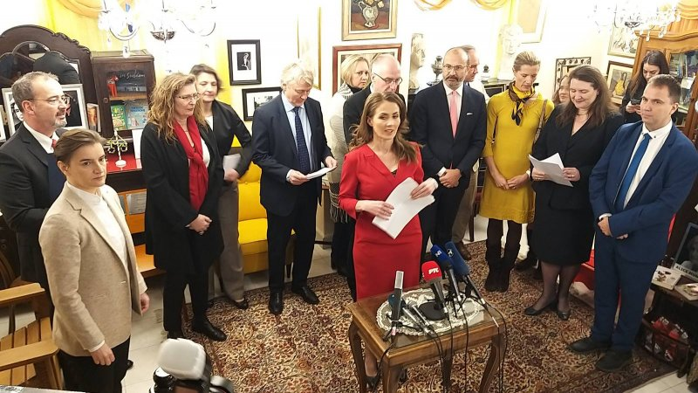
Thank you!
biljana.filipovic@eko.gov.rs

