Slide 1
20th Session of THE PEP Steering Committee Geneva and online, 17-19 October 2022
THE PEP Gender Workshop
Survey to Member States
Notes:
To begin, I’m Thomas Hartley from the UK, an Intern with UN ECE, I’ve been with the team for 3 months and it’s a real pleasure to be here today speaking to you all about this important issue and opportunity for improvement.
To set the scene:
Members of the Steering Committee will have the opportunity of discussing the relevance of a gender perspective related to transport, health, and environment issues. The outcomes of the discussions could contribute to the preparation of the comprehensive pan-European strategy on transport, health, and the environment, as per the mandate from the Fifth High-level Meeting on Transport, Health and Environment’

Slide 2
20th Session of THE PEP Steering Committee Geneva and online, 17-19 October 2022
Introduction
Survey sent out on 14 September 2022
Survey consisted of two broad questions:
Do you have any policies, plans, programs or projects on Transport, Health and Environment where gender has been integrated? Which ones?
What are the barriers and gaps in integrating gender?
The aim of the survey is to understand the current landscape for gender integration in transport, health and environment policies of member States
We received 12 responses including 1 from ITF
Notes:
I first want to extend my thanks to Amy Choi ,a previous colleague and consultant with UN ECE, who drafted the questions for this survey. The survey was sent out to member States and some related interested parties on the 14th of September just over a month ago.
The survey consisted of two questions (along with others related to who was responding), these being:
Do you have any policies, plans, programs or projects on transport, health and environment where gender has been integrated? Which ones?
And
What are the barriers and gaps in integrating gender?
The aim of the survey was to understand the current landscape (in a casual way) for gender integration in these sectors in member States
We received 12 responses including from ITF who will be speaking later, and we are grateful to the member States that responded and helping provide this picture

Slide 3
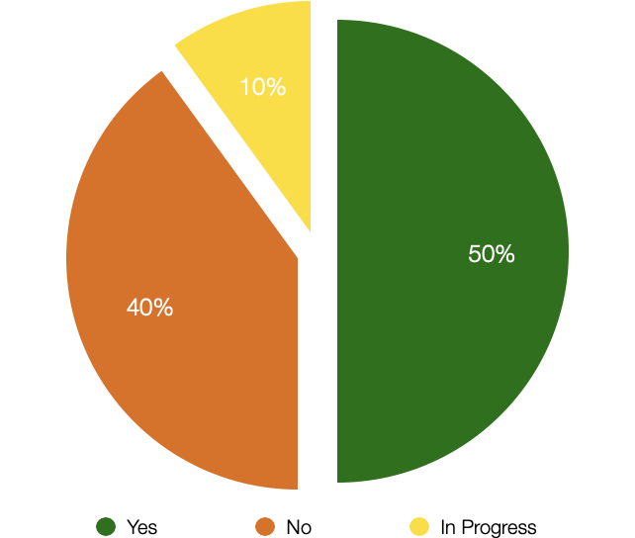
20th Session of THE PEP Steering Committee Geneva and online, 17-19 October 2022
Question 1:
Do you have any policies, plans, programs or projects on Transport, Health and Environment where gender has been integrated? Which ones?
Selected Examples
Portugal
Austria
Notes:
This was the first question of the survey and as you can see from the pie chart, 50% of respondents already have policies relating to transport, health and the environment where gender has been integrated.
The phrasing of this question caused some problems with respondents often stating that they had policies related to one of the three sectors that integrated gender but perhaps not the entire nexus.
To draw out two responses, we have chosen those of Portugal and Austria.
Portugal: The proposed National Walking Strategy addresses Gender issues – of particular relevance of THE PEP’s development of a Pan-European Walking Strategy – would be interested in hearing more about how this was done
Austria: Action Plan for Women’s Health includes 17 goals and 40 measures addressing the health of women in different life phases, including socioeconomic determinants such as poverty, access to transport, and social participation. Interesting example of the holistic way to think about gender disparities in health – would be interesting to hear more about this too.

Slide 4
20th Session of THE PEP Steering Committee Geneva and online, 17-19 October 2022
Question 2:
What are the barriers and gaps in integrating gender?
Barriers:
Bureaucracy
Low priority
Stereotypes and Cultural Norms
Lack of awareness
”Novelty” of gender considerations
Historical domination of “male thinking”
Historical domination of men in the transport sector
Gaps:
Lack of female participation in the formulation of policies
Lack of data for specific gender inequalities in transport
Lack of guidelines for gender mainstreaming in transport
Insufficient studies regarding the impact of gender
Notes:
In the framing of the question we asked for barriers or gaps; and in this slide I have attempted to split them out using that distinction. It is worth stating that there is a lot of overlap between what might be considered a barrier or a gap. I will not spend time individually discussing each of the items in the list in order not to spend too long on this slide.
Drawing attention to the ‘Novelty’ of gender considerations; this is important because it reflects that gender is more and more becoming an important consideration in public policy which gives momentum to the project of creating a more equitable country / system. It is important to capitalise on this momentum in developing effective policies. As the novelty of gender consideration wears off, not only is it important to maintain this momentum, but hopefully, barriers of a lack of awareness or domination of ‘male thinking’ and men in positions of power and influence should be changing.
On the gaps side, we see important and recognisable problems for a ‘new’ policy perspective and this is a lack of data on the extent and specifics of the problem, a lack of experience in introducing policies to deal with the problem, and then the wider problem of a lack of women in the transport sector which is a macro issue related to the lack of women studying STEM subjects among other reasons.
To conclude this slide; I ask you to reflect on your own country’s experiences and whether there is something obvious missing from these lists or solutions that you have found to overcome these problems.

Slide 5
20th Session of THE PEP Steering Committee Geneva and online, 17-19 October 2022
Summary and Next Steps
The survey questions were broad and the answers given were consequently broad
Potential Action: Include more focussed questions relating to the integration of gender into transport, health and environment policies in the biennial THE PEP survey
The survey highlighted a lack of data and research regarding the impact of gender in the specific sectors
Potential Action: Dissemination of studies and encourage increased data collection and sharing
The survey also raised a lack of institutional awareness and the capability to integrating gender into transport, health and environment policies
Potential Action: Include advancing the integration of gender in THE PEP strategy through the sharing of best practises [or a toolkit?]
Notes:
I extend a further thank you to those that took part in the survey, without whom we wouldn’t have any takeaways now.
We have identified three key takeaways
The first relates to the nature of the survey and how best to improve soliciting information on this topic. There were only two questions in the survey and both were quite broad which left a broad scope for how member States responded. This has been useful in giving us high-level themes however, more detailed questions would have perhaps yielded more detailed answers/ To this end therefore, a potential action to considered is to include more focussed questions relating to the integration or interaction of gender in Transport, Health and Environment in the biannual THE PEP survey.
Secondly, a common response in the survey was a lack of data and research regarding the impact of gender in the concerned sectors – . This is also something that will be discussed in the future presentations in this workshop. A first potential action this point would be the dissemination of materials that concern the impact of gender in transport, heath and environment sectors and something that the secretariat is having ongoing discussions regarding internally.
Finally, the survey raised the fact that many member States feel that they lack the institutional capacity and/or experience of integrating specific gender considerations into policy. On this point, a potential action could be the sharing of best practises and experiences of such integration that member States can use as blueprints or inspiration for their own policies. The presentation from Biljiana is an example of this with the sharing of experience in Serbia.
Thank you for your time, and I hope that the information in this presentation has been interesting and I look forward to the following presentations and the discussions that follow.

