Slide 1
Status report to 77th GRBP
(February 2023)
Transmitted by the co-chairs
of TF for Tyre Abrasion
Informal document GRBP-77-31
(77th GRBP, Feb 7-12, 2023,
agenda item 5)
Task Force on Tyre Abrasion
On behalf of GRBP and GRPE

Slide 2
Task Force on Tyre Abrasion
Targets | Develop a procedure for measuring the abrasion of tyres: test conditions and methods Rate the abrasion performance of a wide range of tyres available in the market Define abrasion limits for tyres in order to limit the emission of microplastics to the environment Assess potential correlation between abrasion performance and durability of tyres. Develop a UN Regulation (or addition to UN Regulation No 117) for the type approval of tyres in respect to their abrasion
Roles | Co-chairs: France and European Commission Secretariat: ETRTO (European Tyre and Rim Technical Organisation)
Reporting | To both working parties: GRPE and GRBP Adoption: GRBP
Web page | Task Force on Tyre Abrasion (TF TA) - Transport - Vehicle Regulations - UNECE Wiki

Slide 3


Task Force on Tyre Abrasion: facts and figures
Meetings
  1st web-meeting: 28th April 2022
  kick off
  2nd web-meeting: 11th May 2022
  3rd web-meeting: 17th June 2022
  4th web-meeting: 2nd Sept. 2022
  5th web-meeting: 30th Sept. 2022
  6th hybrid meeting: 14th Nov. 2022
  7th hybrid meeting: 9th Dec. 2022
  8th hybrid meeting: 30th-31st Jan 2023
Attendees ~80
  CPs:
  European Commission, France, China, Germany, India, Japan, Norway, Netherlands, South Korea, Spain, Switzerland, UK, USA, Canada
  NGOs:
  ADAC, AVL, ETRMA, ETRTO, HORIBA, IDIADA, ITMA, JAMA, JATMA, LINK, OICA*, SMMT, TRAC, TÜV Nord, UniBW., USTMA, UTAC, VTI
* FCAI, TIC, FFö, FEBIAC, ANFAVEA, ACM, CAAM, CACID, ACEA, Autotuoat r.y., CCFA, FFC Constructeurs, VDA, SIAMGAIKINDO, IVIA, ANFIA, JAMA, KazAvtoProm, KAMA, RAI, BIL, ACAP, APIA, SNAM, UPDVS, NAAMSA, ANFAC, Mobility Sweden, Auto-Suisse, TAIA, OSD, Ukrautoprom, SMMt, Alliance, EMA

Slide 4
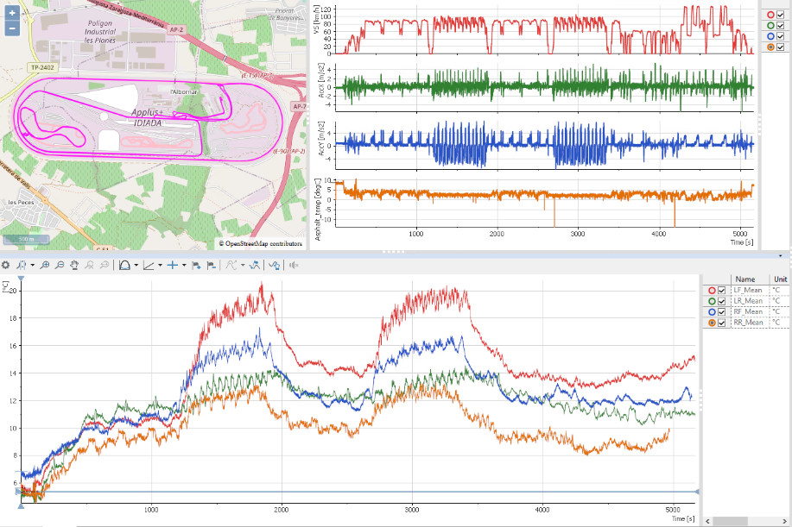
Possible testing methods
LABORATORY
IN-VEHICLE ACCELERATED
ON TEST TRACK
➔ Not retained
(correlation not proven)
IN-VEHICLE REAL LIFE

Slide 5
Task Force on Tyre Abrasion: work progress 1/2
Work on test methods | Description of the different test methods (study or proposals) on tyre abrasion for the correlation and validation workplan in 2023 Vehicle method: Scope Comments IDIADA (EC funded project) C1, C2, C3 final report beg. 2023 ETRTO C1 tests ongoing (2023) ETRTO C2, C3 at a later stage ADAC C1 finished OICA (tyre wear ≠ abrasion) C1 finished (could restart) UTQG (tyre mileage ≠ abrasion) C1 Uniform Tire Quality Grading standard (USA) Accelerated Vehicle method: IDIADA (EC funded project) C1, C2, C3 ongoing (end of Sept 22) Drum method: JASIC C1 ongoing (2023) JASIC C2, C3 at a later stage
Activity scope precision | Definition of durability shall be understood as mileage until the end of life

Slide 6
Task Force on Tyre Abrasion: work progress 2/2
Work on the 2023 test campaign | Definition of the validation and correlation test campaign for 2023: ongoing for C1 Test conditions and methods Tyres selections (candidate and “reference” tyres) For vehicle test: assess cold and warm conditions

Slide 7
Task Force on Tyre Abrasion: next
Next steps | Finalise the methods description and launch the validation and correlation test campaign (8 test centres identified: 5 on-road, 4 drum – TBC) Draft the proposal of method for GRPE review (Jan 24) and GRBP adoption (Feb 24) Once the method(s) is validated and finalised Perform the market review (end of 2023 – 2024 - TBC) Define and introduce reference tyre(s) for abrasion test in ASTM standard Set the limits for abrasion Work on rating and definition (calculation?) of the mileage of tyres Evaluate and adapt or propose method(s) and rating to C2 and C3 tyres

