Slide 1
Informal document GRBP-77-28
Research on Measurement Methods for
HDV in Multiple Driving Mode Conditions
- CATC Data Study and Measurement Methods Research -
7-10th February 2023, GRBP 77th Session
Dongming XIE¹, Yanning CHANG¹, Yu LIU¹, Xi HU¹, Jiewei LIN², Yue WANG³
1. China Automotive Technology and Research Center Co., Ltd., 2. Tianjin University, 3. Beiqi Foton Motor Co., Ltd.
China Automotive Technology and Research Center Co., Ltd.
1
Notes:
1

Slide 2
Review
June, 2020, China introduced “Measurement Methods for Noise Emitted by Light-duty Vehicles in Multiple Driving Mode Conditions” in the 16th ASEP IWG meeting.
August, 2021, the project GB/T “Measurement Methods for Noise Emitted by Heavy-duty Vehicles in Multiple Driving Mode Conditions” launched.
October, 2021, GB/T 40578-2021 “Measurement Methods for Noise Emitted by Light-duty Vehicles in Multiple Driving Mode Conditions” published.
September, 2022, HDV working condition survey conducted for the measurement methods based on CATC data.
January, 2023, GB/T “Measurement Methods for Noise Emitted by Heavy-duty Vehicles in Multiple Driving Mode Conditions” began soliciting public opinion.
2

Slide 3
GB/T 40578-2021 for LDV
Acceleration noise
cruise noise
Cruise noise
Test speeds (km/h) | V_{PP'}=30±1 | V_{PP'}=50±1 | V_{PP'}=70±2
Engine speeds (r/min) | n_{BB'}=Idle to 80%S
Acceleration (m/s²) | 0.5≤a_{test}≤3.5 | 0.5≤a_{test}≤3.0 | 0.3≤a_{test}≤2.5
Test Gears | (1+X/2)/2+1 | (1+X/2) | (X+X/2)/2+1
 | D for unlockable
Accelerator Position | POT or WOT (Both are possible)
Noise Tested | L_{max} per run for left side and right side separately
No. of Runs* | 2
Intermediate Result | Average of per side
Final result | Higher one of averages
*M₁ (PMR≥90 kW/t), 2 runs can be added at different acceleration.
Test speeds (km/h) | V_{PP'}=80±2 | V_{PP’}=110±2 for M₁ V_{PP’}=90±2 for others
Engine speeds (r/min) | n_{BB'}=Idle to 80%S
Acceleration (m/s²) | a_{test}≤0.15
Test Gears | Highest lockable gear or D for unlockable
Accelerator Position | POT (Cruise)
Noise Tested (dB(A)) | L_{max} per run for left side and right side separately
No. of Runs | 2
Intermediate Result | Average of per side
Final result | Higher one of averages
3

Slide 4
Data Survey for HDV
Established a fleet composed of 76 heavy-duty vehicles, covering typical vehicle types, vocations and cities all over China.
Collected 1hz real-time data including vehicle speed, engine speed and other parameters by free driving operation.
Collected about 1.5 million kilometers’ real-road data by 3-6 months of stable driving.
 | Bus | Coach | Heavy Truck | Light Truck | Dumper | Tractor
Fleet Size | 13 | 12 | 15 | 12 | 10 | 14
Distance (10000 km) | 43.74 | 28.14 | 23.22 | 13.23 | 13.46 | 29.63
City | 16 cities
Vocation | Intercity Long Haul, Local Delivery, City Construction, Passenger Transportion…
Based on collected data, determine typical scenes that are prone to generate noise. Establish corresponding test projects in the standard system.
Based on scene information, calculate statistical characteristics to design specific test methods and conditions.
4

Slide 5
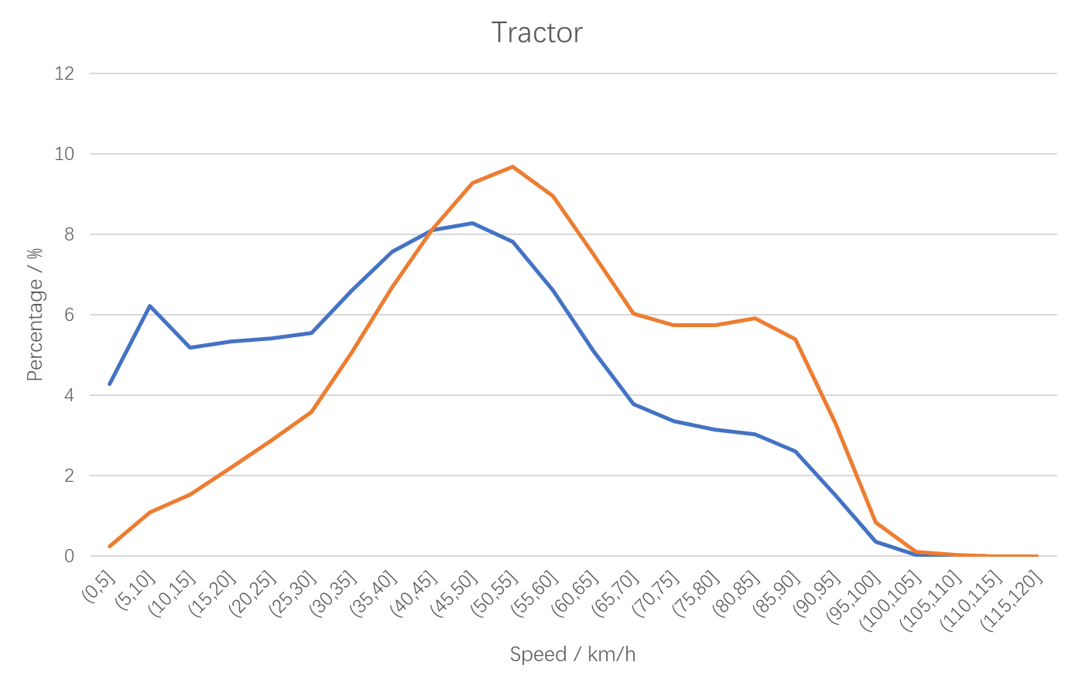
Data Survey for HDV (Speed & Engine Speed)
Engine Speed ( Rated：1900rpm）
Percentile （Time） | 50% | 80% | 90% | 95% | 99%
50 | 1142 | 1300 | 1355 | 1397 | 1470
Percentage | 60.1% | 68.4% | 71.3% | 73.5% | 77.4%
80 | 1519 | 1575 | 1615 | 1637 | 1683
Percent | 79.9% | 82.9% | 85.0% | 86.2% | 88.6%
Acceleration Percentile(m/s2)
50 | 0.14 | 0.25 | 0.33 | 0.42 | 0.61
80 | 0.08 | 0.14 | 0.19 | 0.25 | 0.44
Distributions: Blue-time, orange-distance.
The test methods here are quite different from current test methods.
The methods are designed firstly by speed range and then other parameters are considered.
5

Slide 6
GB/T “Measurement Methods for Noise Emitted by Heavy-duty Vehicles in Multiple Driving Mode Conditions”
Vehicle Type | Testing Driving Mode Conditions
 | Starting | Low-Speed Acceleration | Mid-Speed Cruise | High-Speed Cruise
Tractor | √ | √ | √ | √
Dumper | √ | √ | √ | ——
Truck | √ | √ | √ | √
Bus | √ | √ | √ | ——
Coach | √ | √ | √ | √
1. Dumpers and Buses do not take the High-Speed Cruise test. 2.“√”: the test is required，“——” the test is not required.
6

Slide 7
GB/T “Measurement Methods for Noise Emitted by Heavy-duty Vehicles in Multiple Driving Mode Conditions”
Starting condition test L_{start}
Start the vehicle, wait for the engine speed or power system to stabilize, measure the maximum "A" weighted sound pressure level (Unloading sudden noise of compressed air system is not included).
Low-speed acceleration test L_{low acc}
v_{test}: 30 km/h ±2km/h, n_{test}≤90％S
Gear selection (if possible): can be accelerated steadily, within the v_{test} range and n_{test} range, n_{test} as high as possible.
Mid-Speed Cruise
test L_{med cru}
v_{test}: 50 km/h ±2km/h, n_{test}≤80％S*
Gear selection (if possible): can be accelerated steadily, within the v_{test} range and n_{test} range, Gear as high as possible.
High-Speed Cruise
test L_{high cru}
V_{test}: 80 km/h ±2km/h, n_{test}≤80％S*
Gear selection (if possible): can be accelerated steadily, within the v_{test} range and n_{test} range, Gear as high as possible.
* If it is limited by the maximum speed, acceleration performance of the test vehicle and measurement site, the test target speed can be adjusted appropriately and noted in the test report.
7

Slide 8
GB/T “Measurement Methods for Noise Emitted by Heavy-duty Vehicles in Multiple Driving Mode Conditions”
Vehicle Type |  | Weighting coefficient k_{i}*
 |  | Starting weighting coefficient k_{start} | Low speed acceleration weighting coefficient k_{low acc} | Mid-speed cruise weighting coefficient k_{med cru} | High-speed cruise weighting coefficient k_{high cru}
Speed Range (km/h) |  | 0-10 | 10-35 | 35-60 | 60+
Tractor |  | 18.2% | 20.3% | 14.9% | 46.6%
Dumper |  | 36.2% | 34.6% | 29.2% | --
Truck | （GVW≤5 500 kg） | 26.3% | 29.7% | 23.3% | 20.7%
 | （GVW＞5 500 kg） | 26.6% | 26.7% | 26.8% | 19.9%
Bus |  | 44.9% | 44.0% | 11.1% | --
Coach |  | 28.8% | 21.0% | 22.0% | 28.2%
* Derived from the time accumulation survey results.
8

Slide 9
GB/T “Measurement Methods for Noise Emitted by Heavy-duty Vehicles in Multiple Driving Mode Conditions”
$${\text{L}}_{\text{mul} \text{mod}}\text{=10}\text{∙}\text{lg}\left[\sum_{\text{i}\text{=1}}^{\text{4}}{{\text{k}}_{\text{i}}\text{∙}{\text{10}}^{\left(\text{0.1}\text{Li}\right)}}\right]$$
i : driving mode conditions number（i =1, 2, 3, 4）
k_{i} : weighting factors k_{start}, k_{low acc}, k_{med cru}, k_{high cru}
L_{i}: noise result L_{start} , L_{low acc} , L_{med cru} , L_{high cru}
9

Slide 10
Conclusions
GB/T “Measurement Methods for Noise Emitted by Heavy-duty Vehicles in Multiple Driving Mode Conditions” is soliciting public opinion.
30 km/h±2km/h, 50 km/h±2km/h, 80 km/h±2km/h are three typical speed ranges.
Starting, low-speed acceleration, mid-speed cruise, high-speed cruise testing are with different target vehicle speed, engine speed and gears.
A consolidate noise result was calculated according to the time accumulation, reflecting the real influence of HDVs.
10

Slide 11
Thanks for your attention!
China Automotive Technology and Research Center Co., Ltd..
11

