Slide 1
HLG MOS Flexibility and Adaptability
HLG MOS Workshop
November 24, 2015
The Hague
Pádraig Dalton

Slide 2
What am I going to talk about?
Environmental context
Creating an innovative environment
Achievements
What’s next
Challenges
Changing nature of collaboration in some domains

Slide 3
Environmental context
Increased user demand
Emergence of global user
Digital age – technology, sources, strategic alliances?
Skills: Re-profiling, outsource?
Data sources evolving
Politicisation – crisis, targets and indicators – real or perceived
Regulation & scrutiny – changing the nature of relationships?

Slide 4
Creating an innovation friendly environment
Flexibility and adaptability
Collaboration of the willing – we are here because we want to be here – we are open
Focus on the art of the possible
We take a partnership approach
We have a social conscience - nobody gets left behind – we create road-maps

Slide 5
Statistical Modernization Community
Four main principles:
Openness
Flexibility
Participation
Pragmatism
A vision for an aligned and collaboratively led community
Allows all of us to benefit from collaboration and sharing
Notes:
Vision
An active community allows statistical organisations to contribute towards achieving a shared goal. Individual organisations retain control over the nature of their own contributions with the support of a global community to create a robust and scalable business driven statistical production platform.
The role of HLG is to provide stewardship and to assist in steering the community to deliver on the shared goal in an efficient manner which recognises the right of individual organisations to determine their own contributions based on their own priorities. HLG are the holders of the vision and they are influential supporters of the work done to help realise this goal.

Slide 6
Modernisation activities: Practical example
Shift from primary data collection to increased usage of secondary data sources
Continued evolution from product based to process based organisational structures
Embedding process based models aligned to the GSBPM and GAMSO
Increased usage of visualisation tools across the GSBPM
Recruiting resources with new skill sets
Developing a CSPA compatible architecture

Slide 7
Customers
Strategy & leadership
Statistical Processing
Quality Management Framework
Specify needs
Design
Build
Collect
Process
Analyse
Disseminate
Evaluate
Business Support & Capability Building
Corporate Support
Finance
Coordination & Irish Statistical System wide support
Methodology
Quality Framework Management unit
HR
Marketing
Administrative Data Centre
IT
Transformation & Performance
Office services
Communications
Procurement
Data Office
Dissemination
Legal
LDU
Typesetting
Printing

Slide 8
Sharing in the Community
Extending our existing sharing practices to the next level
Heads of organizations agree in principle to sharing and collaborating in the community
Organizations contribute as much as they can, in what form they can (capability, funding, etc.)
Notes:
The statistical community already shares a lot. CSPA for example is merely taking this sharing to the next level, and to allow us to continue to benefit from sharing.
A Statement of Intent will set out the agencies commitment to issues such as CSPA and to sharing and to global solutions. Formalisation of our commitment:
Defines expected behaviour
Helps drive change through our organisations

Slide 9
What have we been doing?
Generic skills profile for data scientists
Papers on
“Machine learning” in statistical organistions
Marketing official statistics
Intellectual property
Risk and change management
Generic Activity Model for Statistical Organisations (GAMSO)

Slide 10
GAMSO
Released in March 2015

Slide 11
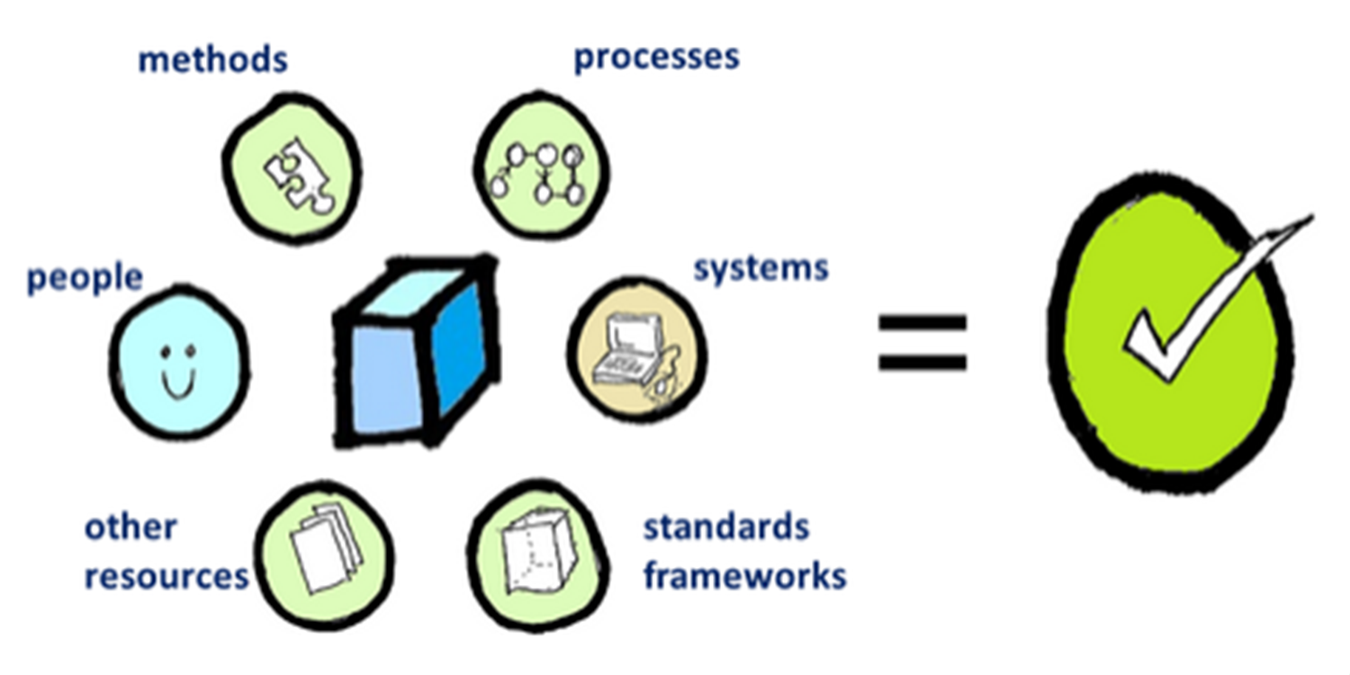
Capabilities
Combination of organisation, people, processes, methodology, standards and technology

Slide 12
The Sandbox
New subscription model
€10,000 per organisation per year
Non-profit
Managed by subscribers
Not just for Big Data
Open for all statistical collaboration that needs a shared computing environment

Slide 13
GSDEMs
Generic Statistical Data Editing Models
Standard models, language and definitions for statistical data editing
Process flow models based on process steps and process controls

Slide 14
So what’s next?
That’s what we are here to decide this week
Need balance between continuity and new initiatives
Need balance between evolution and revolution

Slide 15
Some modernisation activities - Evolution
Standards based modernisation:
GSBPM
GAMSO
SDMX
DDI
Plug & Play - CSPA
Big Data – Sandbox, privacy, partnership
Branding
Identification of new skill sets

Slide 16
Modernisation - Technology - Revolution
Proliferation of mobile technology
Web services
Web scraping
Visualisation

Slide 17
Modernisation – What is next
Greater focus on the potential of mobile technology
Opportunities associated with artificial intelligence
Marketing of HLG work and products
Coherent and consistent modernisation standards
CSPA – next phase
Big Data – next phase
People related initiatives – skills – next phase

Slide 18
Modernisation Challenges
Busy playing field – a lot of actors
Data sources - access, technology, skill-sets, quality, partnerships
Privacy & Data Protection
Availability of skill sets
Leadership
Communications – one voice
Developing a navigable road-map
Suffocation!!!!
Politicisation – indicators – moving closer to decision makers
Changing nature of collaboration

Slide 19
Conclusions
Innovation environment
Staying flexible and adaptable
Collaboration – our model works (?)
Coordination
Communication
Its all about people!!

