Slide 1
Submitted by the expert from the European Association of Automotive Suppliers (CLEPA)
Informal document GRVA-15-49
15th GRVA, 23-27 January 2023
Agenda item 8(b)
Status report Electro Mechanical Brakes
(UN Regulation No. 13)

Slide 2
Purpose and scope
Electric transmission:
Current regulation only addresses electric control transmission
The purpose of the EMB amendment is to address electric energy transmission in the regulation
In a first step, the scope is limited to EMB on the motor vehicle; the trailer remains as today

Slide 3
Main challenges
Same safety level as with current technologies
Account for new technology, while avoiding design restrictions
Keep the requirements performance-oriented
Avoid unwanted side-effects on existing regulation
Keep R13 and R13H definitions and principles aligned
Some technical/regulatory challenges:
Effect of ageing and temperature on the performance of the electrical energy reserves
Ensure a minimum performance level at the time warnings are displayed to the driver

Slide 4
Layouts (examples)
Pneumatic braking
Air tank FA
ICE
Compressor
Governor, air dryer...
Non-return valves
Air tank RA
Energy source
Energy supply
Energy reserve
EMB
Energy reserve FA
ICE
Generator
Energy reserve RA
Energy source
Energy supply

Slide 5
Layouts (examples)
Pneumatic braking
Air tank FA
Traction battery
Electric Compressor
Governor, air dryer...
Non-return valves
Equivalent to the fuel tank
Air tank RA
Energy source
Energy supply
Energy reserve
EMB
Energy reserve FA
Traction battery
DC/DC
Energy reserve RA
Energy supply

Slide 6
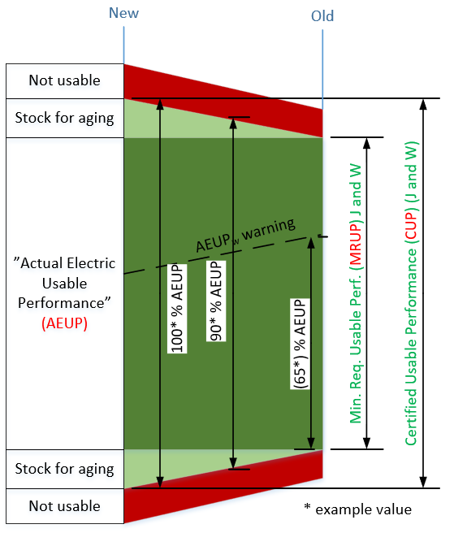
Electrical Energy Storage device
Addressing the effect of ageing
New definitions:
“Certified Usable Performance (CUP)” means the maximum usable performance of an electrical energy storage device available for an electro-mechanical braking system determined at the time of type approval.
“Minimum Required Usable Performance (MRUP)” means the minimum usable performance of an electrical energy storage device available for an electro-mechanical braking system to fulfil the relevant requirements of this Regulation.
“Actual Electric Usable Performance (AEUP)” is the level of energy stored in an electrical energy storage device, as well as its available power, at a given time. It is defined as a percentage of the CUP value.
New proposal
The “usable performance” means the portion of the performance of an electrical energy storage device that is actually available to the supplied system (e.g. the system may not use the maximum theoretical performance).

Slide 7
Status of the work / Next steps
Finalize the still open topics during winter and spring:
Review of the different concepts, e.g.
to create new definitions of energy source, energy supply and energy reserves
How to deal with the effect of ageing and temperature on the performance
Warning to driver
Freeze the concepts
Review and simplify the draft text accordingly
Prepare for an informal document to be presented at 16th GRVA in May.
Present a formal document to 17th GRVA in September.

Slide 8
Organization
Weekly meetings since February 2022 with Industry Group representatives.
Open meetings every two weeks (on Thursdays 16.00-17.30 CET)
Interested stakeholders are welcome to participate
Contact CLEPA to join

Slide 9
Backup slides

Slide 10
UN R13 and Electro Mechanical Brakes (EMB) Introduction and recap
UN Regulation 13 defines:
Transmission means the combination of components comprised between the control and the brake and linking them functionally. The transmission may be mechanical, hydraulic, pneumatic, electric or mixed.
Control Transmission - means the combination of the components of the transmission which control the operation of the brakes, including the control function and the necessary reserve(s) of energy.
Energy Transmission - means the combination of the components which supply to the brakes the necessary energy for their function, including the reserve(s) of energy necessary for the operation of the brakes.
→ The transmission may be mechanical, hydraulic, pneumatic, electric or mixed.
UN R13 was updated in 1990s to account for an electronic “Control Transmission” but still assumes Pneumatic “Energy Transmission” in the service braking system.
Pneumatic Energy limitation is shown in two ways: Design Specifications – E.g. Where limits are in kPa. Design Limitations – E.g. Where it is assumed air is the medium.
Electro Mechanical Brake Technology is being developed by the industry using Electric Energy Transmission in the service braking system and the UN R13 needs to be updated accordingly.

Slide 11
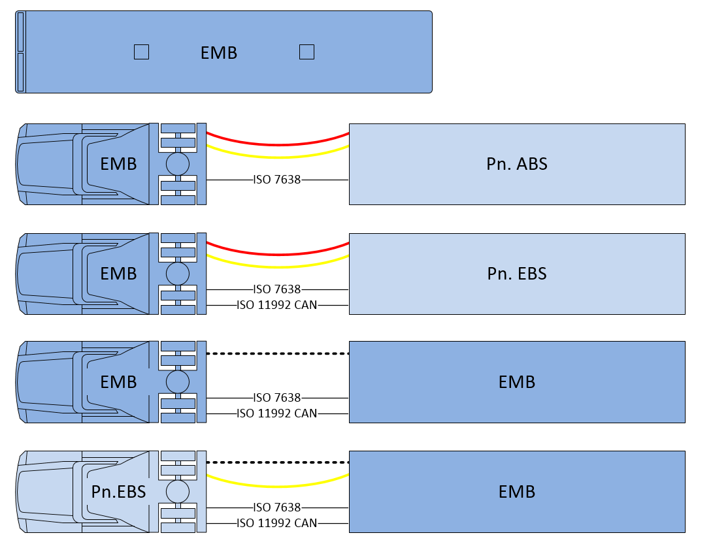
UN R13 and Electro Mechanical Brakes (EMB) Amendment scope and motivation
Motor vehicle with EMB brakes on all axles (not mixed with Pneumatic Or Hydraulic systems)
Motor vehicle with EMB brakes with “conventional” trailer interface according to current UN R13
Trailers with EMB excluded from scope
UN R13-H not included but considered, in particular when creating new definitions
Advantages and possibilities by amending Electric Energy Transmission to UN R13
Improved energy efficiency in EV´s (vs. air compressor)
Improved braking control
Elimination of noise emissions from pneumatics

Slide 12
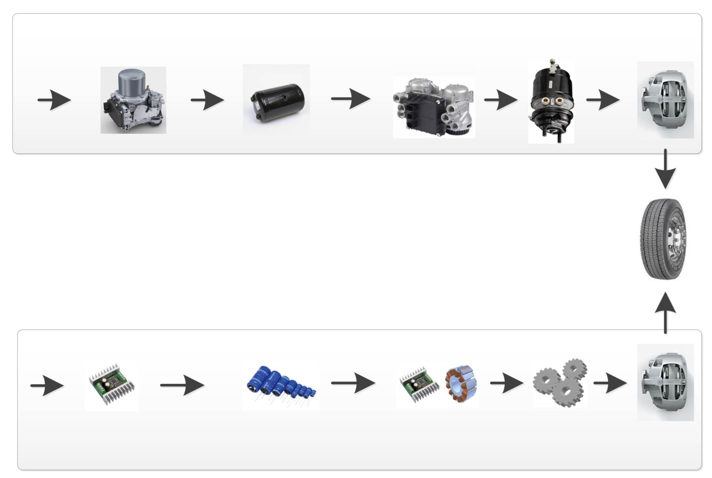
UN R13 and Electro Mechanical Brakes (EMB) Energy Transmission principles (Pneumatic vs. Electric)
E-APU
Pneumatic energy
storage
EBS Modulator
Actuator
Caliper
Pneumatic
Energy
EBS
Annex 7 part A
Energy supply
Energy storage
Actuation
EMB
Annex 7 new part D
New 5.2.1.35.
Electric
Energy
DC/DC
Electric energy storage
Drive and Motor
Gears
Caliper
12

