Slide 1
Submitted by the expert from Italy
Informal document GRVA-15-48 15th GRVA, 23-27 January 2023 Agenda item 10
Proposal for amendments to UN Regulation No. 90
15th GRVA, 23-27 January 2023
GRVA-15-14 (unece.org)

Slide 2
Proposal for amendments to UN Regulation No. 90 – par. 6.1.1 and 6.1.2 (1/3)
Paragraph 6.1.1, amend. to read
“Replacement brake lining assemblies or replacement drum brake linings conforming to a type approved in accordance with this Regulation shall be marketed in axle sets. In case of category L vehicles, they may be marketed in caliper sets and/or drum sets.”
Paragraph 6.1.12, amend. to read
“Each axle, caliper and drum set shall be contained in a sealed package constructed to show previous opening.”
Justification
In case of category L vehicles application, the same brake lining assemblies could be fitted for a various wide of different applications. For example, the same brake pads/shoes could be fitted both on vehicle with single disc and on vehicle with double discs; moreover, the same brake pads/shoes could be fitted both on front application and on rear application vehicle. Since there are too many cases or variables and it’s impossible to have a package for axle set for category L vehicles: the proposal of amendment is meant to consider the caliper set/drum set, instead of the axle set.
Example
The following example is taken basing on catalogue of brake lining (pads) of SBS Friction: 2023-24 SBS EWW BRAKE PADS EN_FR.pdf (flippingbook.com)
Considering the brake pads 900HS, it is possible to see that the same brake pads (with the same compound HS) could be fitted in some different applications. In the right figure, it is possible to see that it can be fitted both on front axle of Ducati Scrambler Street Classic 803 and on front axle of Ducati Supersport 950.
But in these 2 different vehicles the number of total brake pads requested is different:
Scrambler 803: in front axle, this vehicle has only 1 disc.
Supersport 950: in front axle, these vehicle has 2 discs.
The symbol “*” in the catalogue means that 2 sets are required for that specific application.
Following the current regulation, it means that the same brake lining assemblies shall be marketed in 2 different ways, one for front disc vehicles and another one different for double disc vehicles.
This example could be done for a lot of others brake pads and compounds considering the many various wide of configuration and possibility available and it’s not feasible in logistic point of view.
This variability is not present in cars, in fact for those the axle set is defined and unique.
Instead, with caliper and drum set the number of brake lining assemblies inside the packaging is always the same for both situations (1 disc and 2 discs).

Slide 3
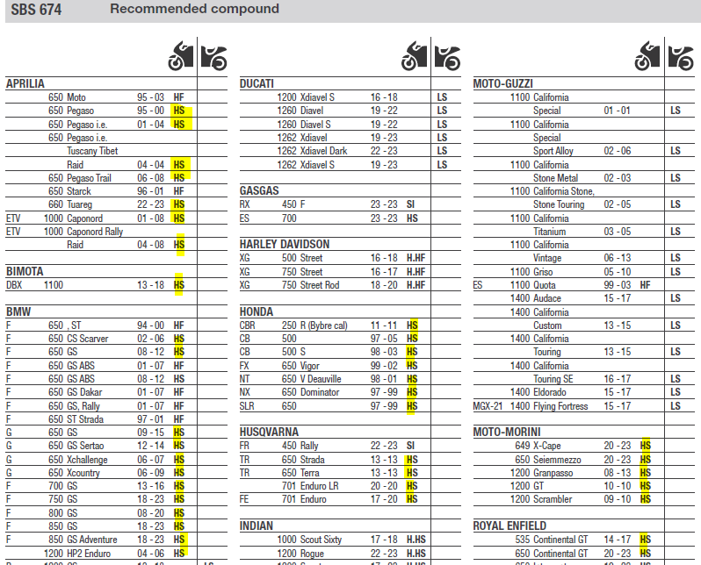
Proposal for amendments to UN Regulation No. 90 – par. 6.1.3.4 (2/3)
Paragraph 6.1.3.4, amend. to read
The vehicles/axles/brakes for which the contents are approved. It is allowed to provide this information through digital format (e.g. QR code, internet website) leading at least to a general application catalogue.”
Justification
Packaging of brake pads/drums has a limited dimension and it’s impossible to report in the packaging all applications approved, because there is no space available.
In addition, should all applications approved be reported in the packaging, the updating of each packaging every time there is a new application available in the market would be
needed. This is not feasible, and it represents a risk to have a product with no updated information for the final consumer. For these reasons, the proposal of amendment is aimed at allowing, as option, to report the approved vehicles/brakes/axle information through digital format (e.g. QR code, website) leading at least to a general catalogue.
Moreover, using digital elements, it’s also possible to have a green solution and having a less environmental impact. The modification proposal is optional, and not exclusively for category L vehicles, but it is meant for every type of motor vehicles even if the major criticalities are with category L vehicles because their packaging is smaller than brake pads/drums of passenger car.
Example
The following example is taken basing on catalogue of brake lining (pads) of SBS Friction: 2023-24 SBS EWW BRAKE PADS EN_FR.pdf (flippingbook.com)
Considering as example the brake pads 674HS, in its packaging a lot of applications has to be reported.
In the screenshot on the right, there is a partial list (not exhaustive of all applicatons), but it’s already possible to count about 30 applications.
Generally, the packaging itself is standard for almost all brake linings family (e.g. street brake pads, scooter brake pads, etc…) and in the packaging are reported some general information such as warranty, general safety statement, environmental marking and so on; therefore the information about applications and others requested by UNECE R90 are reported in a label applied in the packaging. This because a label could be customized with the specific information to be reported (specific approval code, specific part number, etc…).
Dimensions of label of brake pads for L vehicle is limited and it’s not feasible to report all application requested (e.g. Brembo label size 60x40mm, SBS label: size 105x48mm).
Lastly, also dimension of packaging itself is small, and it reflects the brake lining assembly dimension for L vehicles.

Slide 4
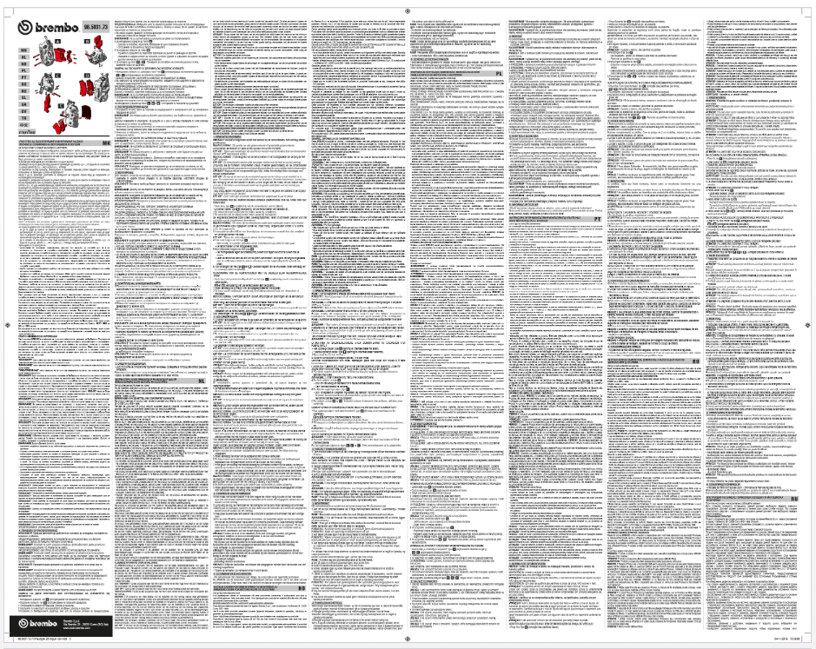
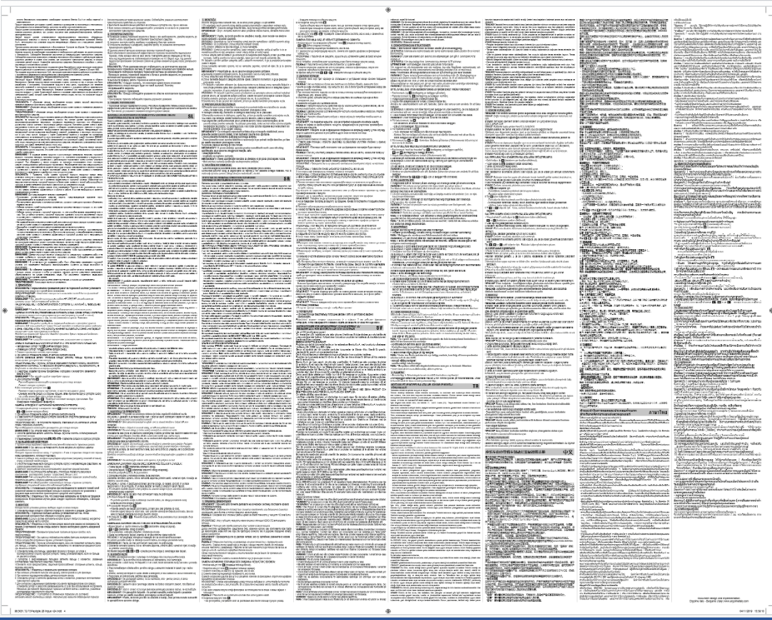
Proposal for amendments to UN Regulation No. 90 – par. 6.1.4 (3/3)
Paragraph 6.1.4, amend. to read
Each package shall contain fitting instructions in an official ECE language, supplemented by the corresponding text in the language of the country where it is sold. It is allowed to provide these fitting instructions also through digital format only (e.g. QR code, internet website).”
Justification
The current requirement asks to have fitting instructions inside the packaging with at least an ECE language supplemented by the corresponding text of the language of the country where the product is sold. It means two options: To have a specific fitting instruction for each country where the component is sold; or To have a unique fitting instruction with all languages. Option 1 is not feasible from management and logistic point of view. Option 2 is not feasible because there is limit space available in the packaging: for example, to be sold in EU (that recognize UNECE R90), it's needed to have all official 24 languages of EU in a unique fitting instruction paper but there are applications where the packaging is too small to contain the fitting instruction paper. For these reasons, the proposal of modification asks the possibility to have these fitting instructions also through digital format only (e.g. QR code, internet website, ...). Moreover, using digital elements/formats, it's possible to reduce the environmental impact because the instructions become paperless. The modification proposal is optional, and not exclusively for category L vehicles but it is meant for every type of motor vehicles: even if the major criticalities are with category L vehicles because their packaging is smaller than brake pads/drums of passenger cars.
Example
Below an example of paper fitting instruction to be reported with almost all languages (as reported above, only for EU it’s needed to have 24 languages): minimum space available with a lot of information in a minimum size of text font. The reason is because it’s needed to have a fitting instruction inside the small packaging of L motorcycle brake lining assemblies (as also said and stated in slide 2 of this presentation).
Instead, an example of online fitting instructions where the QR code leads could be the following: English (sbs.dk)
With this second option, an easier and more efficient communication mode is also provided to final end user (in terms to readable, maintenance, …).
Lastly, with an online fitting instruction is possible to report all information that final end user needs because there is no limit on space dimension.

