Slide 1
5th Session of IWG on ITS
Note by the secretariat
Informal Document GRVA-15-40
15th GRVA, 23-27 January 2023
Provisional agenda item 5(c)
Information sharing with GRVA

Slide 2
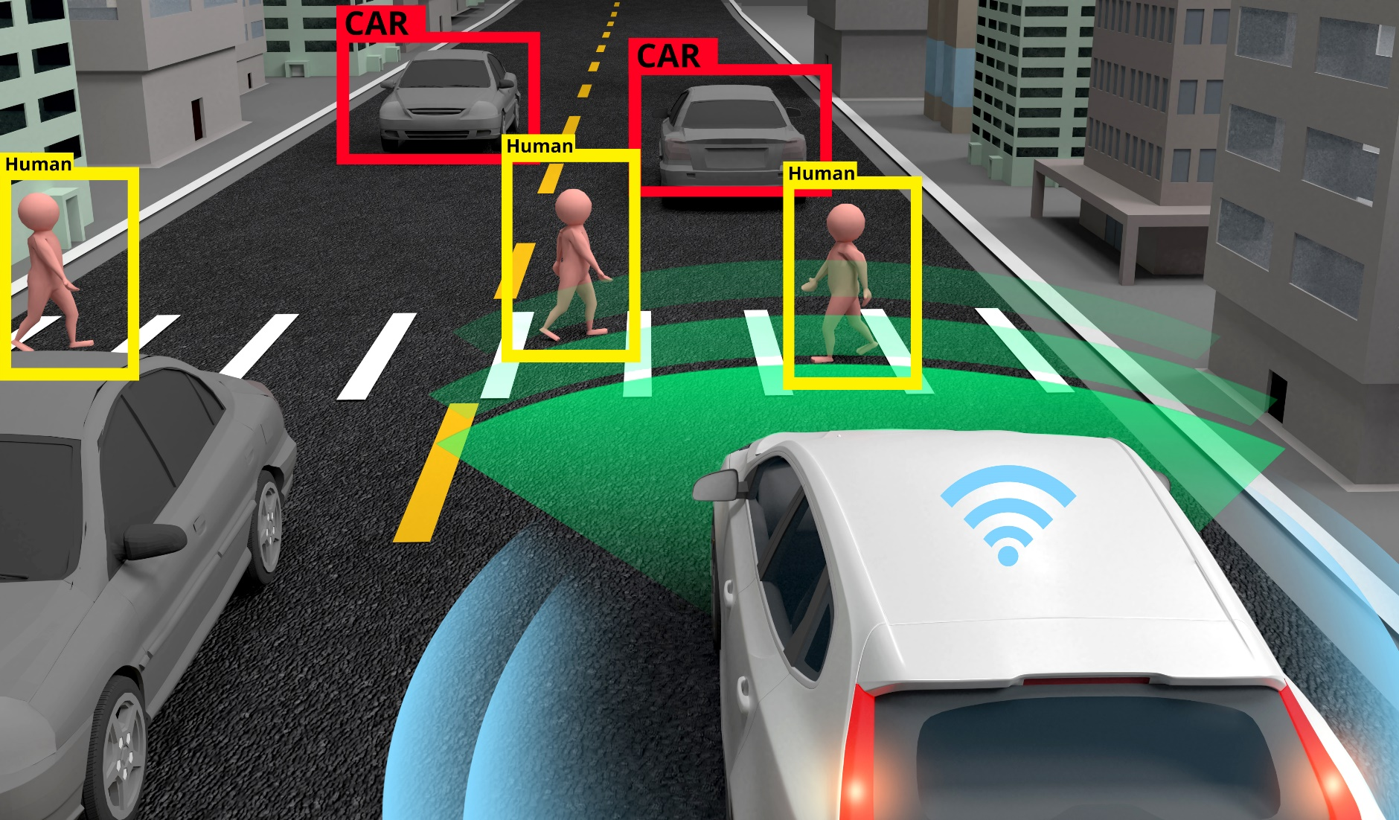
Setting the Scene
A special session of the IWG on ITS was held on 17th January 2023:
Presentation by China at the September 2022 session of GRVA
GRVA consulted AC.2 and WP.29 in November 2022
WP.29 tasked the IWG on ITS to explore the potential role of WP.29 in the field of V2V

Slide 3
Outputs of the discussion on V2V and V2X
The IWG on ITS received presentations from China, ERTICO, ITU, OICA, and SAE International
The presentations highlighted the latest trends in V2V and V2X with presenters highlighting uses cases where this technology has demonstrated benefits
They highlighted the numerous activities both directly and indirectly linked to V2V and V2X
These activities include regulations and voluntary standards at the national and regional levels

Slide 4
Suggested next steps on V2V and V2X
The discussions resulted in several stakeholders expressing their interest in internationally harmonized regulations to allow for the information sharing between vehicles to be uniformed
Other stakeholders expressed the view of an alternative approach to regulations, similar to that taken by GRVA, through the development of guidelines
Another suggestion was the creation of a dedicated IWG or Task Force for V2V discussions, this could be under the IWG on ITS, GRVA or WP.29

Slide 5
Other business of the IWG on ITS
The Future Network Car event is scheduled to take place from the 13-16 March 2023 and as usual, the IWG on ITS will be partnering with ITU for a dedicated session.
OPENING + SESSION 1: Will AI Controlled Automated Vehicles Be Safe for Road Users ?

Slide 6
Next steps
Outputs of the discussions on V2V and V2X will be reported at the March session of AC.2 and WP.29
We would also like to invite the experts of GRVA to add further inputs to these discussions to include them in our report to the session

