Slide 1
Reviewing GRVA Regulations And GTRs On Their Fitness For ADS
Transmitted by the co-chairs of the TF on FADS
Informal document GRVA-15-37 15th GRVA, 23–27 Jan 2023 Provisional agenda item 4(e)

Slide 2
Background
WP.29 manages more than 200 Regulations, GTRs and other documents concerning motor vehicles and their equipment
Regulations rely on specific technical provisions to ensure a globally harmonised framework for performance and testing
Most Regulations were drafted according to the traditional definition of a motor vehicle, which needs a human to perform the driving task

Slide 3
The redefinition of “vehicle”
No driver
No cockpit
No windscreen
No occupants
No seats
No front or back
No pedals
No steering wheel
No doors
Designed for automated driving
Similar to existing vehicles

Slide 4
Consequence on existing Regulations
Some prescriptions need to be slightly modified
Other prescriptions make no sense with automated driving
We need to consider both the text and the spirit of Regulations
UNECE R102 ­§2.2.1. “Straight line stability test”
Vehicles shall be tested at a speed of 85 +5/-0 km/h and remain aligned. During the test, it must be possible to travel along a straight section of the road without unusual steering correction by the driver.
UNECE R13 ­§5.1.2.2. “Secondary braking system”
The driver shall be able to achieve this braking action from his driving seat while keeping at least one hand on the steering control.

Slide 5
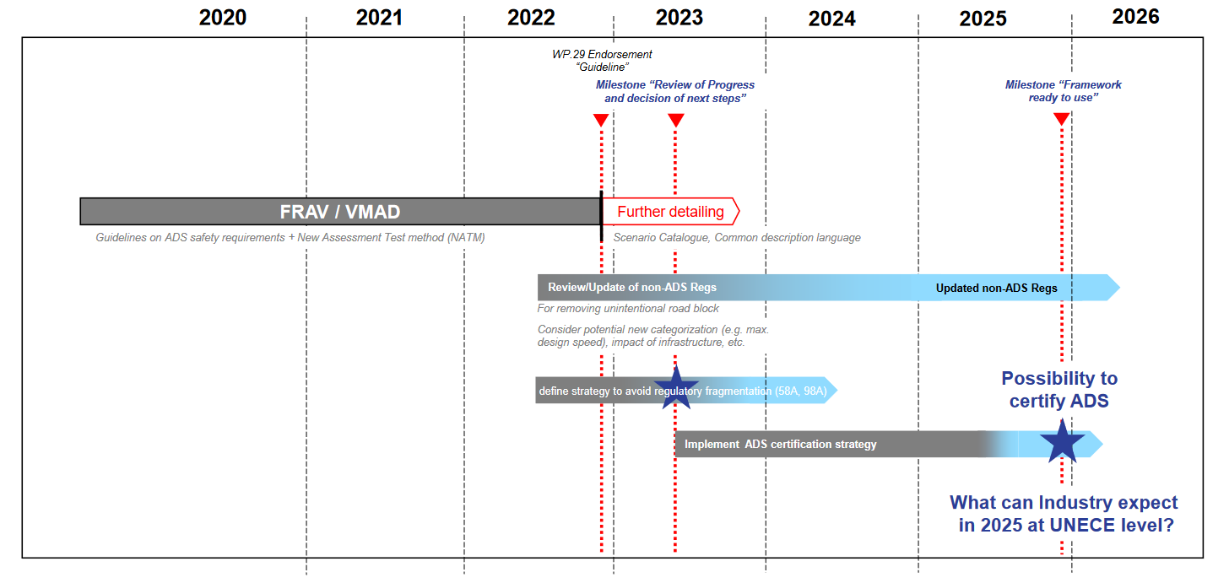
Industry timeline
GRVA-13-18 (OICA/CLEPA)

Slide 6
Mandate from WP.29
At its 186th session in March 2022, WP.29 requested all its subsidiary working parties to perform a screening of the UN Regulations and Global Technical Regulations (GTR) of relevance regarding their fitness for Automated Driving Systems (ADS) until March 2023.
At its 14th session in September 2022, GRVA gave additional guidance as to what kind of automated vehicles to consider, etc. (informal document GRVA-14-54r1)
Pending request for deadline extension until June 2023 to let each GR approve the results of their taskforce before WP29

Slide 7
FADS activities
High-level assessment of GRVA Regs & GTRs
Completed
Detailed screening of GRVA Regs & GTRs
Ongoing
Contact point for taskforces of other GRs for automated driving topics
Ongoing

Slide 8
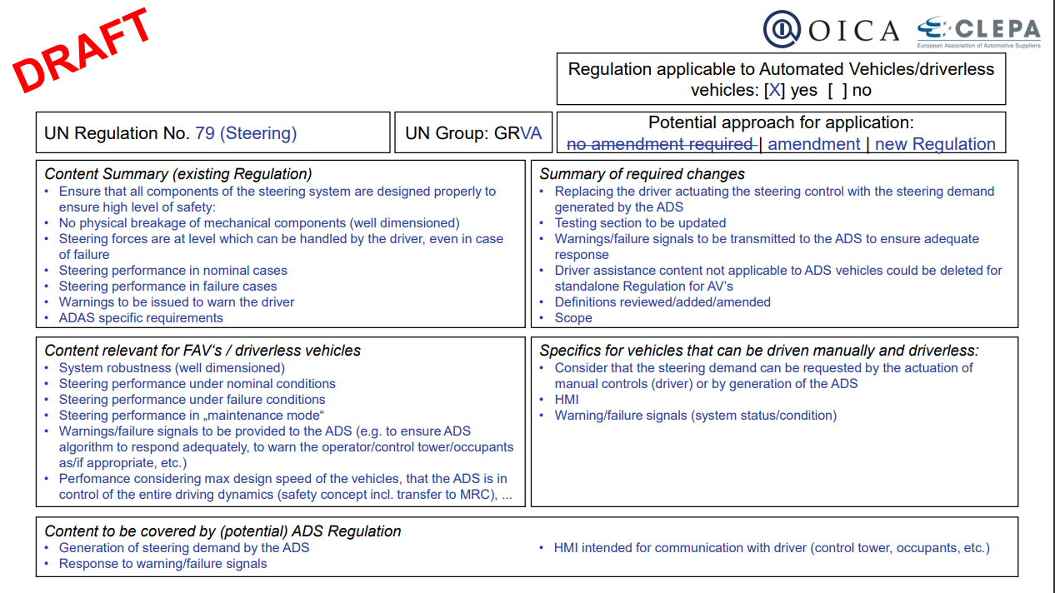
High-level assessment of GRVA Regs & GTRs
This template can both serve as a preliminary analysis of a Regulation before its detailed review, and as a final report to give a summary of the detected issues and possible options

Slide 9
High-level assessment of GRVA Regs & GTRs
R13 | To be determined by detailed screening
R13H | To be determined by detailed screening
R78 | To be determined by detailed screening
R79 | To be determined by detailed screening
R89 | To be determined by detailed screening
R90 | Applicable
R130 | Mostly not applicable
R131 | Mostly not applicable
R139 | Mostly not applicable
R140 | Mostly not applicable
R152 | Mostly not applicable
R155 | Applicable
R156 | Applicable
R157 | Not applicable
GTR3 | Not applicable
GTR8 | Mostly not applicable
Applicable = can be used for automated vehicles with minor changes
Mostly not applicable = not applicable to automated driving but relevant for dual-mode vehicles
Not applicable = not relevant for Level 4 or 5 automated vehicles
To be determined = depending on the results, either amendments or a new Regulation may be needed

Slide 10
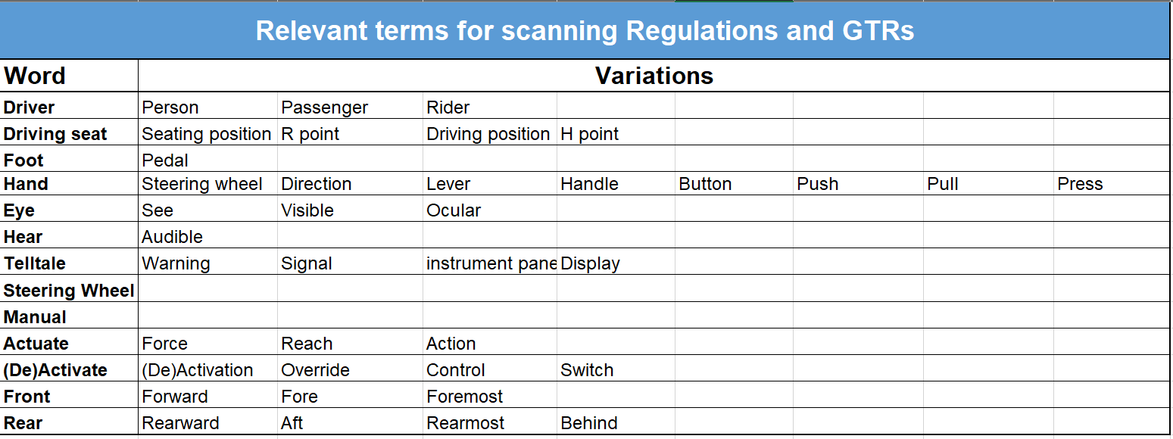
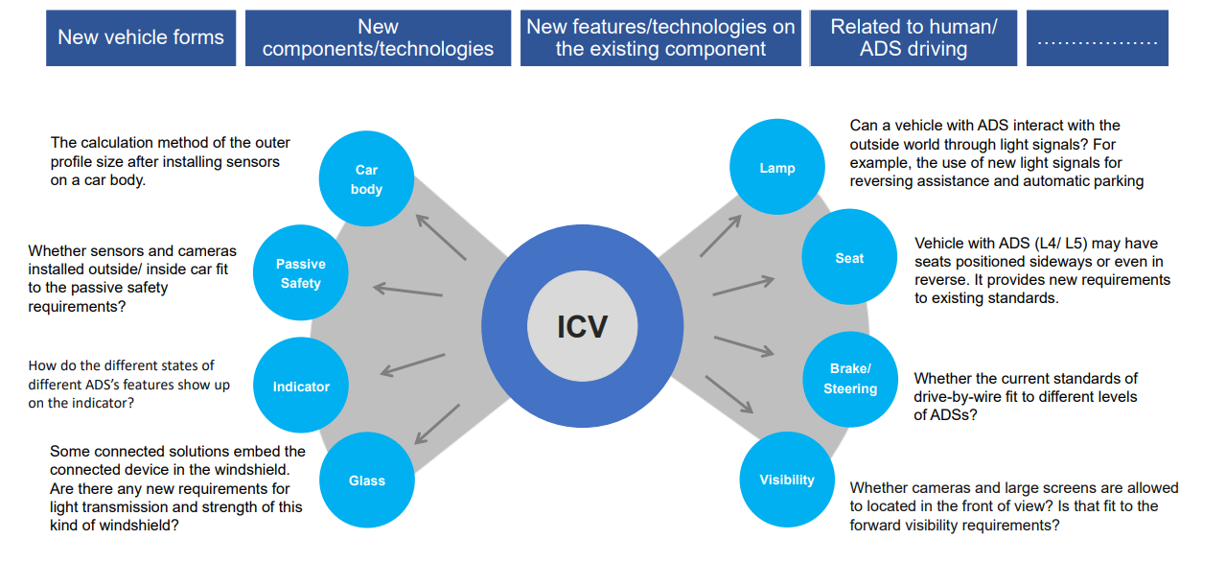
Detailed screening of GRVA Regs and GTRs
Points of interest:
Use cases: full automation, dual-mode, no occupants, etc.
Possible approaches: amending Regulations, drafting specific Regulations for automated vehicles, creating new vehicle categories, etc.
Consider both explicit and implicit concepts

Slide 11
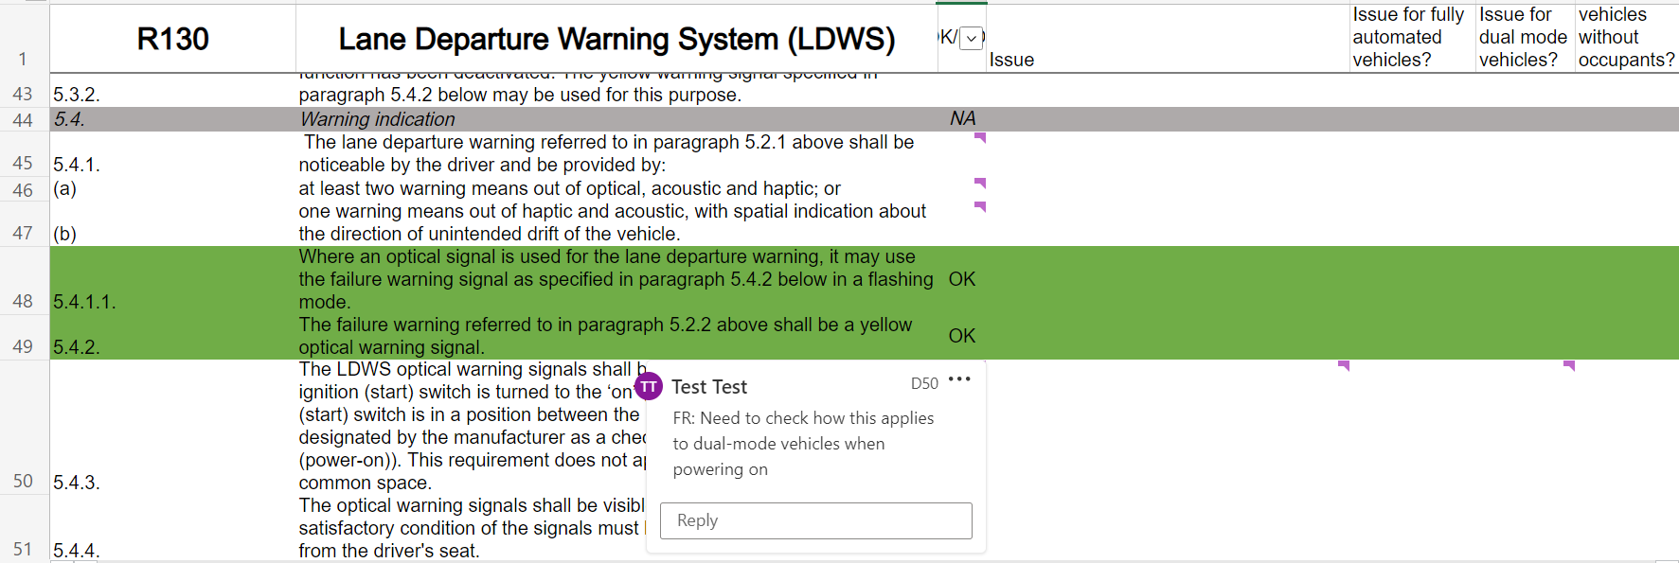
Detailed screening of GRVA Regs and GTRs
Online collaborative environment and example of a detailed review

Slide 12
Detailed screening of GRVA Regs and GTRs
Most annexes not included yet

Slide 13
Common work method across GRs
The taskforces of the different GRs have agreed to work on the same deliverables:
High-level summaries for each Regulation (cf. slide 8)
Comprehensive files for the detailed screening (cf. slide 11)
A “whitebook” for handling automated driving when drafting new Regulations
Note: The review does not include definitive solutions for changing Regulations, but taskforces may offer suggestions (amendments, new Regulations, new vehicle categories…)

Slide 14
Common work method across GRs
The GRVA taskforce has contributed by:
Providing templates
Sharing high-level open issues
Presenting the reviewing process to GRPE, EC, etc.
GRSG and GRSP have also started their detailed review

Slide 15
Timeline
Screen all prescriptions
Create list of relevant terms
High level assessment
Draft deliverables
Harmonise results between GRs
10/2022
01/2023
03/2023
05/2023
16th GRVA
06/2023
WP29
Current status at GRVA

Slide 16
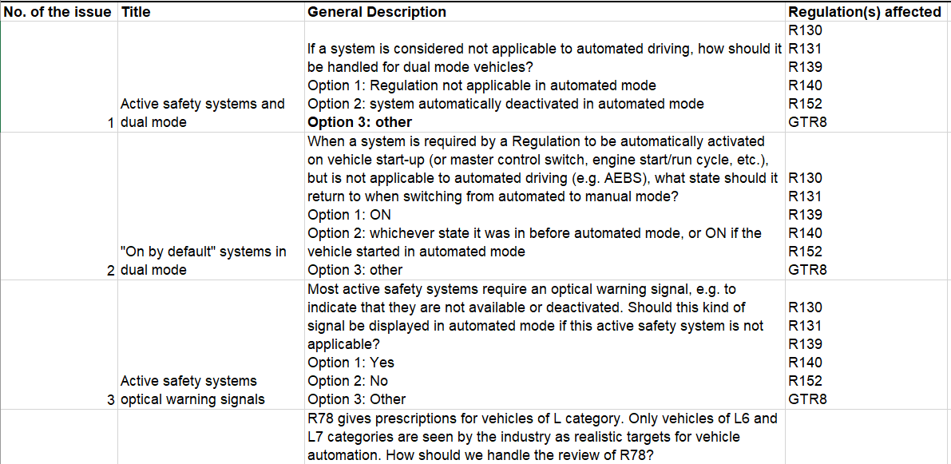
Next steps
Complete the detailed screening
Particular attention to annexes and testing
Compile open issues and share with other taskforces
Hybrid meeting planned for March 2023
+ potential meeting in China in May

Slide 17
Contact information
Co-chairs :
Romain PESSIA (FR): romain.pessia@developpement-durable.gouv.fr
Linlin ZHANG (CN): zhanglinlin@catarc.ac.cn

