Slide 1
Virtual testing method Use case application
Submitted by the expert from France
Informal document GRVA-15-20
15th GRVA, 23-27 January 2023
Provisional agenda item 7

Slide 2
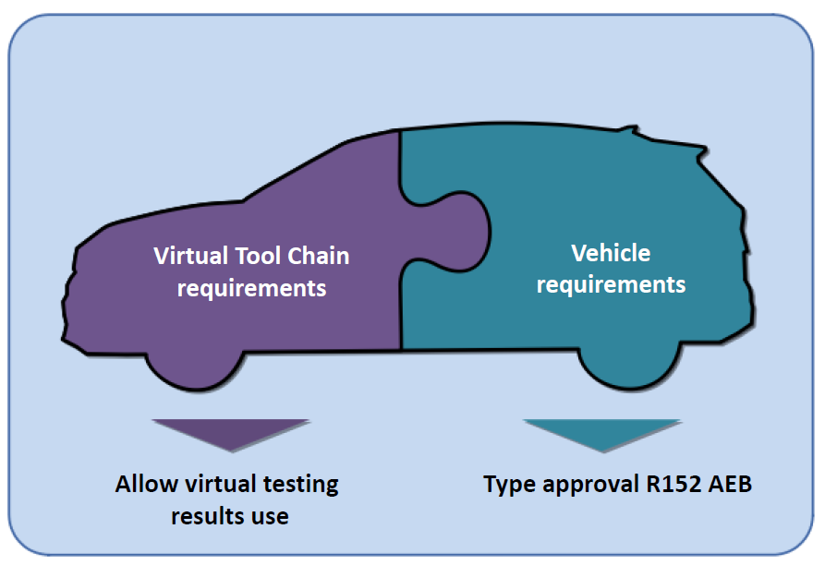
AEBS on virtual testing 2 separate assessment

Slide 3
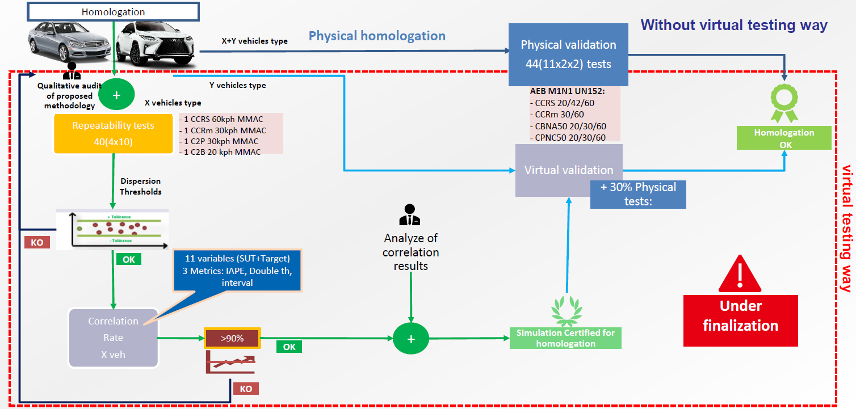
AEBS on virtual testing Global overview

Slide 4
AEBS on virtual testing 2 separate assessment

Slide 5
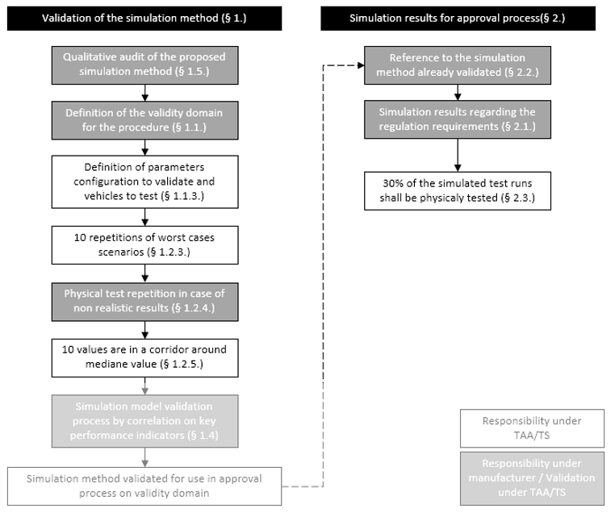
AEBS on virtual testing Example of application

Slide 6
AEBS on virtual testing #1 : validity domain
OEM defines validity domain for virtual testing with TAA/TS (example) :
Vehicle types definitions to be covered including variability having impact on AEBS (mass, braking systems, …)
Scenarios to be covered
Speed range
[…]

Slide 7
AEBS on virtual testing Example of application

Slide 8
AEBS on virtual testing Example of application

Slide 9
AEBS on virtual testing #2 : configurations selection
TAA/TS specify to test vehicle 1 and 3 to cover the requested validity domain (example) :
CCRs scenario 42kph MMAC x 10 times
CCRm scenario 30kph MMAC x 10 times
CPNC scenario 30kph MMAC x 10 times

Slide 10
AEBS on virtual testing Example of application

Slide 11
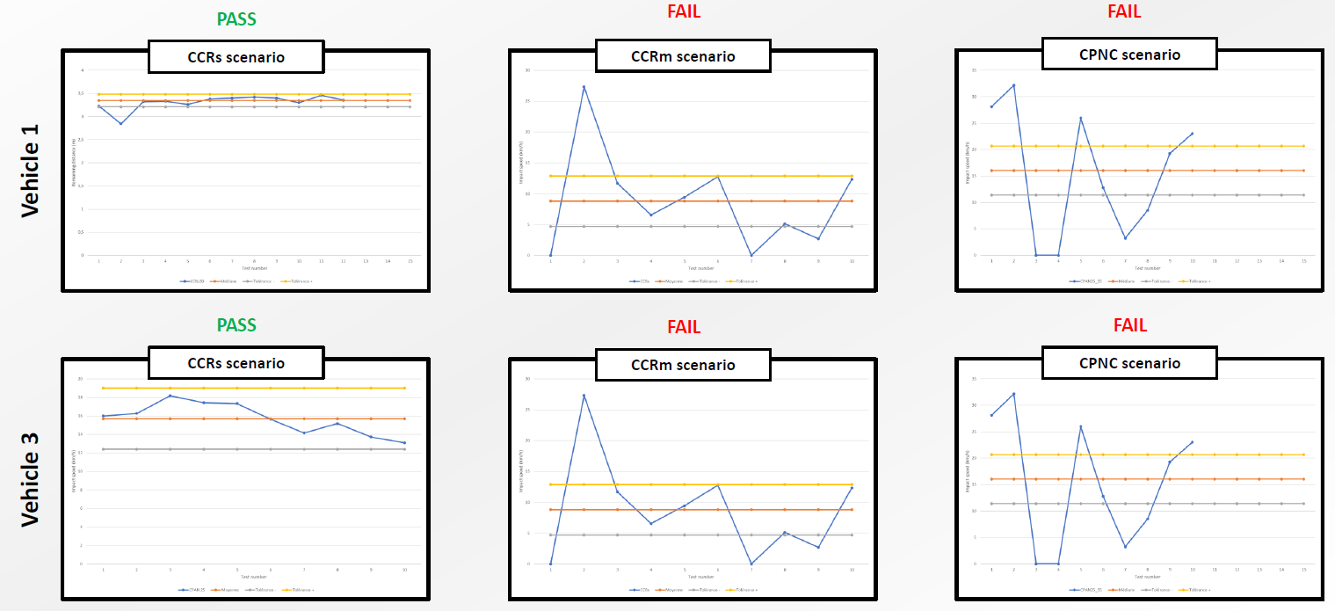
AEBS on virtual testing #3 : physical repeatability testing

Slide 12
AEBS on virtual testing Example of application

Slide 13
AEBS on virtual testing #4 : assessing physical and virtual results

Slide 14
AEBS on virtual testing Example of application

Slide 15
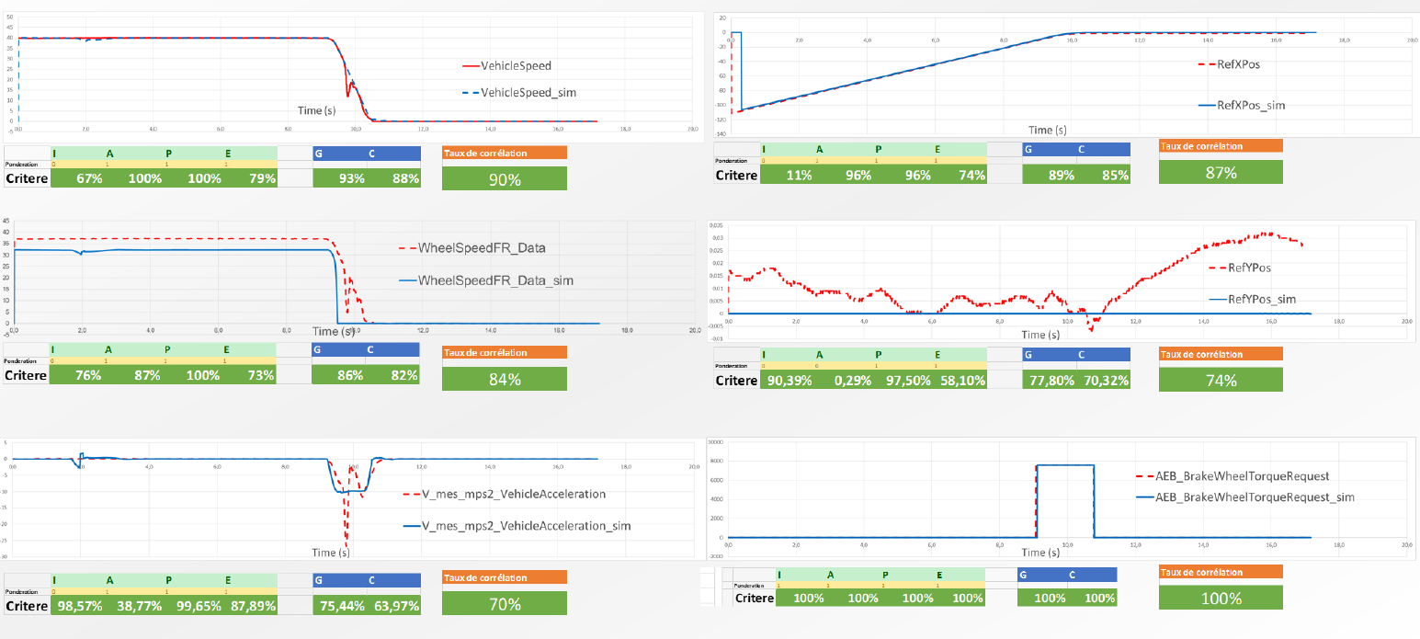
AEBS on virtual testing #5 : correlation scoring
After results analyzis, the virtual testing methodology can only be used in the following range :
Mass from 900kg to 2500kg
Vehicle defintiions from 1 to 3
Car to car scenarios
From 20kph to 50kph
All white range shall be physically tested because outside the validity domain

Slide 16
AEBS on virtual testing 2 separate assessment

Slide 17
AEBS on virtual testing Global overview
For each type approval, OEM is able to use alternatively
Full physical evaluation
OR
Virtual testing results within the validity domain + 30% physical tests within the validity domain + physical tests outside the validity domain if any

