Slide 1
87th UNECE GRPE session
PMP IWG Progress Report
Informal document GRPE-87-46
87th GRPE, 09 - 13 January 2023
Agenda item 7.
B. Giechaskiel,T. Grigoratos
Geneva, 09th – 13th Jan. 2023
UNITED NATIONS

Slide 2
PMP MEETINGS IN 2022
Before GRPE 86th session
2022-03-22: PMP Webconference (exhaust)
2022-03-29: PMP Webconference (non-exhaust)
2022-05-25: PMP Webconference (non-exhaust)
2022-06-15: PMP Webconference (non-exhaust)
Several ad-hoc webconferences to discuss specific issues related to exhaust and non-exhaust particle measurement procedures

Slide 3
PMP MEETINGS IN 2022
Before GRPE 87th session
2022-09-22: PMP Webconference (comments draft GTR)
2022-10-04: PMP Webconference (comments draft GTR)
2022-11-23: PMP Webconference (GTR families, reg. braking)
2022-12-13: PMP Webconference (GTR families, reg. braking)
2023-01-09: PMP hybrid meeting (Geneva)
Several ad-hoc webconferences to discuss specific issues related to exhaust and non-exhaust particle measurement procedures

Slide 4
SUMMARY OF ACTIVITIES
Exhaust emissions
Monitoring of new procedures (on-going) and improvement of calibration procedures
Non-exhaust emissions
Tyres: Task force (TF) on tire abrasion (TA) UNR under GRBP. Progress presented to GRPE and GRBP by TF TA chair
Brakes: GTR for light-duty vehicles up to 3.5t

Slide 5
UN GTR ON BRAKE EMISSIONS
Full friction
Draft informal June 2022
Working document Oct 2022
Regenerative braking and families (Jan 2022)
Current version has “fixed” friction share braking coefficients for each “electrification” category
OICA strongly opposed the submission in order to include “case by case” by June 2023. An agreement was reached and PMP will continue working to have a method as soon as possible (aim June 2023)

Slide 6
OUTLOOK
ToR (expiring June 2023)
Non-exhaust emissions:
Tyres/road: Continue monitoring on-going projects
Brakes: (i) LDV friction share coefficients (ii) Adaptation to future technologies (iii) Real-world cycles in lab (iii) HDV
Exhaust emissions:
No new topics are expected. Continue monitoring current measurement and calibration* procedures
* Calibration procedures for brakes might be need assessment

Slide 7
GTR ON BRAKE EMISSIONS

Slide 8
PROCEDURAL BACKGROUND
June 2016: PMP ToR (GRPE-73-15-Rev.1) – Mandate to develop a suggested common test procedure for sampling, measurement and characterization of brake wear particles.
June 2019: PMP ToR (GRPE-79-14-Rev.1) – The method development includes (a) Validation of the novel test cycle; (b) Definition of the requirements for brake particles generation and sampling; (c) Selection of the appropriate instrumentation; (d) Validation of the proposed approach.
June 2020: PMP ToR (GRPE-81-13) – Include all elements from June 2019 and (e) Extend the proposed methodology to include regenerative braking and future technologies.
June 2021: PMP ToR (GRPE-83-10) – “Development of a test procedure to be applied in a GTR for sampling and assessing brake wear particles both in terms of mass and number”.
A long development phase with the last two years – following the Workshop on brake emissions in Jan. 2021 – being dedicated to the development of a regulatory proposal.

Slide 9
TECHNICAL BACKGROUND
TF1
Development of the
WLTP-Brake Cycle
(30 meetings – 1 ILS study – Completed activities in 2019)
TF2
Development of sampling & measurement requirements
(30 meetings – 1 ILS study – Completed activities in 2019)
TF3
Intelaboratory Study
(6 meetings – 1 ILS study – Completed activities in 2022)
TF4
Introduction of non-friction braking in the GTR
(21 meetings – Completed activities in 2022 – will be active)
Technical
Working
Groups
More than 100 technical group meetings, two completed Interlaboratory campaigns (ILS), and numerous testing campaigns that supported with data over the last years;
23 non-exhaust related PMP meetings (physical and virtual) with more that 60 technical presentations on the topic of brake emissions that supported with data the method development;
1 dedicated workshop “Towards a regulation on brake wear emissions” organized at the 82nd GRPE session with the participation of more than 200 stakeholders.

Slide 10
RAODMAP TO THE GTR
Preparation of the draft GTR
Submission of the draft GTR at the GRPE session – Request for comments on the draft GTR
Preparation of the
Submission of the final Working Document for adoption at the January 2023 GRPE session
Submission of the GTR and the “technical report” to the GRPE for adoption
Refinement of methodologies
Formal Document
Submission of the informal document amending the working document
Introduction of "lessons learnt" from the ILS to the proposed method
Final proposal for PM and PN methods to the PMP group
Completion of the ILS exercise – Submission of the results to the SC
PMP Meeting
(29.03)
PMP Meeting
(25.05)
PMP Meeting
(15.06)
PMP Meeting
(22.09)
PMP Meeting
(04.10)
PMP Meeting
(23.11)
PMP Meeting
(13.12)
PMP Meeting
(09.01)
High level PM and PN results
Initiation of the activity (11.2021)
Final proposal for the inclusion of non-friction braking
NOV
2021
JAN
2022
FEB
2022
MAR
2022
APR
2022
MAY
2022
JUN
2022
JUL
2022
AUG
2022
SEP
2022
OCT
2022
NOV
2022
DEC
2022
JAN
2023
PMP Activities
TF2 Activities
TF3 Activities
TF4 Activity

Slide 11
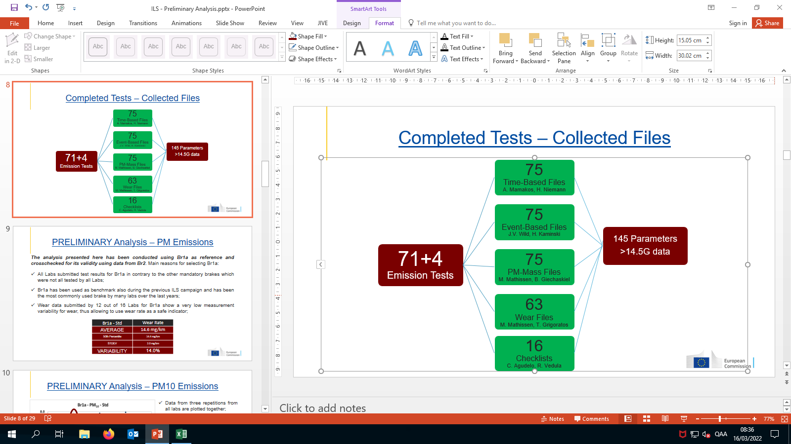
UN GTR ON BRAKE EMISSIONS
HIGHLIGHTS
1. Purpose
This Global Technical Regulation (UN GTR) provides a worldwide harmonised methodology for the measurement of brake wear particulate matter and particle number emissions from brakes used on Light-Duty vehicles.
2. Scope and application
This UN GTR applies to vehicles using some type of friction braking using a combination of dry friction materials and a mating brake disc or brake drum. The UN GTR applies to category 1-1 and category 2 vehicles with a fully laden mass below 3500 kg.
3. Definitions
This UN GTR applies 129 definitions covering the following sub-categories: 3.1. Vehicle and Brake Dyno Settings  3.2. Test setup  3.3.Brake Hardware  3.4. WLTP-Brake Cycle  3.5. PM & PN  3.6. Test System  3.7. Non-friction braking.
4. Abbreviations and Symbols
Table 4.1. presents 68 abbreviations used throughout the GTR text. Similarly, Table 4.2. presents 102 symbols used throughout the GTR text. In both cases, definitions and units are also provided.
5. General requirements
5.1. Compliance Requirements against the regional emission limits as defined by each Contracting Party by testing the worst-performing representative of a brake family  5.2. Brake Family defined for OEM brakes – aftermarket brakes will be covered in the first amendment to this UN GTR  5.3. Rounding Requirements with at least six significant or all available digits and matching number of decimal places in Paragraph 13.
6. General overview
6.1. Test sections defines the three sections of the brake emissions test: (a) Brake cooling adjustment, (b) Brake bedding, and (c) Brake emissions measurement  6.2. Test execution steps that describe all the necessary requirements for the correct execution of a brake emissions test and provides guidance where to find the information on the different aspects in the GTR.

Slide 12
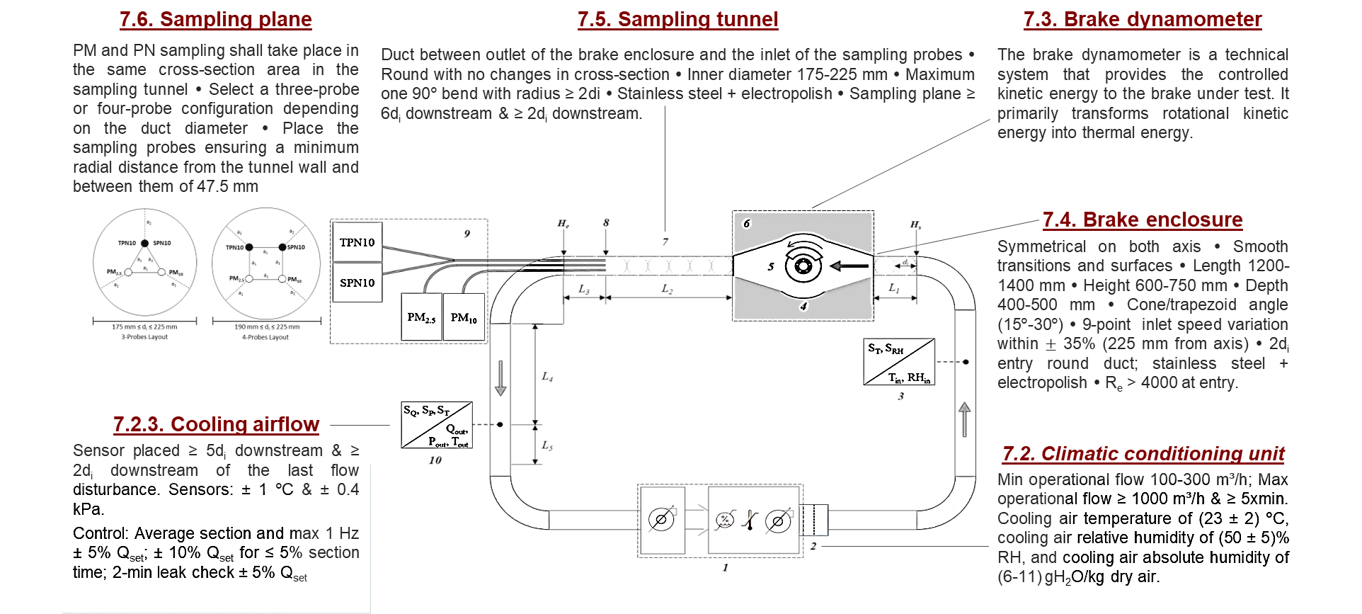
UN GTR ON BRAKE EMISSIONS
HIGHLIGHTS
7. Test System Requirements
* Slide includes info from Agudelo et al. [53rd PMP Meeting – 09.01.23]

Slide 13
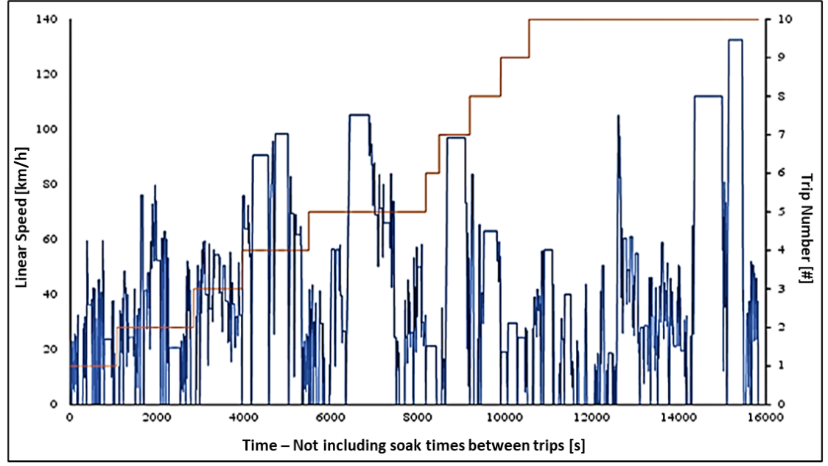
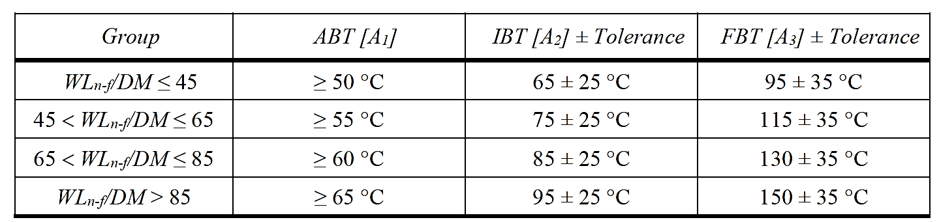
UN GTR ON BRAKE EMISSIONS
HIGHLIGHTS
8. Test Preparation Requirements
8.1. Input Parameters for full-friction and non-friction braking testing indicates all the required parameters that shall be available to the test facility  8.2. Test Setup Preparation discusses the 15 verification key steps before starting the test  8.3. Brake Temperature Measurement describes how to install embedded thermocouples for testing  8.4. Brake Positioning describes how to install the brake assembly, the allowed fixtures, the correct calliper orientation, and the correct disc rotation according to evacuation direction.
9. WLTP-Brake Cycle
9.1. General information about the cycle (10 trips – 15826 seconds – 303 brake events – 192 km distance – etc.)  9.2. WLTP-Brake Cycle Application describes the correct application of the cycle over the three brake emissions test sections  9.3. WLTP-Brake Cycle Interruptions describes the necessary actions when the cycle is interrupted  9.4. WLTP-Brake Cycle Quality Checks discusses the speed violation, number of brake events, and kinetic energy dissipation quality checks.
10. Cooling Airflow Adjustment
10.1. Method description provides details regarding the definition of the brake groups, the verification of parameters and tolerances for brake temperature, the computation of verification parameters and acceptance criteria, and the testing method to adjust the cooling airflow.
Table 10.2. Default temperature metrics and tolerances for brakes
Figure 9.1. Time-resolved vehicle speed for the WLTP-Brake cycle

Slide 14
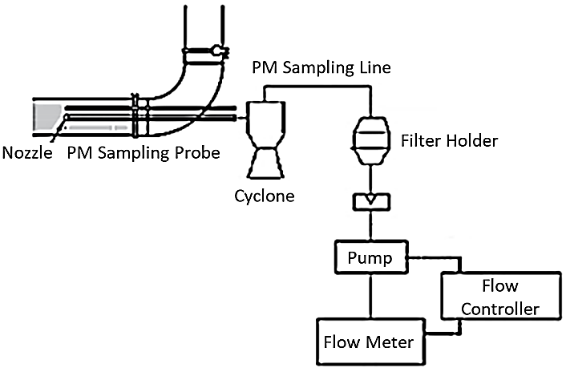
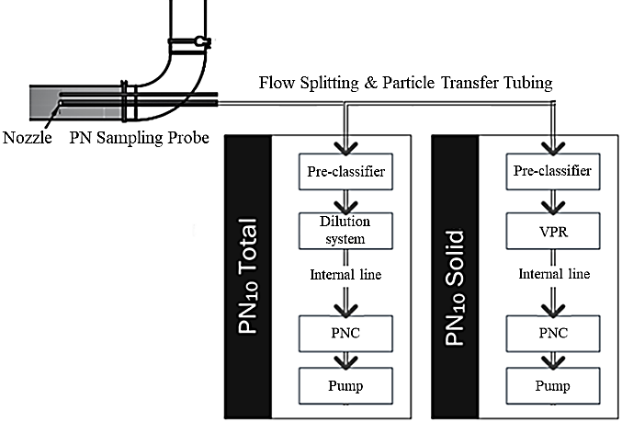
UN GTR ON BRAKE EMISSIONS
HIGHLIGHTS
11. Bedding Section
11.1. Front brakes describes the procedure to carry out bedding of front brakes  11.2. Rear brakes describes the procedure to carry out bedding of rear brakes – In both cases, a sequence of 5 WLTP-Brake cycles shall be followed.
12. Emissions Measurement Section
12.1. Measurement of Particulate Matter Mass  12.2. Measurement of Particle Number Concentration  12.3. Mass Loss Measurement provides details on how to perform the mass loss measurement of the brake parts correctly.
12.1 Measurement of Particulate Matter Mass
Describes the specifications for the PM emissions measurement during a brake emissions test. Detailed specifications and provisions for the design and use of the i. Sampling plane, ii. PM sampling probes, iii. PM sampling nozzles, iv. PM separation device, v. PM sampling line, vi. PM sampling flow, vii. Isokinetic ratio, viii. Filter holder, ix. Sampling filters, x. Weighing procedure, and xi. PM emissions calculation are provided.
Figure 12.1. Indicative setup of the PM sampling unit
12.2 Measurement of Particle Number Concentration
Describes the specifications for the PN emissions measurement during a brake emissions test. Detailed specifications and provisions for the design and use of the i. Sampling plane, ii. PN sampling probes, iii. PN sampling nozzles, iv. Particle transfer tube, v. PN pre-classifier, vi. Sample conditioning (dilution/VPR), vii. PN internal transfer line, viii. Particle number counter (PNC), ix. PN sampling flow, and x. PN emissions calculation are provided.
Figure 12.2. Indicative setup of the PN sampling unit

Slide 15
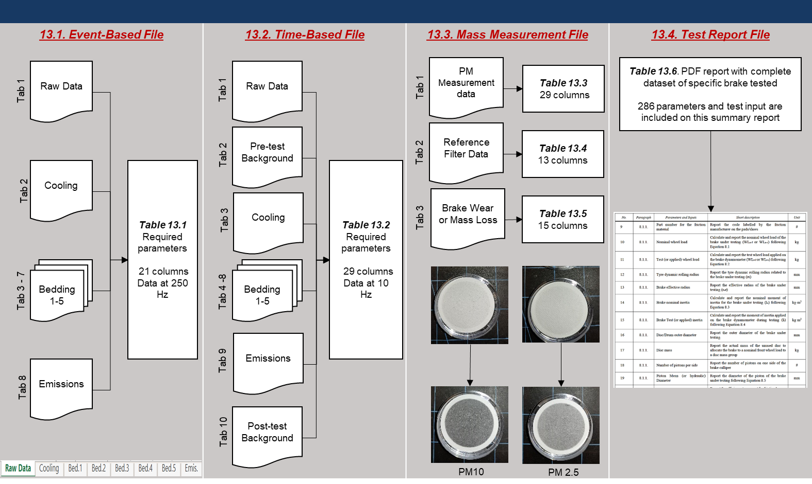
UN GTR ON BRAKE EMISSIONS
HIGHLIGHTS
13. Test Output
* Figure adapted from Agudelo et al. [53rd PMP Meeting – 09.01.23]
13.1. Event-Based File includes the necessary data for each brake deceleration event throughout the entire brake emissions test (21 parameters sampled at 250Hz)  13.2. Time-Based File includes information about 29 testing parameters sampled throughout the entire brake emissions test at 1Hz  13.3. Mass Measurement File includes information about weighing the filters and reporting the PM measurement data (29 parameters), reporting the reference filters data (13 parameters), and reporting the mass loss of the brake parts (15 parameters)  13.4. Test Report File contains all the necessary information regarding the tested brake that shall be included in the report. It includes 286 parameters that shall be calculated and reported.
14. Calibration Requirements and Ongoing Quality Controls
14.1. General Calibration Requirements summarizes the minimum calibration requirements for the equipment used for brake emissions testing  14.2. Brake Dynamometer summarizes the calibration criteria and the intervals for the brake dynamometer defined in this UN GTR  14.3. Cooling Airflow Measurement Device summarizes the calibration criteria and the intervals for the cooling air flow measurement device  14.4. PM and Mass Loss Scales provides specifications for the calibration of the scales  14.5. Sample Treatment and Conditioning Devices provides calibration specifications for the dilution system and the volatile particle remover  14.6. Particle Number Counter provides calibration specifications for the PNC.

Slide 16
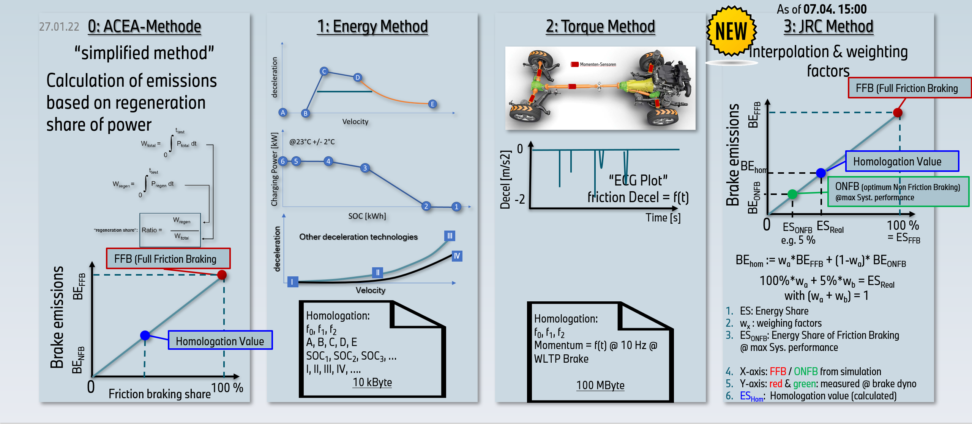
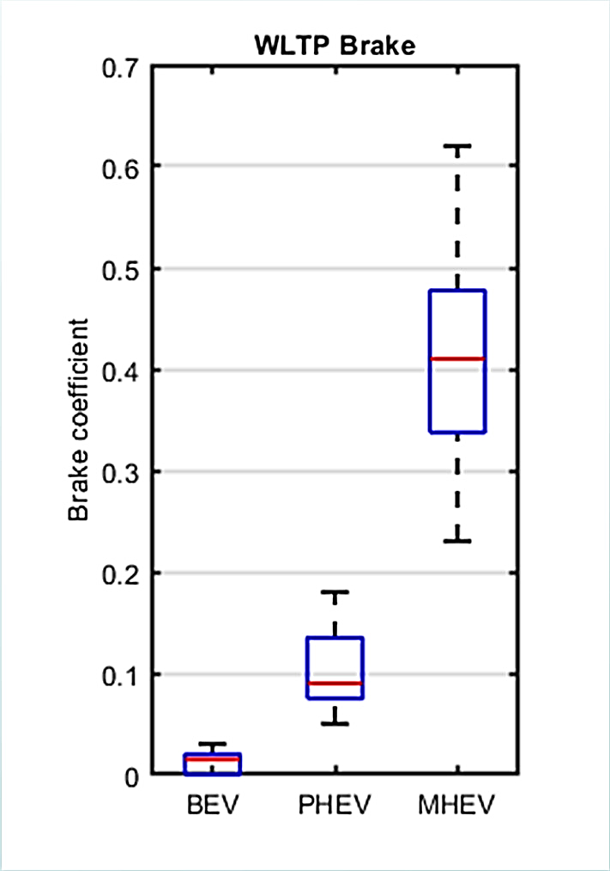
TF4 IN A NUTSHELL
NON-FRICTION BRAKING
TF4 shall propose a simplified, open and transparent, reproducible, and accessible to “third party” testing facilities method for introducing non-friction braking in the UN GTR.
Final Method
Final Brake
PM/PN EF
=
Full-friction
PM/PN EF
*
Friction braking share coefficient*
A fixed friction braking share coefficient is defined for each vehicle type based on “electrification” level (PEV, OVC-HEV, NOVC-HEV Cat. 1, NOVC-HEV Cat. 2, ICE).
* Slide presented by OICA at the 19th TF4 Meeting on 28.04.2022
Third party coefficient values “fitted” to the WLTP-Brake cycle. Bigger circles denote >1 data points. The point in red represents a full-hybrid vehicle.
The coefficients for each vehicle type represent the friction brake energy share over the total energy share.
*A detailed testing method to determine vehicle-specific friction braking share coefficients will be included in the first amendment to this UN GTR

Slide 17
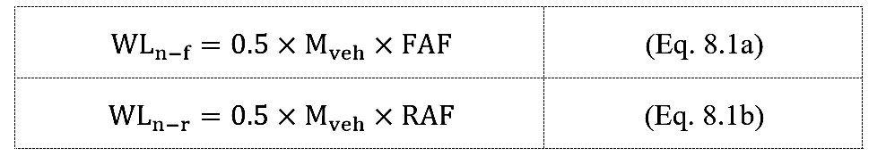
BRAKE FAMILIES
The vehicle with the highest product of wheel load and the friction braking coefficient shall be the parent of the brake emissions family when multiple vehicle types or vehicles in the same type feature the same brake assembly.
*
Only vehicles with an identical brake assembly based on the characteristics listed below may be part of the same emissions family.
Type of caliper (floating or fixed calliper, number and size of pistons, type of retraction elements);
Type of brake: (friction surface, coating, single, dual, ventilated, solid, dimensions, mass, material formulation) or drum-backplate assembly (friction surface, simplex, duplex, dimensions, mass, material formulation);
Type of friction material: pad (friction surface, size, shape, material, backing plate, material formulation) or shoe (friction surface, size, design, material, backing plate, material formulation).
The current definition of the brake families includes provisions for testing OEM brakes – families for aftermarket brakes will be elaborated and introduced in the first amendment to this UN GTR.

Slide 18
UN GTR ON BRAKE EMISSIONS
REMARKS
The UN GTR on brake emissions is the first regulation ever, worldwide, addressing particle emissions from a non-exhaust traffic related source;
This UN GTR provides the means to measure PM and PN emissions from all types of brakes mounted on light-duty vehicles up to 3.5t;
Besides well established pollutants such as PM2.5, PM10, and Solid-PN, this UN GTR provides specifications for measuring Total-PN (TPN) emissions for the first time – TPN data collection will allow for a better understanding of this parameter and the need to address it further;
The UN GTR on brake emissions is expected to become the backbone of regulations at regional level aiming to reduce brake particle emissions from road transport;
This UN GTR also covers non-friction braking (e.g. regenerative braking) which is expected to be the most important technology for reducing brake emissions. The method will be further expanded to include technology specific friction share coefficients based on transparent experimental procedures.

Slide 19

Thank you
© European Union 2023
Unless otherwise noted the reuse of this presentation is authorised under the CC BY 4.0 license. For any use or reproduction of elements that are not owned by the EU, permission may need to be sought directly from the respective right holders.
Notes:
Update/add/delete parts of the copy right notice where appropriate.
More information: https://myintracomm.ec.europa.eu/corp/intellectual-property/Documents/2019_Reuse-guidelines%28CC-BY%29.pdf

