Slide 1
Transmitted by the expert from CITA
Informal document GRPE-87-36
87th GRPE, 10 – 13 January 2023
agenda item 13.
UN ECE GRPE
Technologiestraat 21-25 I 1082 Brussel
Tel 02 469 09 00 I Fax 02 469 05 70 I www.gocavlaanderen.be I info@gocavlaanderen.be

Slide 2
PN measurement in Flanders - Belgium
First results July - October 2022
Pascal Buekenhoudt, UN ECE GRPE January 12th 2023
Technologiestraat 21-25 I 1082 Brussel
Tel 02 469 09 00 I Fax 02 469 05 70 I www.gocavlaanderen.be I info@gocavlaanderen.be

Slide 3
PN measurement in Belgium
PN
BELGIUM
Scope
 | Flanders & Brussels | Wallonia
Vehicle category | M1, N1 | M1, N1
Fuel type | Diesel | Diesel
Euro Norm | Euro 5a and higher | Euro 5b and higher
Threshold [cm⁻³] | (250.000) – 1.000.000 | (250.000) – 1.000.000
Equipment specifications | NMi (NPTI) TEN & CAPELEC | NMi (NPTI) TEN & CAPELEC
September 2022- © GOCA Vlaanderen
Technologiestraat 21-25 I 1082 Brussel I Tel 02 469 09 00 I Fax 02 469 05 70 I www.gocavlaanderen.be I info@gocavlaanderen.be

Slide 4
Measurement procedure
PN
BELGIUM
Easy procedure during Idle test
Response time
15s
PN average over
15s
Average > 1.000.000 cm⁻³ ?
Yes
NOK
250.000 cm⁻³ < Average < 1.000.000 cm⁻³ ?
Yes
Remark
No
OK
September 2022- © GOCA Vlaanderen
Technologiestraat 21-25 I 1082 Brussel I Tel 02 469 09 00 I Fax 02 469 05 70 I www.gocavlaanderen.be I info@gocavlaanderen.be

Slide 5
TEST RESULTS
PN
FLANDERS
Results of study in 2018
Results of 4 months implementation in 2022
September 2022- © GOCA Vlaanderen
Technologiestraat 21-25 I 1082 Brussel I Tel 02 469 09 00 I Fax 02 469 05 70 I www.gocavlaanderen.be I info@gocavlaanderen.be

Slide 6
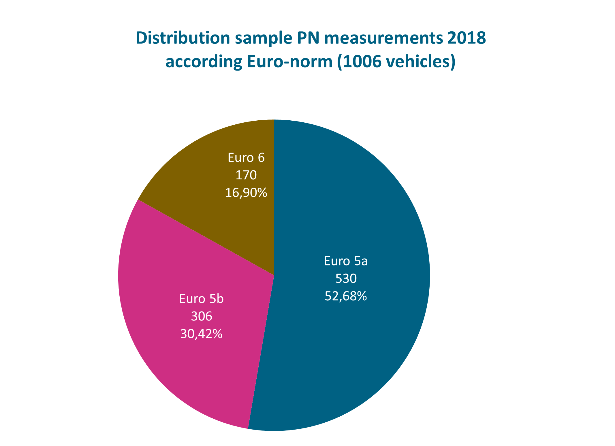
Sample 2018
Sample
2018
2018 – 1006 vehicles tested
September 2022- © GOCA Vlaanderen
Technologiestraat 21-25 I 1082 Brussel I Tel 02 469 09 00 I Fax 02 469 05 70 I www.gocavlaanderen.be I info@gocavlaanderen.be

Slide 7
Sample 2018
Sample
2018
September 2022- © GOCA Vlaanderen
Technologiestraat 21-25 I 1082 Brussel I Tel 02 469 09 00 I Fax 02 469 05 70 I www.gocavlaanderen.be I info@gocavlaanderen.be

Slide 8
Sample 2018
Sample
2018
0,29%
September 2022- © GOCA Vlaanderen
Technologiestraat 21-25 I 1082 Brussel I Tel 02 469 09 00 I Fax 02 469 05 70 I www.gocavlaanderen.be I info@gocavlaanderen.be

Slide 9
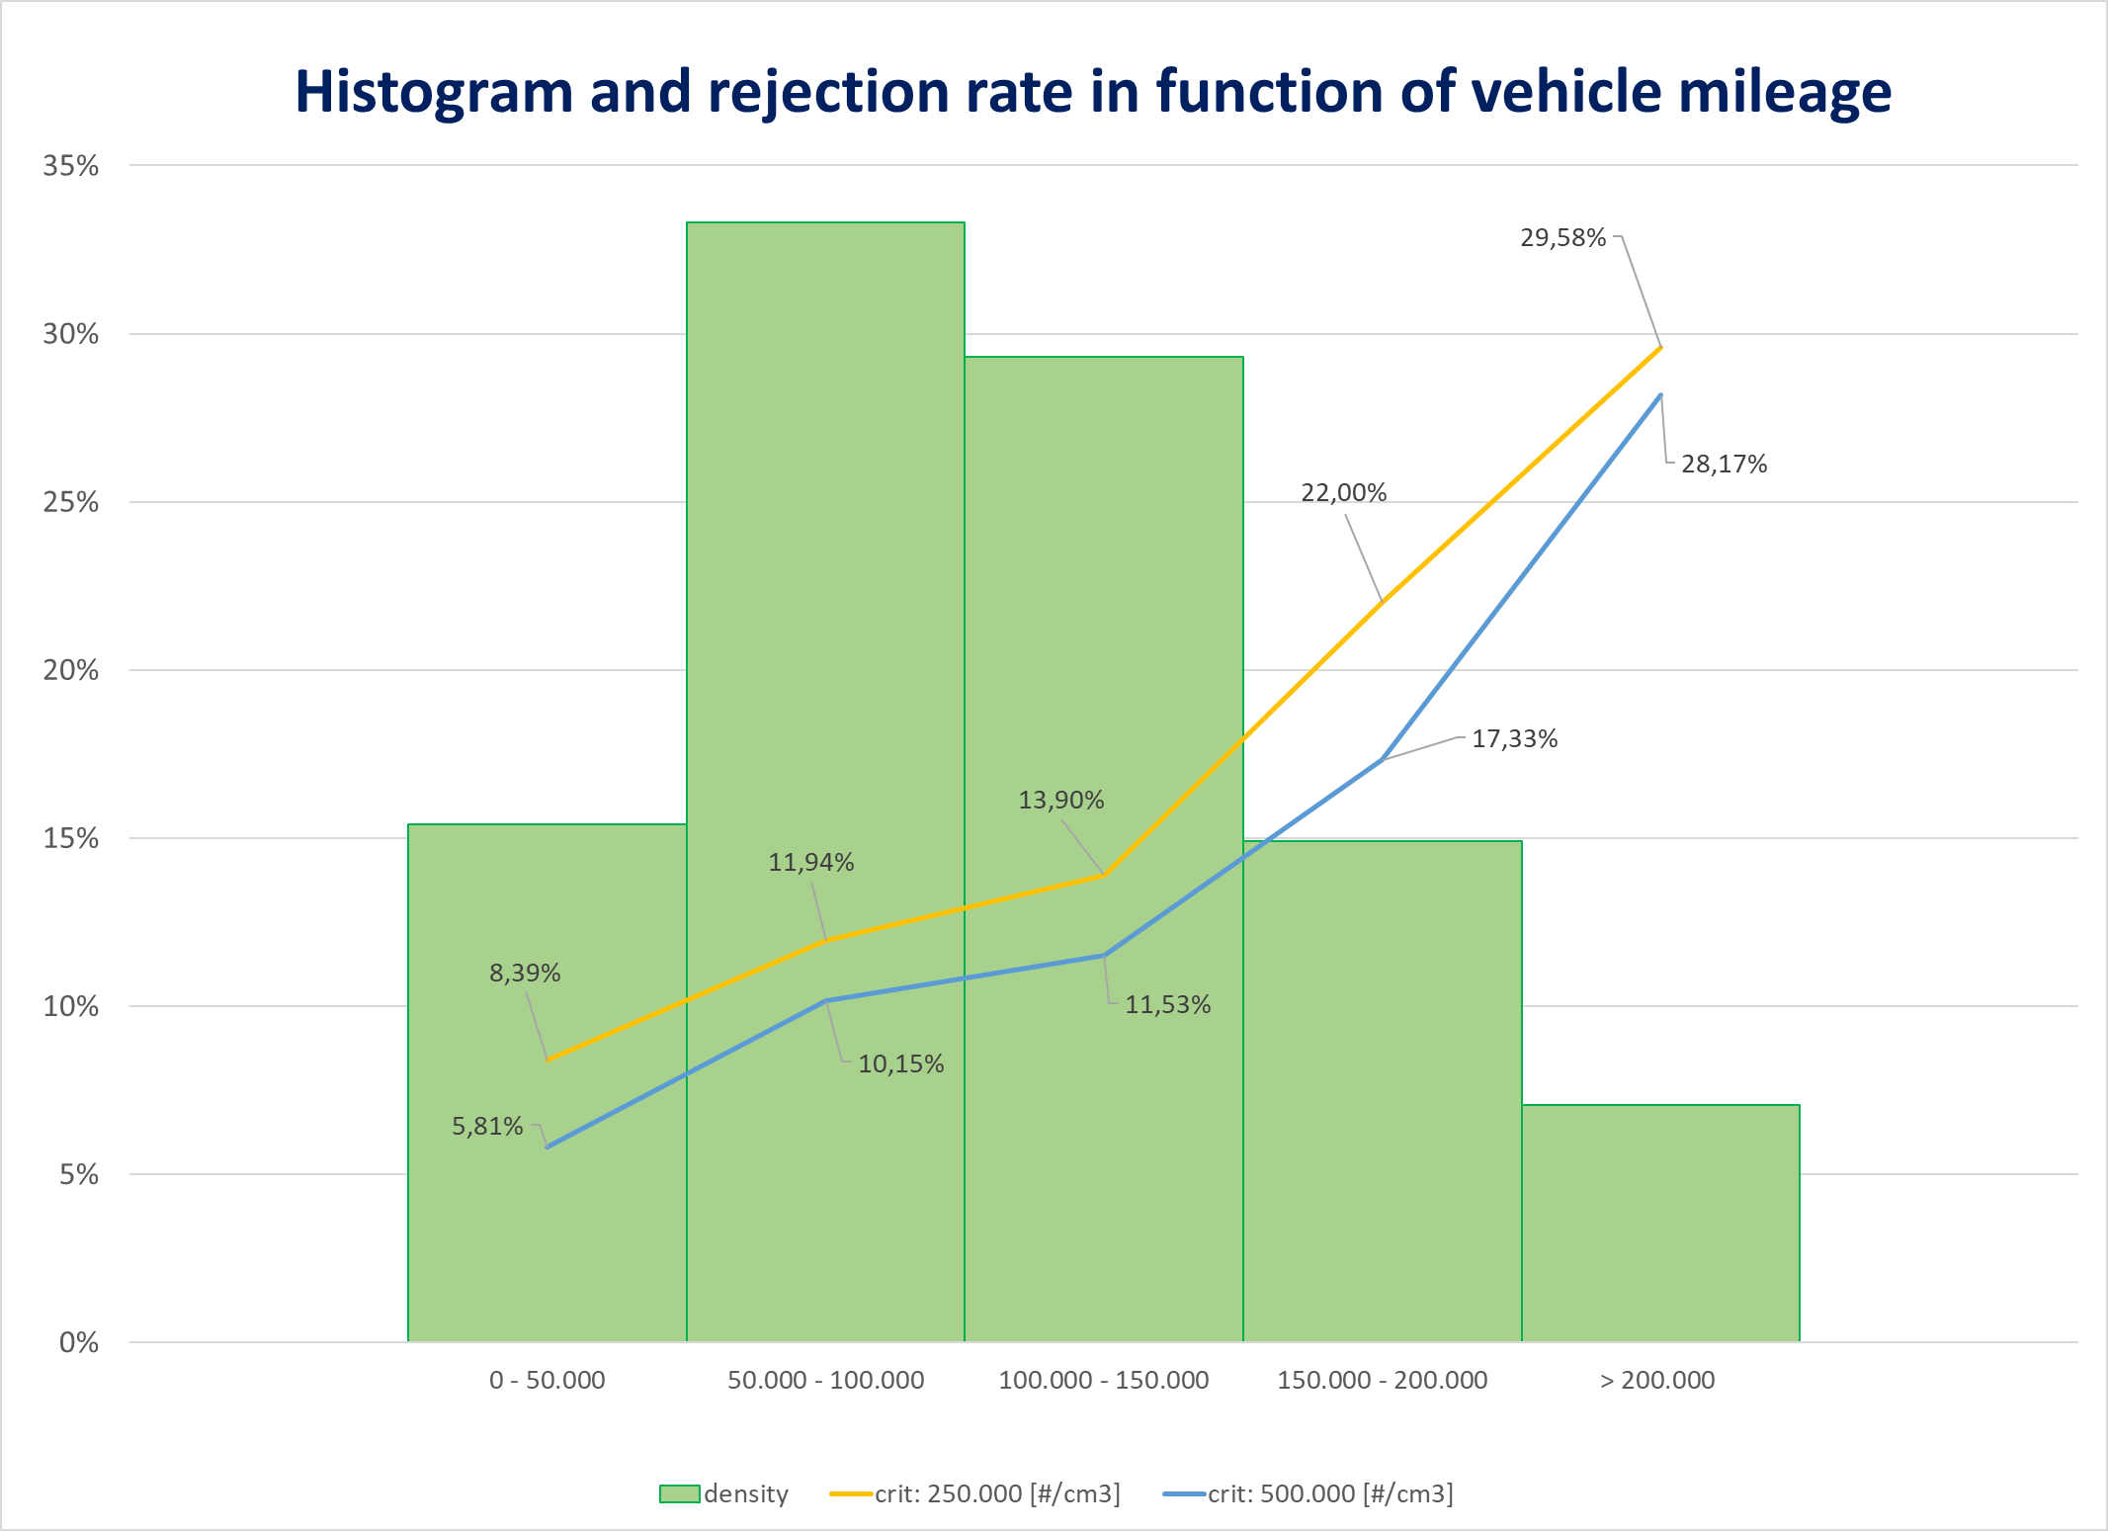
Sample 2018 – distribution by millage
Sample
2018
September 2022- © GOCA Vlaanderen
Technologiestraat 21-25 I 1082 Brussel I Tel 02 469 09 00 I Fax 02 469 05 70 I www.gocavlaanderen.be I info@gocavlaanderen.be

Slide 10
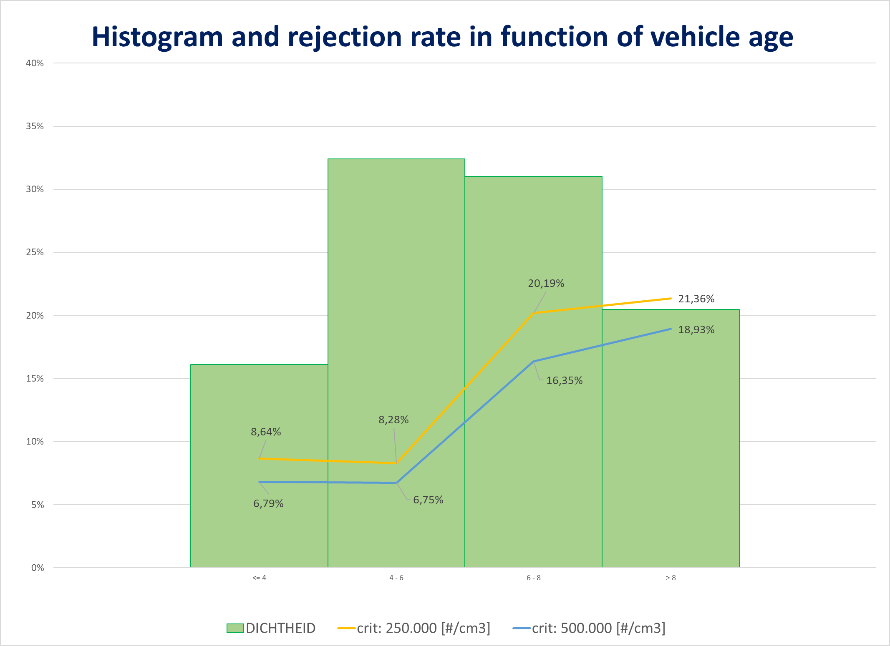
Sample 2018 – distribution by age
Sample
2018
September 2022- © GOCA Vlaanderen
Technologiestraat 21-25 I 1082 Brussel I Tel 02 469 09 00 I Fax 02 469 05 70 I www.gocavlaanderen.be I info@gocavlaanderen.be

Slide 11
TEST RESULTS
PN
FLANDERS
Results of study in 2018
Results of 2 months implementation in 2022
September 2022- © GOCA Vlaanderen
Technologiestraat 21-25 I 1082 Brussel I Tel 02 469 09 00 I Fax 02 469 05 70 I www.gocavlaanderen.be I info@gocavlaanderen.be

Slide 12
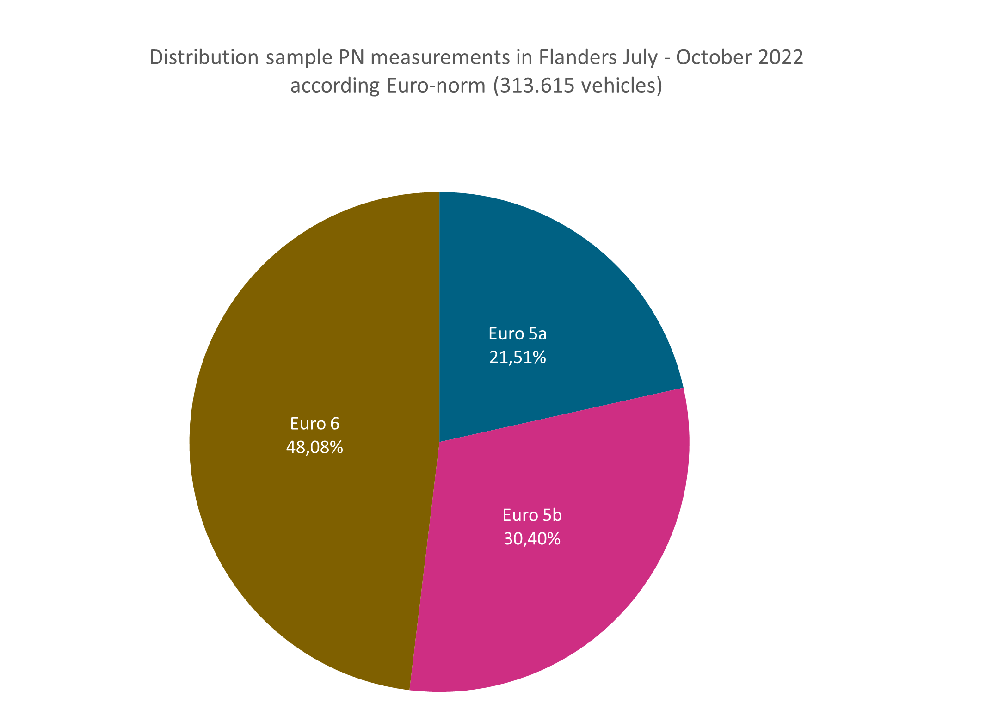
Sample of Flanders
PN
FLANDERS
313.615 tested vehicles
September 2022- © GOCA Vlaanderen
Technologiestraat 21-25 I 1082 Brussel I Tel 02 469 09 00 I Fax 02 469 05 70 I www.gocavlaanderen.be I info@gocavlaanderen.be

Slide 13
Sample of Flanders
PN
FLANDERS
RESULTS threshold is 1.000.000 cm⁻³ ➔ 6,76 % was rejected
Euro | 2018 | 2022
Euro 5 | 11,20% | 10,96%
Euro 5a | 13,68% | 13,81%
Euro 5b | 6,79% | 8,94%
Euro 6 | 1,89% | 2,22%
 | 0,29% | 0,20%
September 2022- © GOCA Vlaanderen
Technologiestraat 21-25 I 1082 Brussel I Tel 02 469 09 00 I Fax 02 469 05 70 I www.gocavlaanderen.be I info@gocavlaanderen.be

Slide 14
Sample of Flanders
PN
FLANDERS
What if threshold would be 250.000 cm⁻³ ➔ 9,87% would be rejected
 | 2018 | 2022
Euro 5 | 16,73% | 15,30%
Euro 5a | 20,52% | 19,01%
Euro 5b | 10,00% | 12,67%
Euro 6 | 6,29% | 4,01%
 | 0,29% | 0,29%
September 2022- © GOCA Vlaanderen
Technologiestraat 21-25 I 1082 Brussel I Tel 02 469 09 00 I Fax 02 469 05 70 I www.gocavlaanderen.be I info@gocavlaanderen.be

Slide 15
Sample of Flanders
PN
FLANDERS
RESULTS threshold is 1.000.000 cm⁻³ related to mileage of vehicle
mileage | 2022
0 - 50.000 | 1,21%
50.001 - 100.000 | 3,79%
100.001 - 150.000 | 7,29%
150.001 – 200.000 | 10,38%
+ 200.000 | 13,20%
September 2022- © GOCA Vlaanderen
Technologiestraat 21-25 I 1082 Brussel I Tel 02 469 09 00 I Fax 02 469 05 70 I www.gocavlaanderen.be I info@gocavlaanderen.be

Slide 16
Sample of Flanders
PN
FLANDERS
RESULTS threshold is 1.000.000 cm⁻³ related to age of vehicle
Date first registration | Number of vehicles | % Rejected
2010 | 29.621 | 9,48%
2011 | 36.070 | 15,32%
2012 | 32.294 | 12,23%
2013 | 31.796 | 10,15%
2014 | 31.921 | 8,33%
2015 | 30.541 | 5,70%
2016 | 33.222 | 3,56%
2017 | 27.589 | 2,73%
2018 | 36.326 | 1,39%
2019 | 12.824 | 1,36%
2020 | 12.900 | 0,77%
2021 | 10.723 | 0,35%
2022 | 5.393 | 0,02%
September 2022- © GOCA Vlaanderen
Technologiestraat 21-25 I 1082 Brussel I Tel 02 469 09 00 I Fax 02 469 05 70 I www.gocavlaanderen.be I info@gocavlaanderen.be

Slide 17
Thank you for your attention
Questions?
Technologiestraat 21-25 I 1082 Brussel
Tel 02 469 09 00 I Fax 02 469 05 70 I www.gocavlaanderen.be I info@gocavlaanderen.be

