Slide 1
UN R14: Proposal on Alternative Seating Positions
Informal Document GRSP-72-25
(72nd GRSP, 5-9 December 2022,
agenda item 24(h))

Slide 2
Preliminary Remarks
The overall idea is to enable alternative seating positions during driving.
This proposal only affects UN Regulation No. 14 on Safety-belt anchorages and introduces alternative positions for anchorage points fitted to the seat structure.
The introduced amendments will not allow alternative seating positions as there are other UN Regulations, which need to be amended as well. This proposal is seen as a first step.

Slide 3
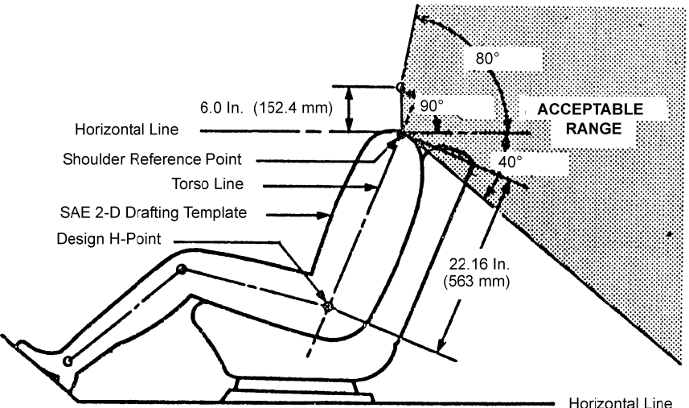
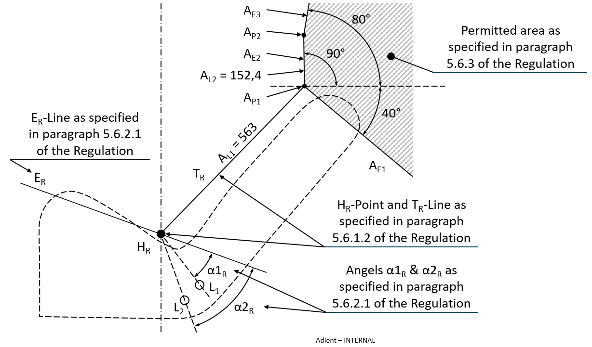
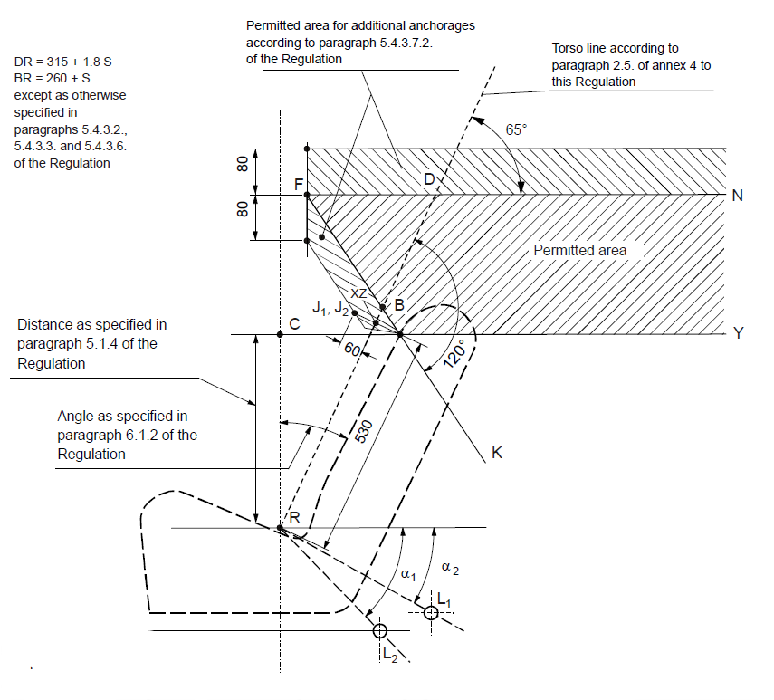
Alternative Positions before Test
Transfer of effective lower and upper belt anchorage points
FMVSS 210
Proposal: UN-R 14 Draft
UN-R 14.09

Slide 4
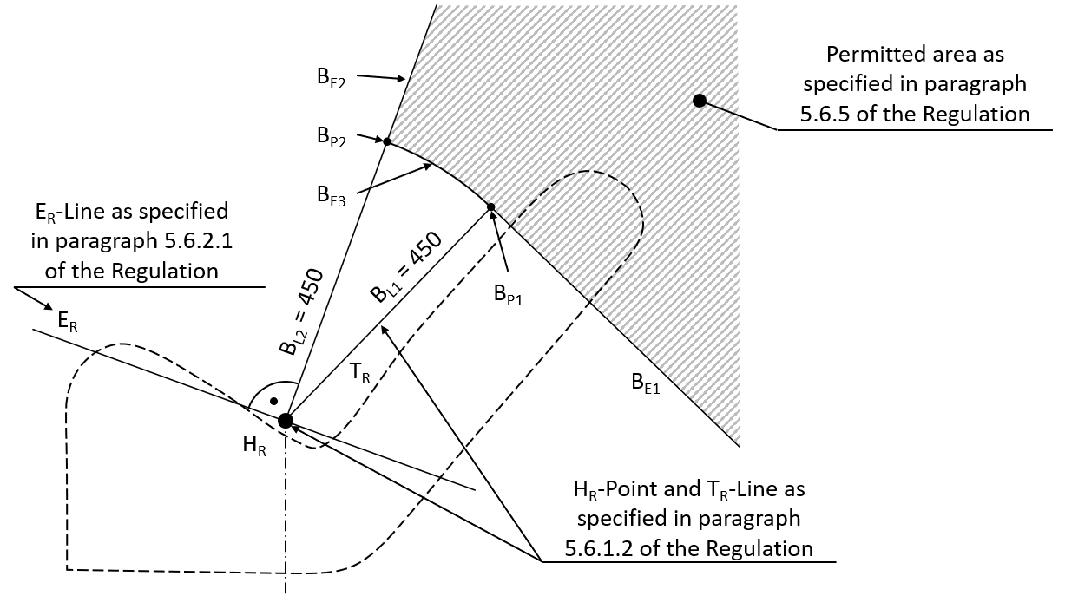
Alternative Positions during and after Test
Transfer of effective upper belt anchorage point
UN-R 14.09
Proposal: UN-R 14 Draft
RC = 450

Slide 5
Further Steps
OICA will finalise a proposal.
A meeting for interested persons will be scheduled in the beginning of 2023.
Aim is an informal document for 73rd GRSP in May 2023.

