Slide 1
Informal document GRSP-72-21
72nd GRSP, 5-9 Dec. 2022 agenda item 3
Overview of Hydrogen Fuelled Vehicle
Phase 2 Project
Global Technical Regulations No.13
GRSP 72nd Meeting
Martin Koubek
UNECE/WP.29/GRSP

Slide 2
Outline
Hydrogen fuelled vehicle GTR background
Scope of work
Summary of work in 6 taskforces of IWG
Comments addressed in formal document
Chair: USA
M. Koubek/NHTSA
Co-Chair: JPN
K. Sato/ METI
Co-Vice Chair: KOR
S. Kim/KATRI
Co-Vice Chair: CN
Y. He/CATARC
CP: EU
B. Acosta-Iborra
R. Ladret Piciorus
CP: USA NHTSA
I. MacIntire
Secretary: OICA
M. Iwasaki/A. Ryan
CP: Transport Canada
K. Hendershot
Government
OICA
CLEPA
Container mfrs
Standards Orgs
Laboratories
Academia
CP: UK DFT
M. Levet

Slide 3
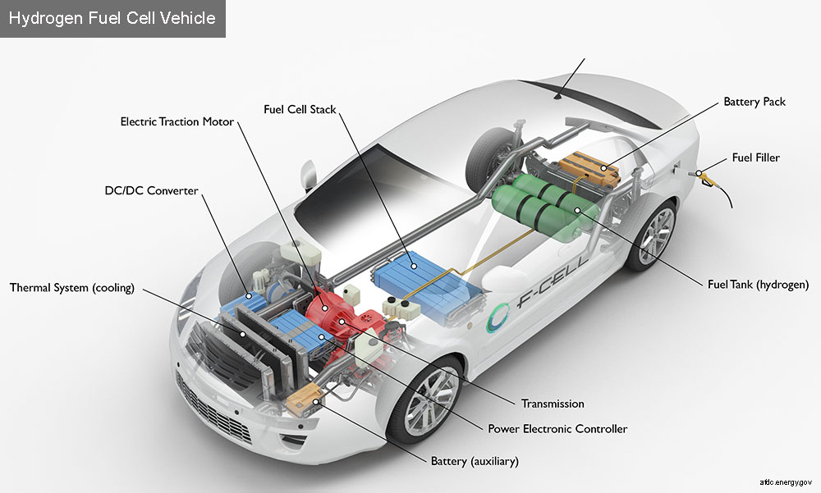
Hydrogen Fuelled Vehicle GTR Background
In 2009, a working group was established under the 1998 Global Agreement to develop a GTR that would address the safety and environmental concerns associated with fuel-cell compressed gaseous and liquid hydrogen vehicles.
Sub-group on Safety (SGS): GTR for hydrogen vehicles ensuring high pressure container safety, hydrogen fuel system including FC and exhaust system, and high voltage electrical safety.
Photo: NREL

Slide 4
Hydrogen Fuelled Vehicle GTR Background
GTR13 Phase 1 |  | GTR13 Phase 2
2009 | 2013 | 2017 | 2018-2021 | 2022
Wkg Grp est. GTR | Jun- GTR13 adopted by AC.3 Begin transposal to 58 Agreement | Mar-Authorization to start Phase 2 (WP.29, AC.3) Oct- First IWG mtg | IWG mtgs (x10) Nov ‘20-Mandate extended to Dec ‘22 by WP.29 | Jan-Jun – IWG mtg (x4) Mar- Mandate extended to Dec 2022 by AC.3. May- Informal draft Sep- Formal draft Dec- GRSP

Slide 5
GTR13 Scope Development
Phase 2
Phase 1
Category 1, 2
Receptacle requirements
Updated test procedures based on research data
Revised initial burst pressure requirement
Extended service life
Category 1-1, 1-2
Compressed gaseous hydrogen system for FCEV
Liquefied hydrogen system
High pressure fuel container system: 35/70 MPa NWP
Fuel system at vehicle level: in-use and post-crash hydrogen leakage limits
Electrical integrity of high voltage system: in-use and post-crash

Slide 6
Taskforce #1: Heavy Duty Vehicles & Buses
Co-led by A. Schuessling and Y. He
Goal: Address safety issues associated with heavy vehicles and buses
Extension of the scope to cover Commercial/Heavy Duty Vehicles
Service life of the container (15 → 25 years)
Crash requirements/sled test
Thermally activated pressure relief device (TPRD) venting direction
Container permeation and pneumatic cycling
Notes:
This is a combined fire test on a container: localized and engulfing fire
NHTSA and Transport Canada had jointly conducted a series of research: TC identified the need for localized fire test and developed the test procedures; NHTSA picked up the second phase of the research by conducting a series of test to identify the mitigation materials.

Slide 7
Taskforce #2: Fuelling Receptacle
Led by L. Gambone
Goal: To standardize references to fuelling receptacle designs
Ensures that vehicles of lower Nominal Working Pressure (NWP) are not fuelled at hydrogen dispensers operating at a higher NWP
Ensures vehicles fuelled by hydrogen are not fuelled by other gaseous fuel dispensers
Notes:
This is a combined fire test on a container: localized and engulfing fire
NHTSA and Transport Canada had jointly conducted a series of research: TC identified the need for localized fire test and developed the test procedures; NHTSA picked up the second phase of the research by conducting a series of test to identify the mitigation materials.

Slide 8
Taskforce #3: Test Requirements & Procedures
Led by L. Gambone
Goal: To update qualification test procedures
To correct editorial errors and test specs from Phase 1
To modify test procedures based on industry experience
To incorporate requirements for medium and heavy-duty vehicles
To incorporate requirements for new storage technologies
Notes:
This is a combined fire test on a container: localized and engulfing fire
NHTSA and Transport Canada had jointly conducted a series of research: TC identified the need for localized fire test and developed the test procedures; NHTSA picked up the second phase of the research by conducting a series of test to identify the mitigation materials.

Slide 9
Taskforce #4: Fire Test
Led by G. Scheffler
Goal: To improve the repeatability and reproducibility of the fire test
Burner specifications
Pre-test check of fire test
Accommodate vehicle specific components
Extend the application of the fire test to containers on heavy vehicles and to conformable containers
Notes:
This is a combined fire test on a container: localized and engulfing fire
NHTSA and Transport Canada had jointly conducted a series of research: TC identified the need for localized fire test and developed the test procedures; NHTSA picked up the second phase of the research by conducting a series of test to identify the mitigation materials.

Slide 10
Taskforce #5: Interoperability
Led by A. Tchouvelev
Goal: To review safety dependencies between hydrogen refuelling station and HFCV
Fueling station components (e.g., dispenser)
Fueling protocol
Vehicle to station communication
References to relevant industry documents (ISO, SAE)
Notes:
This is a combined fire test on a container: localized and engulfing fire
NHTSA and Transport Canada had jointly conducted a series of research: TC identified the need for localized fire test and developed the test procedures; NHTSA picked up the second phase of the research by conducting a series of test to identify the mitigation materials.

Slide 11
Taskforce #0: Phase 2 Drafting and Editing
Co-led by: A. Ryan and I. MacIntire
Goal: To develop informal/formal drafts of GTR13 Phase 2
TF0 members include CP and industry
Collect agreements among CP, industry from various discussions and taskforces to draft language for Part 1 (Rationale) and Part 2 (Mandatory Requirements)
Reflected in formal draft submitted in September.
Notes:
This is a combined fire test on a container: localized and engulfing fire
NHTSA and Transport Canada had jointly conducted a series of research: TC identified the need for localized fire test and developed the test procedures; NHTSA picked up the second phase of the research by conducting a series of test to identify the mitigation materials.

Slide 12

Selected Feedback and Resolutions
“Generic approach in which both HFCV and H-ICE vehicles are included and treated equally from a safety POV”
“LPG used in fire test could vary by region or time of year and could cause differences”
Revised to make more inclusive: “fuel cell or ICE” or “hydrogen fuelled vehicles”
The newly added burner pre-test check allows test lab to match fuel flow of LPG to the temperatures produced by the burner
“Reference to SAE J2601 fueling ramp rates should be replaced by actual values”
“Horizontal drop test language for confor-mables is unclear”
Revised: “In case of non-axisymmetric container, the largest projection area of the container shall be oriented downward and aligned horizontally… , the shut-off valve interface location and its centre of gravity should be horizontally aligned as it is feasible;”
Included table of fueling ramp rates per SAE J2601 and extrapolated for large CHSS for HDV
Notes:
This is a combined fire test on a container: localized and engulfing fire
NHTSA and Transport Canada had jointly conducted a series of research: TC identified the need for localized fire test and developed the test procedures; NHTSA picked up the second phase of the research by conducting a series of test to identify the mitigation materials.

Slide 13
Items Identified for Phase 3
Consideration of research results after Phase 2 (CHSS systems, post-crash safety)
Fuel system integrity requirements (e.g., acceleration/sled test and side impact test for HDV)
Review of liquified hydrogen storage system
Improvements to test procedures
  Fire (e.g., withstand test)
  CHSS qualification (e.g., station risk, remote TPRD, etc.)
Review CP options to achieve further harmonization

Slide 14
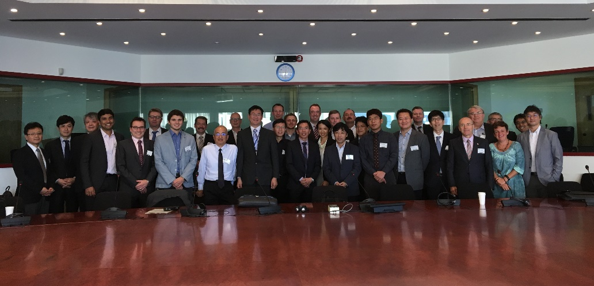
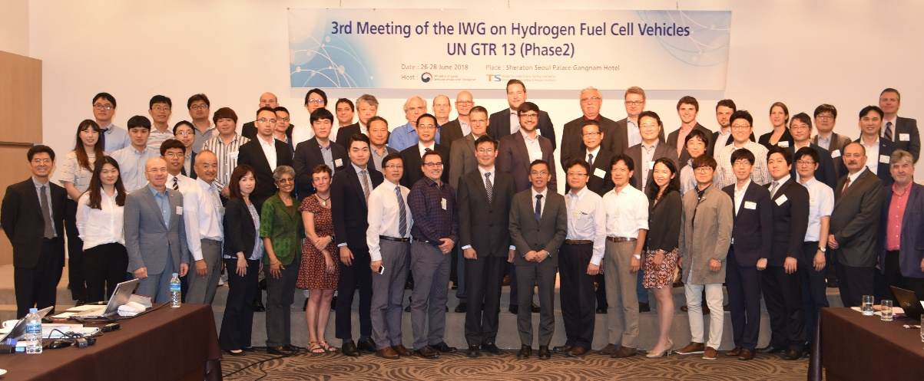
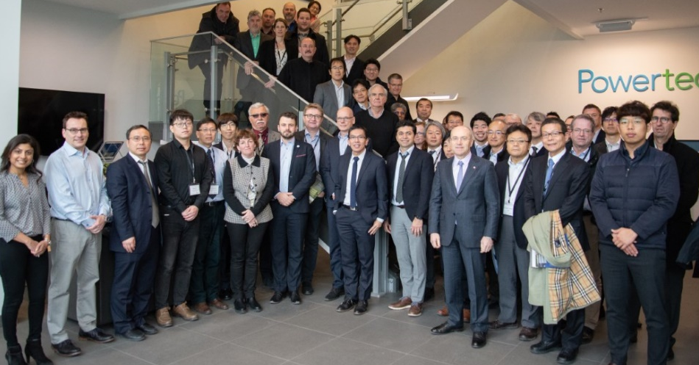
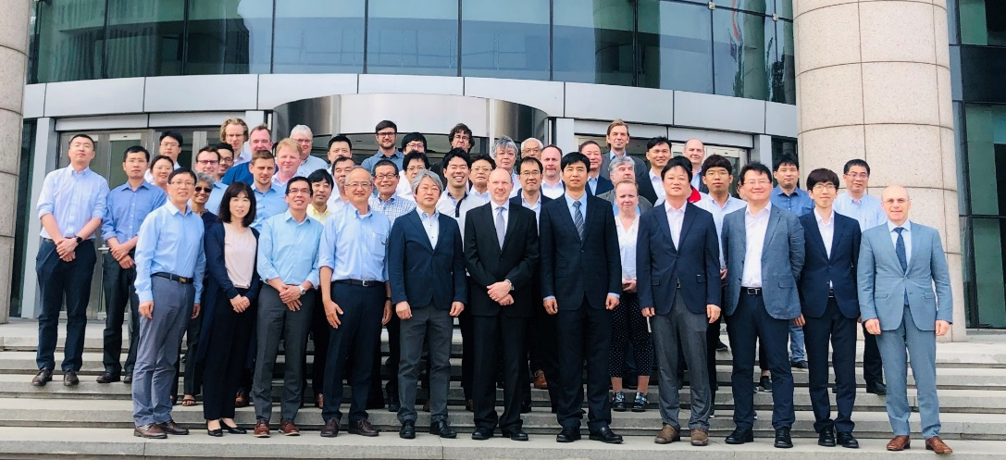
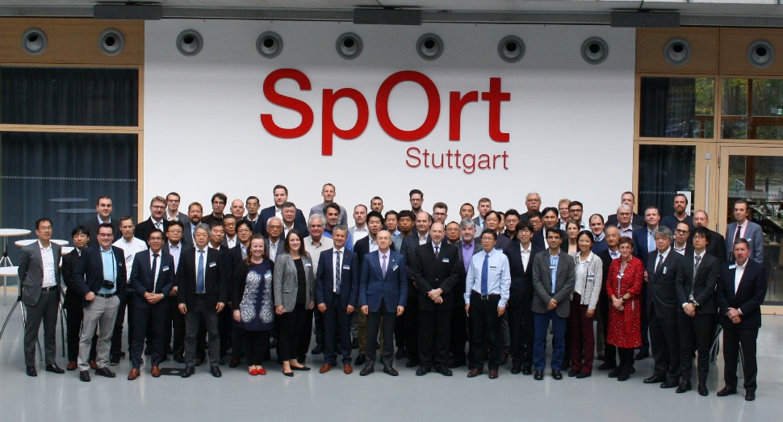
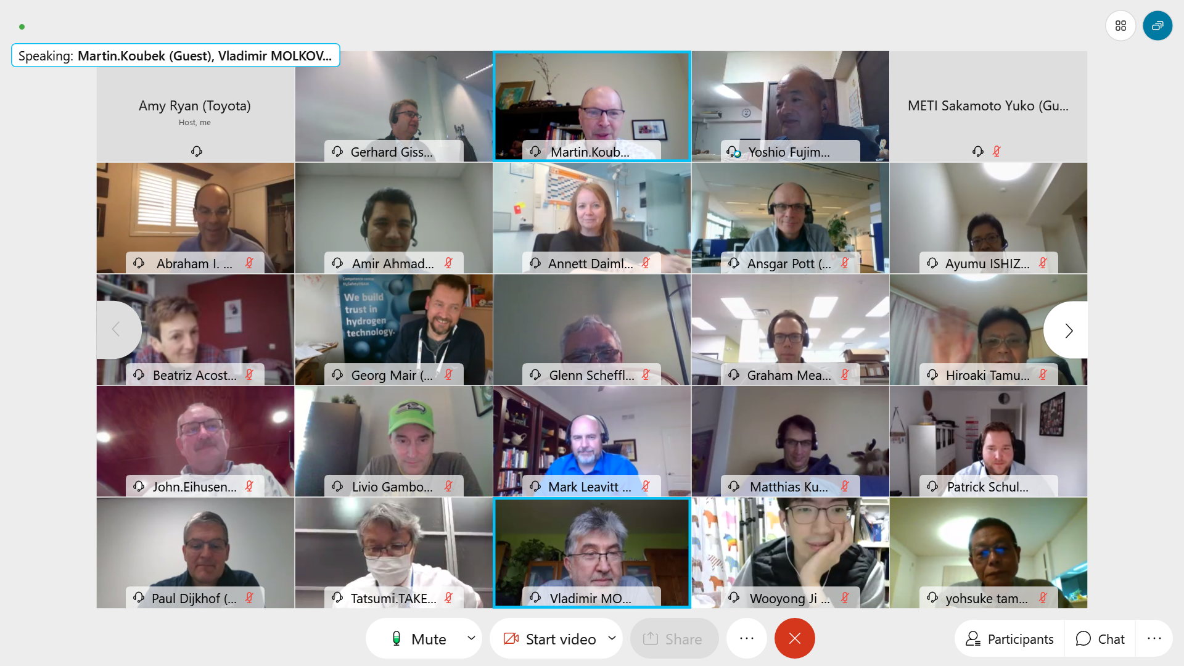
Thank You

