Slide 1
OICA Comments to Working Paper GRPE/2023/02 (UN-R83.08)
Submitted by the expert of OICA Informal document GRPE-87-10 87th GRPE, 10 - 13 January 2023 agenda item 3.(a),
GRPE 87 – January 2023

Slide 2
General Comments to GRPE/2023/02
The need for this proposal was discussed in Informal Working Group WLTP in September 2018.
This working paper is the first written proposal and was first uploaded in November 2022.
The working paper remains incomplete at the time of compilation of this paper leaving no time for assessment.

Slide 3
Detailed Concerns re. GRPE/2023/02 (1)
OICA previously raised concerns regarding requiring both UN R154 and “UN R-RDE” with no option for CPs. These concerns can be expressed by an example:
A Contracting Party applies UN R83 but does not have a local RDE requirement.
They would have to issue approvals to UN R83.08 on demand and would have to conduct RDE ISC testing
Not only would they have no experience, there may be no RDE approved cars on their market.

Slide 4
Detailed Concerns re. GRPE/2023/02 (2)
For this reason OICA believes that Transitional Provisions and optional levels are required to: a) protect CPs which have applied UN R83 for many years from these new and potentially undesired obligations b) clarify which series of UN R83 is subject to mutual recognition under the 58 Agreement c) allow a CP with no current desire to introduce RDE requirements to continue to apply emissions ISC

Slide 5
Detailed Concerns re. GRPE/2023/02 (3)
The proposal contains references to EU based systems and processes which are not currently known by non-EU Contracting Parties (e.g. ISC Electronic Platform, „Forum for Exchange of Information on Enforcement“ etc.)
As many of these systems and processes have been initiated since the concept of UN R83.08 was developed, OICA believes their inclusion should be discussed with stakeholders.

Slide 6
Detailed Concerns re. GRPE/2023/02 (4)
The proposal uses the terminology „third parties“ which is copied over from EU legislation.
In EU legislation however such third parties have to demonstrate their legitimacy and are bound to confidentiality. These necessary restrictions appear absent for UN R83.08 and the 58 Agreement.
The following important elements were absent from the Working Document:
Test conditions, communication document, addendum to communication document (approx. 25 pages of text)

Slide 7
OICA Conclusion re. GRPE/2023/02
Considering the absence of an informal document, the incomplete nature of the proposal and the number of critical concerns, OICA strongly requests that the adoption of UN R83.08 is delayed until GRPE 88 to give its members sufficient time to assess the proposal and make constructive proposals for amendment where necessary.
Of course OICA members are available for open discussions with Contracting Parties where desired.

Slide 8
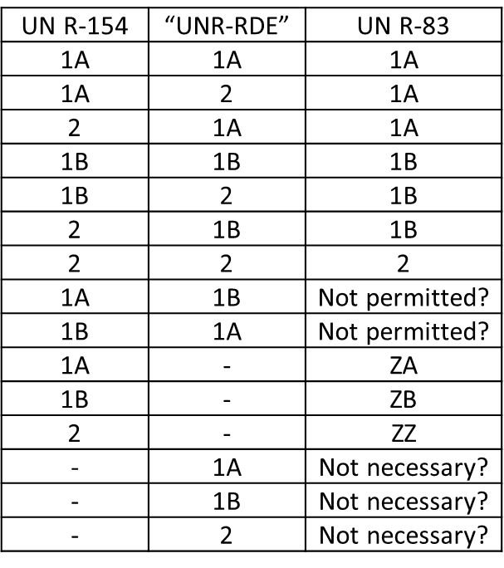
Additional Comment re. GRPE/2023/02
In case the OICA proposal for Levels in UN R-RDE is accepted, it would be useful to also include them in UN R83.08 as follows:

