Slide 1
Transmitted by the expert of the Netherlands
Informal document GRSG-124-33 GRSG 124th session, 11 – 14 October 2022 Agenda Item 16
TF-AVRS
Status Update October 2022

Slide 2
Status Update TF-AVRS (Automated Vehicles Regulatory Screening)
GRSG-124-XX
2 meetings: 12 September and 7 October 2022, both online.
As a result of the 1st meeting a document was prepared to be discussed at the GRVA-14 end of September: GRVA-14-41 with the request for guidance
Other related documents discussed during the GRVA: GRVA-14-31 (OICA, CLEPA), GRVA-14-36 (France), GRVA-14-53 (France, Germany, the Netherlands) and GRVA-14-56 (OICA)
Intense discussions followed at the GRVA-14.
The GRVA secretariat eventually introduces GRVA-14-54r1 which was edited during the session into revision 1.

Slide 3
Status Update TF-AVRS
GRSG-124-XX
This document GRVA-14-54r1 to be considered as a first step and guidance of what type of vehicles shall be covered and how to do the screening

Slide 4
GRVA-14-54r1
GRSG-124-XX

Slide 5
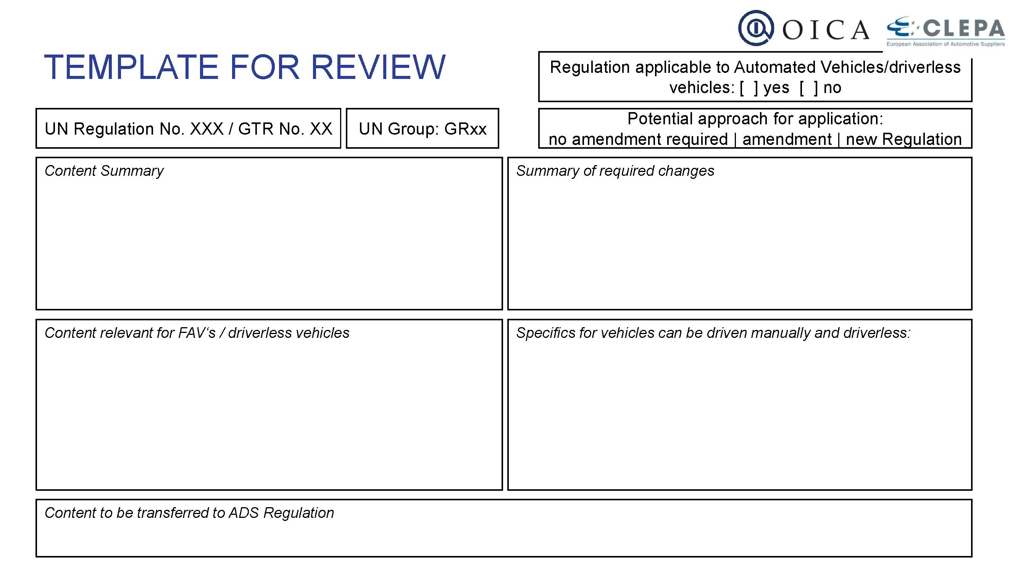
GRVA-13-18
GRSG-124-XX

Slide 6
Way forward
GRSG-124-XX
Schedule a meeting with 1-2 representatives of each GR, to finalise the procedure and template how to do the screening. Tentatively scheduled for November 11th.
After this, each GR can gather with their own Task Force to go through all Regulations falling under their responsibility.

Slide 7
GRSG-124-XX
Thank you for your attention !

