Slide 1
General Motivation
Submitted by the expert from Germany | Informal document GRSG-124-03 (124th GRSG, 11–14 October 2022 Agenda item 4(d))
EC establishing ambitious direct vision requirements for heavy vehicles to address moving off accidents → massive cab redesigns
DE position: Reliable active safety systems possibly better in many aspects, no driver reaction to pedestrian required for avoidance
Accidents prevented by Active Safety
Accidents prevented by new Direct Vision

Slide 2
What is Active Vehicle Safety?
Active Vehicle Safety Avoidance of Accidents!
Passive Vehicle Safety Mitigation of Consequences
Can we make active safety as safe, robust and reliable as a window?

Slide 3
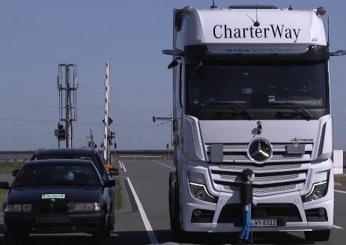
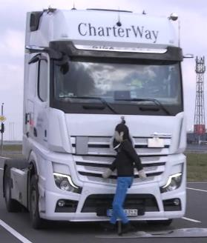
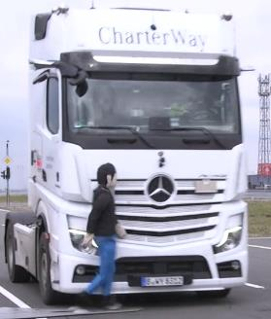
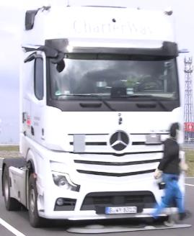
Overview of Scenarios - Crossing
CPFA50: Running (8 km/h)
CPNA25 Walking (5 km/h)
CPNA75 Walking (5 km/h)
CPNC: Hidden Child (5 km/h )
Initially hidden behind these cars

Slide 4
AEBS already can avoid accidents

Slide 5
Boundary Condition: General Safety Regulation 2
The EU has fixed in their General Safety Regulation: “Requirements should therefore be introduced to improve direct vision to enhance the direct visibility of pedestrians, cyclists and other vulnerable road users from the driver’s seat by reducing to the greatest possible extent the blind spots in front and to the side of the driver. The specificities of different categories of vehicles should be taken into account.”
“Greatest possible extend” is not verifyable, so there seems to be at least some technical flexibility
This interpretation will fall under the responsibility of GRSG

Slide 6
UEBS Strategy
Adjusting direct vision requirements for specific, active safety-equipped vehicles requires information on expected performance
Current discussions in GRSG suffered from an unclear expectation for possible performance & robustness
Strategy: establish a safe active safety standard in GRVA – produce a regulation with ambitious performance thresholds and robustness as basis for following discussions on DV requirements

Slide 7
Related Documents in GRVA
ECE/TRANS/WP.29/GRVA/2022/24 – proposal for a regulation
GRVA-14-37 – introduction presentation to the proposal
GRVA-14-10 – position paper from Denmark

Slide 8
Basics – Cross Traffic AEB (1)
Before the accident, participants move orthogonal
View fixed in world
View fixed on vehicle
VRU
VRU
VRU
VRU
VRU
Vehicle
Veh: 10 km/h VRU: 5 km/h
VRU
Vehicle
Veh: 10 km/h VRU: 0 km/h
VRU
Vehicle
Veh: 10 km/h VRU: 10 km/h
VRU
Vehicle
Vehicle
Vehicle

Slide 9
„Reaction time blind spots!“ (RTBS) (for all impact positions, all VRU speeds)
Human drivers need 1-1.2 seconds time to react to suddenly appearing obstacles
Driver cannot react to threats appearing in the areas shown on right side →
Typical crossing accidents will not be prevented with increased vision beyond the RTBS
Key task of increased Direct Vision: Prevent moving off accidents
10 km/h
5 km/h
Vehicle

Slide 10
GIDAS Accidentology: AEBS-HDV-SP-02-05 (CLEPA)
DV
DV
DV
Direct vision: mainly moving off

Slide 11
UN-R159 (Moving Off Information System) Specs
When vehicle moving (<= 10 km/h):
Inform for VRU: stationary up to longitudinally 10 km/h
When vehicle stopped
Inform for VRU: crossing 3-5 km/h
In blue area as shown
>= 15 lux ambient lighting
max 3.7 m
0.5 m
0.8 m

Slide 12
R159 shortcomings
Information requires timely driver reaction
Vehicle moving: only reacting to longitudinally moving / stationary VRU
Vehicle stopped: only reacting to crossing VRU 3-5 km/h
→ no wholistic requirements
Gap between vehicle and blue area

Slide 13
Proposal – Perf Req’s
Stationary
Motion inhibit when VRU in dark blue zone (new!)
Motion inhibit when VRU in orange zone (total: 1.5 m)
Moving
Avoid collision with all longitudinal VRU up to 10 km/h vehicle speed
Avoid collision with all crossing VRU <=5 km/h vehicle speed <=5 km/h 0-100% impact
Avoid collision with all crossing VRU <=5 km/h vehicle speed <=20 km/h for center impacts (connection to R131-02, starting 20 km/h)
Avoidance of all cases R151, alt test procedure
max 3.7 m
0.5 m
GRVA activity with active safety experts started
0.8 m

Slide 14
Backup

Slide 15
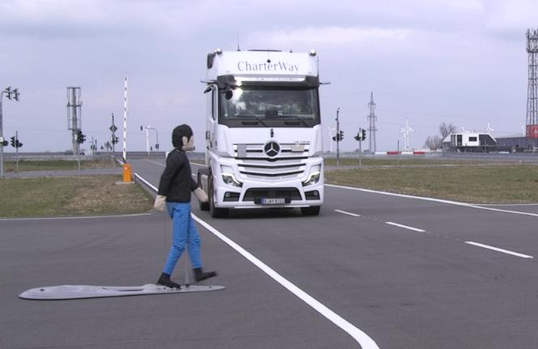
Basics – Cross Traffic AEB
Tests are carried out with different impact positions
Impact position is controlled by the timing the dummy starts
The lower the number:
the later the dummy starts,
the less time the dummy travels in front of the vehicle,
the more demanding is the situation.
75%
50%
25%

Slide 16
Basics – Cross Traffic AEB (2)
Avoidance possible when seen here
VRU
VRU
10 km/h = 2.78 m/s
1.2 s reaction time → 3.34 m
5 km/h = 1.39 m/s
1.2 s reaction time → 1.67 m
5 vs. 5 km/h
3.34m
10 vs. 5 km/h
1.67m
Vehicle
Avoidance possible when seen here
Conclusion: Close Proximity Vision is not relevant for crossing accidents!
AEB VRU is relevant for crossing accidents!
2.55m

Slide 17
Why no avoidance 0-100% impact at 10 km/h?
1. Vehicle stopping distance from 10 km/h: → stopping dist. 3 m, braking starts at ~ 1 s TTC
2. Pedestrian: 5 km/h → distance travelled in 1 s approx. 1.4 m
3. Pedestrian stopping distance is about 0.3 – 0.5 m
Pedestrian stopping distance
4. Ped position when braking needs to start is before (!) the pedestrian has reached it’s own stopping distance
Lower vehicle speed → lower stopping distance:
1. stopping distance from 5 km/h : → braking distance 1.5 m, braking starts ~ 0.5 s TTC
2. Ped.: 5 km/h → travels approx. 0.7 m in 0.5 s
3. Pedestrian stopping distance ~0.3 – 0.5 s
4. Pedestrian stopping distance ~= vehicle stopping distance, so vehicle needs to start braking when it is clear that pedestrian will not stop in time.

Slide 18
Why avoidance 20 km/h vehicle speed?
1. Vehicle stopping distance from 20 km/h: → stopping dist. 13 m, braking starts at ~ 2.5 s TTC
Center impacts
2. Pedestrian: 5 km/h → distance travelled in 1 s approx. 1.4 m
3. Pedestrian stopping distance is about 0.3 – 0.5 m
4. But for center impacts: Pedestrian is not able to prevent entering in vehicle path (orange line) when vehicle starts braking.

Slide 19
Robustness Requirements
No lux limit → not dependent on ambient lighting! → classifying RADAR, possibly 2x → low-cost LIDAR or ultrasonic for confirmation
Rain/fog etc. should be ok for RADAR & close distances
No deactivation foreseen; automatic deactivation if sensors are covered with ice (similar to R151, R159)

