Slide 1
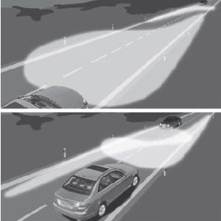
Informal document GRE-87-19
Agenda item 10 (c)
“Headlamp Safety Performance Rating” (HSPR)
GTB Recommended Practice
Today’s light distributions of modern headlamp systems can be adapted in traffic situations, according to the oncoming and preceding vehicles, by combining a passing-beam with horizontal cut-off shape and an ADB lighting function. The purpose of this system is to avoid a critical glare level for other traffic participants, while providing maximum illumination range for the driver.
Therefore, for a complete, fair and objective rating of modern headlamp systems, all main lighting functions like passing-beam, ADB and driving-beam must be considered.
This GTB “Recommended Practice” aims to define an objective standard for headlamp rating systems, including ADB functionality.
The HSPR Recommended Practice and software are publicly available here:
https://www.gtb-lighting.org/publications/
87th GRE session - 25-28 October 2022

