Slide 1
GRE
IWG
SLR
Transmitted by GRE-IWG SLR
Informal document GRE-87-10
(87th GRE, 25-28 October 2022,
agenda item 4)
Simplification of the UN Lighting and Light-signalling Regulations
Progress report
to GRE-87

Slide 2
- Workload and meeting pace -
11 September 2014 in Brussels (BE)
23 October 2014 in Geneva (CH)
14 January 2015 in Brussels (BE)
13 April 2015 in Geneva (CH)
13 October 2015 in Brussels (BE)
5-6 November 2015 in Brussels (BE)
15-16 December 2015 in Brussels (BE)
13-14 January 2016 in Brussels (BE)
29 February & 1 March 2016 in Brussels (BE)
14-15 April 2016 in Brussels (BE)
9-10 June 2016 in Brussels (BE)
5-7 September 2016 in Brussels (BE)
5-7 October 2016 in Brussels (BE)
5-7 December 2016 in Brussels (BE)
21-23 February 2017 in Brussels (BE)
22-24 March 2017 in Brussels (BE)
16-18 May 2017 in Tokyo (JP)
13-15 June 2017 in Brussels (BE)
12-14 July 2017 in Brussels (BE)
4-6 October 2017 in Brussels (BE)
18-21 December 2017 in Brussels (BE)
29 Jan / 1 Feb 2018 in Shenzhen (CN)
4-6 April 2018 in Brussels (BE)
30 May / 1 June 2018 in Brussels (BE)
3-5 July 2018 in Brussels (BE)
24-26 September 2018 in Brussels (BE)
10-12 December 2018 in Brussels (BE)
25-27 February 2019 in Brussels (BE)
27-29 March 2019 in Brussels (BE)
22-24 May 2019 in Brussels (BE)
3-5 July 2019 in Brussels (BE)
3-5 September 2019 in Tokyo (JP)
9-11 October 2019 in Brussels (BE)
4-6 November 2019 in Brussels (BE)
58 meetings
11-13 December 2019 in Brussels (BE)
8-10 January 2020 in Brussels (BE)
2-4 March 2020 in Brussels (BE)
27-29 May 2020 – WebEx
7-10 July 2020 – WebEx
26-28 August 2020 – WebEx
21-23 September 2020 – WebEx
3-5 November 2020 – WebEx *
9-11 December 2020 – WebEx *
12-14 January 2021 – WebEx *
17-19 February 2021 – WebEx
24-26 March 2021 – WebEx
10-12 May 2021 – WebEx
16-18 June 2021 – WebEx *
20-22 July 2021 – WebEx *
9-10 September 2021 – WebEx *
6-8 October 2021 – WebEx
15-17 December 2021 – WebEx
19-21 January 2022 – WebEx
23-25 March 2022 – WebEx
18-20 May 2022 – Brussels (BE) *
27-29 June 2022 – Brussels (BE) *
15-16 September 2022 – Karlsruhe (DE) *
12-14 October 2022 – Brussels (BE)
Next meetings (Hybrid sessions from Brussels):
SLR-59 on 14-16 December 2022
SLR-60 on 18-20 January 2023
SLR-61 on [22-24 March] 2023
* = In conjunction with a special SLR session on “headlamp levelling” (https://wiki.unece.org/pages/viewpage.action?pageId=113345289)

Slide 3
SLR submission to GRE-87
“Summary document” to be placed in DETA for supporting the Unique Identifier (UI)
ECE/TRANS/WP.29/GRE/2022/10 → Suppl. 1 to UN Regulation No. 148.01
ECE/TRANS/WP.29/GRE/2022/11 → Suppl. 1 to UN Regulation No. 149.01
ECE/TRANS/WP.29/GRE/2022/12 → Suppl. 1 to UN Regulation No. 150.01
“Device transition” to enable phasing out the installation of devices approved according to the previous series of amendments
GRE-87-xx → Draft proposal for UN Regulation No. 48.09
Note: A package of 4 proposals, one for each installation Regulation will be submitted as formal documents to GRE-88 in April 2023: R48.09, R53.04, R74.03 and R86.03
Notes:
A complete package of 12 documents will be discussed at GRE-85 in October 2021. This will include:
a presentation of the main changes (3 informal documents)
a consolidated text for each of the draft 01 series of amendments to the new device Regulations No. 148, 149 and 150 (3 formal proposals)
all the installation Regulations (R48, R53, R74, R86) will be amended to introduce references to the headlamp Classes in the 01 series of amendments to Regulation No. 149 (6 formal proposals)
This has been a huge challenge for GTB and its WGs which have heavily contributed to this work since “Day #1”

Slide 4
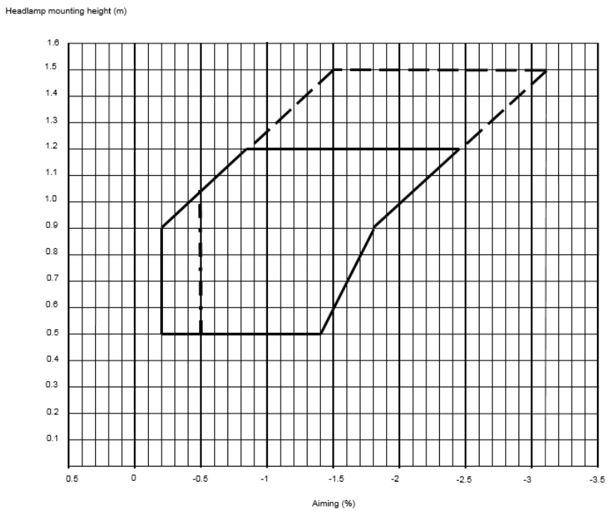
Headlamp Levelling
GRE-IWG SLR submitted a Revised proposal to GRE-84
GRE/2020/8/Rev.2
Removal of the manual levelling option,
except for off-road vehicles
(i.e. M₂G, M₃G, N₂G, N₃G)
New
aiming
diagram
Unfortunately GRE could not endorse such a proposal and asked SLR to further work on this.
Discussion is still in progress:
Nine special SLR sessions on “headlamp levelling” have taken place. The last one was in Karlsruhe (Germany) on 13-14 September 2022.

Slide 5
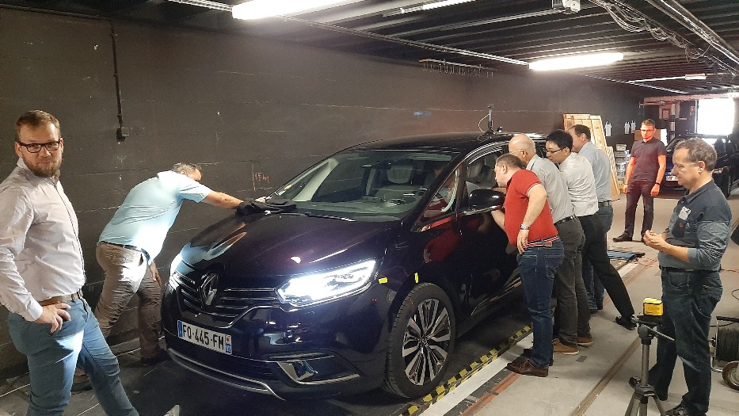
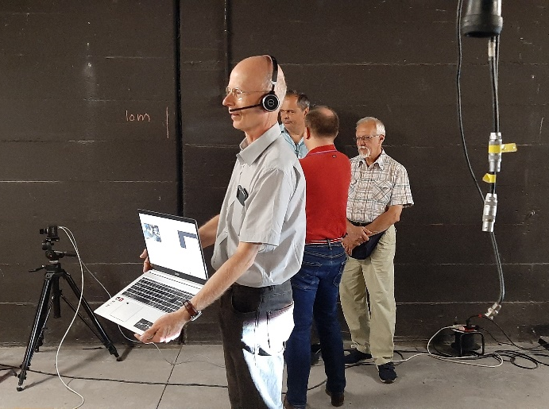
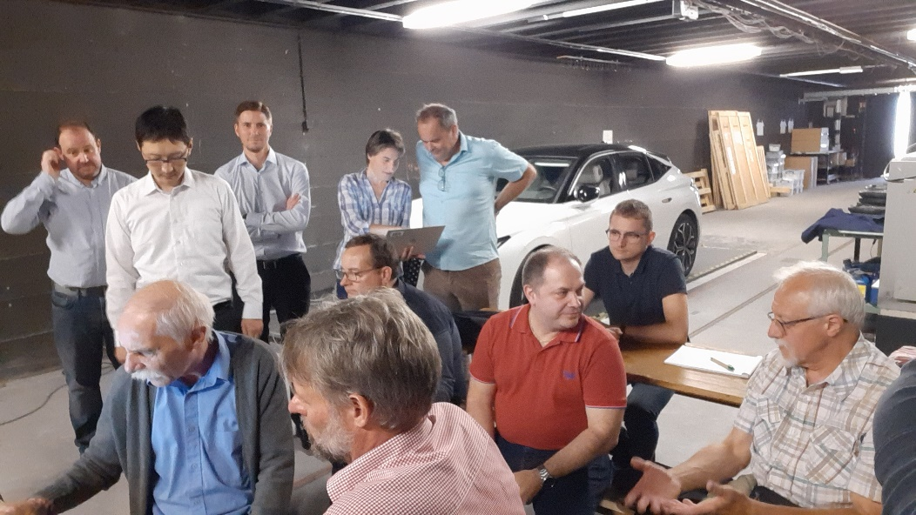
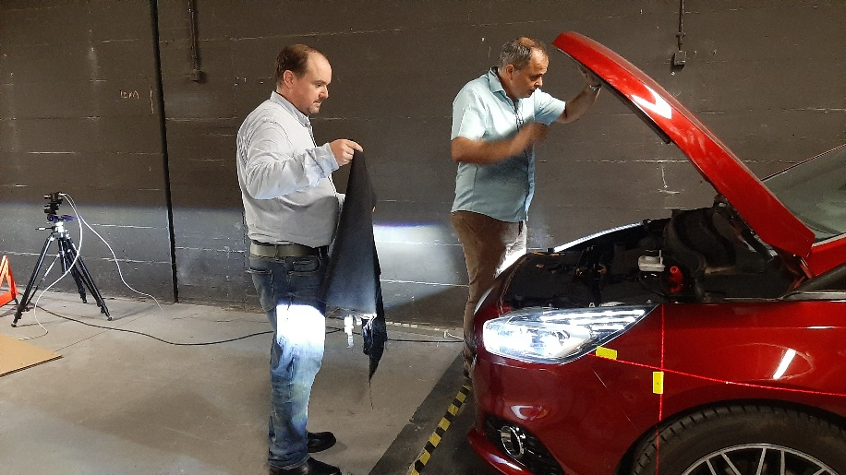
Headlamp Levelling
Special SLR session on “headlamp levelling” in Karlsruhe (Germany)
on 13-14 September 2022.

Slide 6
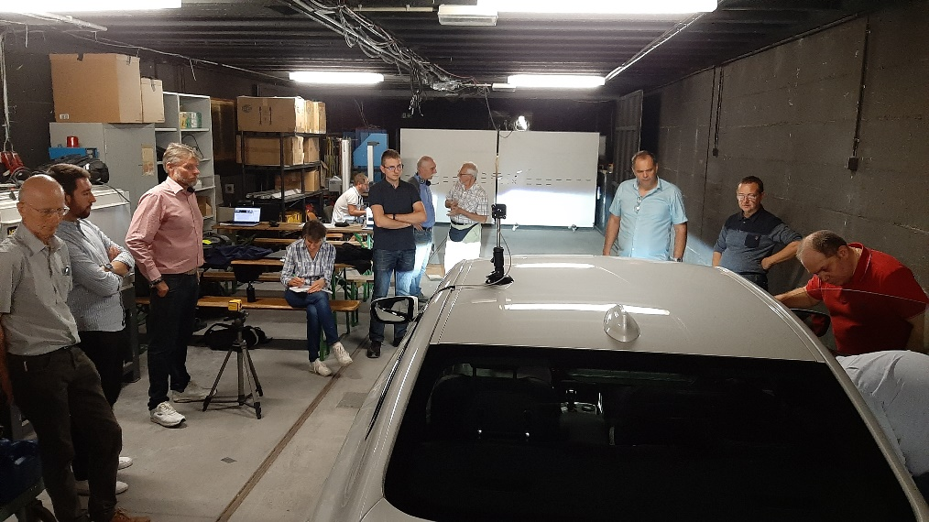
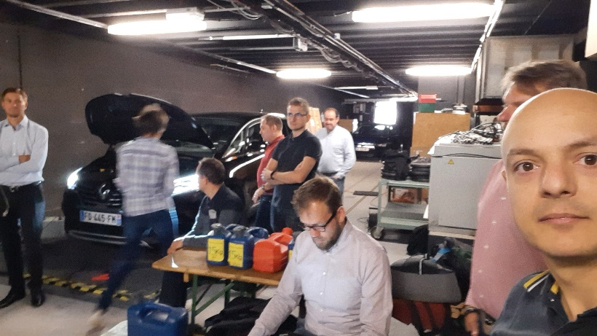
Headlamp Levelling
Special SLR session on “headlamp levelling” in Karlsruhe (Germany)
on 13-14 September 2022.
The session included a set of measurements on vehicles fitted with automatic aiming devices of current production; scope of the measurements was to understand the reaction to the loading condition and the potential ability of these systems to fulfill possible new aiming ranges.
SLR intended to work on a suitable solution, based on the results of this meeting and taking into account all the constraints in the practical application of the new aiming requirements.
A new, more stringent, aiming diagram proposed by Poland (doc. SLR-HL-28/Rev.2) was discussed but received no support from SLR.

Slide 7
Headlamp Levelling
The SLR target was to submit a first proposal to GRE-87 (Oct 2022) followed by
a formal one for GRE-88 (April 2023).
However, no consensus could be reached on the aiming diagram.
Decision by GRE is needed

Slide 8
Stage 2 / Step 2
Specific items and general topics for consideration
THE GOAL:
“Simplify and update the technical requirements of the UN installation Regulations (Nos. 48, 53, 74, 86), to become technology neutral with performance-based and objective test requirements”
3 “Homework Teams” have been established for the specific Installation Regulations:
Reg. 48, Regs. 53 & 74, Reg. 86
SLR produced a list of specific items and general topics that should be dealt with in “Stage 2 / Step 2” of the Simplification. For example, the following subjects are considered as relevant ones:
Simplify and improve the definition of apparent surface
Objective assessment of the actual functions (visibility vs. glare, recognition vs. distraction) as installed on the vehicle
Harmonise requirements with other regions where possible
Consistency among similar requirements and definitions in installation regulations
The complete list is available in doc. SLR-52-03/Rev.7. Having completed the collection from CPs and NGOs, inputs have been grouped and prioritised by assigning different colours and a brief “problem statement” has been indicated for each subject. → Need input on contents from CPs and NGOs on specific items.

Slide 9
Input from CPs and NGOs is always welcome
Please feel free to join!

