Slide 1
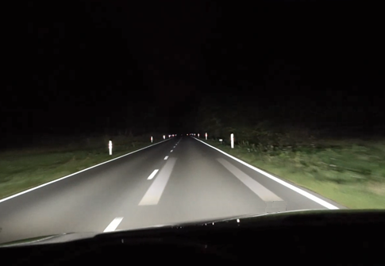
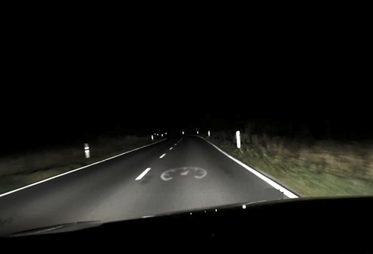
Informal document GRE-87-06
“Driver Assistance Projections” (DAP)
Live demonstrations during GRE-87
On Wednesday, 26 October, and (if necessary) on Thursday, 27 October, there will be the possibility to participate between 19:00 and 23:00 hours in live demonstrations of “Driver Assistance Projections” at a location close to Geneva. A Shuttle service for the delegates that are interested in this demonstration will be provided, starting and ending at “Les Brasseurs” in front of the Central station.
Vehicles presented: 3-5 with different functionalities, symbols, patterns, etc.
Scenarios: - static scenarios (including encounter and symbols to be watched from different perspectives)
- dynamic scenarios (including encounter and different functionalities during test drive)
Further details will be provided during the 87th GRE session.
87th GRE session - 25-28 October 2022

