Slide 1
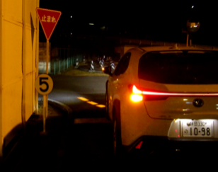
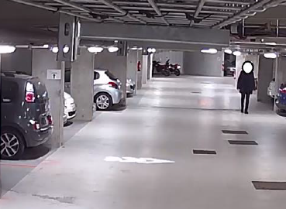
Informal document GRE-87-03
(87th GRE, 25-28 October 2022, agenda item 11)
“Signalling Road Projection” (SRP)
Status report & Request for guidance
87th GRE session
25-28 October 2022
- GTB/WG-SL (Signal Lighting) -

Slide 2
Signalling Road Projection
Introduction
In Fall 2021, GTB initially introduced the idea for Signalling Road Projection (SRP) to GRE and presented informal document GRE-85-38. Note: the context is limited to projections combined with turn indicators and/or reversing lamps.
GTB experts are convinced that SRP is contributing to road safety as it allows also vulnerable road users to recognize driver’s intentions on intuitive basis.
Scientific evidence has already been proven for reversing projection and further scientific research has been initiated for direction indicator projection.
A draft text for Signalling Road Projection is under preparation by the experts.
GTB is asking for guidance to GRE about how to implement SRP into the existing UN Regulations.
- GTB/WG-SL (Signal Lighting) -

Slide 3
Signalling Road Projection
Content
Introduction
Scientific research
Direction indicator projection – ongoing studies
Yeungnam University
ELS
Reversing projection – scientific evidence of benefit for Traffic Safety
Impact of Advanced Lighting Function based on Road Projection for Departing Indication in Parking Lots, S. Azouigui, ELS, ISAL 2019
Guidance needed from GRE
Timeline for a draft proposal to amend UN Regulations Nos. 148 and 48
- GTB/WG-SL (Signal Lighting) -

Slide 4
Signalling Road Projection
Scientific research – Direction indicator projection (Yeungnam)
Pre-study: VR-based driver monitoring and scenario evaluation
Shape of projections
Different angles and scenarios of projection
Checked data: behavioural and subjective
Step 1: Virtual Simulator-Based Finding of Benefits and Potential Distraction
Step 2: Validation based on Mock-up Lamp for Critical Situation
Final results expected for last quarter of 2022
- GTB/WG-SL (Signal Lighting) -

Slide 5
Signalling Road Projection
Scientific research – Direction indicator projection (ELS)
Objective of the study:
Safety relevance of DI SRP
Use-case: Intention of departing from a parallel parking space
Tests on cyclists and in urban situation
Three scenarios (no signal, turn indicator only, turn indicator + SRP)
Final results expected for last quarter of 2022
- GTB/WG-SL (Signal Lighting) -

Slide 6
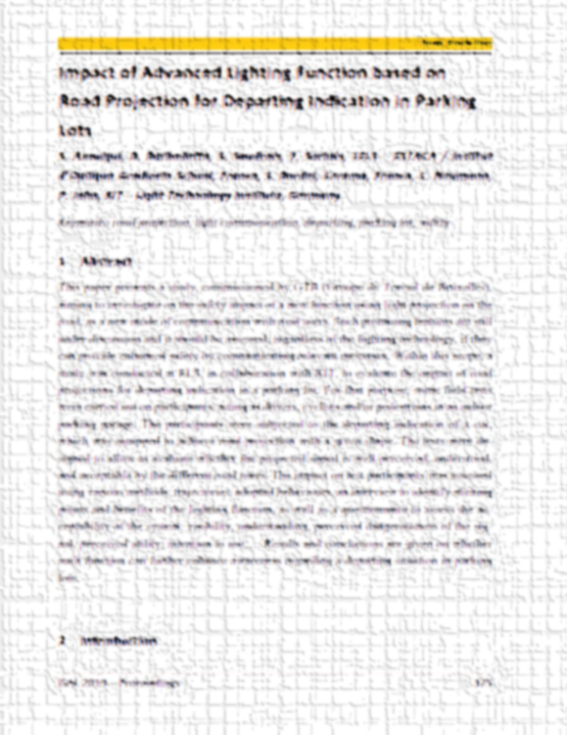
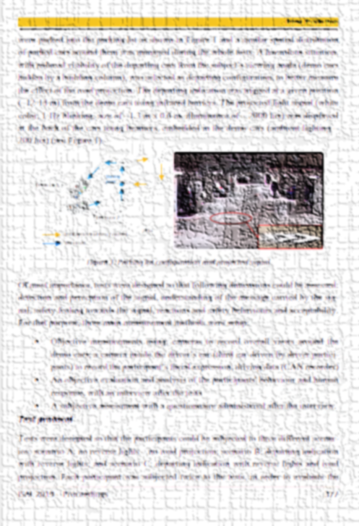
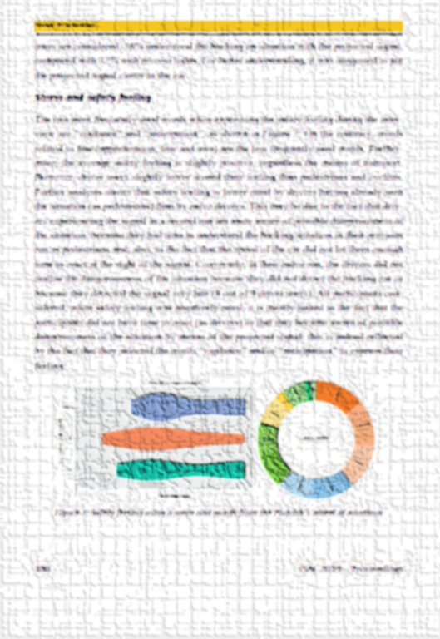
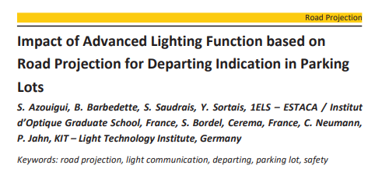
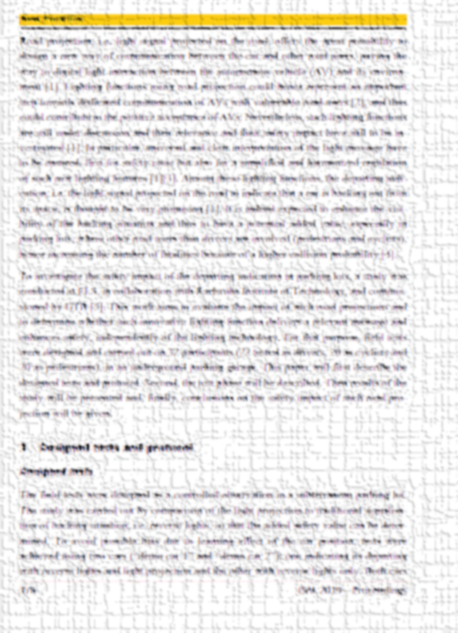
Signalling Road Projection
Scientific research – Evidence for benefit of Reversing projection (ELS)
Impact of Advanced Lighting Function based on Road Projection for Departing Indication in Parking Lots, S. Azouigui et. al., ELS, ISAL 2019
- GTB/WG-SL (Signal Lighting) -

Slide 7
Signalling Road Projection
GRE guidance needed – implementation approach
GTB identified a benefit in allowing the Signalling Road Projection being either combined or independent of the signalling function. GTB also sees a benefit for harmonization of the UN and Chinese regulations on signalling projection.
The draft Chinese standard defines “signalling projection units” that may be independent from, or combined/reciprocally incorporated with, other light signalling devices.
In case of independent devices, they shall not be visible to other road users*.
→ Does GRE agree to amend the UN Regulation(s) accordingly?
Combined/incorporated projection unit
Independent projection unit
* Note: Non-visibility criterion already exists in R48 for courtesy/manoeuvring lamps and can be applied for projection modules as well
- GTB/WG-SL (Signal Lighting) -

Slide 8
Signalling Road Projection
Timeline for Signalling Road Projections
Draft proposal for UN Regulations Nos. 148 / 48
GRE-87: Intermediate information and open questions
GRE-88: Informal draft proposal
If possible, a Live Demonstration of vehicles with Signalling Road Projection will be organised
GRE-89: Formal proposal, taking into account the input received during GRE-87 and GRE-88, including justification and information about the studies
- GTB/WG-SL (Signal Lighting) -

