Slide 1
Approval process of LED replacement light sources
Submitted by the experts from IEC
Informal document GRE-87-02
(87th GRE, 25-28 October 2022, agenda item 5.)
2022-09-26
Ph. Plathner, W. Schlager

Slide 2
Content
UN approval process
National approval process
Summary and request for guidance

Slide 3
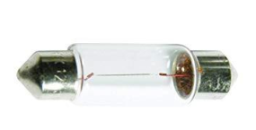
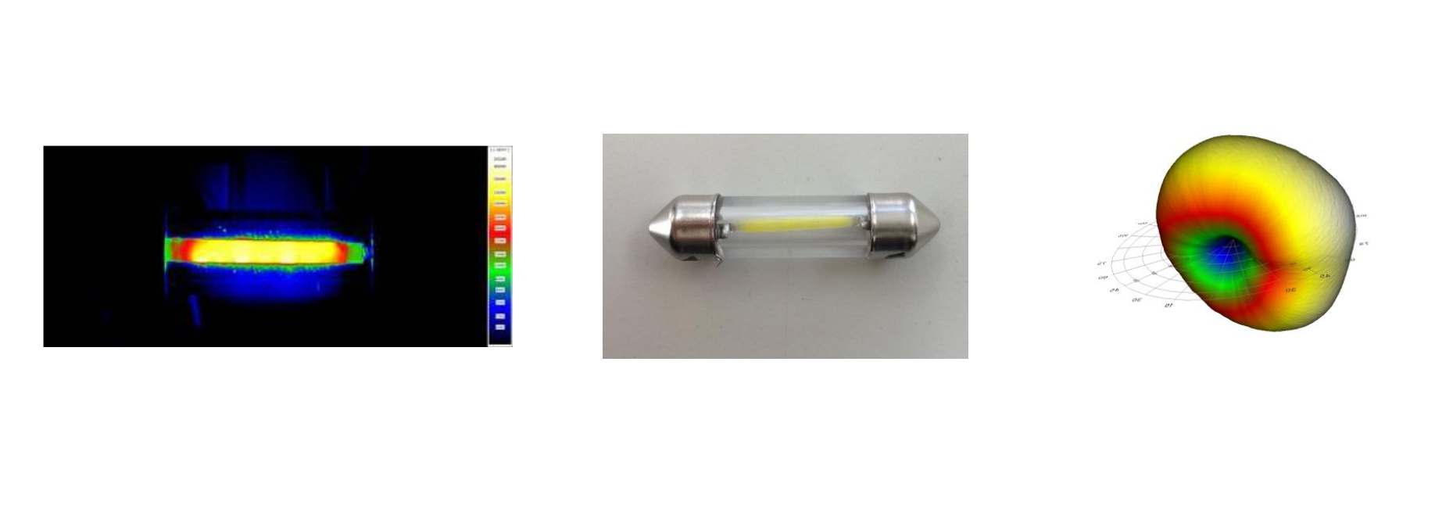
UN R37 approval full photometric equivalence according to guideline (GRE-83-15)
Example 1: Signalling light source C5W (low power)
PRO‘s
complete set of light source specifications based on “full equivalence” to incandescent technology
Possible for 5W types with today LED technology
Possible for 10W and 20W types in near / mid future
Leads to same photometric performance in the application
No need for testing in the luminaire (no need for positive list)
CON‘s
none
Near field: filament-like
Far field: filament-like

Slide 4
UN R37 approval full photometric equivalence according to guideline (GRE-83-15)
Example 2: Road illumination light source H7 (high flux)
PRO‘s
complete set of light source specifications based on “full equivalence” to incandescent technology
But not technically feasible today for high flux categories
It would …
lead to same beam performance
mean no headlamp testing, no positive list needed
CON‘s
Full equivalence (= emulation of filament) would not improve the beam performance, i.e. advantages of LED technology not utilised
Far field: filament-like
Homogeneous illumination
of whole reflector (green and red segments)
from
reflector segment to
light on the road
full-equivalence solutions not feasible for high flux categories
with todays LED technology

Slide 5
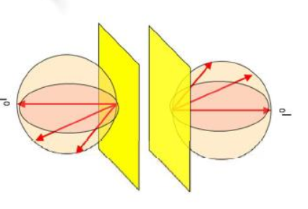
National approvals (Germany, France, Austria …) Deviating from full photometric equivalence
Methodology
Extensive testing (in headlamps and vehicles)
Limited light source specifications
Resulting in positive list
PRO‘s
Enabling legalization of safe LEDr, supporting market surveillance
Increased beam performance in many tested headlamps
Technically feasible with today LED technology
CON‘s
Incompatible with some headlamps / vehicles
Mis-use may lead to non-compliant beams
High effort for industry and approval authorities to maintain the positive list
Country-specific approval processes, limited mutual recognition
Not yet possible in most countries
Less light in green segments
More light in red segments
from
reflector segment to
light on the road

Slide 6
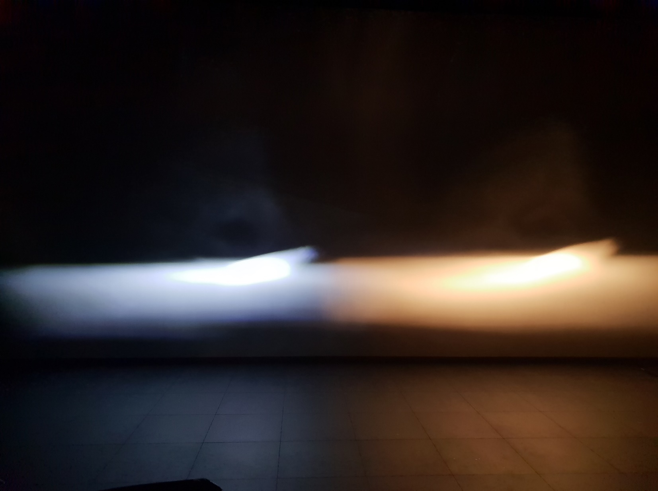
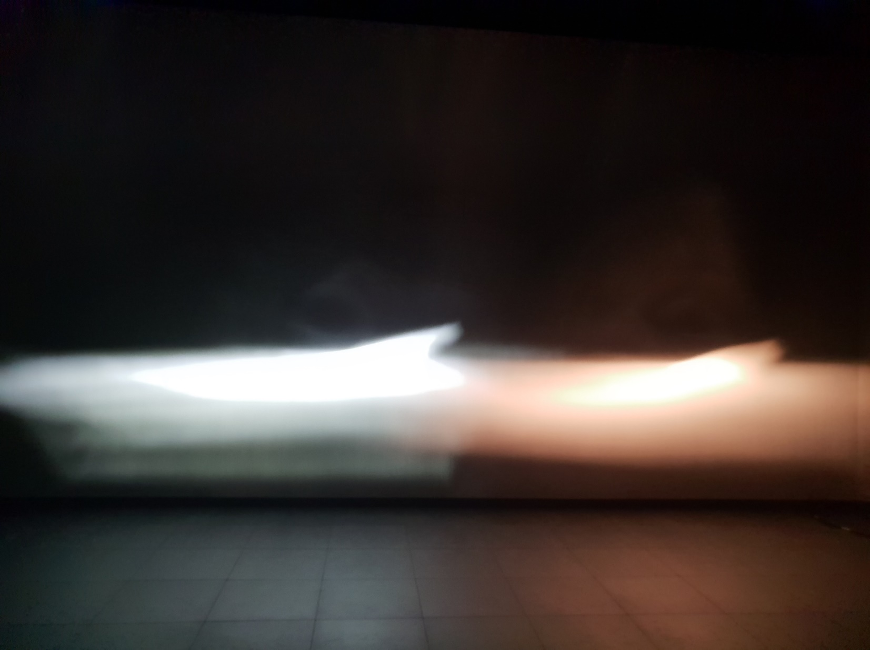
Examples – beam performance comparison
LEDr acc. to R37 with full photometric equivalence
Filament bulb acc. to R37
Nationally approved LEDr,
deviating from full-equivalence
Filament bulb acc. to R37
→ SAME* beam performance with both technologies
→ BETTER* beam performance with LEDr
* Besides the color temperature
*Compliant beam with more light in 50m … 70 m range
=
>
→ SAME beam performance with both technologies
→ BETTER beam performance with LEDr

Slide 7
Summary and request for guidance
SUMMARY:
The UNECE R37 Framework for LEDr is based on “full photometric equivalence” and is enforced. It allows safe LED replacements with the SAME photometric performance as the conventional technology.
For road illumination, a further extension of the framework can offer BETTER beam performance:
Overcome the limitations and drawbacks of the conventional light source
Make full use of the advantages of LED technology
National-approved 2-sided designs have proven that compliant and better performing beams are feasible.
Data from German and French approvals are public.
The basis for the national approvals is always a verification of the photometry in the application (positive list approach)
REQUEST FOR GUIDANCE:
Does GRE support the re-evaluation of the equivalence criteria beyond full-equivalence?

