Slide 1
Informal document GRVA-14-52
14th GRVA, 26-30 September 2022
Agenda item 8(b)
Submitted by the expert from CLEPA
UN Regulation No. 13
and Electro Mechanical Brakes

Slide 2
UN R13 and Electro Mechanical Brakes (EMB) Introduction and recap
UN Regulation 13 defines:
Transmission means the combination of components comprised between the control and the brake and linking them functionally. The transmission may be mechanical, hydraulic, pneumatic, electric or mixed.
Control Transmission - means the combination of the components of the transmission which control the operation of the brakes, including the control function and the necessary reserve(s) of energy.
Energy Transmission - means the combination of the components which supply to the brakes the necessary energy for their function, including the reserve(s) of energy necessary for the operation of the brakes.
→ The transmission may be mechanical, hydraulic, pneumatic, electric or mixed.
UN R13 was updated in 1990s to account for an electronic “Control Transmission” but still assumes Pneumatic “Energy Transmission” in the service braking system.
Pneumatic Energy limitation is shown in two ways: Design Specifications – E.g. Where limits are in kPa. Design Limitations – E.g. Where it is assumed air is the medium.
Electro Mechanical Brake Technology is being developed by the industry using Electric Energy Transmission in the service braking system and the UN R13 needs to be updated accordingly.

Slide 3
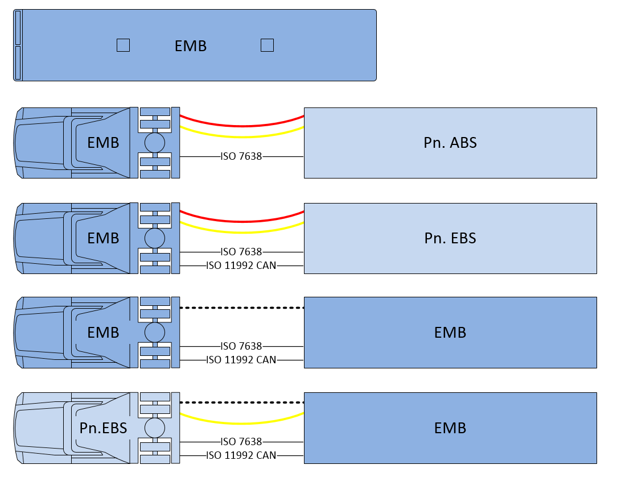
UN R13 and Electro Mechanical Brakes (EMB) Amendment scope and motivation
Motor vehicle with EMB brakes on all axles (not mixed with Pneumatic Or Hydraulic systems)
Motor vehicle with EMB brakes with “conventional” trailer interface according to current UN R13
Trailers with EMB excluded from scope
UN R13-H not included but considered, in particular when creating new definitions
Advantages and possibilities by amending Electric Energy Transmission to UN R13
Improved energy efficiency in EV´s (vs. air compressor)
Improved braking control
Elimination of noise emissions from pneumatics

Slide 4
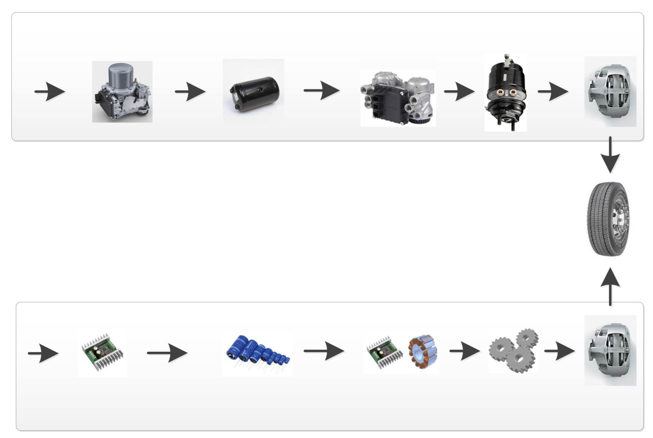
UN R13 and Electro Mechanical Brakes (EMB) Energy Transmission principles (Pneumatic vs. Electric)
E-APU
Pneumatic energy
storage
EBS Modulator
Actuator
Caliper
Pneumatic
Energy
EBS
Annex 7 part A
Energy supply
Energy storage
Actuation
EMB
Annex 7 new part D
New 5.2.1.35.
Electric
Energy
DC/DC
Electric energy storage
Drive and Motor
Gears
Caliper
4

Slide 5
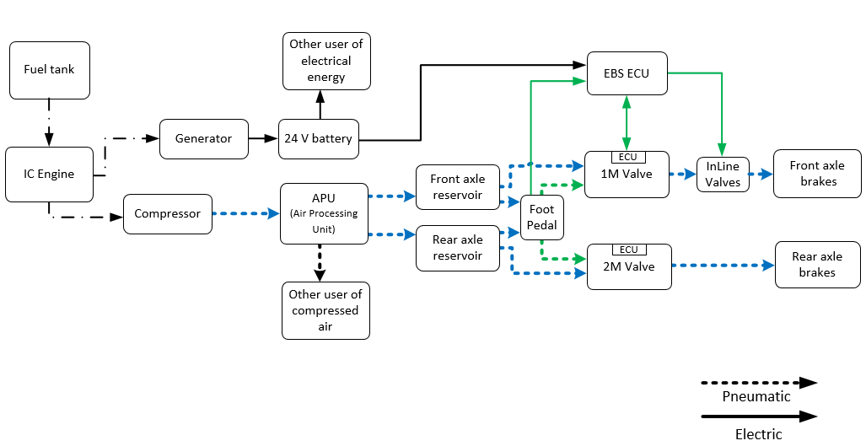
System Description
Example EBS system of today in vehicle with combustion engine
El. Control Transmission (example shown only front axle)
Energy Source
p1
Energy Source
p2
Pneumatic
Storage Device
Pn. Energy Transmission
p1 and p2: Pneumatic energy monitoring and warning if storage falls below a certain level.

Slide 6
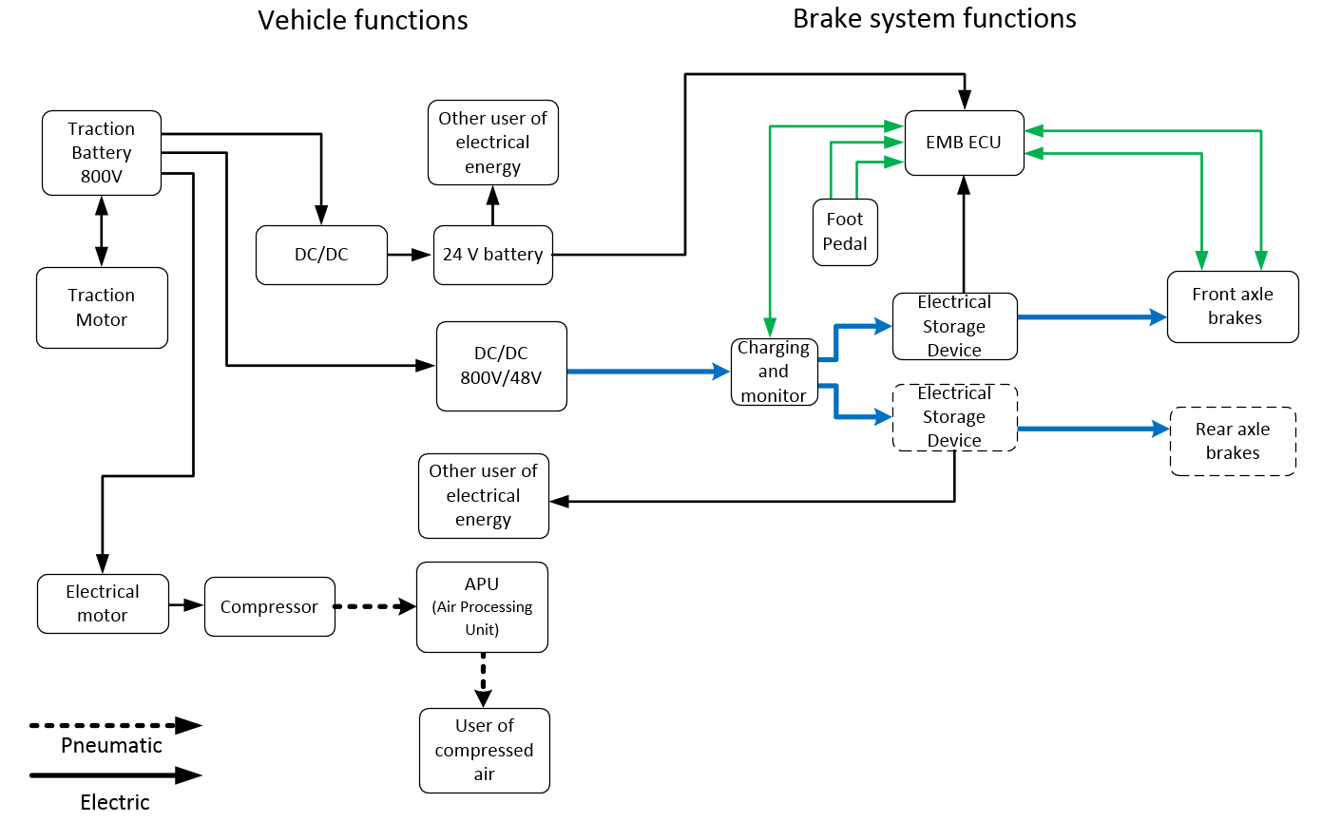
System Description
Example EMB system in electric vehicle
El. Control Transmission (example shown only front axle)
AEUPw1
Pw
Energy Supply Device
AEUPw2
Energy Source
Electrical Storage Device
El. Energy Transmission
Pw: Electric energy monitoring and warning if charging demand cannot be met and if below a certain level.
AEUPw: Electric energy monitoring and warning if storage falls below a certain level.

Slide 7
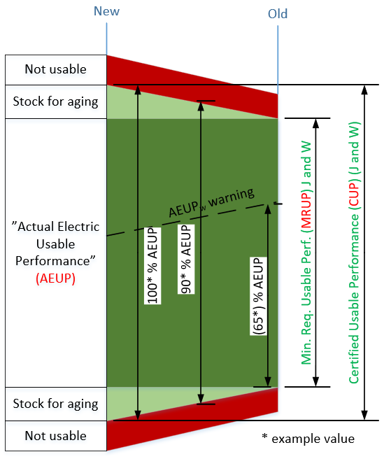
Electrical Energy Storage device
Addressing the effect of ageing
New definitions:
“Certified Usable Performance (CUP)” means the maximum usable performance of an electrical energy storage device available for an electro-mechanical braking system determined at the time of type approval.
“Minimum Required Usable Performance (MRUP)” means the minimum usable performance of an electrical energy storage device available for an electro-mechanical braking system to fulfil the relevant requirements of this Regulation.
“Actual Electric Usable Performance (AEUP)” is the level of energy stored in an electrical energy storage device, as well as its available power, at a given time. It is defined as a percentage of the CUP value.
New proposal
The “usable performance” means the portion of the performance of an electrical energy storage device that is actually available to the supplied system (e.g. the system may not use the maximum theoretical performance).

Slide 8
UN R13 and Electro Mechanical Brakes (EMB) Status and open topics still to be discussed
Newly added definitions
Ref. former slide some definitions still in discussion.
New architecture proposal
5.2.1.2.7.3 One EESD can supply one brake with energy transmission
Paragraphs still being updated
5.2.1.13.x – Energy Storage device(s) and warning signal
5.2.1.35.x – Special additional requirements for service braking systems with electro- mechanical braking system with electric transmission.
New proposed amendments to Annex 2
→ 17 - Additional information in the case of power-driven vehicle equipped with an electro-mechanical braking system (‘EMB’)

Slide 9
UN R13 and Electro Mechanical Brakes (EMB) Status and open topics still to be discussed
Weekly meetings since February with both Industry Group representatives and Contracting parties.
Thursdays 16.00-17.30 CET, contact CLEPA to join.
New meetings set up for coordination of R13, R13H and BBW.
Next steps:
Finalize the still open topics during fall and winter
Prepare for an informal document to be presented at 15th GRVA in January.
Present a formal document to 16th GRVA in May 2023

