Slide 1
Status Report of Informal Working Group on Validation Methods for Automated Driving (VMAD)
Submitted by the IWG on VMAD
Informal document GRVA-14-45
14th GRVA, 26-30 September 2022 Provisional agenda item 4(b)
United Nations Economic Commission for Europe (UNECE) Working Party on Automated/Autonomous and Connected Vehicles (GRVA)
September 26-30, 2022 Hybrid

Slide 2
Purpose
To provide a status update on the work of the Informal Working Group on Validation Methods for Automated Driving (VMAD) :
Brief review of work and deliverables until June 2022
Introduction of new SG4 leader
2 years extension of VMAD activity
VMAD IWG activities since GRVA 13th
Ongoing issues
Collaboration between FRAV and VMAD
Co-chairs proposal for next steps / work

Slide 3
VMAD Deliverables to the WP.29 June 2022
Deliverables | Status
１．Second iteration of NATM MD addressing the “outstanding issues” identified by VMAD and the evaluation of NATM for the motorway use-case | Endorsed in March 2022
２．WP29 guidelines for NATM including outcome of “outstanding issues” and translation of FRAV requirements | Endorsed in June 2022
As the two documents are similar in many respects (though different documents in nature), only the WP.29 guidelines will be updated in principle in the future.
For background information on the considerations, the master document is to be referred to. The MD can also be updated if necessary.
In addition to the continuing considerations contained in the WP.29 Guidelines, proposed amendments have been raised, e.g. appropriate wording, and the informal document (GRVA-14-16) is a part of this continuing activity, not a complete one.

Slide 4
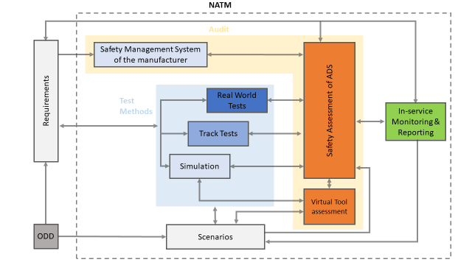
Overview of NATM
Section 9
Section 8
Section 7
Section 12
Section 6
Section 5

Slide 5
Introduction of new SG4 leader
René Claesen, who has been SG4 leader, left the role in the summer.
Many of the SG4 discussions were difficult to navigate as they were closely related to other groups’ activities, and VMAD once again expresses its appreciation for Rene’s contribution.
A new member, Rino Brouwer, took over the SG4 leadership.
He has a strong presence in FRAV and we expect him to play an important role also in the collaboration between FRAV and VMAD.
VMAD would like to welcome him.

Slide 6
2 years extension of VMAD activity
Previously, the timeline for VMAD activities in the list of IWGs included in the Report of WP.29 was until June this year, and after discussion at the last GRVA, the activities of VMAD were extended for two years at the 187th WP.29 in June.
Deliverables for the two-year period should be defined, based on the outstanding VMAD issues and integration with FRAV.
Draft deliverables are included in this presentation for discussion at this GRVA.

Slide 7
VMAD IWG activities since GRVA #13
No VMAD sessions have been held since the last GRVA, as no targets or deliverables of the extended two years have been set.
Same for the activities of the sub-groups, none of which have been held.
No meetings were held, but progress was made in three areas:
Elaboration of the proposed amendments to the WP.29 guidelines, and submission to GRVA
Organisation of the future activities of each sub-group
Drafting VMAD goals/deliverables for the next two years

Slide 8
VMAD open issues (by Subgroup)
 |  | Ongoing issues (linked to FRAV) | Ongoing issues (could be done only in VMAD independently)
SG1 | Scenario | Scenario catalogue update | Maintenance procedure of scenario catalogue Template
SG2 | Virtual Testing and Simulation | Develop blueprint for credibility assessment | -
SG3 | ISMR | Strong link between FRAV discussion and ISMR data from the operational experience | More detailed discussion on the practical implementation such as documentation to be prepared for the safety assessment phase guidelines for authorities on ISMR safety data collection, storage, and sharing with other authorities, etc.
SG4 | Real world/Track testing | General matrix for physical testing Test matrix and test protocols for track testing/real world testing | Validation of the testing approach development of further guidance on several topics such as auditing of test equipment used for track testing, etc.

Slide 9
VMAD co-chairs Proposal for 2 years activities and deliverables
Activities | Deliverables | Timeline
Start of development of safety verification methods, linking to the status of FRAV’s consideration of technical requirements for DDTs, etc. Description how to create and maintain the catalogue for scenarios (SG1) Description of the credibility assessment (SG2) Description of ISM&R (SG3) Description for RWT (SG4) | 2nd iteration of the Guidelines for NATM including outcome of "outstanding issues" | June 2023 (WP.29), May 2023 (GRVA, adopt) January 2023 (GRVA, information)
Progressive increase in FRAV-VMAD collaboration towards 2024 deliverable of consolidated submission. | Consolidated FRAV/VMAD submission (requirements + assessment) | June 2024 (WP.29), May 2024 (GRVA adopt), January 2024 (GRVA, information)

Slide 10
Plans of the Collaboration between FRAV and VMAD
Need to accelerate collaboration between the two IWGs to develop consolidated guidelines in the next two years;
Joint extended leadership meeting:
Small leadership group to make it clear what two IWG to achieve and to develop items such as one clear vision and level of detail (This week/October/November).
Meetings among co-chairs and others of the two IWGs:
Meetings between co-chairs and meetings with SG leaders and WS leaders have so far been held irregularly. We will continue these activities.
Joint sessions:
Sessions of both IWGs will be held in Tokyo in December, and joint sessions are being coordinated. There, one clear vision and level of detail will be reviewed.

Slide 11
Thank you!

